Slide 1
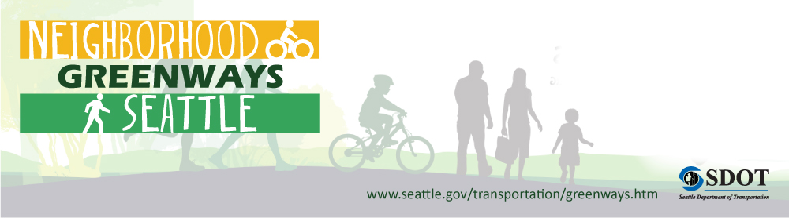

Delridge – Highland Park Neighborhood Greenway
Seattle Bicycle Advisory Board
January 6, 2015

Slide 2
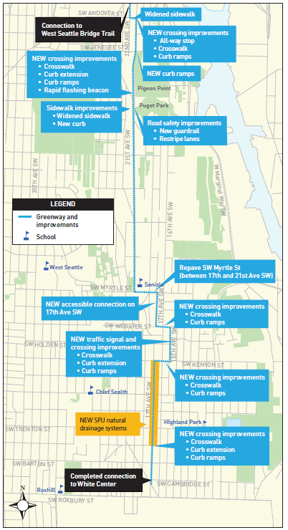
Presentation overview
Neighborhood greenway description
Greenway route selection
Construction update
Completed work
Questions

Slide 3
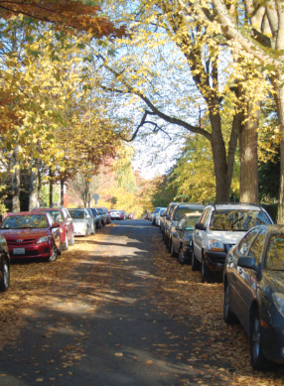
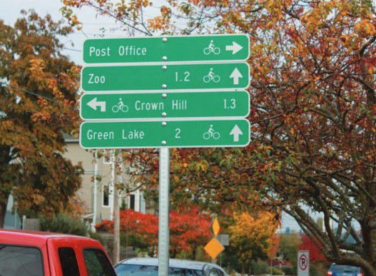
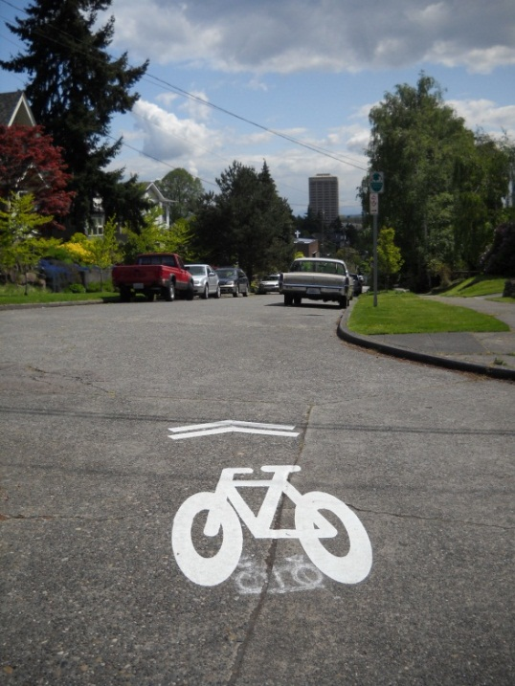
What is a Neighborhood Greenway?
A safer, calm residential street for you and your family to walk and ride bikes

Slide 4
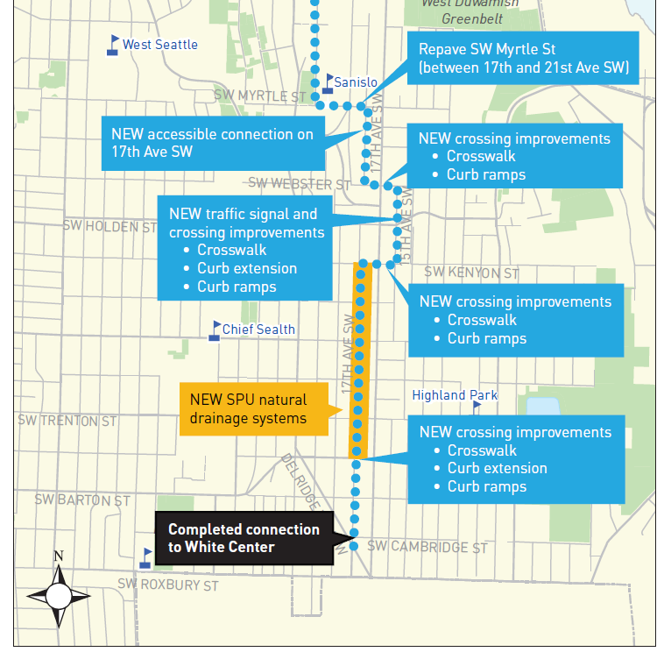
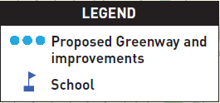
Route selection

Slide 5
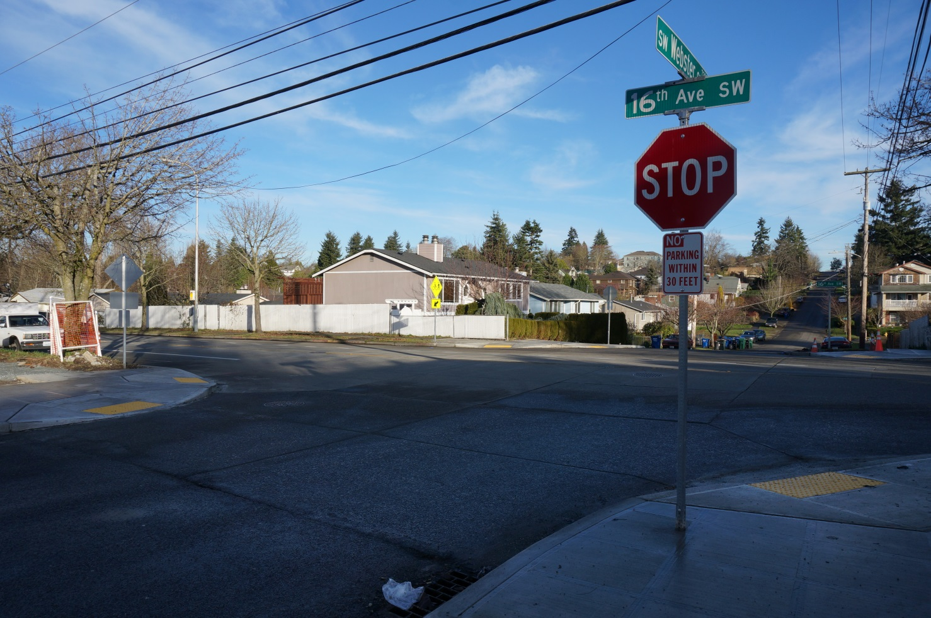
South end improvements
16th Ave SW & SW Webster St
New crosswalk
New sidewalk
New curb ramps

Slide 6
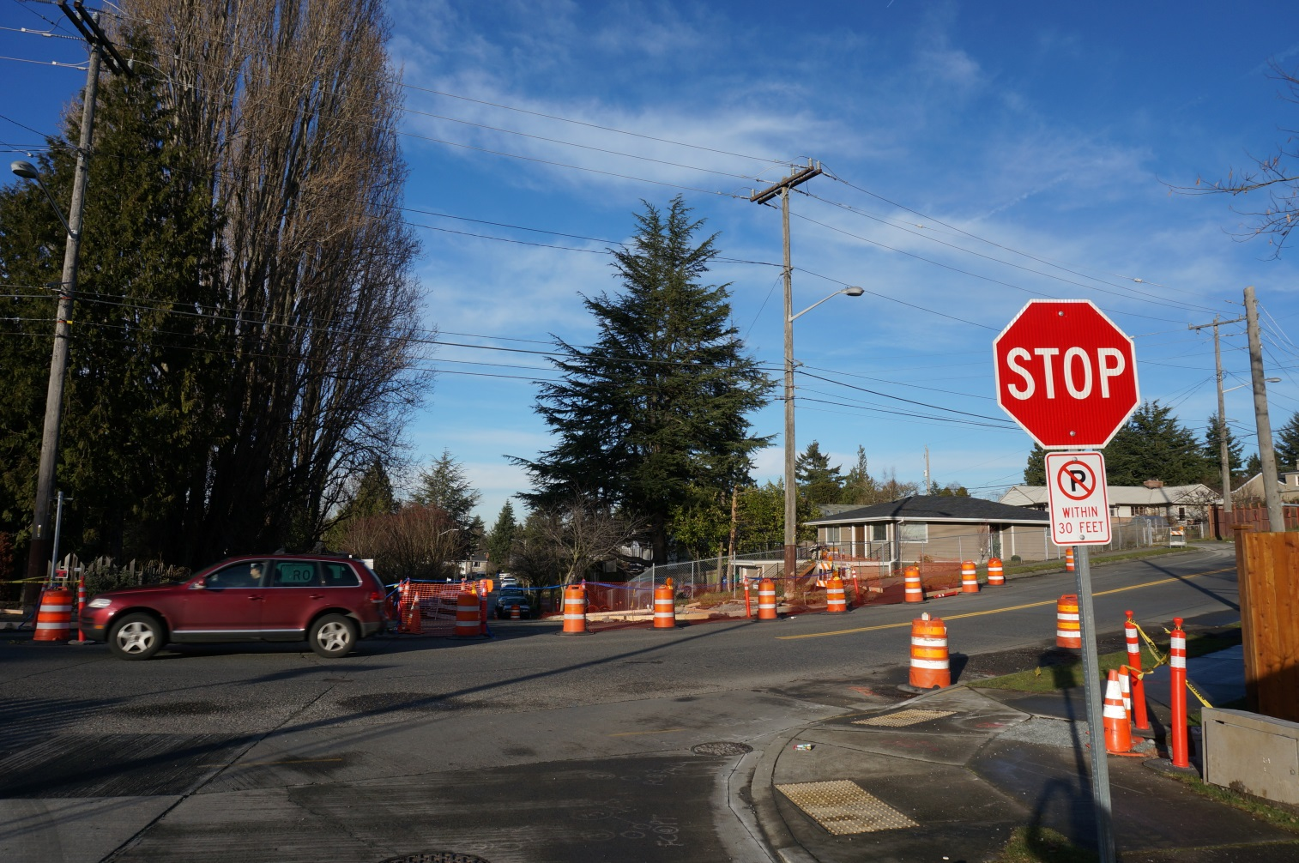
South end improvements
15th Ave SW & SW Holden St
Pedestrian activated signal
Crosswalk
Sidewalk
Upgraded curb ramps

Slide 7
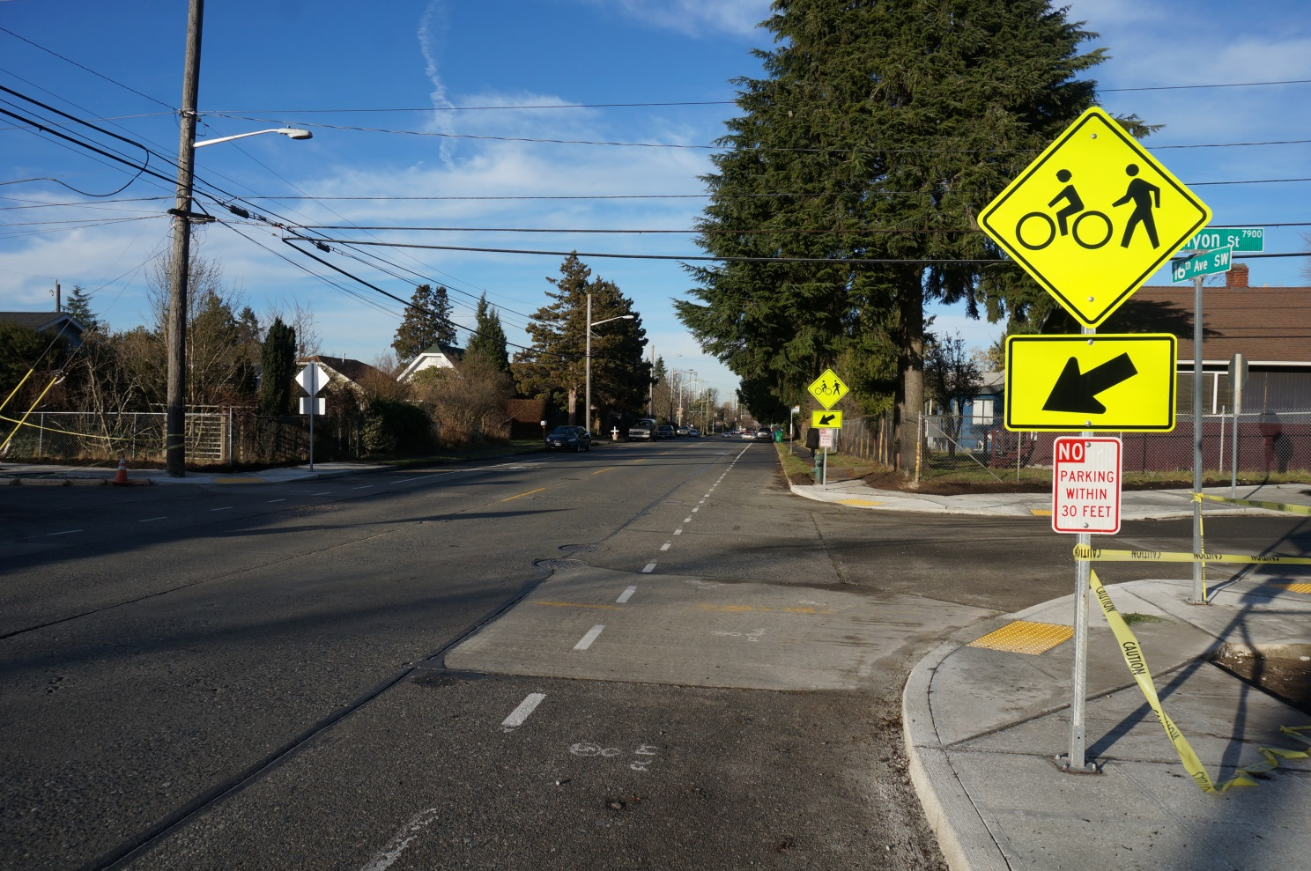
South end improvements
16th Ave SW & SW Kenyon St
New crosswalk
New sidewalk
New curb ramps

Slide 8
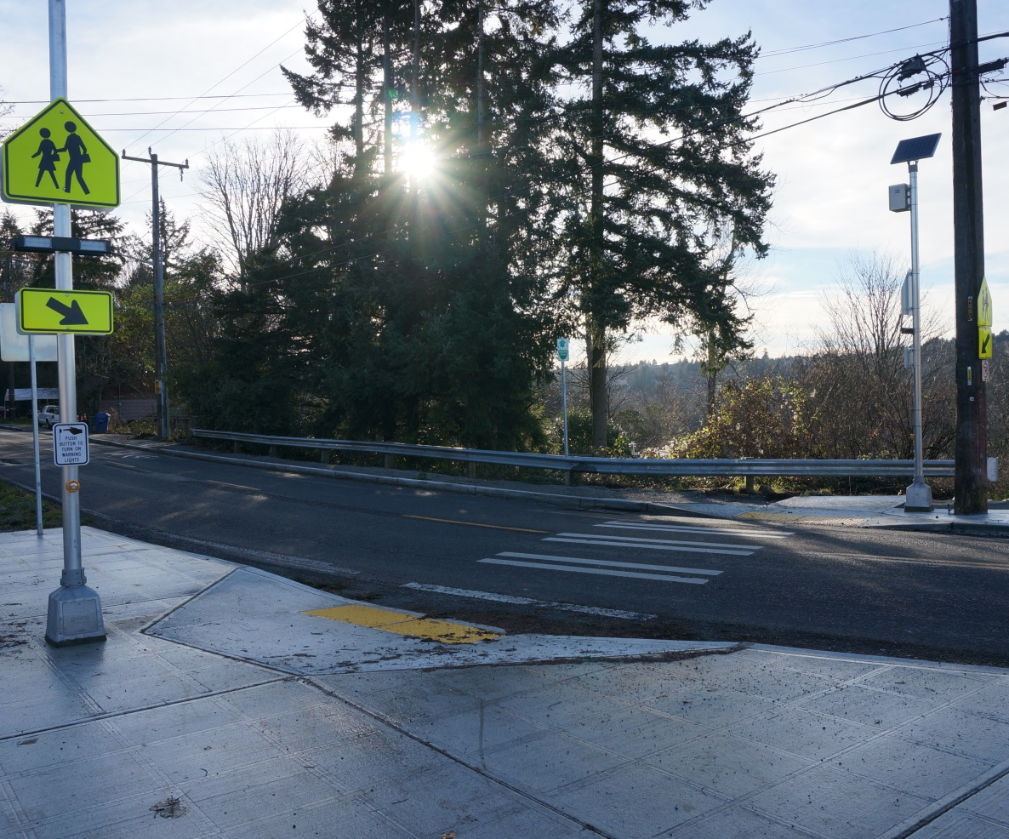
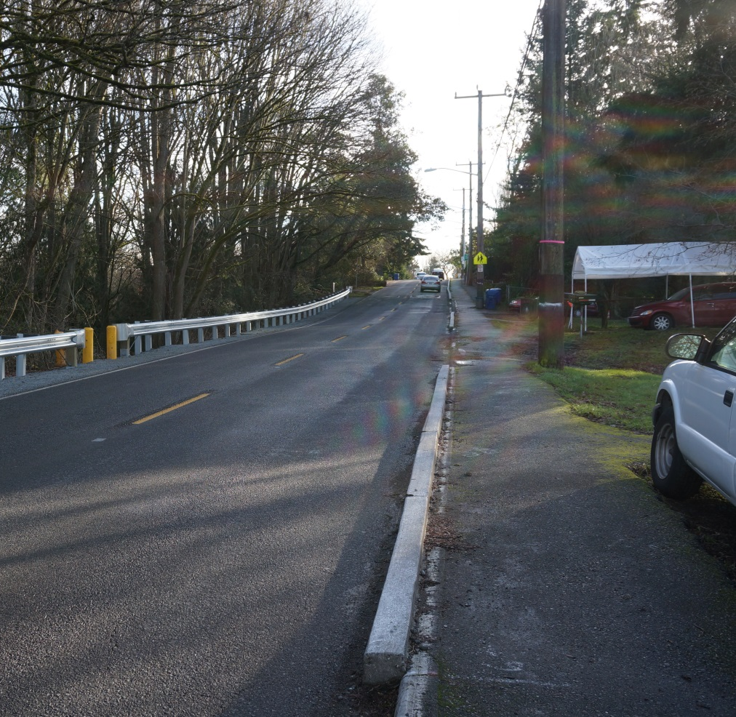
21st Ave SW and 22nd Ave SW

Slide 9
Remaining construction
Work to be completed | When will it happen?
15th Ave SW & SW Holden St curb ramps and sidewalk | Continues this week, expect to wrap up week of Jan. 18
21st Ave SW sidewalk, south of 22nd Ave SW | Work begins end of Jan.
17th Ave SW cul-de-sac ramp | Work begins in Feb.
Striping, signage, and speed hump installation | Installed on an ongoing basis
Install signal at 15th Ave SW & SW Holden St | Late Jan. or early Feb.

Slide 10
Questions?

Slide 11




Thanks!
CJ Holt
(206) 233-1556
CJ.Holt@seattle.gov
www.seattle.gov/transportation/delridgehighparkgreenway.htm

Slide 12
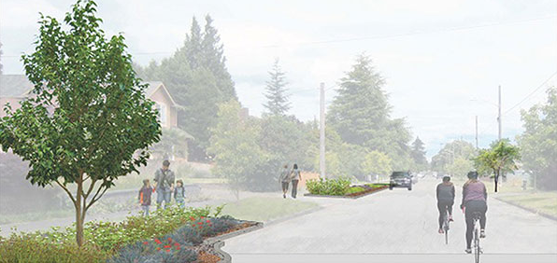
Seattle Public Utilities
Natural Drainage System along 17th Ave SW
Improved drainage and sewer system
Jason Sharpley | (206) 233-1534 | Jason.Sharpley@seattle.gov

Slide 13
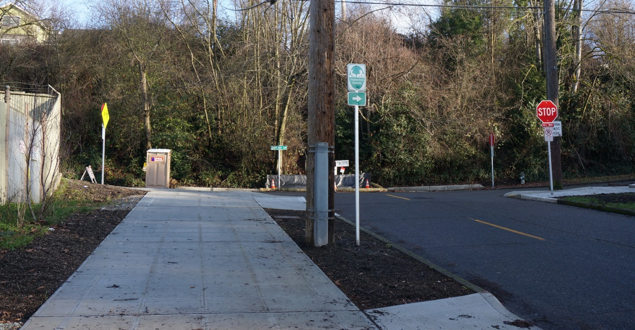
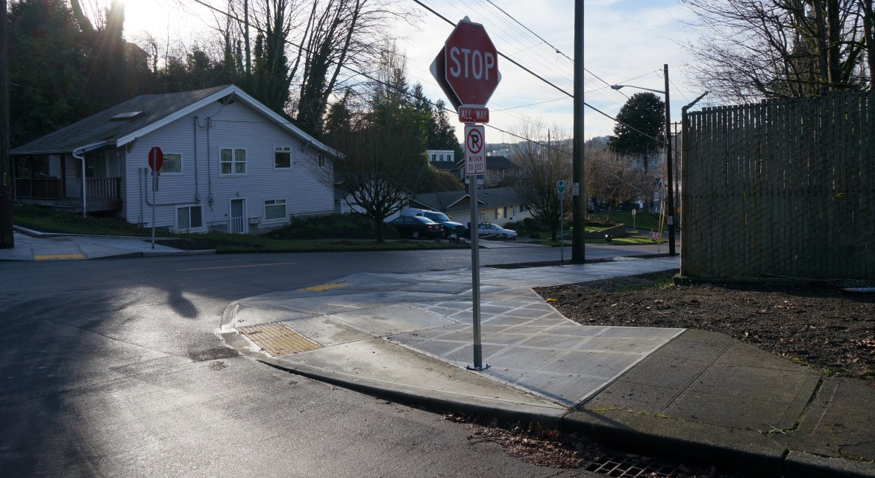
21st Ave SW and SW Andover St
Widened sidewalk
Curb ramps

Slide 14
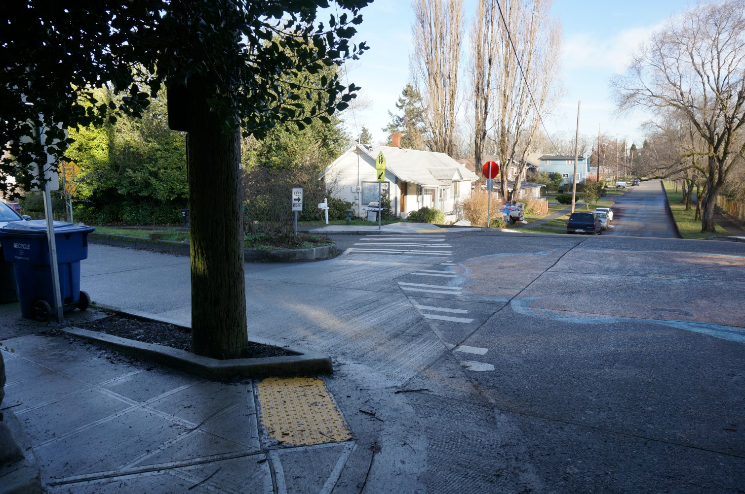
21st Ave SW and SW Genesee St
Before
All-way stop
Curb ramps
Curb ramps, crosswalk and street signs

Slide 15
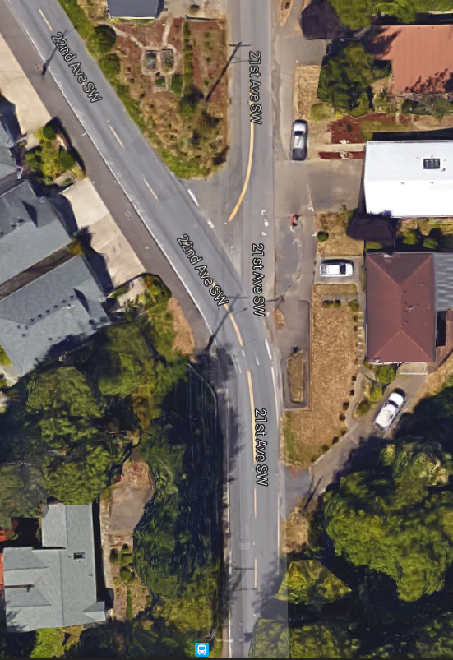
Aerial of 21st Ave SW and 22nd Ave SW

Slide 16
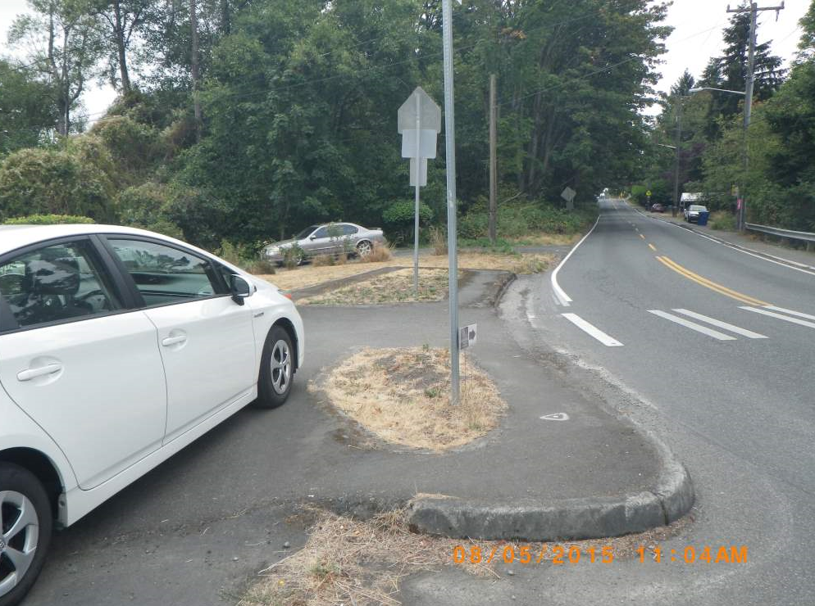
21st Ave SW and 22nd Ave SW
Before
Before

Slide 17
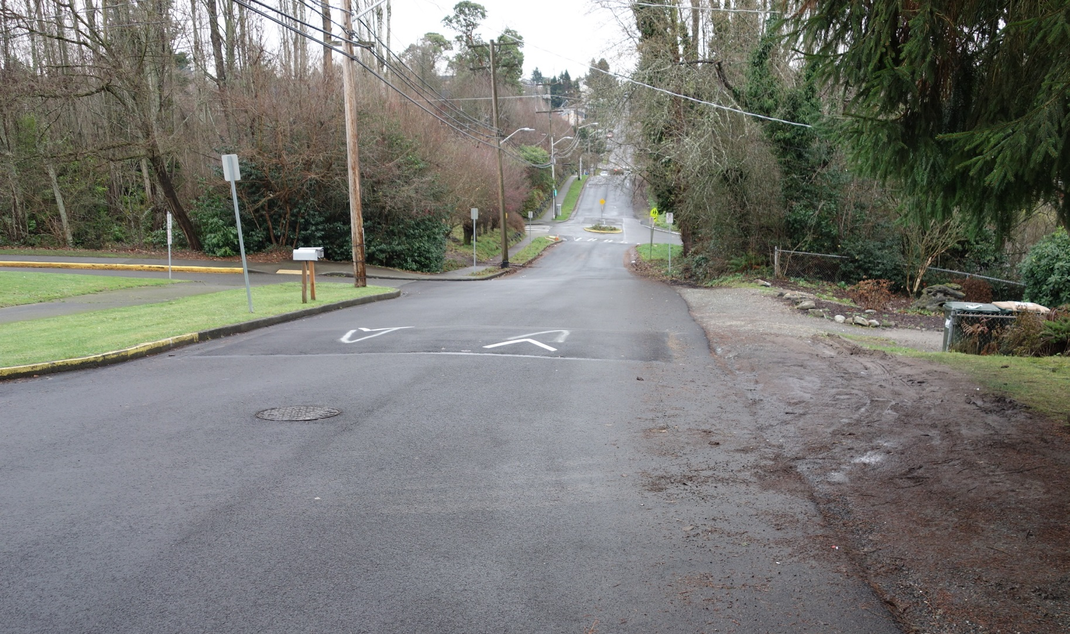
21st Ave SW and SW Myrtle St

Slide 18
Outreach completed to date
Online and door-to-door survey (June 2013)
Delridge Neighborhood District Council briefing (June 2013)
2 public meetings (July and November 2013)
Drop-in session (November 2014)
Sanislo Elementary briefing (August 2015)
Delridge Neighborhood District Council briefing (October 2015)
Targeted property owner outreach focus throughout

Slide 19
Safe Routes to School projects
SW Myrtle St, 18th Ave SW & SW Orchard St: Construction, summer 2016
21st Ave SW cancelled due to drainage challenges

