Slide 1
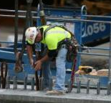
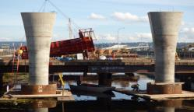
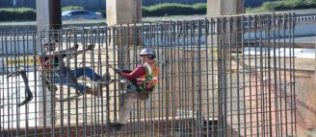
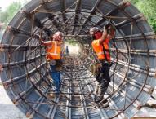
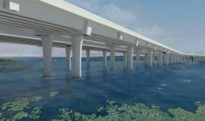
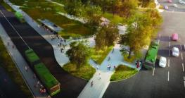
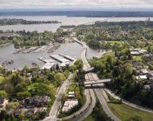
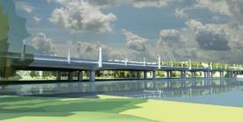
SR 520 Program
Rest of the West
SR 520 Rest of the West Design Team
Seattle Bicycle Advisory Board
June 1, 2016

Slide 2
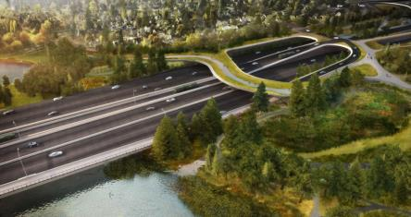
Presentation Overview
  SR 520 Program and Rest of the West update
  Overview of latest design work
  Questions / answers and discussion

Slide 3
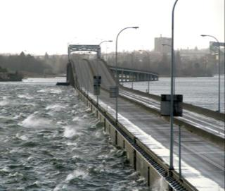
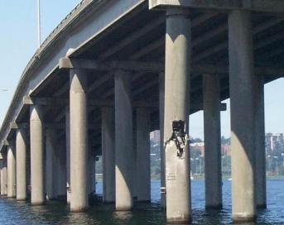
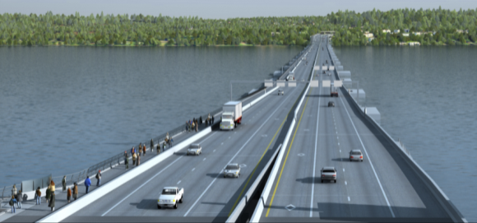
Purpose and Need
Safety and Mobility Improvements
The SR 520 Bridge Replacement and HOV Program is a $4.56 billion investment in the regional transportation system. The program is enhancing a vital connection from Seattle to the Eastside via Lake Washington, resulting in major improvements for drivers, transit riders, bicyclists and pedestrians.
Replacing vulnerable structures
Enhancing mobility
FUNDED
The SR 520 program is improving safety by:
Replacing aging and vulnerable bridge structures currently at risk of failure
Adding full outside shoulders
Adding safer, smoother merges and sightlines
Improving bicycle and pedestrian connectivity
The SR 520 program is enhancing mobility by:
Adding new transit/HOV lanes for better bus and carpool trip reliability
Building a new 14-foot-wide bicycle and pedestrian path
Adding new median transit stops and direct-access ramps along the corridor
3

Slide 4
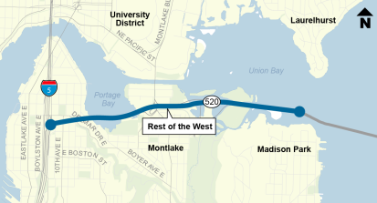
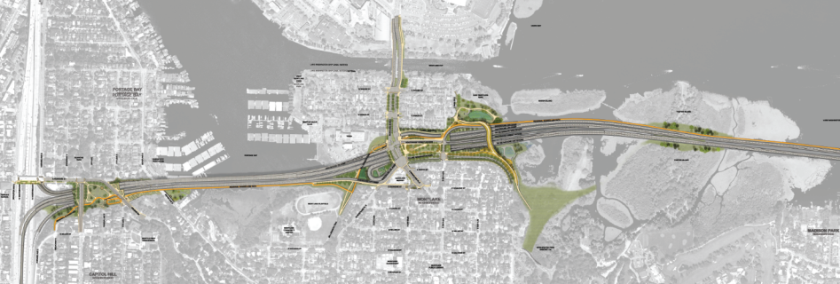
Rest of the West Project Overview
Possible future use of a portion of NOAA property, approximating the area shown in the FEIS, for public pedestrian-bike path is subject to agreement by NOAA as a part of ongoing mitigation discussion
Next phase
Portage Bay Bridge
10th and Delmar lid
I-5 interchange
Montlake Cut crossing
Montlake lid/land bridge
West Approach Bridge South
Under Construction:
West Approach Bridge North

Slide 5
Non-motorized Guiding Principles
  Safe and interesting cycling and walking routes.
  Mobility between and through neighborhoods.
  Access for all levels, abilities and needs.
  Traffic-calming and reduction of potential conflicts.
  Clear and intuitive wayfinding.

Slide 6
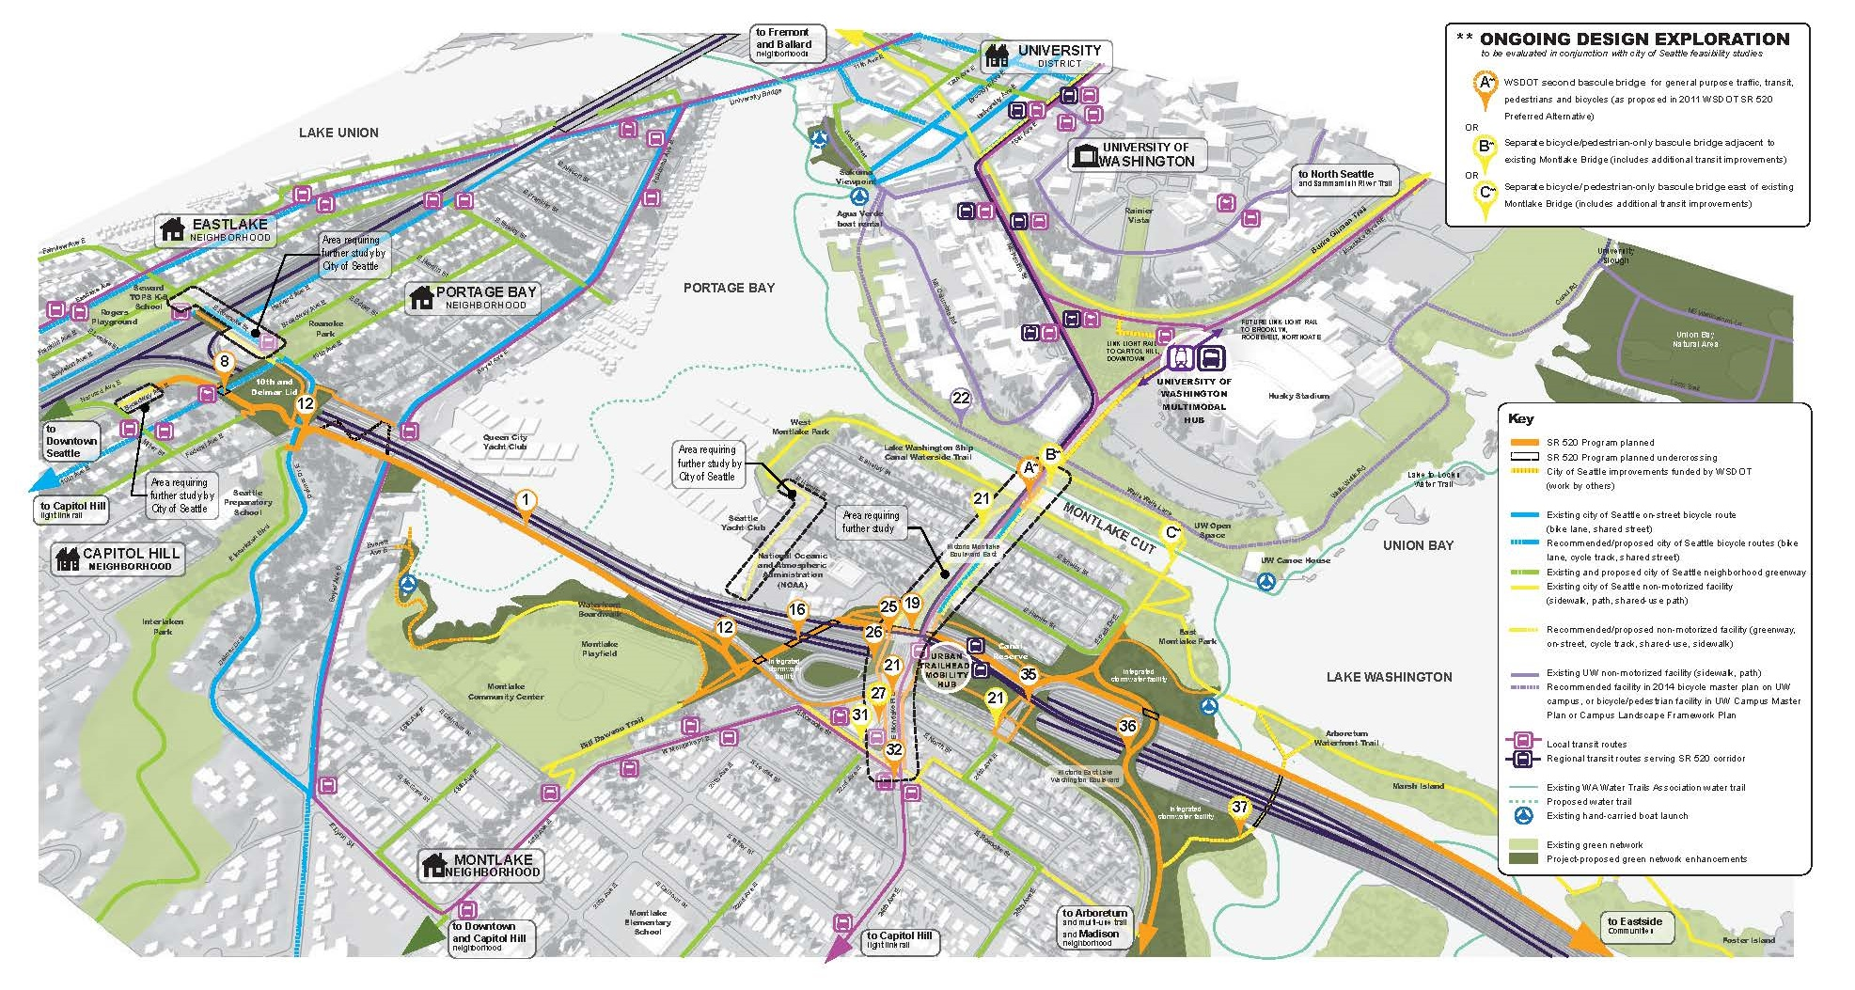
Non-motorized Connectivity Network
Source: 2015 West Side Final Concept Design Report

Slide 7
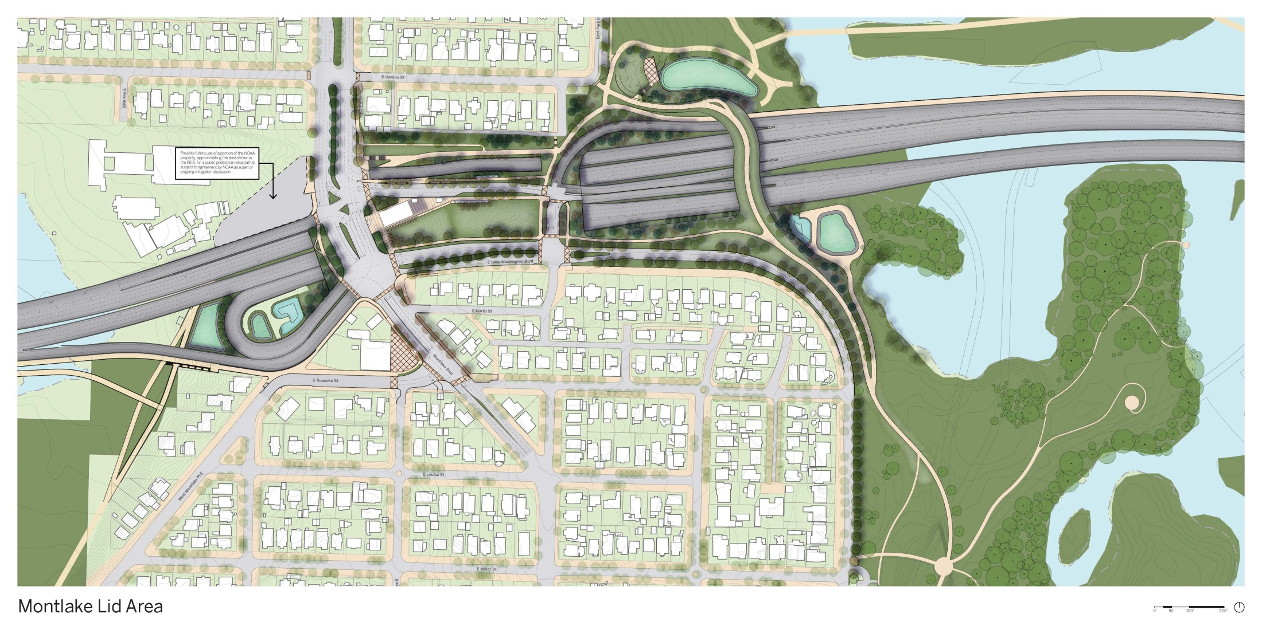
Montlake lid area final WSDOT preliminary design
DRAFT

Slide 8
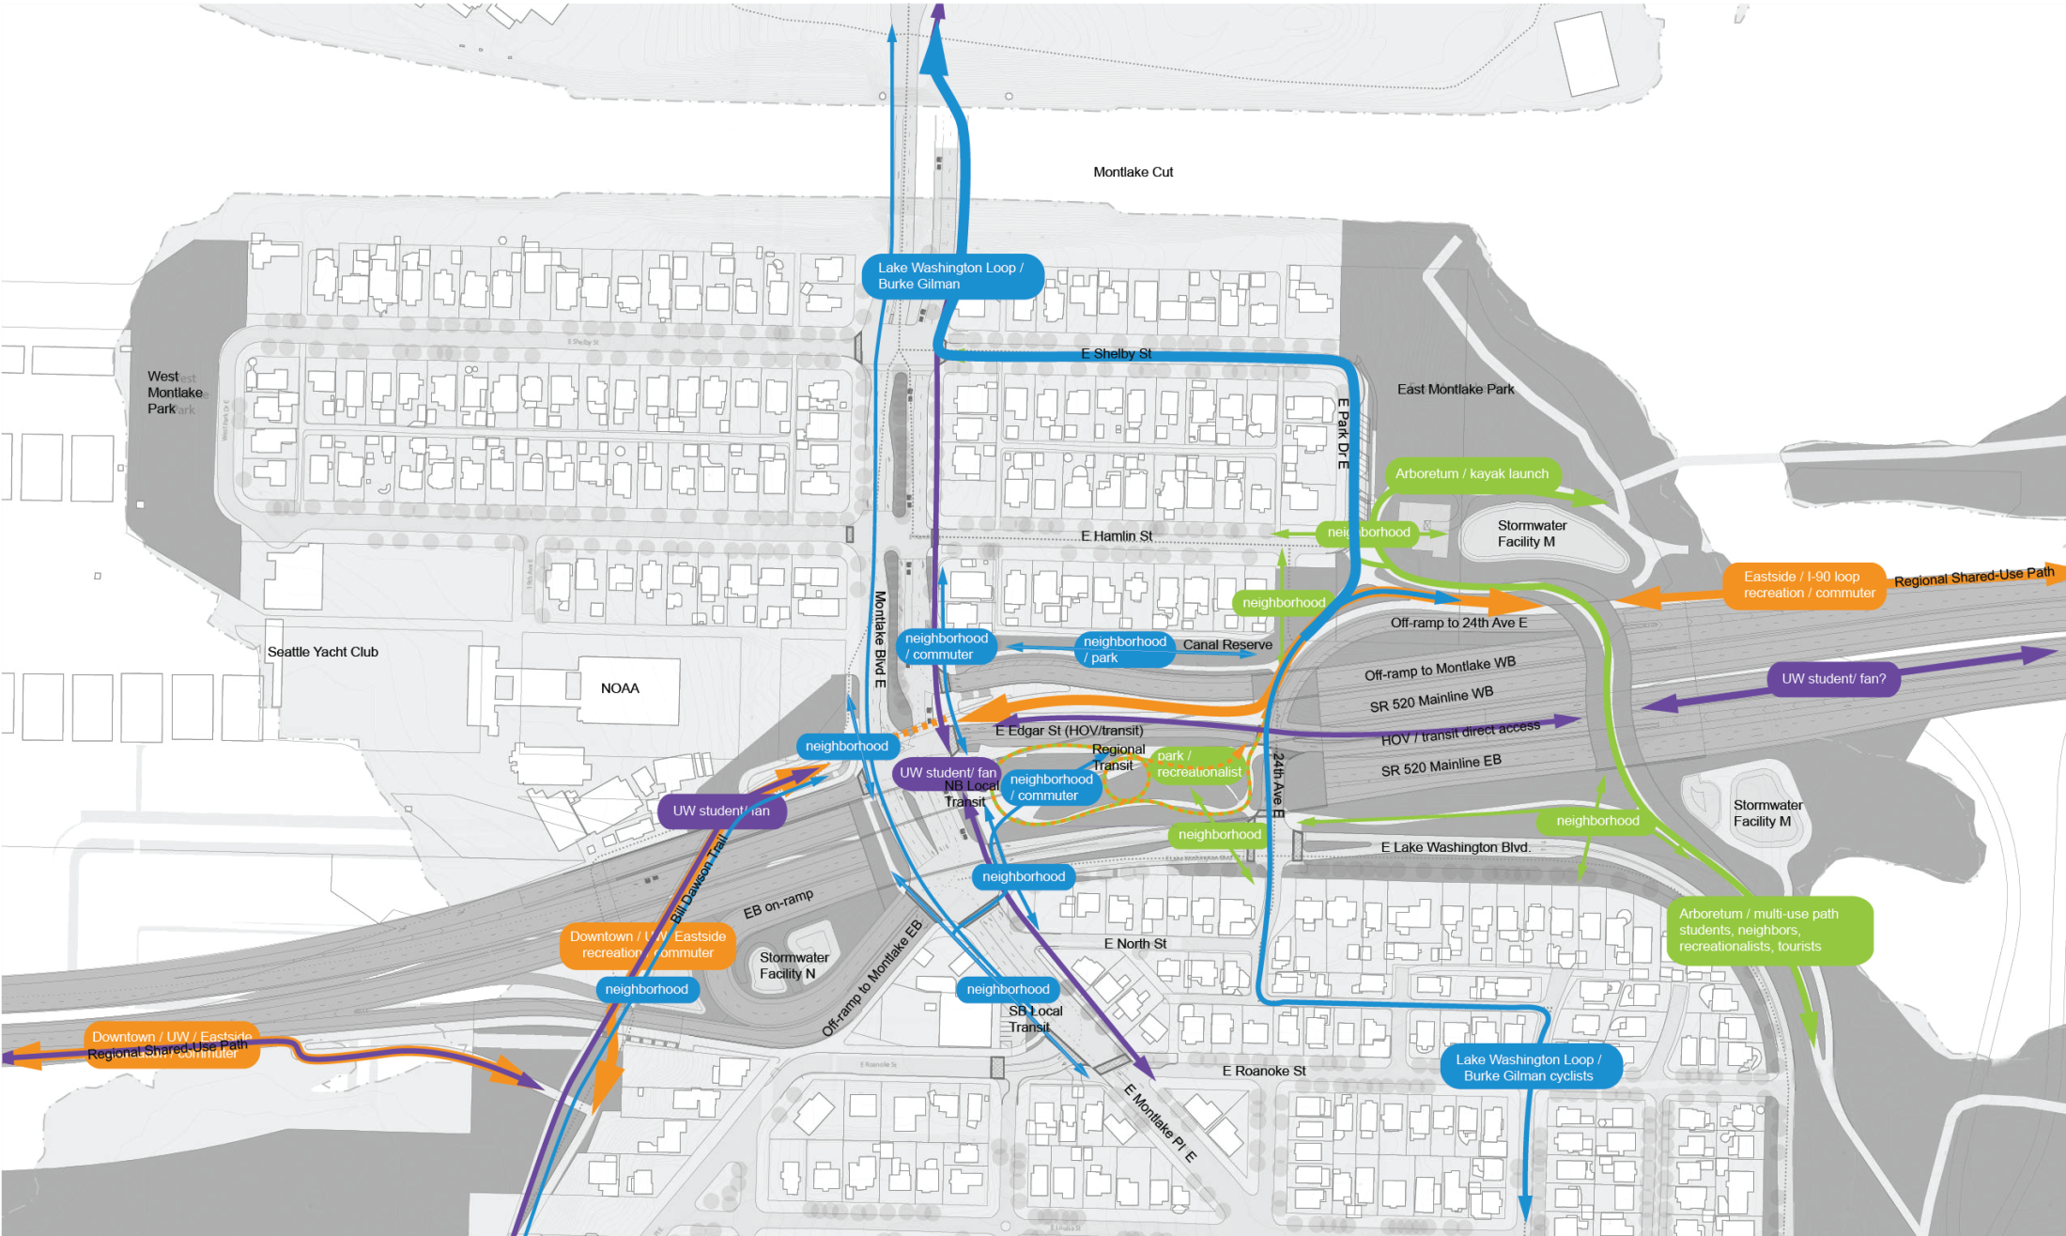
Elements of Continuity
Users and Destinations
Regional Commuter/Recreation
Neighborhood
Local Recreation
Student
DRAFT

Slide 9
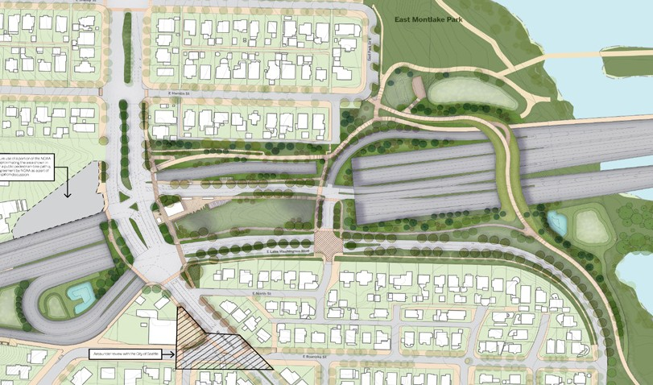
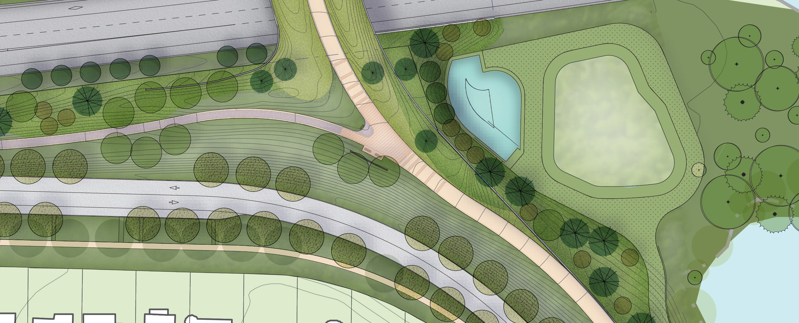
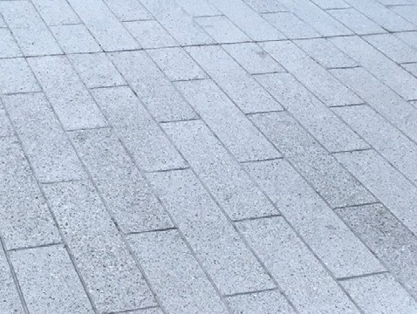
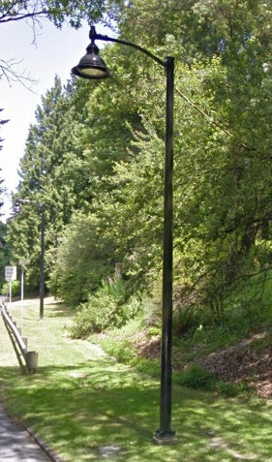
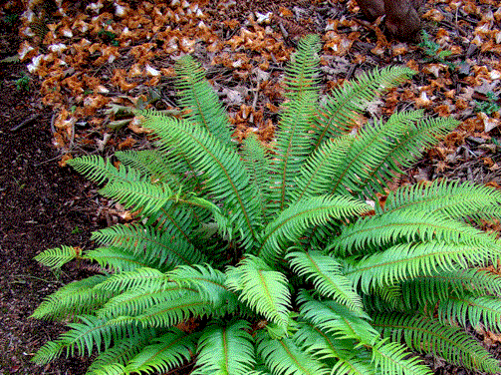
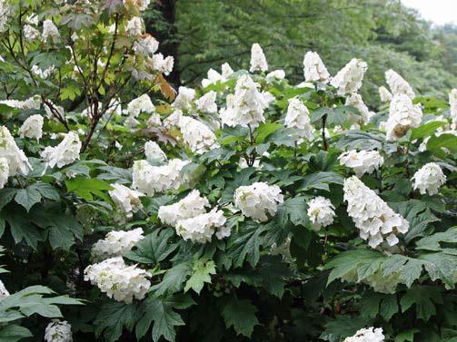
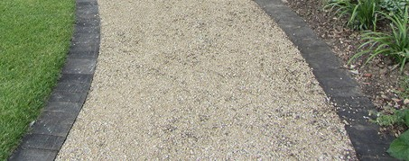
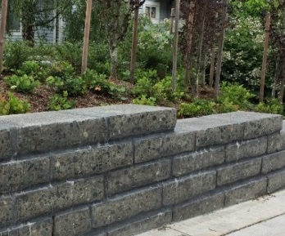
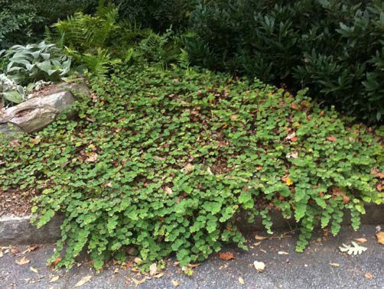

User Experience
Pathway intersection at land bridge approach
concrete bands feather out to indicate key intersections
gravel space for sign
seating area
path intersection
lighting
planting
paving
site walls
Materiality
gravel pathway with concrete edging
scored horizontal concrete
recycled cut concrete
DRAFT
LWB Fixture
Olmsted Legacy

Slide 10
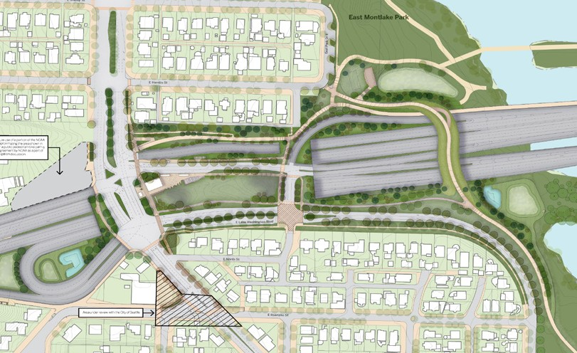
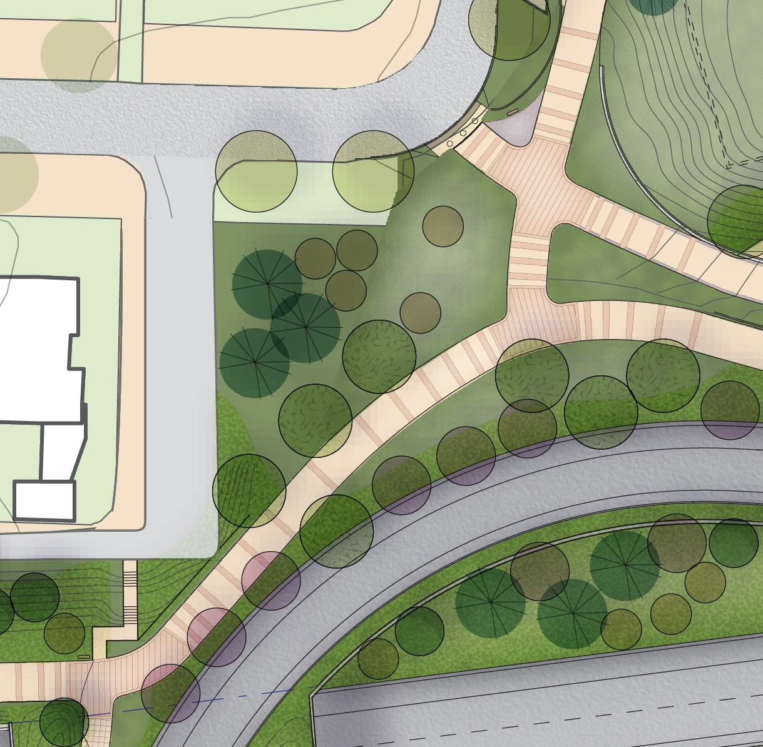
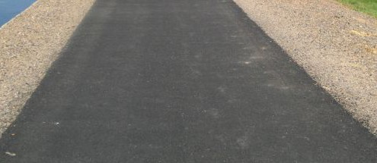
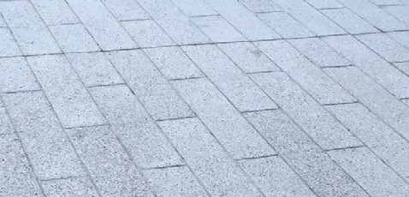

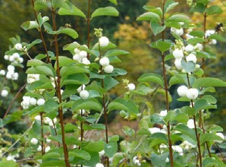
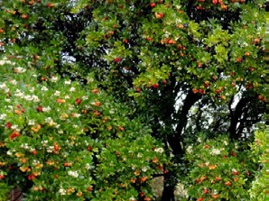
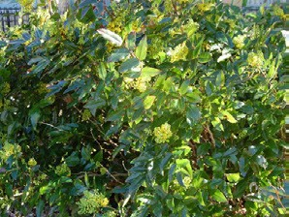
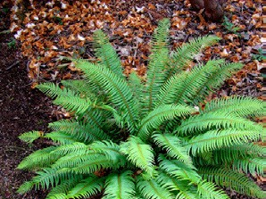
User Experience
Pathway intersection
gravel patch - radius for trucks doubles as signage area
Land bridge paving
asphalt with gravel shoulder
path intersection
scored horizontal concrete
stair jogs for safety off of RSUP, aligns with sidewalk below
RSUP paving
asphalt
planting
concrete bands feather out to indicate key intersections
portage passage
DRAFT

Slide 11
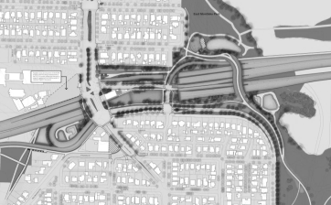
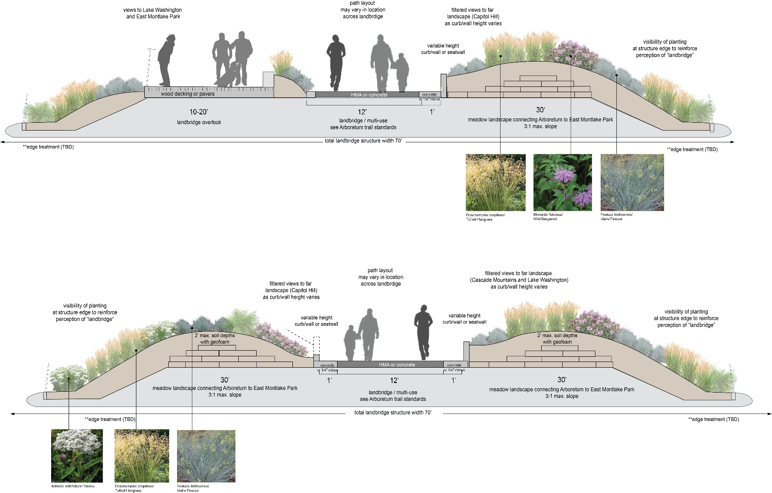
Pathways
Concept Development
Land bridge: Park Path
DRAFT

Slide 12
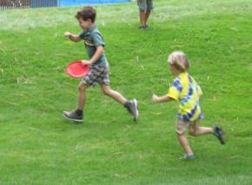
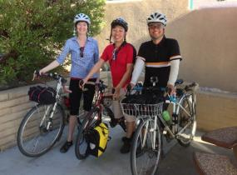
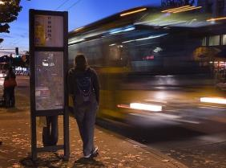
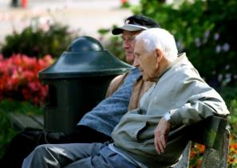
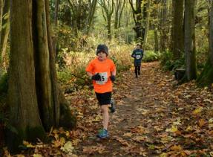
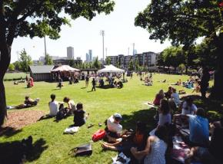
Adjacent
User Experience
Distinct
Neighborhood Families
Bicyclists
Transit User
Casual Strollers
Weekend Warrior
Special Event
DRAFT

Slide 13
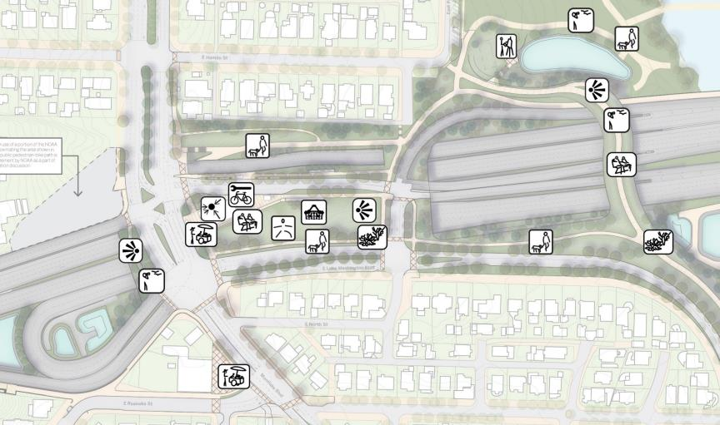
User Experience
Bicycling Trails
Covered Bus Stops
Shelter from Sun and Rain
Outlooks
Iconic Space to Meet-up
Outlooks
Places to Sit
Place for Picnics
Place for Picnics
Dog Walking
Nature Viewing
Running Trails
Nature Viewing
Bird Watching
Place to Stretch
Bike Storage
DRAFT
Bird Watching
Vendors
Place to Stretch

Slide 14

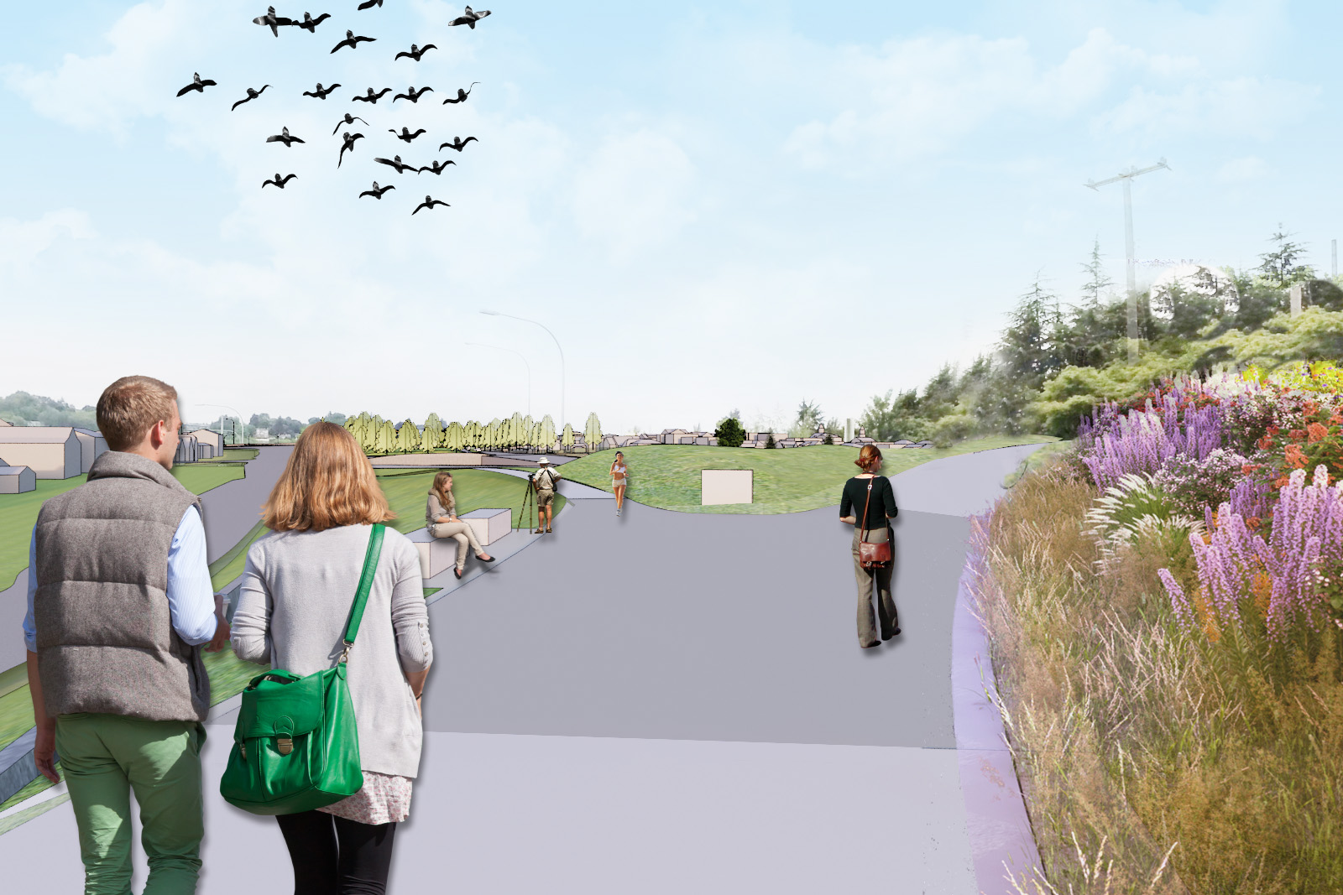
User Experience
Cyclist
Iconic Space to Meet-up
Outlooks
Place for Picnics
Running Trails
Nature Viewing
Bird Watching
Vendors
DRAFT
Place to Stretch

Slide 15
Key bike related topics
  Bicycle amenities
    Lockers
    Covered racks
    Repair station
    Water
  Pavement treatment at intersections

