Slide 1
Draft ST3 Plan
Seattle Bicycle Advisory Board
May 2016

Slide 2
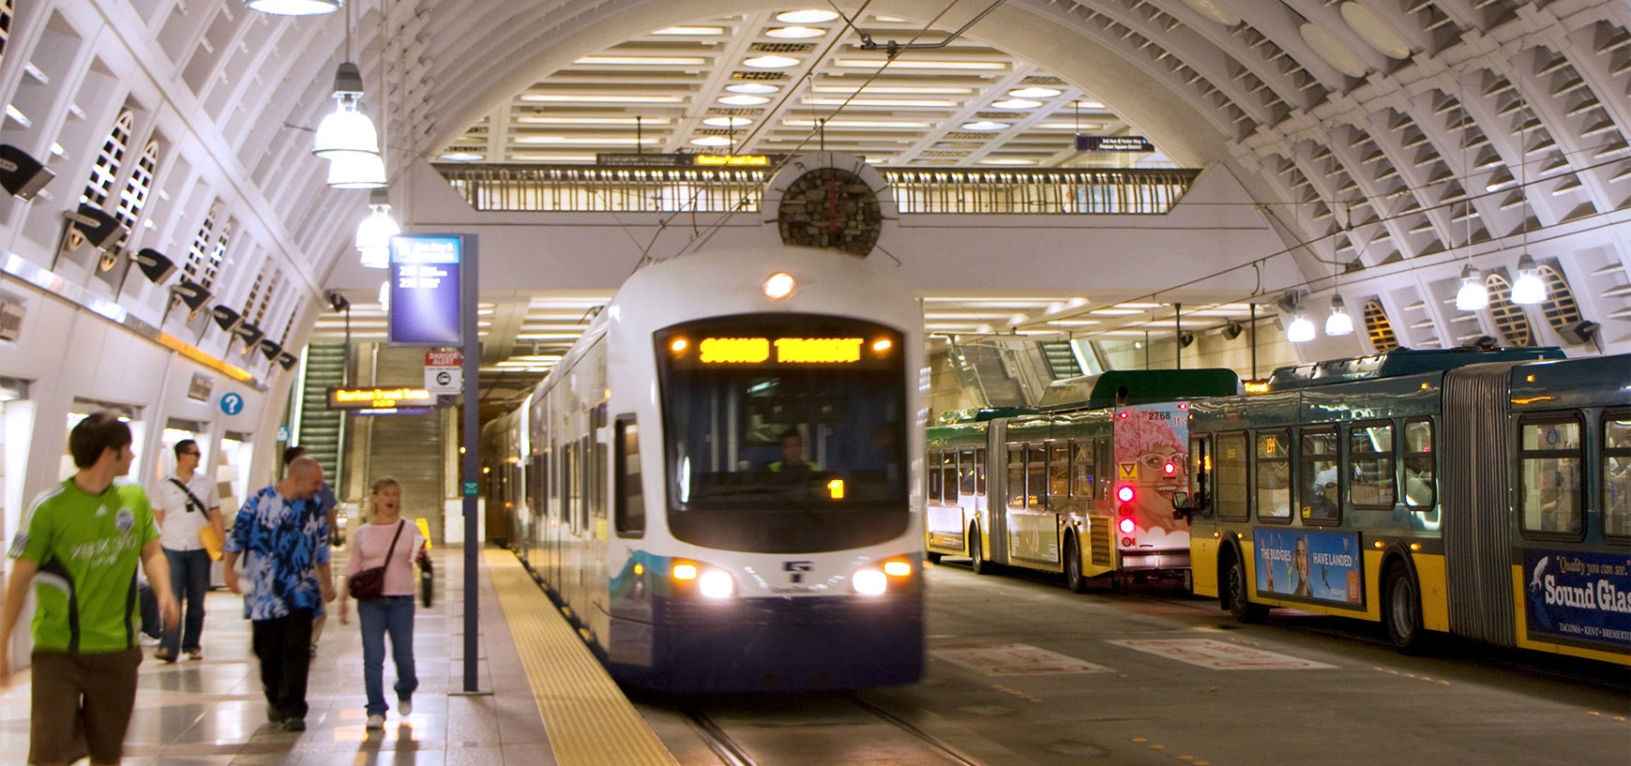
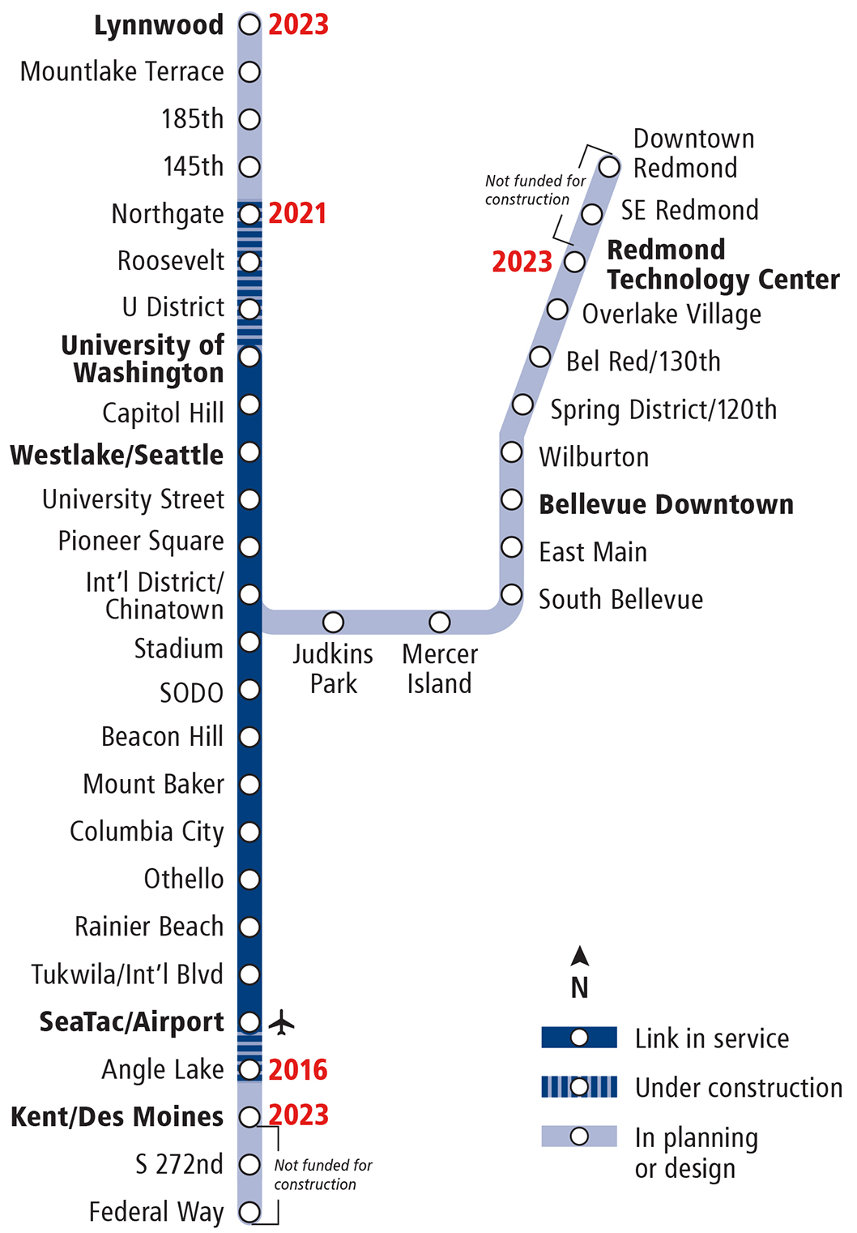
Regional Link light rail expansion
By 2023, Puget Sound will have 50+ miles of light rail, with 30+ stations, directly connecting 11 cities

Slide 3
101M
More riders every year
75M
East Link, Lynnwood Link and Kent/ Des Moines open
39M
University Link & Angle Lake Station open
50M
Northgate Link opens
ACTUAL
In Millions
34.9M
30.3M
18.8M
10.5M
1M
PROJECTED
1999
2001
2003
2005
2007
2009
2011
2013
2015
2017
2019
2021
2023
2025
Source: Sound Transit ridership reports, service implementation plan and financial plan.

Slide 4
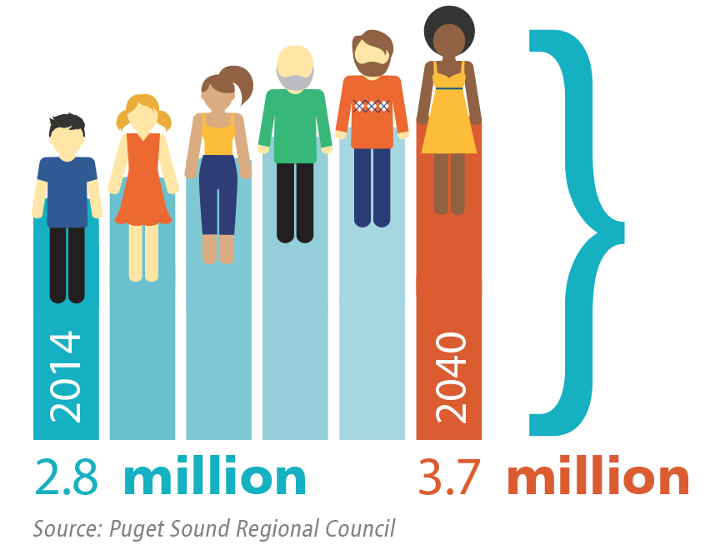
More people calling our region home

Slide 5
ST3 timeline
WE ARE HERE
Long-Range Plan Update
2014
Revenue authority from Legislature
2015
System planning
(Develop ballot measure)
2015 – mid-2016
ST3 ballot
measure
November 2016
Notes:
.

Slide 6
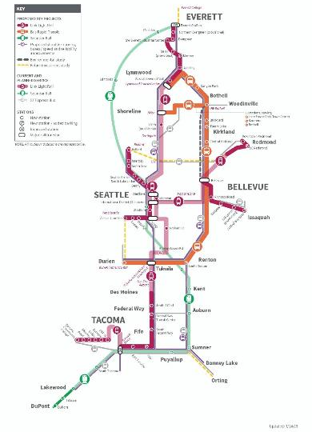
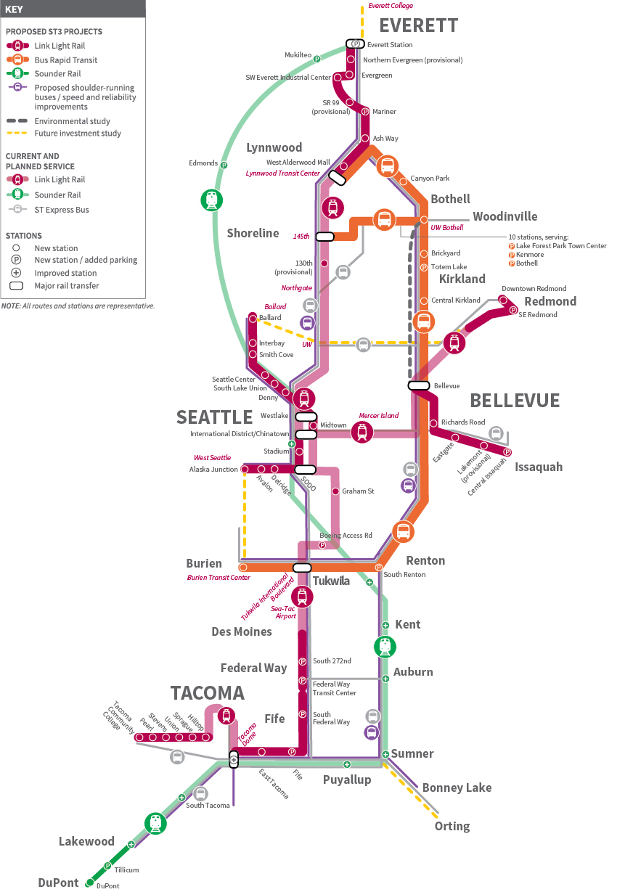
ST3 Draft Plan
Light rail highlights
112-mile regional system
North to Everett, south to Tacoma, east to Redmond & Issaquah, west to Ballard & West Seattle
Tacoma Link to Tacoma Community College
Daily ridership: 470,000-580,000 by 2040
35 new stations
Get details > soundtransit3.org

Slide 7
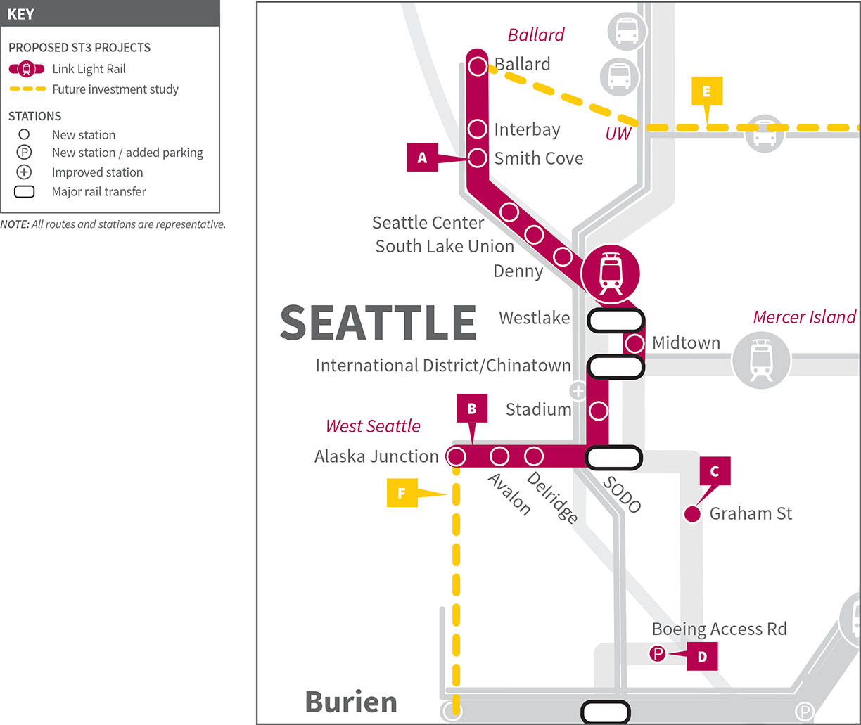
Central corridor

Slide 8
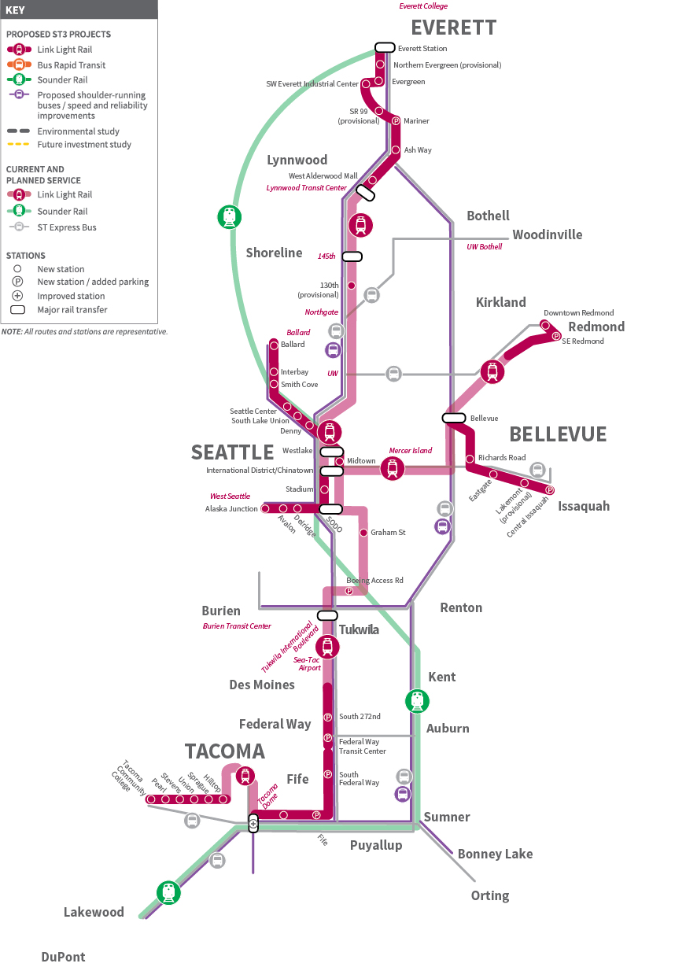
Draft Plan: Light rail
Projects | Draft Schedule
Redmond Technology Center to Downtown LRT | 2028
Kent/Des Moines to Federal Way LRT | 2028
Federal Way to Tacoma Dome LRT | 2033
West Seattle to Downtown Seattle LRT | 2033
Lynnwood to 128th St. SW (Mariner) LRT | 2036
Infill Light Rail Station: Graham Street | 2036
Infill Light Rail Station: Boeing Access Road | 2036
Ballard to Downtown Seattle LRT (with new downtown rail tunnel) | 2038
Tacoma Link Extension to Tacoma Community College | 2041
128th St. SW (Mariner) to Everett LRT via Southwest Everett Industrial Center and Evergreen Way | 2041
Bellevue to Issaquah LRT | 2041
8

Slide 9
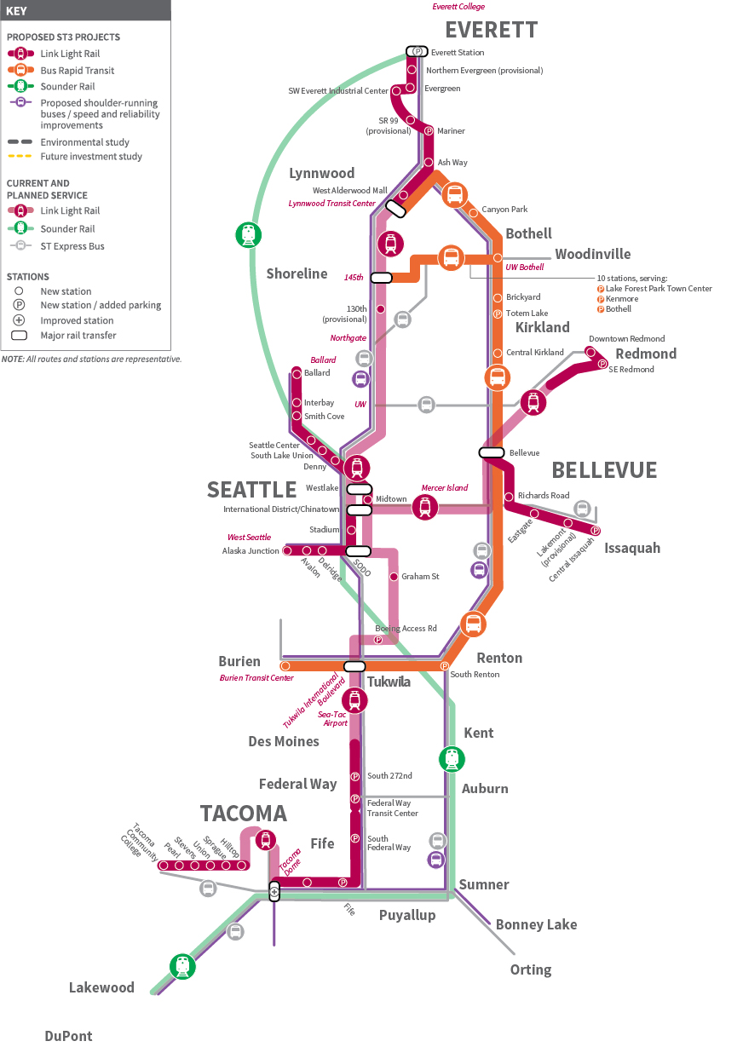
Draft Plan: BRT-ST Express
Projects | Draft Schedule
ST Express: Approximately 600K annual hours to continue providing interim express bus service in future HCT corridors | On-going
I-405 BRT: Lynnwood to Burien | 2024
SR 522 & NE 145th Street BRT: UW Bothell to NE 145th light rail station Includes service from Woodinville | 2024
9

Slide 10
Draft Plan: Environmental & future investment studies
Studies
HCT Environmental Study: Bothell to Bellevue via Kirkland
HCT Study: Northern Lake Washington
HCT Study: Light rail extending from West Seattle to Burien and connecting to light rail spine
HCT Study: Connections from Everett to Everett Community College
HCT Study: Commuter rail to Orting
10

Slide 11
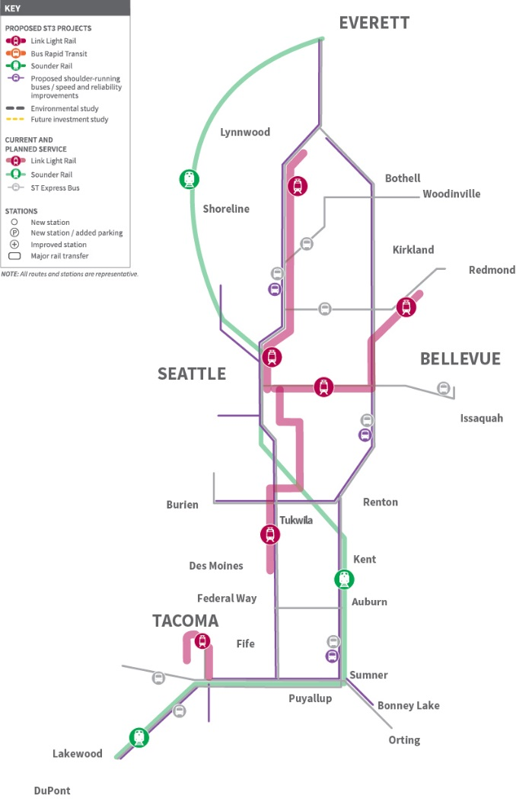
Draft Plan: Early deliverables
Projects | Draft Schedule
To improve bus speed and reliability: Bus-on-shoulder opportunities: I-5, I-405, SR 518, SR 167 Capital improvements for RapidRide C and D Routes Bus capital Improvements for Pacific Ave. (Tacoma) Bus capital improvements in East Pierce County To improve system access: Parking on SR 522 in Kenmore, Forest Park and Bothell I-405: Parking at Kingsgate and new transit center with parking in South Renton Parking for Sounder north and south lines Passenger amenities, including pedestrian and bicycle improvements | 2019-2024
11

Slide 12
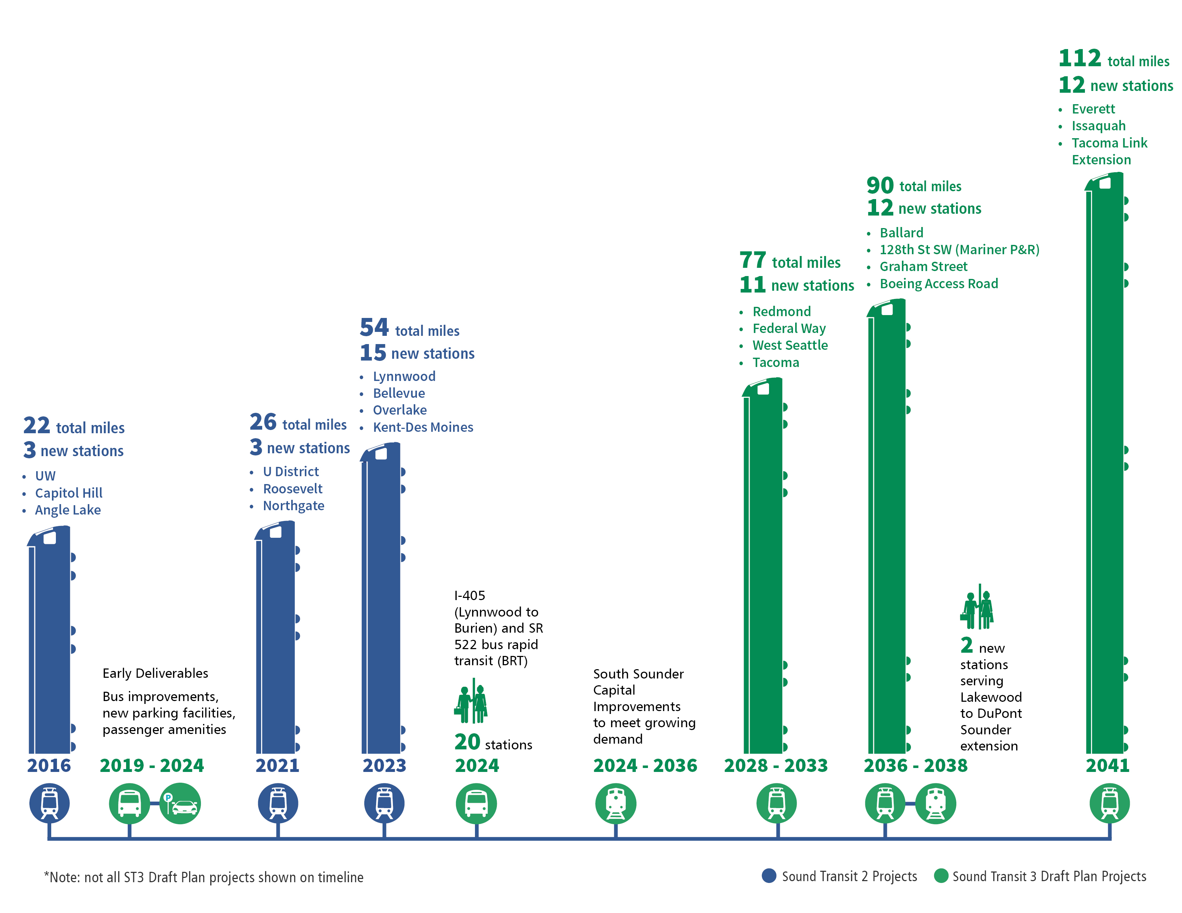
Draft Plan: Project delivery timeline

Slide 13
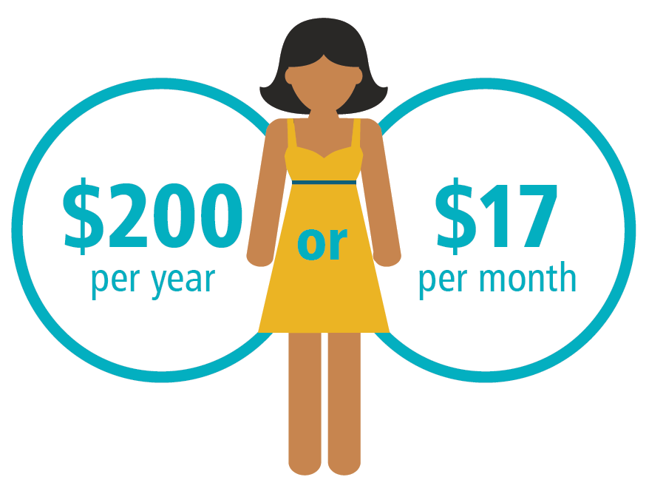
Draft Plan: Funding
Revenue source in billions, YOE | 2017-2041
Sales tax | 16.8
License tabs | 6.9
Property tax | 3.9
Total taxes* | 27.6
Other revenue | 22.5
Total estimated sources of funds | $50.1B
*Current forecast: 0.5% sales & use tax, 0.8% MVET &
property tax of 25 cents per $1,000 of assessed valuation

Slide 14

System Access in ST3 Draft Plan
Convenient access to Sound Transit’s bus and rail stations is critical to growing ridership
Station budgets accommodate design for station access by all modes of transportation
Sound Transit’s Long Range Plan and System Access Policy provide a strong basis for additional investment in improved access
Draft ST3 Plan includes $1.2 billion to improve bus transfers at Sound Transit stations, facilitate bicycling and walking from surrounding areas, and provide additional parking

Slide 15
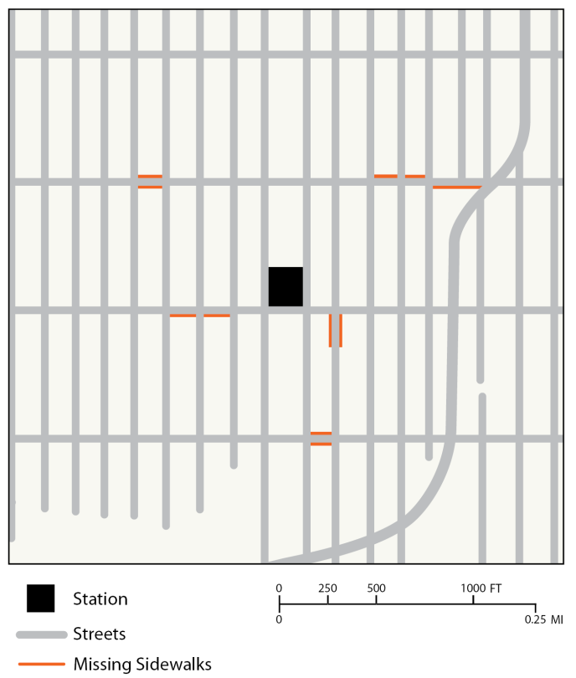
Non-Motorized Access Allowance
Allowance of up to $4.5 million for all ST3 bus and rail stations, totaling $270 million
New and improved paths to stations overcome barriers and increase ridership
Projects will be defined once precise station location is known
Partnerships/agreements can reduce permitting, timeline, and leverage matching funds and grants

Slide 16
System Access Fund
ST2 program was deleted due to recession
ST3 program includes $100m for:
Bicycle and pedestrian access improvements, bicycle parking
Transit transfer and pick up / drop off improvements
Station access studies to prioritize improvements that improve access
Ongoing data collection tracking how ST riders access stations
Staff will seek Board direction on how to prioritize funds

Slide 17
What’s next?
May & June | Board considers 37,000 surveys & written comments
 | Board continues discussions: Project delivery timeframes Financing/affordability Integration Transit-oriented development System access Sustainability
Late June | Board adopts final system plan
November | Voters consider ballot issue
system
17

Slide 18
Connect with us
SOUNDTRANSIT3.ORG
Facebook.com/SoundTransit
Twitter.com/@SoundTransit

