Slide 1
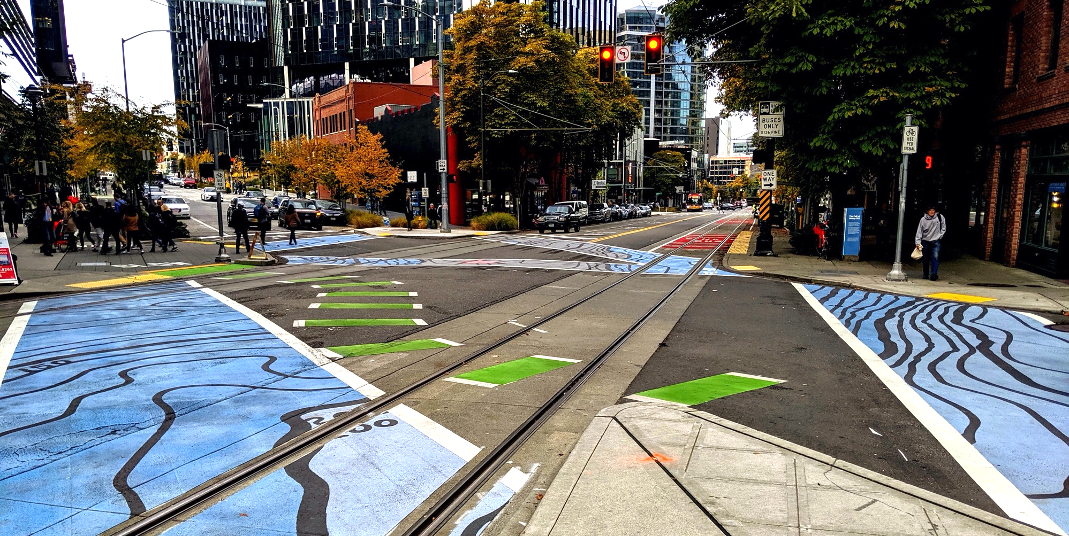
Policy & Operations Advisory Group
Policy & Operations Advisory Group
Transportation Operations and Policy & Planning Divisions

Slide 2
Meeting overview
Re-introductions
Modal Integration
Analysis approach
Examples of modal conflicts
Discussion
Signals Operations
Recap of Pedestrian Signal Policy
Discussion
Wrap-up and next steps

Slide 3
Meeting format
We want to hear from you; we encourage you to chime in and participate; some meetings will have more time for open discussion
During presentations:
We will screenshare slides
Please stay on mute
If you want to chime in or have quick questions answered as we go, please use the chat function (send to "all participants" or "all panelists") or raise hand function
Please say your name before you speak
If you are having technical difficulties, please use the chat or email ellie.smith@seattle.gov

Slide 4
Re-Introductions
Name
Organization you represent
Notes:
N\N to develop

Slide 5
POAG roster
Board, Committee, or Commission | Members
Bike Advisory Board | Alexander Lew & Pierre Brunelle
Business Improvement Association | Mike Stewart
Freight Advisory Board | Warren Aakervik & Geri Poor
Pedestrian Access Advisory Committee | Dorene Cornwell & Steven Feher
Pedestrian Advisory Board | Emily Mannetti & Anna Zivarts
Planning Commission | David Goldberg & Grace Kim
Transit Advisory Board | Erin Tighe & Bryce Kolton
Transportation Equity Workgroup | Kiana Parker & Yordanos Teferi

Slide 6
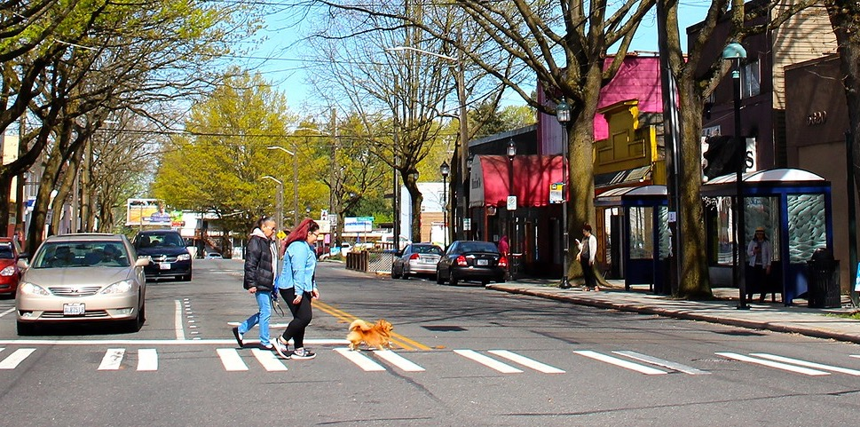
Modal Integration

Slide 7
Tonight’s objectives
Describe our process for identifying common right-of-way constraints/conflicts
Explore common conflicts and how decision are currently made
Discuss key factors in right-of-way allocation

Slide 8
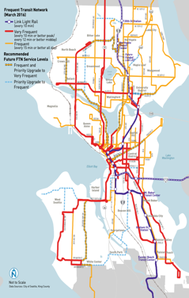
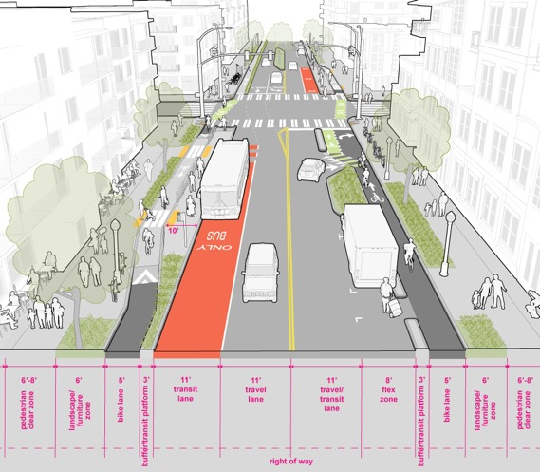
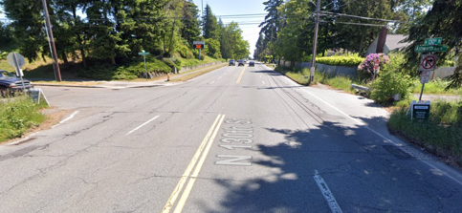
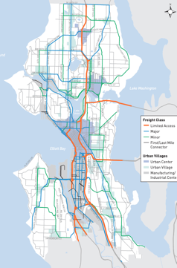
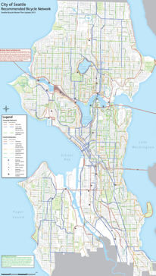
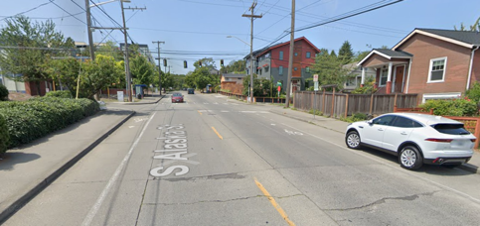
Overview of analysis approach
1. Overlay Modal Plan Network Maps
(transit, freight, bike)
2. Apply Streets Illustrated dimensional standards to existing street geometry
3. Identify curb-to-curb deficiencies where modal plan priorities do not fit

Slide 9
Overview of results
6,500 total arterial and collector block segments
2,900 segments in a center, urban village, or neighborhood commercial area
432 deficient segments

Slide 10

Example: transit and freight priority
About 550 are higher bus ridership segments
About 250 are lower ridership segments
About 80 are an Industrial Access Street type
About 800 block segments are both transit and freight priority (and not a bike priority)

Slide 11
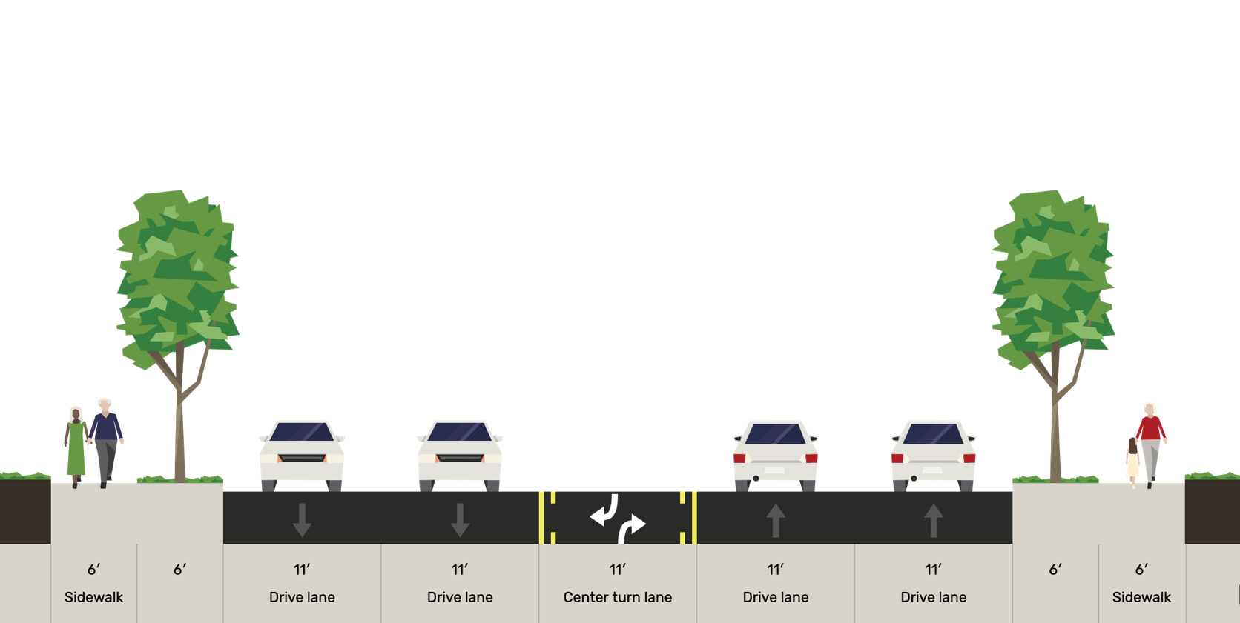
Existing condition
Source: Streetmix

Slide 12
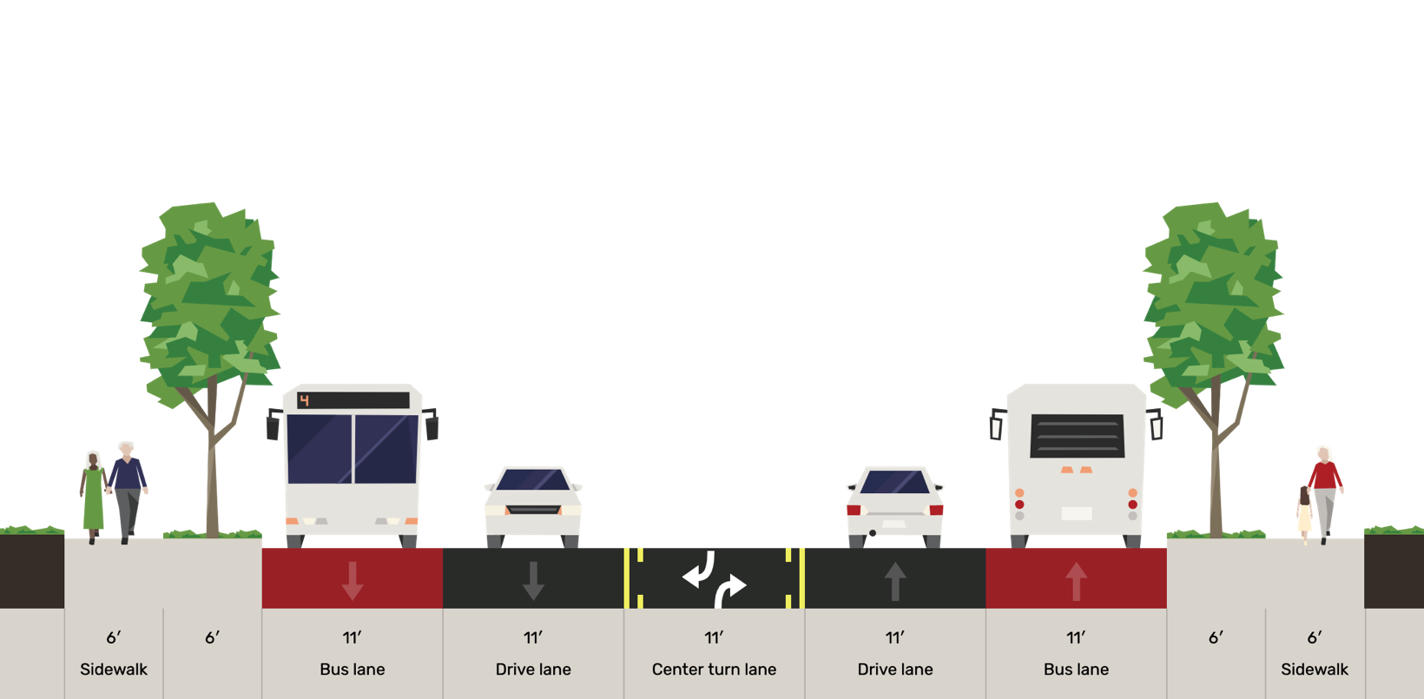
Option: install transit-only lanes
Source: Streetmix

Slide 13
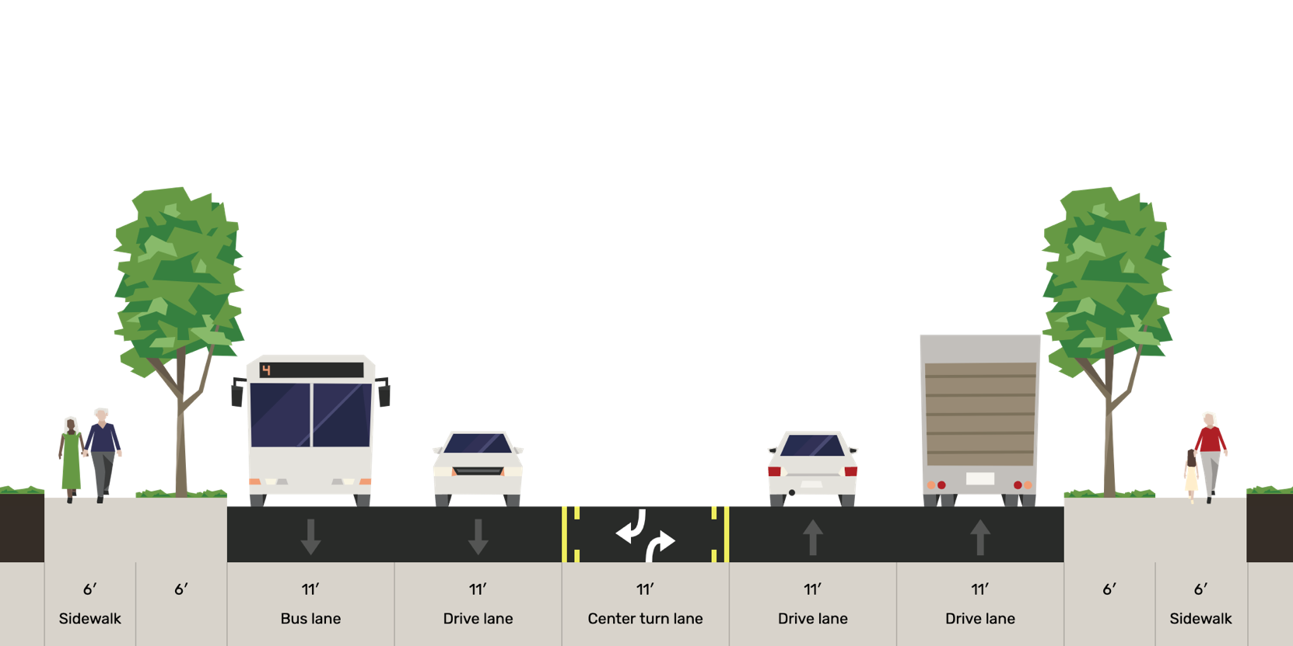
Option: install shared freight & transit lanes
Source: Streetmix

Slide 14
Discussion
In this case, what factors are most important in determining the use of the right of way (safety is always a top priority)
What information would you want to guide this decision?

Slide 15

Example: bicycle priority and the flex zone
About 1,100 block segments require removal of flex zone/parking to implement a bicycle priority
About 450 are in an Urban Center, Urban Village, or neighborhood commercial area
About 400 are planned as protected bike lanes and 700 are standard bike lanes

Slide 16
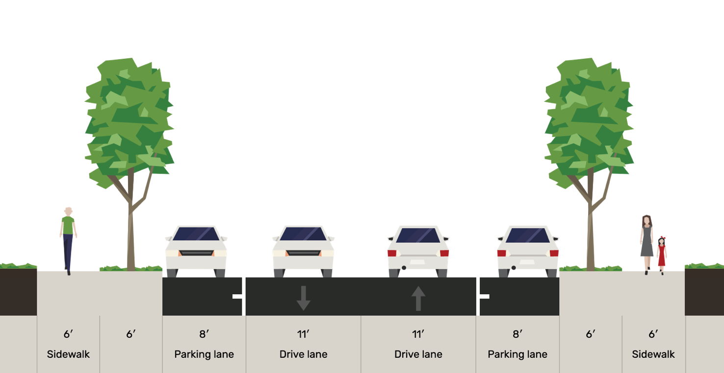
Existing condition
Source: Streetmix

Slide 17
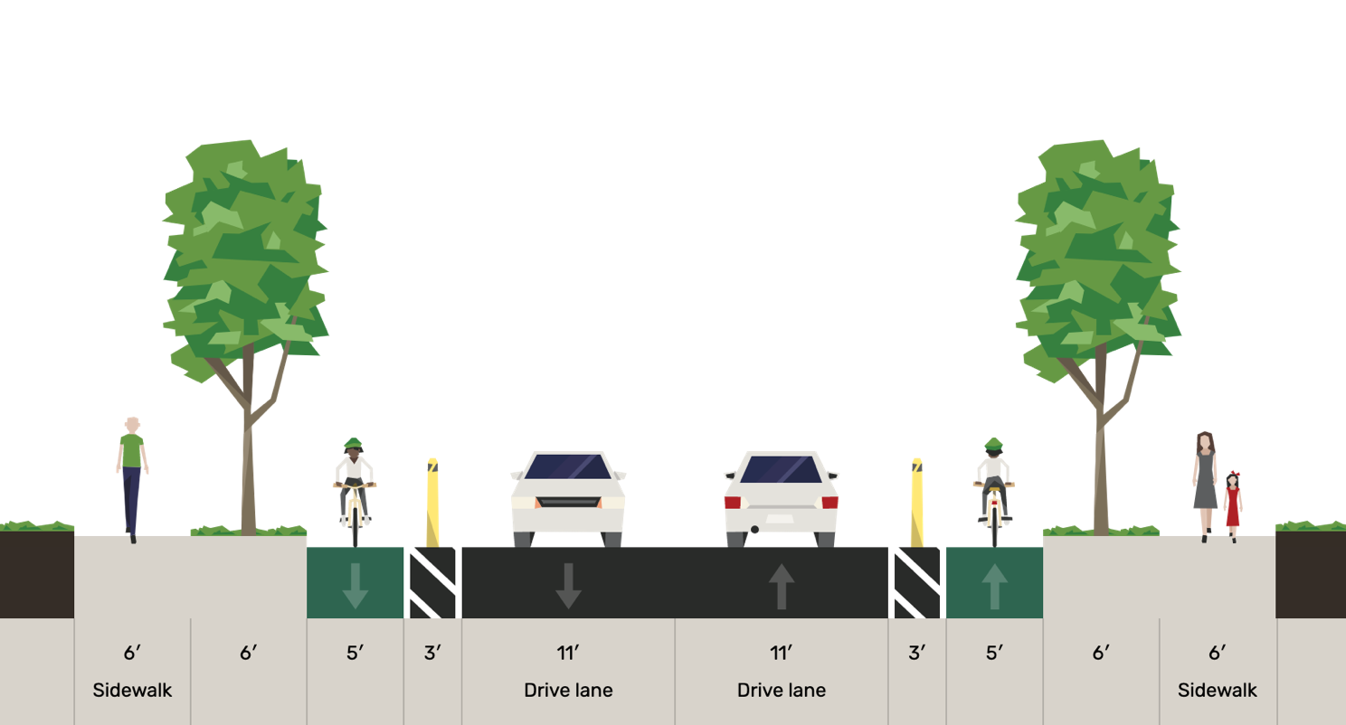
Option: install protected bicycle lanes
Source: Streetmix

Slide 18
Discussion
In this case, what factors are most important in determining the use of the right of way (safety is always a top priority)?
Are there circumstances when flex zone uses should be preserved or when bicycle infrastructure should be clearly prioritized?
What information would you want to guide this decision?

Slide 19

Example 3: transit and bicycle priority
About 1,900 block segments are both a transit and bicycle priority
About 130 block segments are candidates for a transit-only lane and planned for an in-street bikeway
Of those, about 50 segments have a significant right-of-way constraint

Slide 20
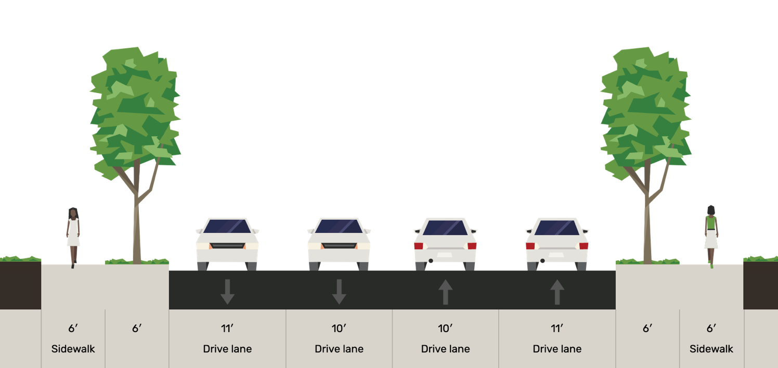
Existing condition
Source: Streetmix

Slide 21
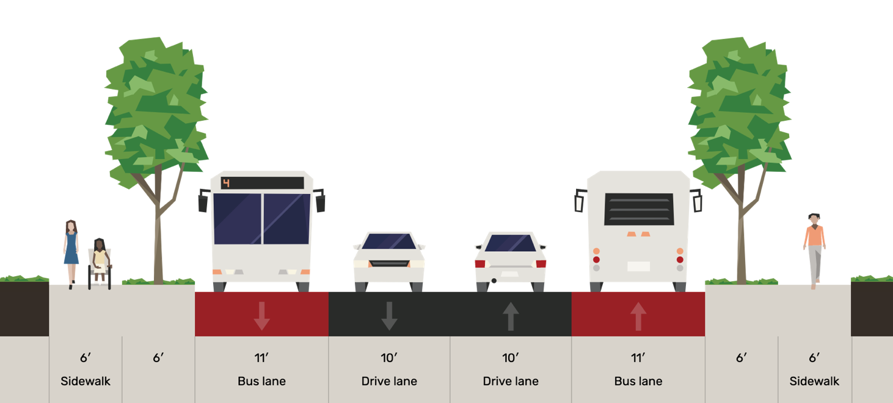
Option: install transit-only lanes
Source: Streetmix

Slide 22
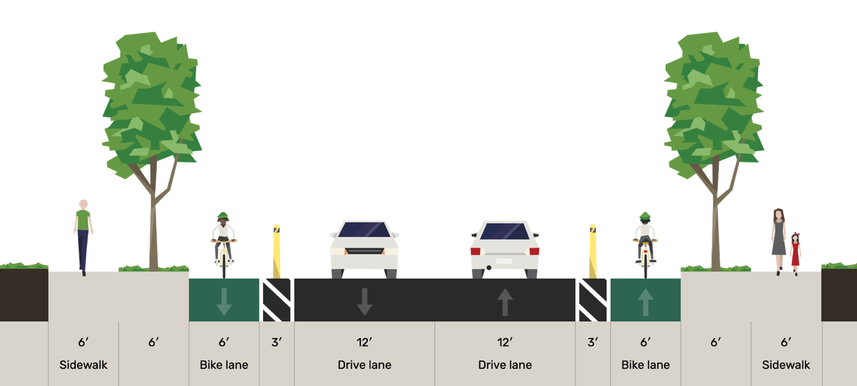
Option: install protected bike lanes
Source: Streetmix

Slide 23
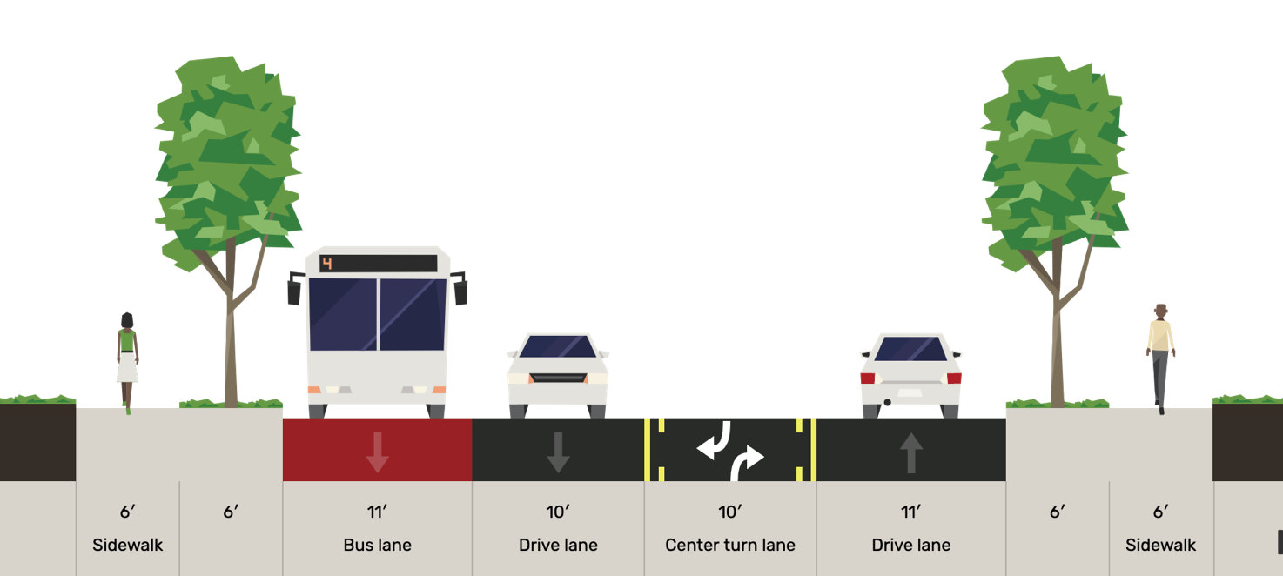
Option: install transit-only lane & turn lane
Source: Streetmix

Slide 24
Discussion
In this case, what factors are most important in determining the use of the right of way (safety is always a top priority)
Are there situations where we would prioritize transit or bicyclists within a given corridor?
What information would you want to guide this decision?

Slide 25
Signal Operations Policy

Slide 26



SDOT values and desired outcomes
Safety: meet our commitment to Vision Zero
Access: increase pedestrian access
Mobility: provide framework for modal shift

Slide 27



Policy components
1. Define maximum cycle length
2. Increase pedestrian crossing time
3. Pedestrian actuation (push buttons)

Slide 28



Policy component
Implementation strategy
Desired outcome
Safety
Signal retiming
Access
Reduced wait time, providing more frequent opportunities to cross the street
1. Define maximum cycle length
Mobility
Signal modification
Safety
Signal installation
Access

Slide 29

Policy component
Implementation strategy
Desired outcome
Signal retiming
2. Increase pedestrian crossing time
Safety
Provides enough time for everyone to cross the street
Signal modification
Access
Mobility
ADA requests

Slide 30
Policy component
Implementation strategy
Desired outcome
Signal optimizations
Safety
Prioritizes people walking and provides consistent operations
3. Pedestrian actuation (push buttons)
Signal modification
Access
Mobility
ADA requests

Slide 31
Policy updates based on feedback
Implement policy consistently:
Setting cycle lengths based on street type
Added Urban Residential Villages to total recall policy
Max cycle lengths differ from NACTO guidelines
Adding cycle length targets that better align with NACTO
Maintain APS even with total recall
APS will not be precluded when we add total recall

Slide 32
Next steps
#1 – June 25
Kick-off
Introduction to signal operations
#2 – July 23
Draft Comprehensive Traffic Signal Operations Policy: presentation and discussion
Modal Integration: introduction
#3 – August 27
Draft Comprehensive Traffic Signal Operations Policy: continued discussion
Modal Integration: analysis
#4 – Sept 24
Modal Integration: draft policy options
#5 – Oct 22
Modal Integration: draft policy options and operational priority
#6 – date TBD
Modal Integration: policy recommendations and discussion
Wrap-up and reflections

Slide 33

Questions?
ellie.smith@seattle.gov | (206) 300-1690
www.seattle.gov/transportation

