Slide 1


Land Use 101: The Comprehensive Plan
Housing Affordability and Livability Agenda

Slide 2
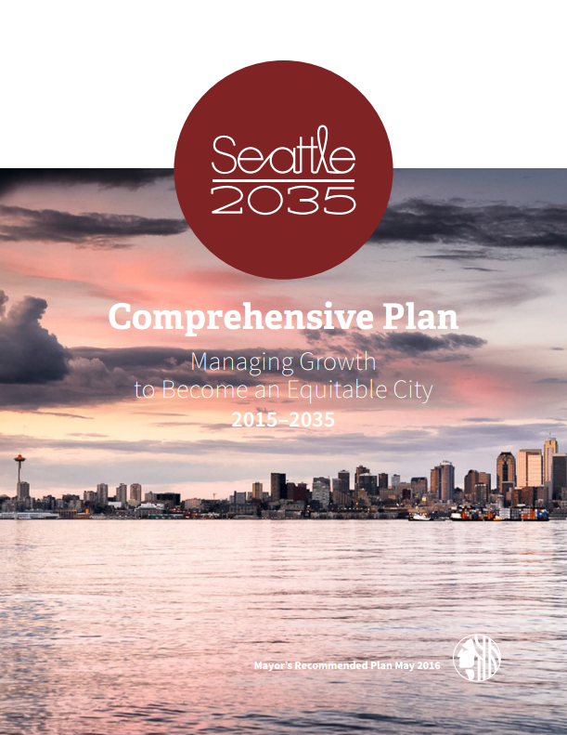
What is the Comprehensive Plan?
The Comprehensive Plan is a 20-year vision for the future of our city.
It’s a blueprint for how the City will manage the growth of population and jobs we expect between now and 2035.
Provides a framework for how Seattle will make big-picture decisions
Directs growth to different parts of the city
Protects and preserves forests, farmland, and natural resources

Slide 3
What is the Comprehensive Plan?
The first Plan was adopted in 1994 following the passage of Washington’s Growth Management Act.
The GMA required the City’s plan for growth
Our first Plan led to the creation of today’s Urban Village boundaries through a neighborhood planning process
No major changes to Urban Village boundaries since 1994

Slide 4
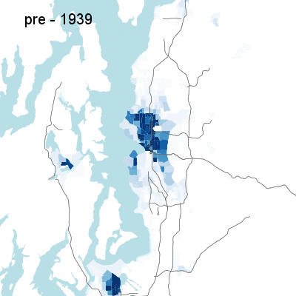
A growing region
Density of housing developed in Puget Sound region, 1939-2010
As part of the Growth Management Act, the Plan directs urban growth in limited areas to prevent sprawl and preserve forests and farmland.
Notes:
Population growth is a big part of the growth management puzzle. Another part is new houses and buildings. These maps show how the urban portion of our region has grown since 1940 – the red portion shows how new people move further and further out into the forests and farmlands of Puget Sound.
A central goal of growth management is encouraging new urban development to build up – in the areas with existing roads, libraries, and schools. That’s one way we can get the benefits of new growth without harming the beautiful natural environment around our cities.

Slide 5
Why plan for the future?
Seattle and the Puget Sound region are growing.
Over the next 20 years, Seattle will add 120,000 people and 115,000 jobs.
By 2040, the region will have 5 million people.
Seattle Growth 1960-2010
Thousands

Slide 6
Core values
Seattle’s Comprehensive Plan has 4 core values:
Race and Social Equity
Environmental Stewardship
Economic Opportunity and Security
Community

Slide 7
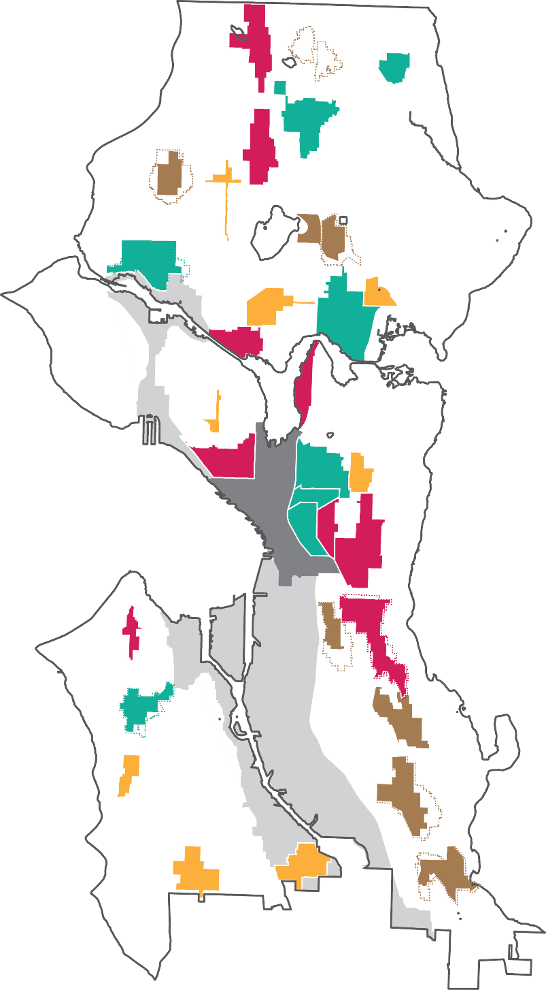
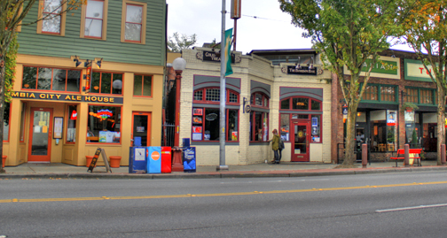
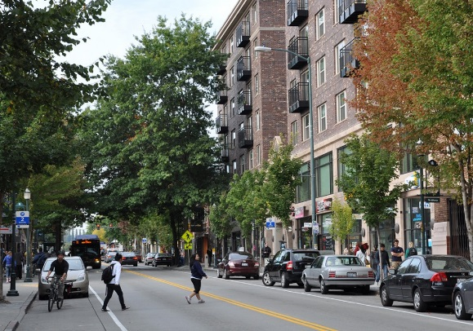
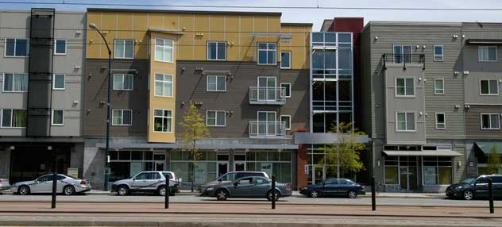
How does the Plan manage growth?
The Urban Village Strategy directs new housing and jobs in neighborhoods with transit, infrastructure, and services

Slide 8
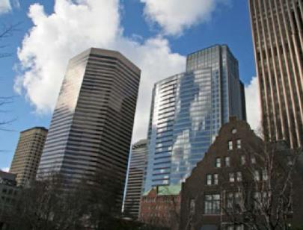
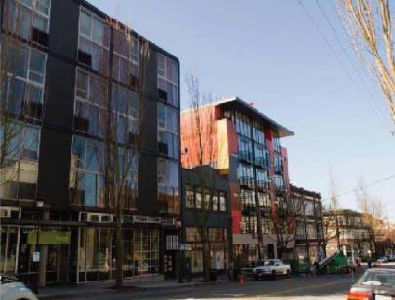
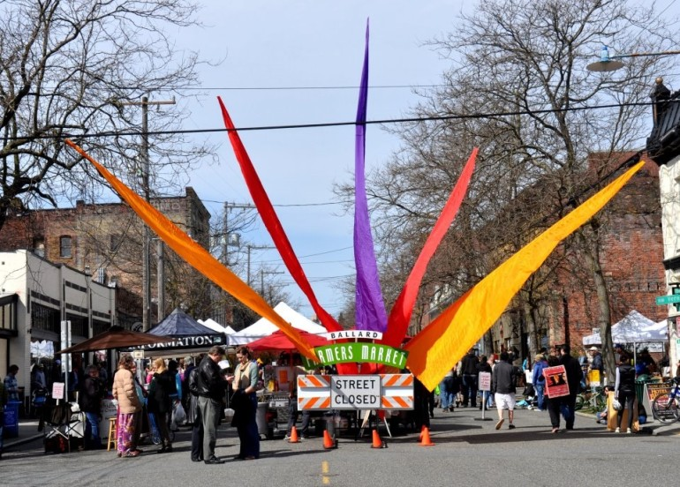
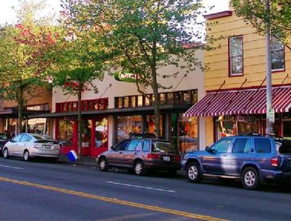
Seattle’s Urban Villages
Downtown is an example of
an Urban Center
Pike/Pine is an example of
an Urban Village
Ballard is an example of
a Hub Urban Village
Columbia City is an example of
a Residential Urban Village

Slide 9
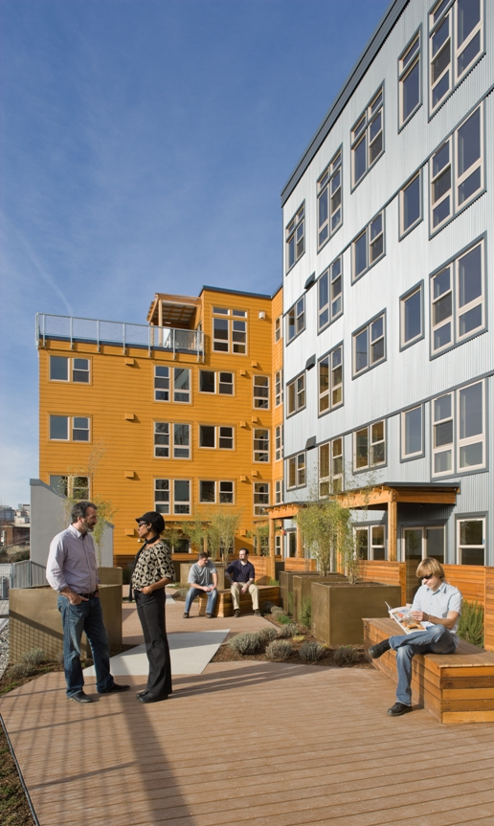
75% new housing in urban villages

Slide 10
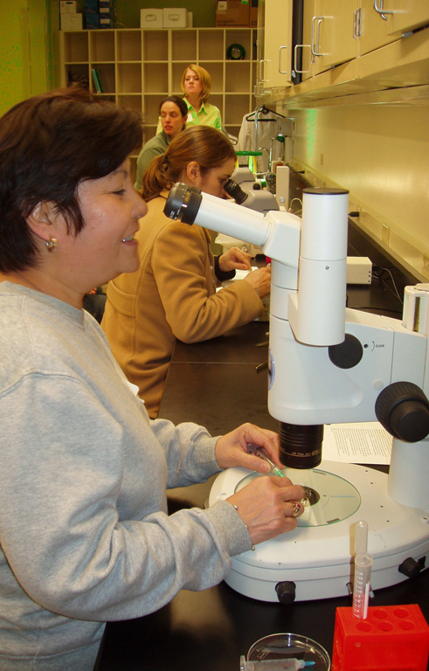
80% new jobs in urban villages

Slide 11
Elements of the Plan
For each aspect of our city, the Plan sets high-level goals and specific policies to achieve them.
Land Use
Housing
Utilities
Parks & Open Space
Transportation
Environment
Economic Development
Capital Facilities
Arts & Culture
Shoreline
Container Port

Slide 12
Investing in the Plan
The City makes investments to achieve the Plan’s vision. Recent ones include:
Affordable housing
$145 million for 2,000 units
Libraries
$291 million for 4 new and 22 renovated libraries
Community Centers
nine new and five renovated centers
Parks
$346 million in two levies (Pro Parks, Parks and Greenspace)
Neighborhood Business Districts
$3.8 million for 19 districts
Infrastructure
$930 million for Move Seattle transportation levy

Slide 13

Seattle 2035
The Mayor recently proposed an update to the Comprehensive Plan to guide growth through 2035.
Opportunities for public involvement
Visit 2035.seattle.gov for information
Urban village boundaries and zoning changes as part of Mandatory Housing Affordability

Slide 14
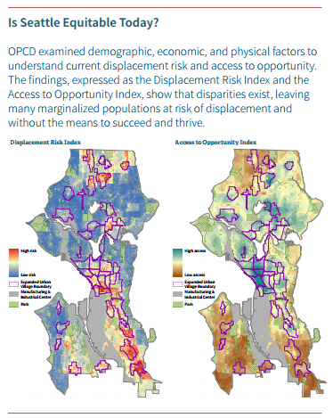
Growth and Equity
The proposed Comprehensive Plan update emphasizes racial and social equity.
Analysis of how growth in Seattle can affect displacement and opportunity, especially for marginalized populations
New policies give greater attention to racial disparities and equity in every element of the Plan

Slide 15
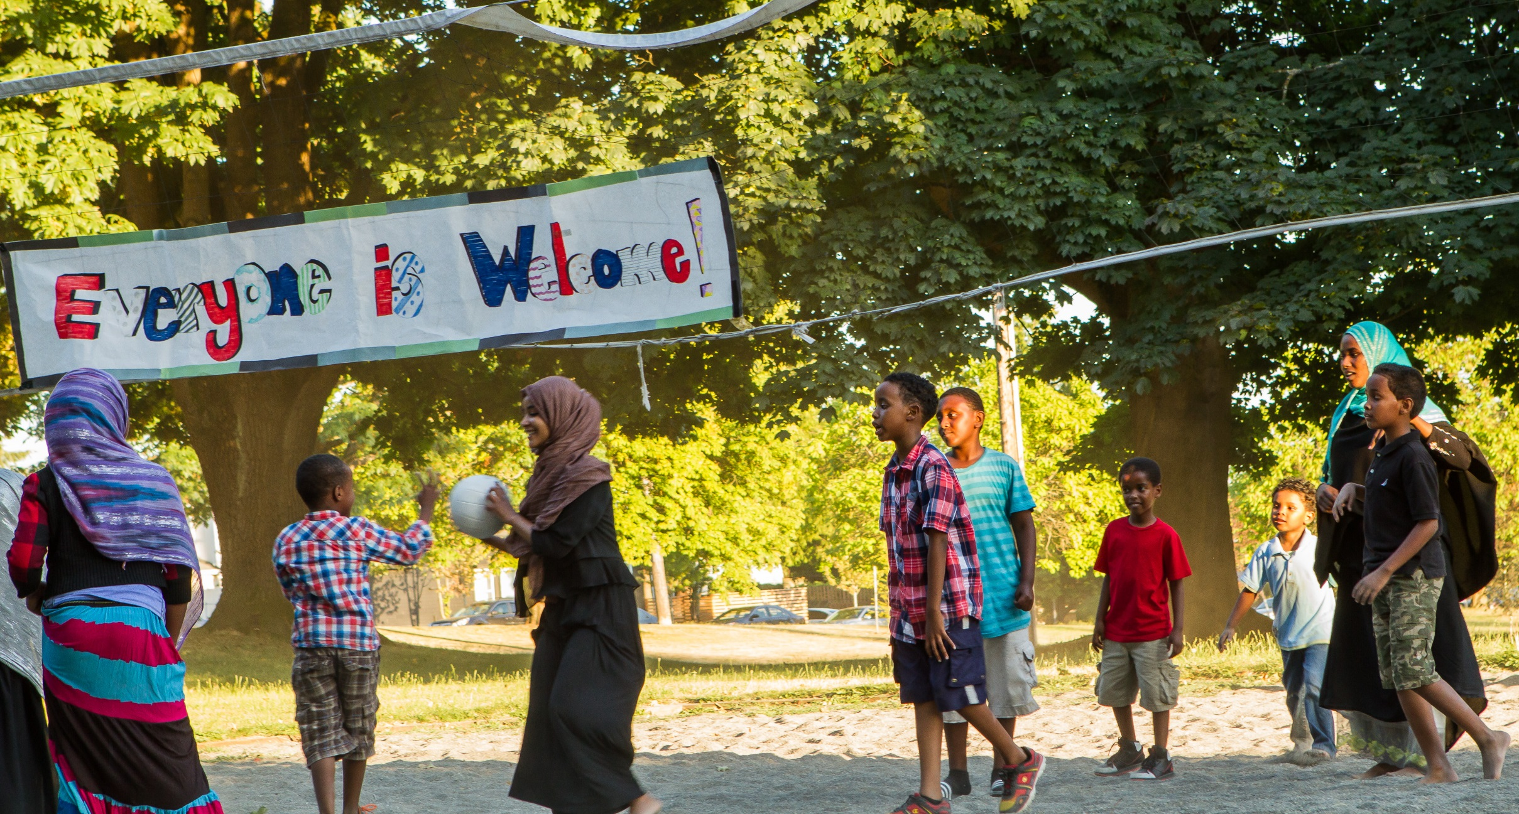
Becoming an Equitable City

Slide 16
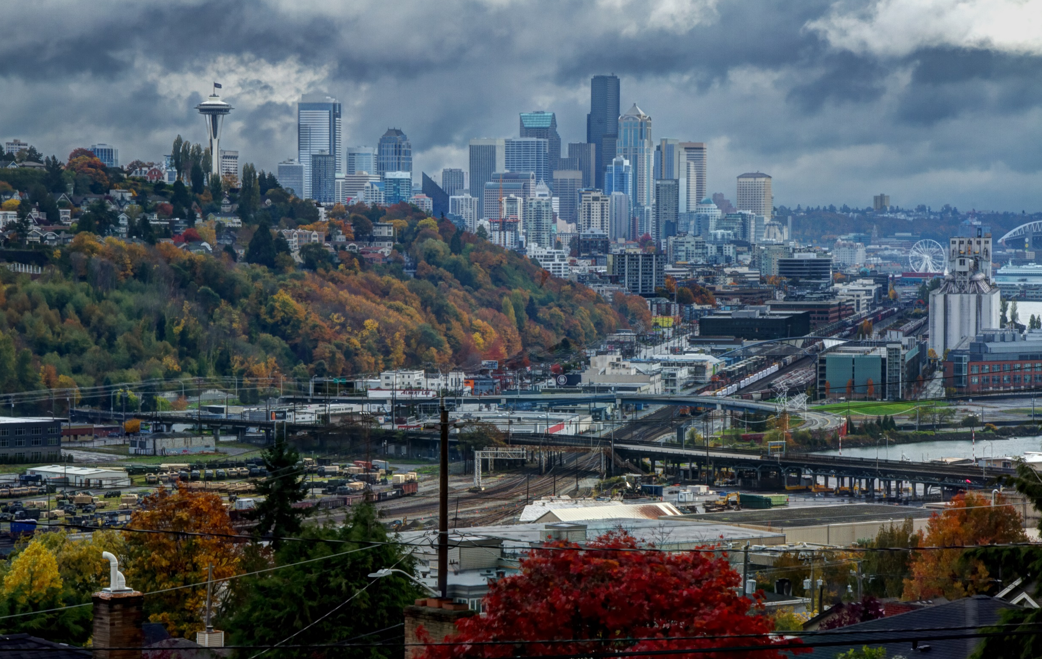
Thank you

