Slide 1


FEPP Levy K-12 Opportunity and Access (O&A) Request for Investment (RFI) Information Session (Webinar)
Department of Education and Early Learning (DEEL)
K-12 & Postsecondary Division
Monday May 11, 2020
SLIDES WITH UPDATED TIMES AND DATES (5 total)
Notes:
SCRIPT START:
Welcome and introduction. This is intended as a sort of Cliff’s Notes of the RFI document that was released last week. This info session doesn’t have any interactive elements, but there will be two upcoming opportunities for in person technical assistance sessions on 3/11 and 3/25.
May be good to remind listeners to have a copy of the RFI application next to them as they view this presentation...

Slide 2
Application Amendment #1:
On March 24, 2020, the FEPP Levy Opportunity & Access (O&A) Request for Investment (RFI) was temporarily suspended due to COVID-19. The O&A RFI will be re-opened on May 11, 2020 with the following revisions:
Modified dates to align with adjusted O&A RFI process timeline, pages 1, 2, 9, and 13.
Addition of COVID-19 Addendum as an application requirement on Page 9 and 13, and the addendum to the submission template, page 21.
Addition of language stating DEEL’s intent to implement O&A contracts as planned unless changes to the budget require otherwise, page 11.
Revisions are highlighted in yellow as an underline (addition) or as a strikeout (deletion) to the original RFI issued on March 4, 2020.

Slide 3
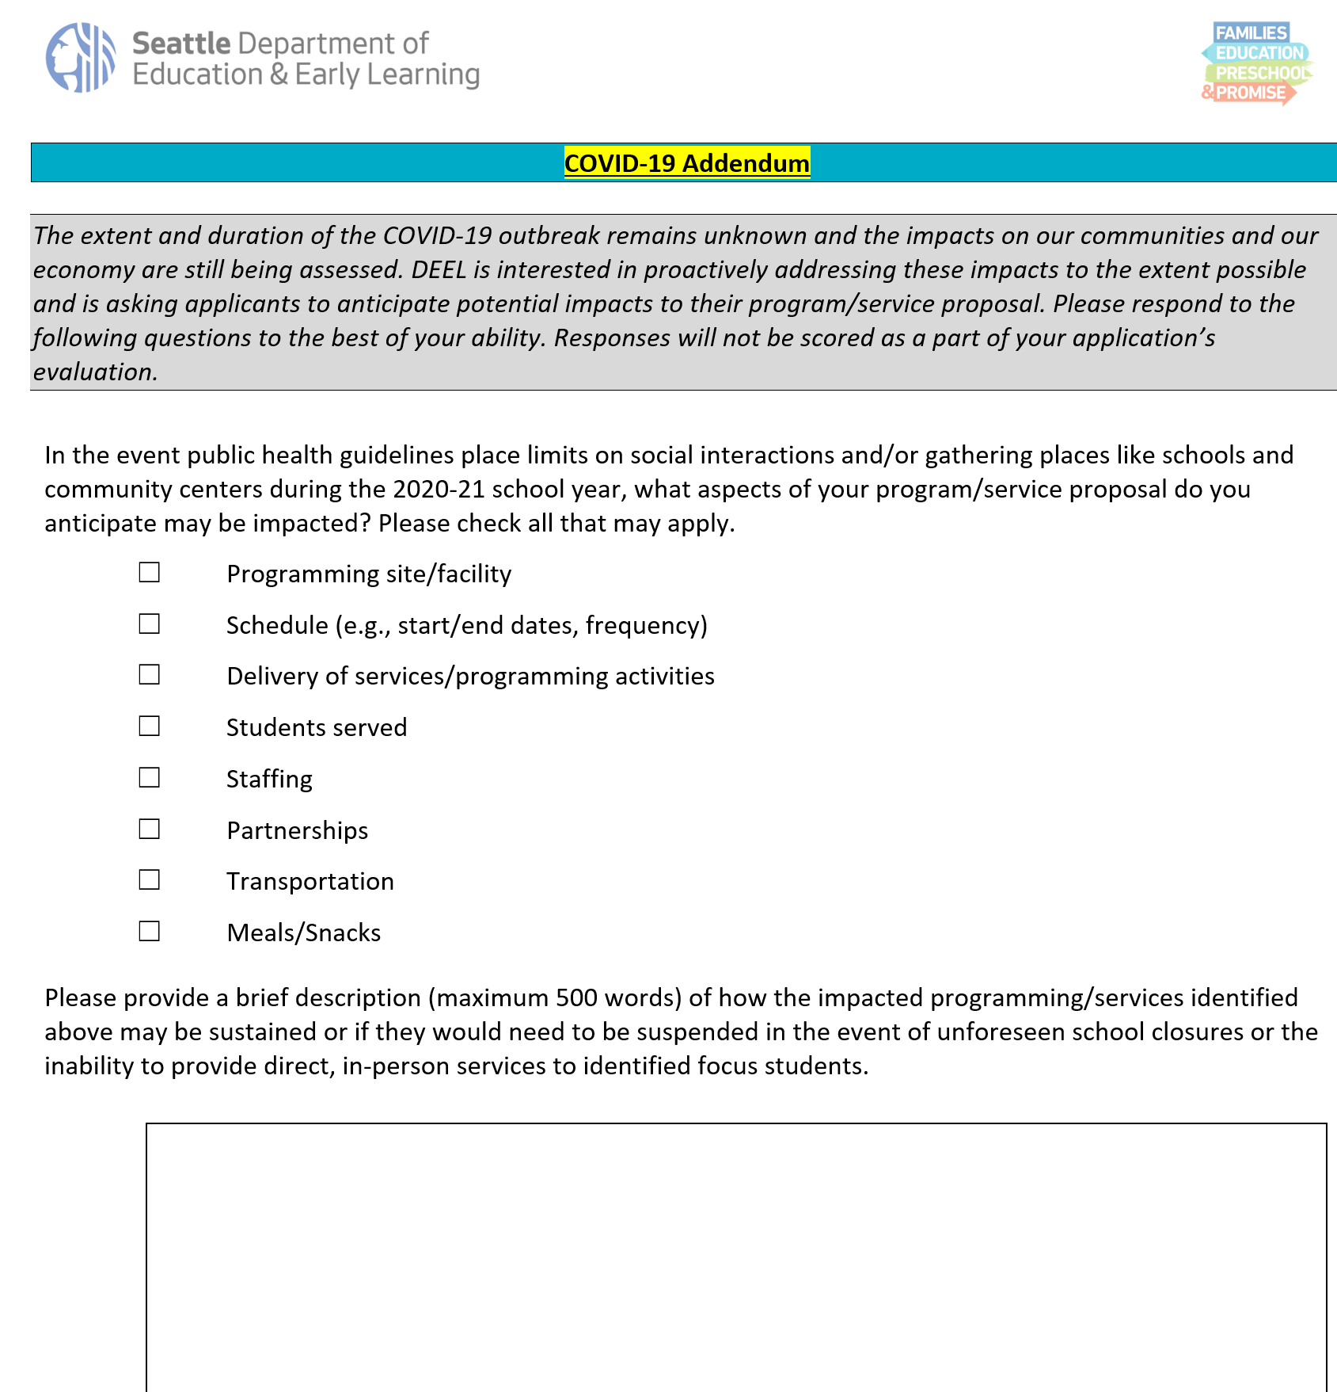
COVID-19 Addendum

Slide 4
Opportunity & Access Investment: 2020-2021 School Year Summary
RFI: p.1
REPLACE SLIDE 10 in original PPT/Webinar
Purpose | Increase access to enrichment and academic experiences for focus students Promote the development of academic and non-academic skills likely to lead to on-time graduation and matriculation into post-secondary programs
Eligible Applicants | Community-based organizations Government agencies Schools not receiving FEPP Levy School-Based Investments | Total Amount Available | $1.28 Million**
Service/ Programming Components | College and Career Readiness Expanded Learning Opportunities* | Maximum # of proposals funded | Up to 20 (proposal minimum is $40,000)
Applications Due | By 3:00 pm Monday, June 22, 2020 | Term of investment | Up to 3 years^
* Organizations may submit no more than two applications and no more than one application per component.
** Annual award size will be contingent upon services provided and students served.
^ Conditional upon annual performance, all O&A funding will be rebid in 2023.
Notes:
When writing application, review key elements to decide which component to apply under

Slide 5
Timeline After Applications Are Submitted (Deadline Monday, June 22, 3:00 pm)
RFI: p.1
REPLACE SLIDE 40 in original PPT/Webinar
Phase 3: Evaluation (dates subject to change)
Applications Reviewed and Rated | June 23 – July 10, 2020
Interviews and Review Panel Deliberations | July 15 – July 24, 2020
Notifications issued to applicants | Friday, August 21, 2020
BOTH Technical Assistance Sessions will be offered online only. Please check out website for times and date: https://www.seattle.gov/education/for-providers/funding-opportunities
Notes:
We will provide more information on interviews at live TA’s on 3/11 and 3/25

Slide 6

Technical Compliance
RFI: p.9
REPLACE SLIDE 41 in original PPT/Webinar
An application will be deemed technically compliant if it:
Is submitted on time(by Monday 3:00 PM, June 22, 3:00 pm) either electronically or in paper copy
Includes all required sections(must be a COMPLETE application)
Ensures submissions for Sections 1 - 5 are typed, single- or double-spaced, size 11 font, page-numbered, single- or double-sided, and all submitted together as one document in PDF or Word format
Ensure Budget is formatted using the Excel template provided and submitted as one file
Include labor harmony attachment (see Section 5)
COVID-19 Addendum
Response is typed, single- or double-spaced, size 11 font, page numbered, single- or double-sided, and maximum of 500 words
Notes:
Please understand these Technical compliance requirements in order to remain eligible

Slide 7
Technical Assistance (TA)
RFI: p.1
REPLACE SLIDE 42 in original PPT/Webinar
Participation is not required, nor are points awarded for participation. However, it is highly recommended a staff member(s) assigned to the development of a proposal should attend a session, so applicants understand the RFI sections, technical compliance, and application tools provided.
For the most current information please visit the DEEL website (www.seattle.gov/education).
Email questions to DEELFunding@seattle.gov.
Event | Date | Time & Location
RFI Information Session (webinar) | Monday, May 11, 2020 | Posted online by 4pm
Technical Assistance Session 1 | Monday, May 18, 2020 | 2:30 - 4:00pm ONLINE
Technical Assistance Session 2 | Monday, June 1, 2020 | 2:30 - 4:00pm ONLINE
Last day to submit questions to DEELFunding@seattle.gov | Friday, June 12, 2020 | All Q&A posted online within 3 business days
Notes:
Please mark your calendar
TA's are not mandatory, but you are encouraged to attend.
Please refer to the DEEL webpage (under FUNDING OPPORTUNITIES) for updates and announcements
Note that the following TA's will provide actual work time and access to DEEL staff for support, meeting, face time, not online

Slide 8

In preparation for upcoming Technical Assistance sessions…
Any appropriate staff may attend
Please review the online RFI Information Session (webinar)
Please go to the DEEL Website and familiarize yourself with this funding opportunity (RFI, supporting docs, FEPP Levy, etc.) located at https://www.seattle.gov/education/funding-opportunities
Please bring your questions on RFI related topics or areas
Please note your questions and ask during the online sessions, or feel free to submit them to DEELFunding@seattle.gov at any time, with the subject line "Question: Opportunity and Access RFI"

