Slide 1
Age Friendly Seattle
Eldad Mekuria
Program Coordinators, Age Friendly Seattle

Slide 2

CONNECTORS
2023: Connected Friends of the Waterfront with community experts in accessible design
CONVENERS
2022: Held an Age-Friendly Candidate Forum for new City Councilmembers
2022: Compiled and shared location data mapping older adults' homes to inform potential snow shoveling program
LEARNERS/SHARERS
ADVOCATES
2024: Weighed in on PSRC transportation plans to highlight the needs of older adults
2022: Supported the re-launch of Parks and Recreation’s Sound Steps walking program
ENABLERS
DO-ERS
2024: Managed Gold Card Discount Program;
Produced monthly Civic Coffee events
SEATTLE HUMAN SERVICES

Slide 3
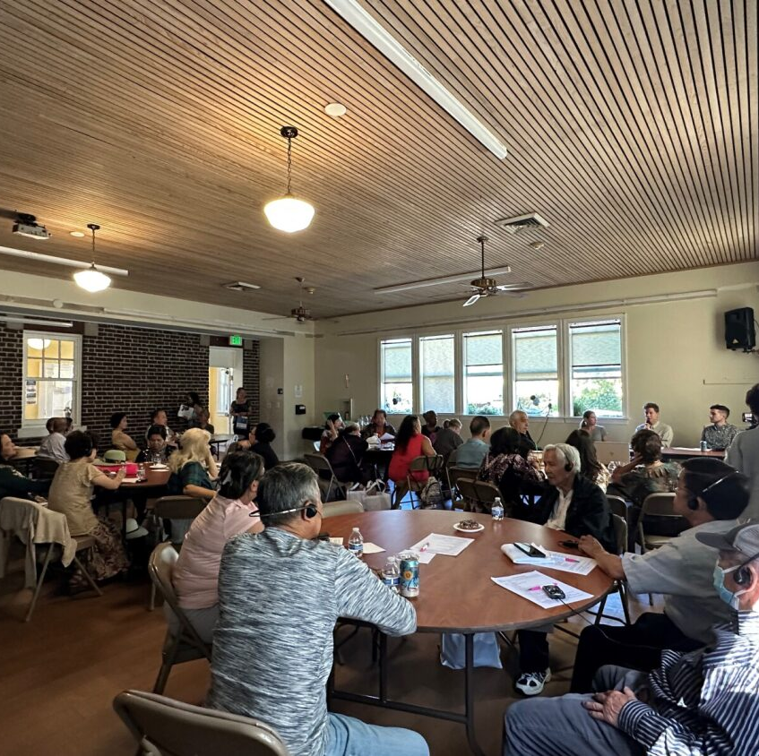
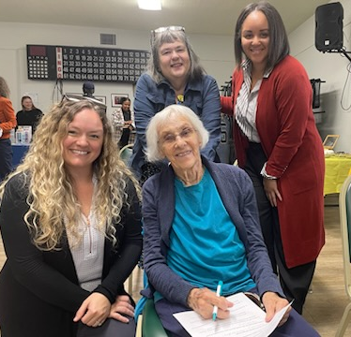
Civic Coffee
Monthly events hosted in partnership with The Seattle Public Library.
Opportunities for older adults to gather, meet local government and community leaders, learn about key issues, and ask questions and provide feedback.
We collaborate with several partners around the city to bring these events into different communities.
Provide simultaneous interpretation during events

Slide 4
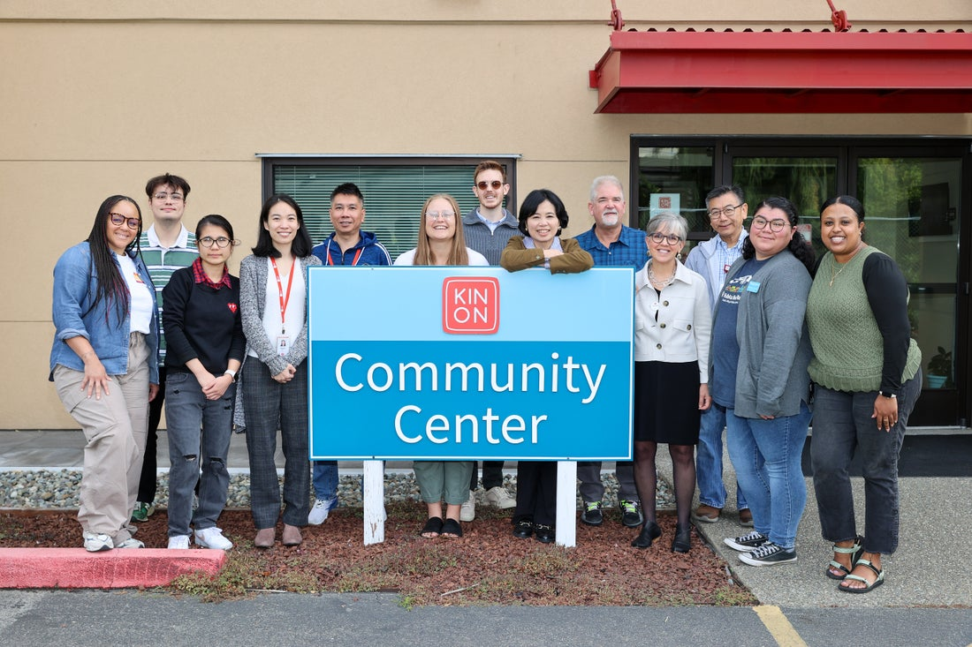
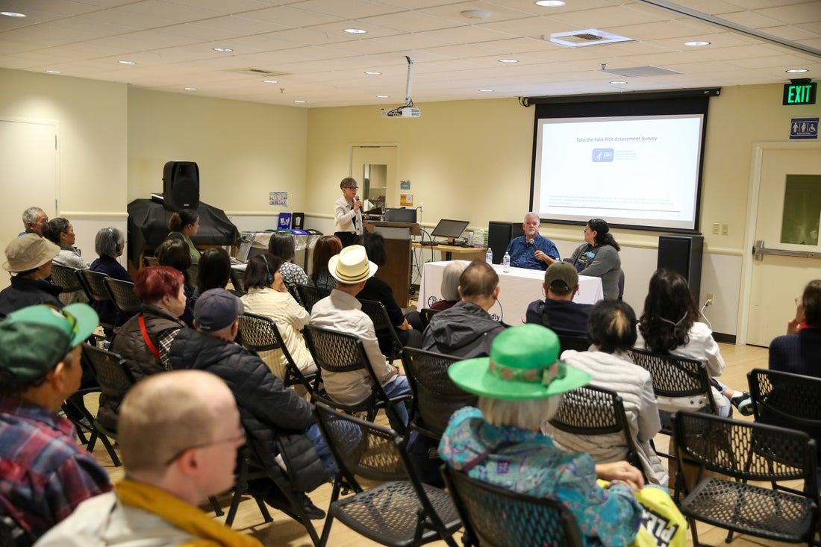
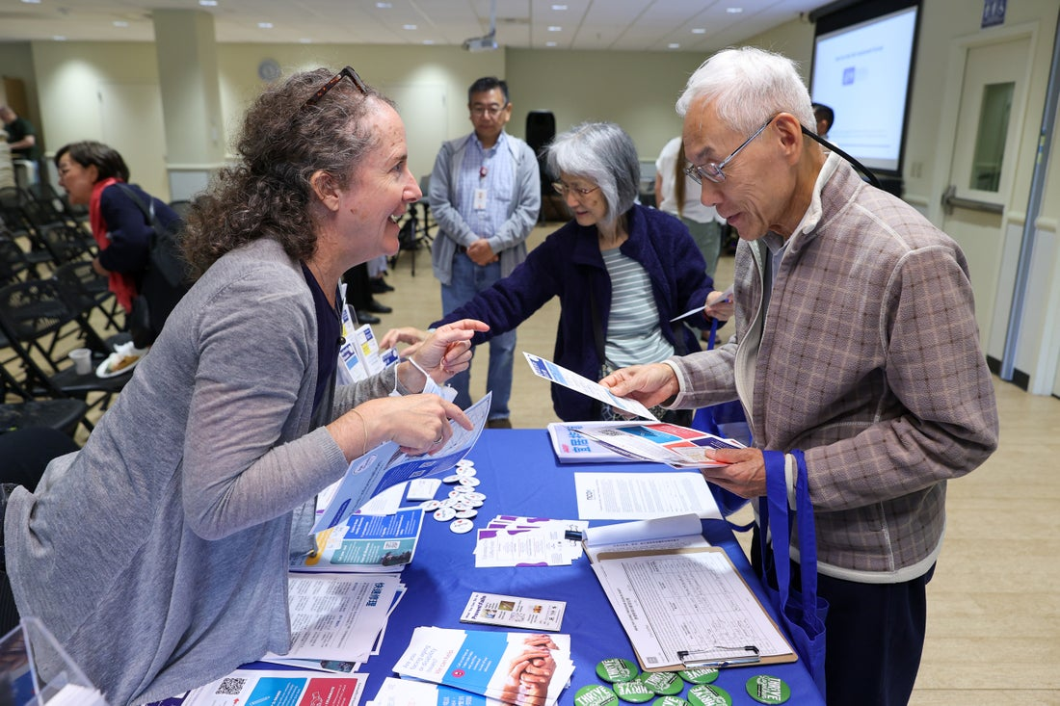
Civic Coffee
Cover a range of topics
  Medicare, Social connectivity, Home safety modifications, Brain health, Identifying accurate information, etc.
Recap articles and recordings
  https://www.youtube.com/
  @AgingKingCounty

Slide 5

Age Friendly Discount Program?
GOLD card: age 60+
FLASH card: age 18-59 with disabilities
Discount Directory online

Slide 6
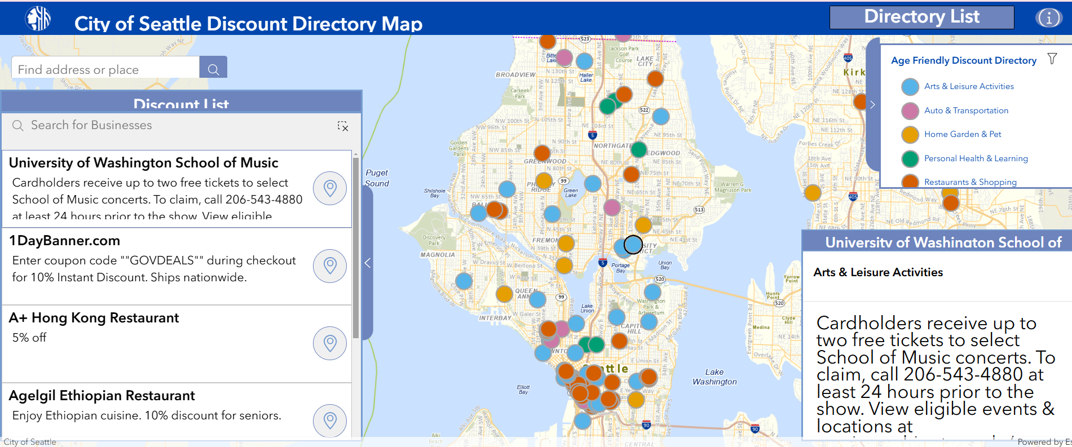
Discount Directory
(www.seattle.gov/AgeFriendlyDiscounts)
Search for discounts:
By Business/ Org. name
Category
Zip code
etc.

Slide 7

How can you support?
Help Civic Coffee attendees access resources shared
Encourage folks to use recordings and recap articles as resources
Help folks apply for Gold/Flash Cards
Navigate the business directory
Navigate the Age Friendly Seattle Website
Notes:
Attend Age Friendly programs
Find calendar at: seattle.gov/agefriendly/programs/events
Stay curious—take the ‘Anti-Ageism’ Training
Challenge yourself—notice ageist ad/statements/self-thoughts
Schedule Follow-Up facilitated discussion with your team
Recruit local businesses for Discount Directory
Become an Anti-Ageism Advocate or Ambassador!
Speak up! And impact real culture change…
Use Age Friendly Seattle as a resource

Slide 8
Questions
Thank you!
Eldad Mekuria (she/her)
Human Services Coordinator
Aging and Disability Services | Human Services Department | City of Seattle
C: 206-247-8968 | Eldad.Mekria@seattle.gov
Connect with us: seattle.gov/agefriendly

