Slide 1
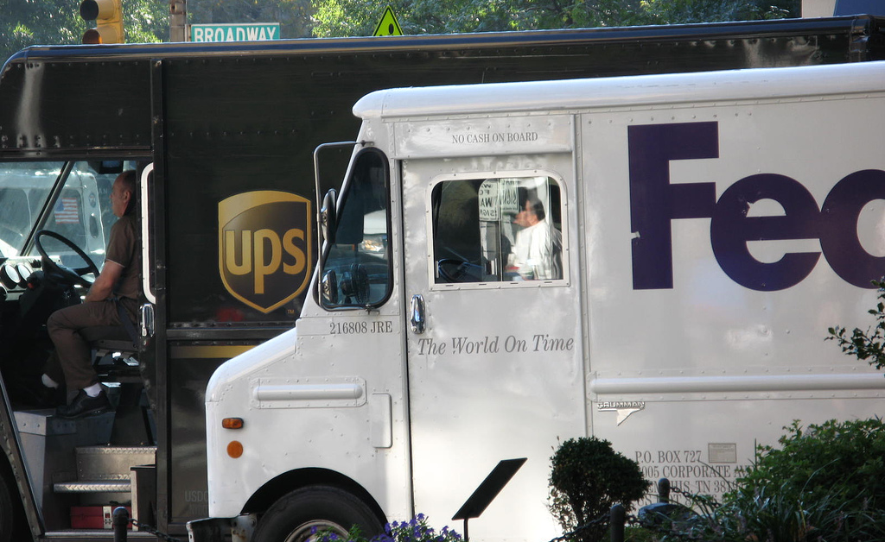
Freight Master Plan
Seattle Bicycle Advisory Board
Ian Macek
June 1, 2016

Slide 2
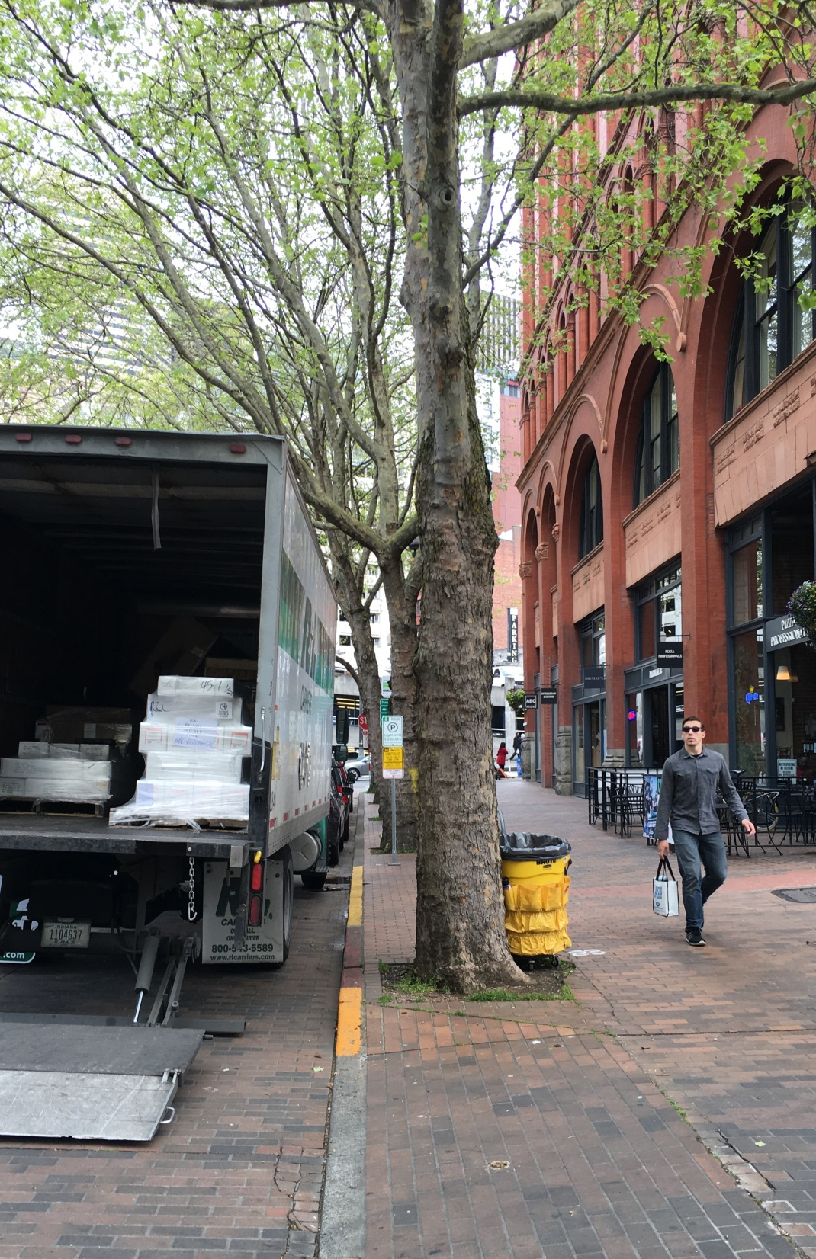
Presentation overview
Summary of draft FMP document
Next steps
2
Notes:
We’ve been working on the plan since 2014. The document reflects the huge amount of work we’ve done over the past two years.

Slide 3
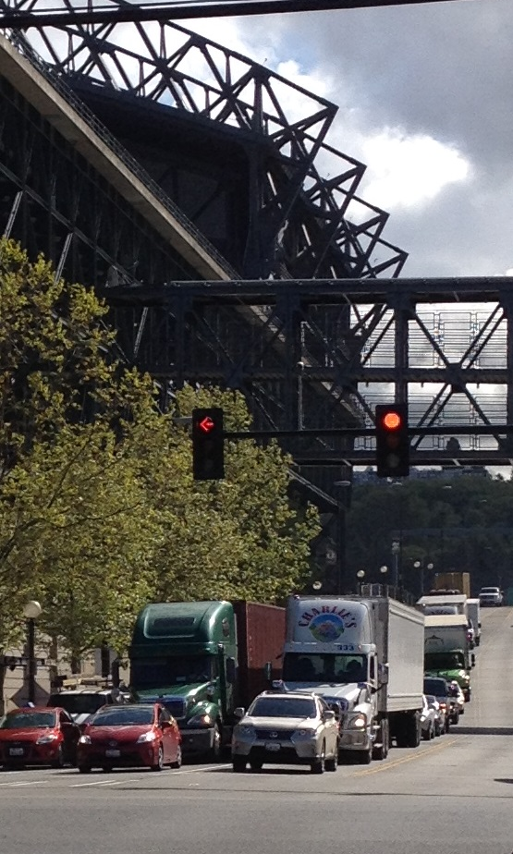
What is the FMP?
20- year plan to improve goods movement and deliveries
Focus on truck freight
Data-driven process
3
Notes:
Efficient movement of goods is critical in sustaining the city’s quality of life and maintaining its competitiveness.
Improve freight mobility to support increasing demand for goods and services while addressing
How goods movement and deliveries benefit Seattle

Slide 4
Community engagement
Phase 1
Gather information
Freight stakeholder interviews
Met with over 50 organizations
Survey for people who drive trucks in Seattle
60 responses
Phase 2
Input to draft network
2 Open Houses
Georgetown
Ballard
Feedback from:
Modal Advisory Boards
Industrial and business associations
District Councils and Community Councils
Notes:
Stakeholders included:
Freight carriers
Manufacturers
Restaurant owners
Business and industrial organizations
State and local partners
District and neighborhood councils
Community organizations
City commissions and boards
We are now in Phase 3 – which is the public review of the draft FMP to obtain input.

Slide 5
What we’ve heard
Develop a resilient and connected freight network
Provide safe and predictable movements for all modes
Urban deliveries need a reliable network and easy loading
Provide more trees and vegetation in industrial areas
Streets and neighborhoods near industrial areas have greater impacts from truck movements
Concerns about truck parking on residential streets
Provide broader understanding of goods movement and deliveries
Notes:
Stakeholders included:
Freight carriers
Manufacturers
Restaurant owners
Business and industrial organizations
State and local partners
District and neighborhood councils
Community organizations
City commissions and boards

Slide 6
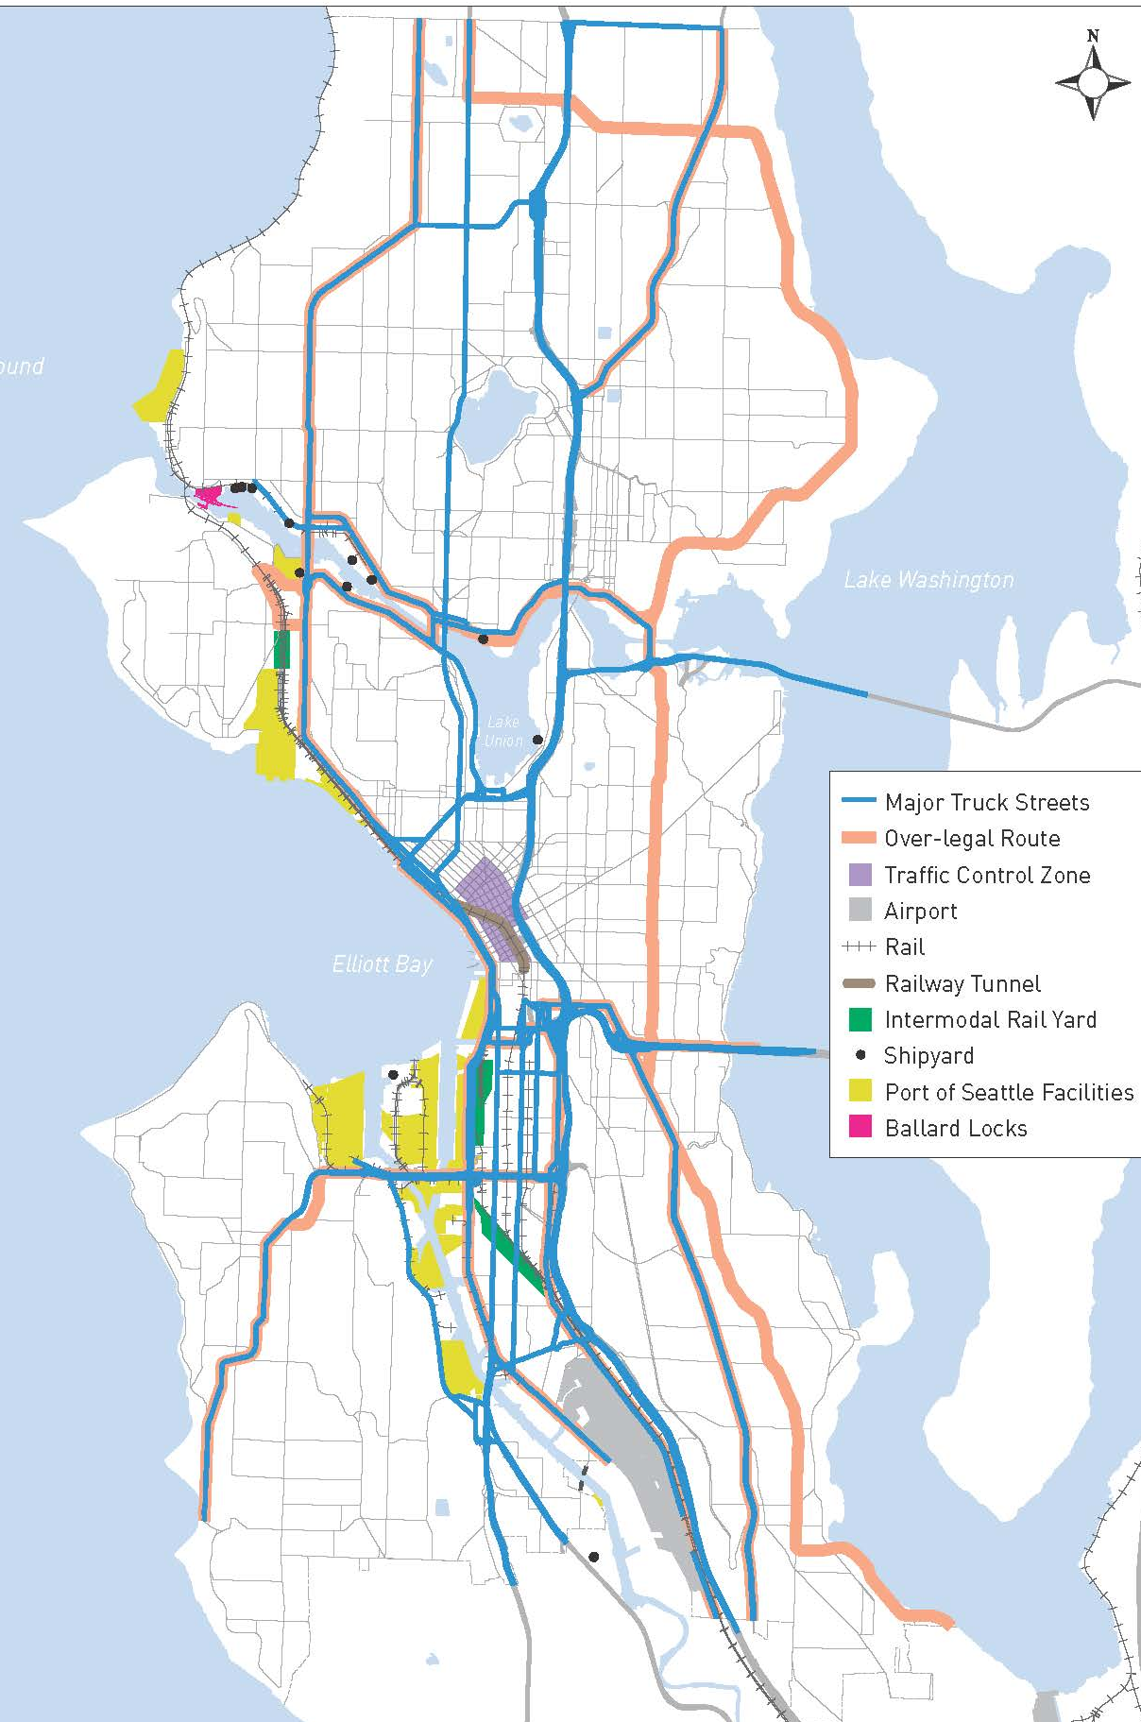
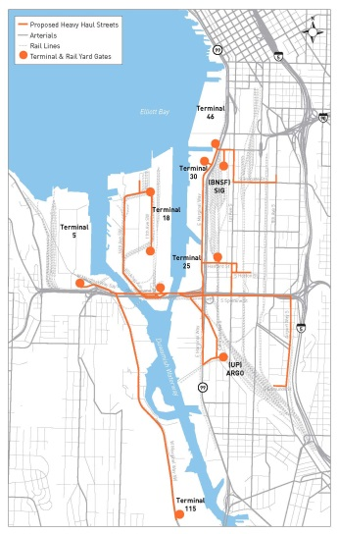
Goods movement in Seattle
Population, employment, and economic growth
Seattle’s freight assets
Current and future freight trends
Notes:
Existing conditions, current and future trends in goods movement
Retail, Wholesale and Manufacturing
Existing Conditions:
2014 First truck flow map
City of Seattle: 780 count locations
Other input from WSDOT, KC Metro
Future Conditions:
2035 Truck flow map
Create districts for analysis
Employment industries: Retail, Wholesale and Manufacturing
Develop Growth factors and apply to districts
Calibrate future volumes against other projects

Slide 7
Policy framework
Vision | Move Seattle Goals | Freight Master Plan (FMP) Goals
A vibrant city and thriving economy connecting people and products within Seattle and to regional and international markets. | A vibrant city | Economy Provide a freight network that supports a growing economy for Seattle and the region.
 | A safe city | Safety Improve safety and the predictable movement of goods and people.
 | An interconnected city | Mobility Reliably connect manufacturing/industrial centers and business districts with the local, state, and international freight networks.
 | An affordable city | State of Good Repair Maintain and improve the freight transportation network to ensure safe and efficient operations.
 |  | Equity Benefit residents and businesses of Seattle through equity in freight investments and improve the health of communities impacted by freight movement.
 | An innovative city | Environment Improve freight operations in Seattle and the region by making goods movement more efficient and reducing its environmental footprint.
Notes:
Vision: Desired end state
Goals: What the plan will accomplish
Also shares the planning context that helped shape the FMP.

Slide 8
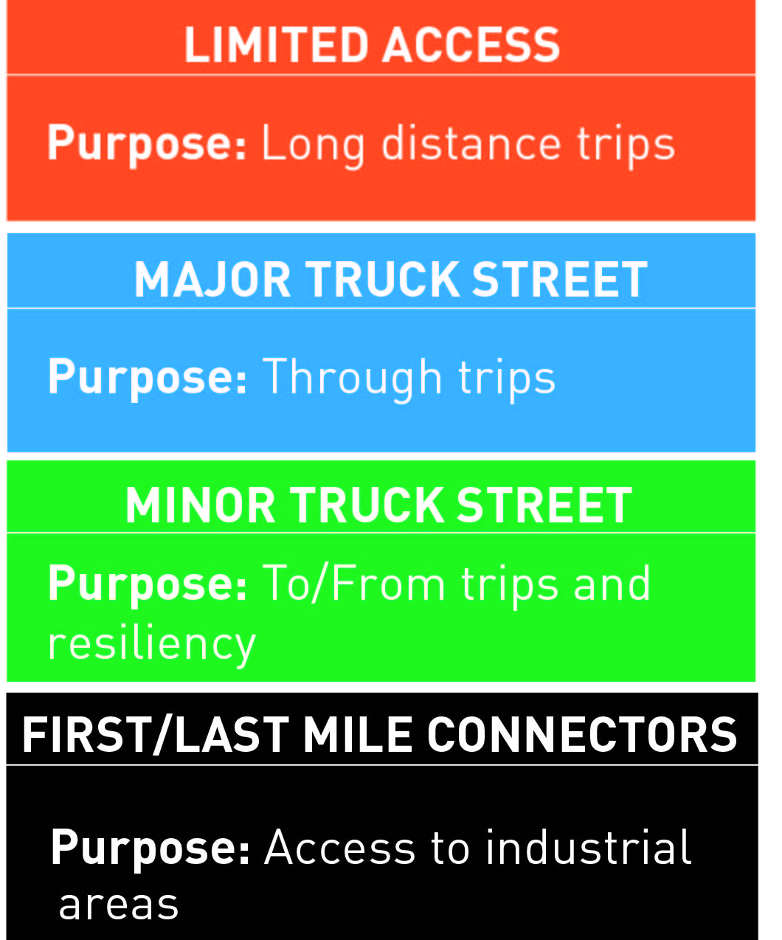
Seattle’s freight network
Presents the draft freight network
Developed using the following steps:
Evaluate existing and future truck volumes
Establish land use connections
Provide connectivity within the network
Review roadway classifications
Assess resiliency of the network
Incorporate public input
Consider other modal priorities
Notes:
Freight goes everywhere
Need to recognize different levels of freight movement and needs
Need for context sensitivity
Network purpose
Encourage and accommodate freight
Prioritize future investments
Identify design needs
Expanded, tiered network:
Limited Access
Major Truck Street
Minor Truck Street
First/Last Mile Connectors

Slide 9
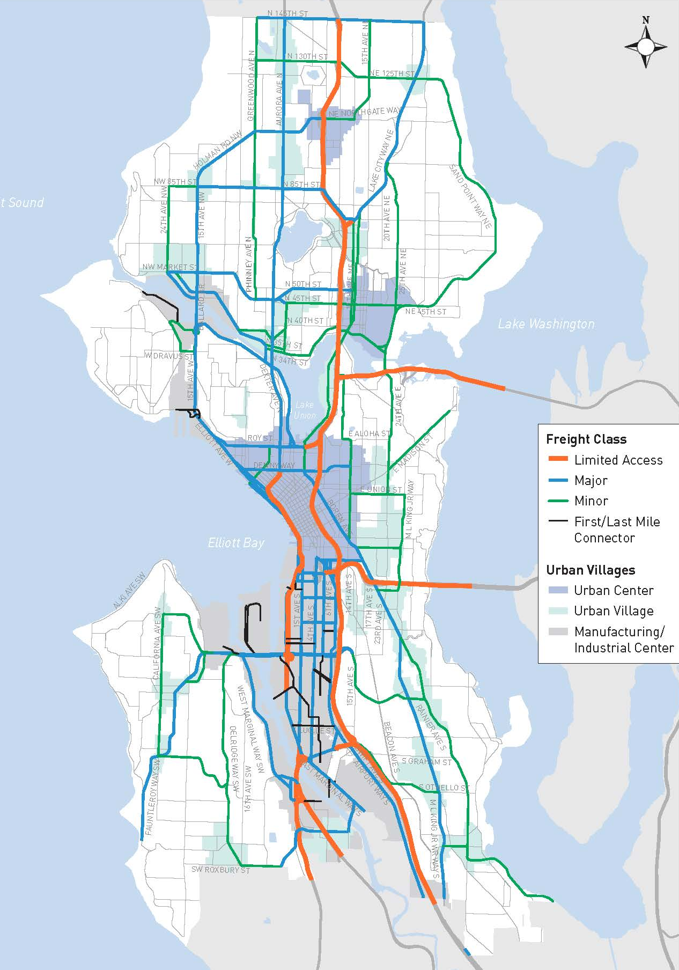
Draft freight network
Network purpose
Encourage and accommodate freight
Improve city-wide and regional connections
Identify design needs
Draft network
Notes:
There are many streets in the city that have multiple modal needs identified in the various plans
Just because it’s a freight corridor doesn’t preclude bike facilities if it’s also in the BMP (East Marginal is a good example)
If a street is part of the freight network then we would have to consider lane widths, in order to ensure that goods movement can be accommodated
For the BMP (a) we generally stayed away from Major Truck Streets with our bike network, but some overlap was unavoidable, and (b) if a street is used for freight and bikes, it’s probably even more important to design bike facilities in a safe manner which clearly separates bikes from trucks.

Slide 10
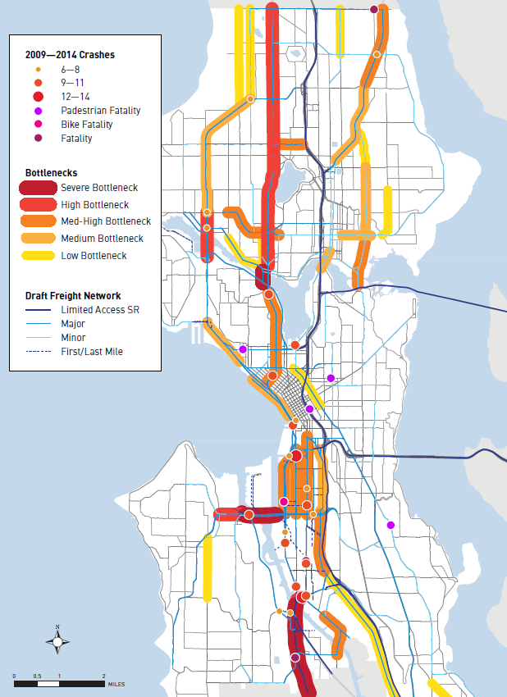
Developing solutions
Performed bottleneck and truck collision analysis
Developed a freight toolbox of improvement types
Identified 50+ projects
Developed strategies to implement the FMP
Implementation strategy
Notes:
Performed bottleneck and truck collision analysis
Mapped freight projects from previous planning efforts (Move Seattle, Large Capital, FAP, etc.)
Identified locations with unaddressed needs
Recommended ideas/solutions to improve safety and mobility
Prioritization framework
Quantitative and qualitative data
Potential funding opportunities
Move Seattle
FMSIB
FAST Act
Other partnerships

Slide 11
Bicycle considerations
Integrate planning for freight with other modes
Minimize conflicts between bicycle and freight mobility
Address freight delivery needs, including alley access and Commercial Vehicle Load Zone locations, when developing bicycle infrastructure projects
Design bicycle facility treatments to provide predictable movement of people on bicycles
Work with communities impacted by goods movement
Support efforts to increase bicycle and electric vehicle freight deliveries
Notes:
Address and mitigate freight impacts on incompatible land uses through integrated planning and implementation of small-scale projects
Strengthen and grow the city’s tree canopy to improve air quality, especially in and adjacent to industrial areas

Slide 12
FMP Public release
Public comment period:
Due July 8th
Hard copy of the plan distributed to:
Seattle libraries
City Council
Mayor’s office
Available online
Email comments to FreightMasterPlan@seattle.gov
Work with Department of Neighborhoods (DON) to spread the word!
Notes:
Comments will be used to develop the Mayor’s Recommended Plan that will go to City Council for adoption.

Slide 13
SDOTs request for the SBAB
Review the Freight Master Plan
Submit comments to SDOT
Provide a letter of support for the FMP

Slide 14
Next steps
 | April | May |  | June | July | August
Develop draft plan
Release draft plan for public review
Public review and outreach
Address comments
Anticipated Mayor’s recommended plan*
*Implementation Plan will be developed after Plan adoption
Notes:
Discuss public outreach coordination with DON

Slide 15
Questions?
gabriela.vega@seattle.gov | (206) 733-9029
ian.macek@seattle.gov | (206) 684-7576
http://www.seattle.gov/transportation/freight.htm
http://www.seattle.gov/transportation

