Slide 1
Onsite Stormwater Management BMPs
Photo by John Skelton
Seattle Home Fair
February 4th, 2023
Eric Dripps and Jessica Batterman

Slide 2
AGENDA
Background on Stormwater and Side Sewers in City of Seattle
Thresholds for review in permitting
On-Site Stormwater Management
Infiltration Feasibility and Testing
OSM Best Management Practices (BMPs)
Standard Plans
Visit the Stormwater Code Page for all the documents discussed in this presentation
www.seattle.gov/sdci/codes/codes-we-enforce-(a-z)/stormwater-code

Slide 3
Background

Slide 4
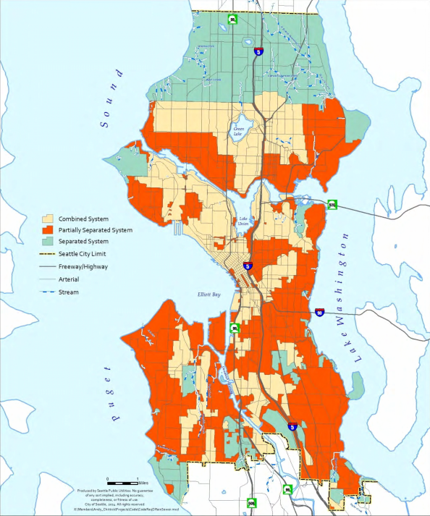
Stormwater
SDCI Permitting and Review
Code is to protect life, property and environment
NPDES Permit - SDCI role to Review on private property
Types of Drainage Systems
Seperated System
Combined System
Partially Seperated
Contact sidesewerinfo@seattle.gov for your property
Notes:
History of the Drainage System
Combined systems in most of the City started to separate in the 1960’s and 70’s. Show as the partially separated area.
Combined systems are still a monitored issue for Combined Sewer Overflow’s. Entered a Consent Decree with EPA and WA Dept of Ecology to reduce CSO’s in 2013. Large scale projects as the Ship Canal Water Quality Project which will store 29 million gallons. Also includes making updates to the stormwater manual for private development.

Slide 5
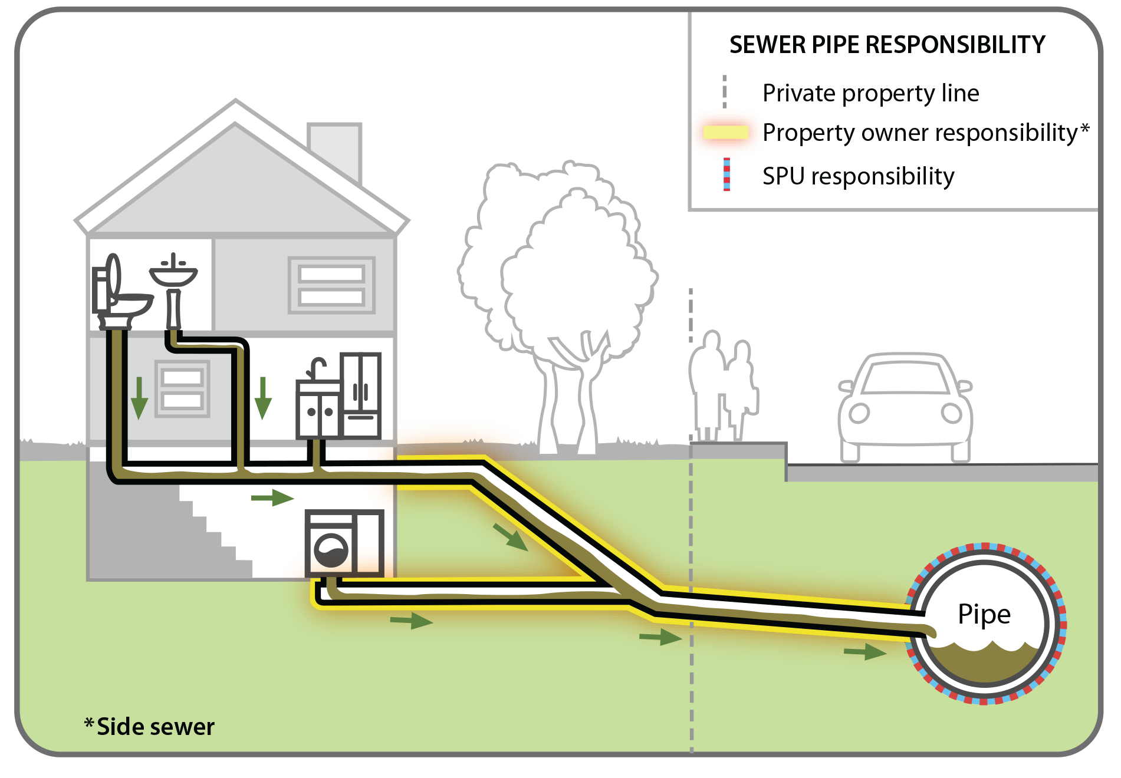
Side sewers
Connections from private property to the public system outside of building
Side sewers include both sanitary and drainage connections
Side sewers are owned by the property owner up to the point of connection to the main
Side Sewer permit required for any exterior work done to the pipe, repairs, liners, new pipe
https://www.seattle.gov/sdci/permits/permits-we-issue-(a-z)/side-sewer-permit
https://www.seattle.gov/utilities/your-services/sewer-and-drainage/side-sewers
https://www.seattle.gov/utilities/construction-resources/water-and-sewer-map
https://web6.seattle.gov/dpd/sidesewercardsv2/

Slide 6
Approved point of discharge
Varies by site
Drainage Points of Discharge
Direct to Receiving Water
Connection to Public Storm Main
Connection to Ditch and Culvert system
Curb Weep Connection
Alley Discharge
Connection to Public Combined Sewer
Onsite Infiltration/Dispersion
Sanitary Points of Discharge
Connection to Public Sanitary or Combined Main
Septic System (rare)

Slide 7
Review Thresholds

Slide 8
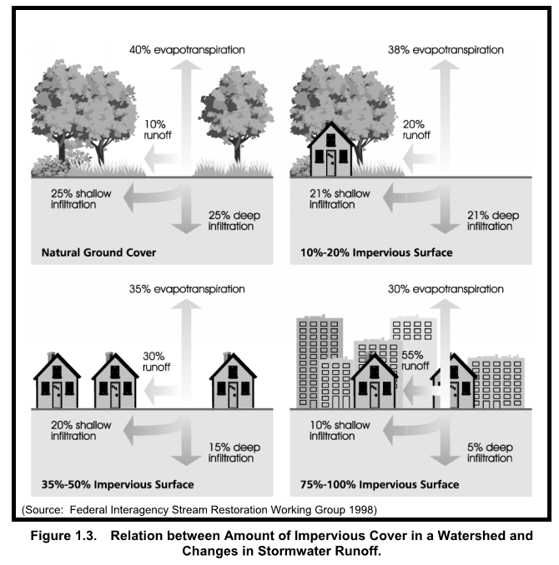
New and replaced hard surface
Hard surface includes any impervious surface(roofs, pavement, other compacted surfaces and permeable pavement/vegetated roof). Does not include open, uncovered decking without underlying slab
Replaced hard surface - removing pavement to base or removing a building including foundation and rebuilding

Slide 9
Thresholds
Based on New Plus Replaced Hard Surface
All Projects | > 750 SF | > 750 SF + New lot | > 1,500 SF | > 2,000 SF Parcel Based | > 5,000 SF
Side Sewer Review | Drainage Review | Drainage Review and OSM | OSM All Projects | FC may apply | PE REQ WQ may apply
SS Conflicts Discharge Points | CSC Sheet DWC Sheet with OSM project info Completed Small PIT for no approved discharge point | OSM BMPs Complete Summary Sheet PDF of entire workbook Infiltration testing

Slide 10
Drainage Review
Stormwater Code website: https://www.seattle.gov/sdci/codes/codes-we-enforce-(a-z)/stormwater-code
2021 Stormwater Manual
Standard Plans required when Drainage Review is triggered:
Standard Construction Stormwater Control and Soil Amendment (CSC/SOIL) Plan
Drainage and Wastewater Control Plan (DWC) Plan
Approved point of discharge for Sanitary and Drainage. Shown on Preliminary Assessment Report (PAR) or by contacting Drainage Review at sidesewerinfo@seattle.gov or leave a message at 206-684-5362 to receive a call back. Also you may use the Virtual Applicant Services Center https://www.seattle.gov/sdci/about-us/who-we-are/applicant-services-center.

Slide 11
On-Site Stormwater Management

Slide 12
On-site Stormwater Management
Two methods to meet requirement:
On-Site List Approach | On-Site Performance Standard
Choose BMP in highest category feasible | Choose BMPs to meet discharge requirements
BMPs are pre-sized except Rainwater Harvesting | Continuous Rainfall-Runoff Modeling Requires a report and sizing calculations (PE Required)
Notes:
No change in methods, but some BMPs have been added to the on-site list or moved to another category

Slide 13
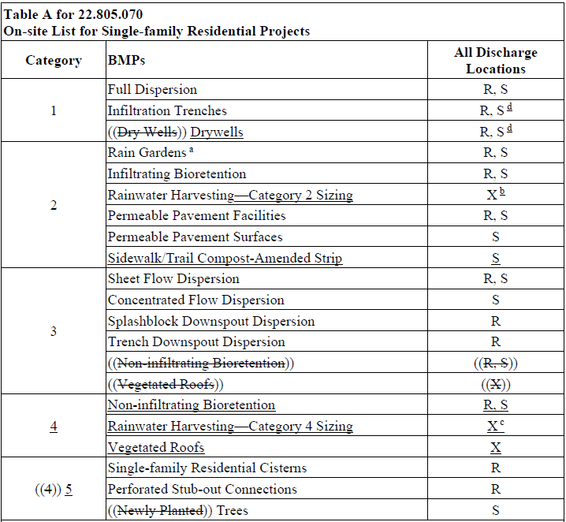
Notes:
Similar edits were made for Single‐family Residential Projects:
Infiltration Trenches and Drywells can be used for non‐roof hard surfaces, but is not required
New Category 2 BMP – Sidewalk / Trail Compost Amended Strip
Moved Non-infiltrating Bioretention and Vegetated Roofs and RWH to Category 4 (shifted former Category 4 BMPs to Category 5)
Added that water quality treatment BMPs can be used in lieu of non‐infiltrating bioretention for surfaces discharging to designated receiving waters (applies to Parcel-based Projects)
RWH sizing – RWH still is an option in Category 2 sized to meet the OSM performance standard, but is not required. Added RWH as a Category 4 BMP that needs to be evaluated, but sized at 25% volume reduction based on feedback from designers as 25% volume reduction is a realistic target.
Removed “Newly Planted” to acknowledge that both new and retained trees count towards On-site List

Slide 14
On-Site Stormwater Management
On-Site List Calculator has been updated.
Updates periodically. Please use the most up-to-date version from the website.
Use the Preliminary Assessment Report (PAR)
Enable Content
Combine as many surfaces as possible for clarity
www.seattle.gov/Documents/Departments/SDCI/Forms/OnSiteStormwaterListCalculator.xlsm

Slide 15
Infiltration Feasibility and Testing

Slide 16
Infiltration Feasibility and Testing
Volume 3, Section 3.2 (Determine Infiltration Feasibility)
Appendix D (Subsurface Investigation and Infiltrating Testing for Infiltration BMPs)
Simple Test Checklist www.seattle.gov/Documents/Departments/SDCI/Forms/SimpleInfilTestChecklist.pdf
Pilot Infiltration Test Checklist www.seattle.gov/Documents/Departments/SDCI/Forms/StormwaterPITChecklist.pdf
Notes:
Updated links, but both checklists need minor revisions for consistency with the 2021 Manual

Slide 17
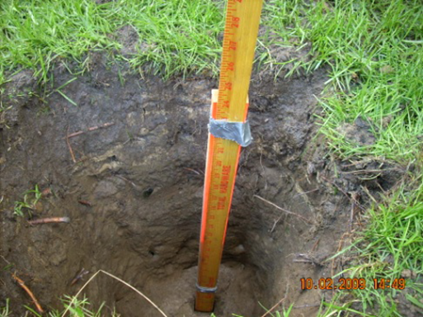
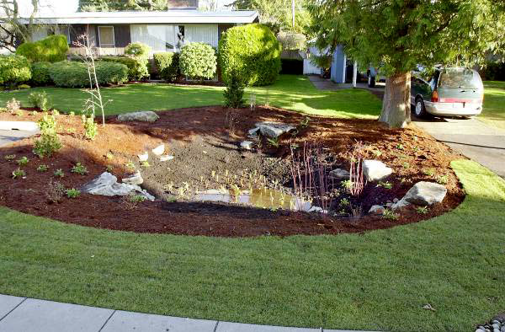
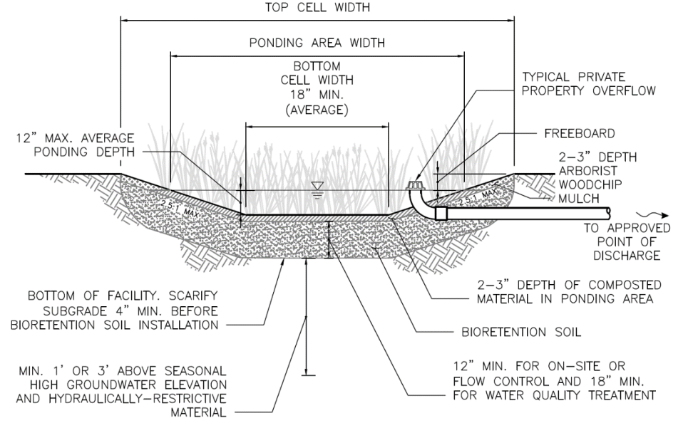
Infiltration Feasibility and Testing
Investigation and Testing
Design
Construction

Slide 18
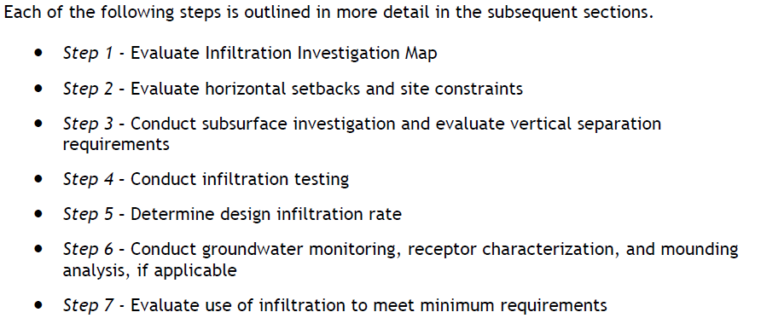
Infiltration Feasibility and Testing
Volume 3, Section 3.2 (Determine Infiltration Feasibility)
Notes:
No changes to the overall procedure for determining infiltration feasibility, but some clarifications made to individual steps in the process
Step 1 revisions discussed on next slide
Step 2: Minor clarification to one infeasibility criterion for Permeable Pavement Surfaces to clarify that the constraint applies to petroleum, chemical, or liquid hazardous waste storage tanks
Step 4: revisions to Table 3.3 discussed on a future slide

Slide 19
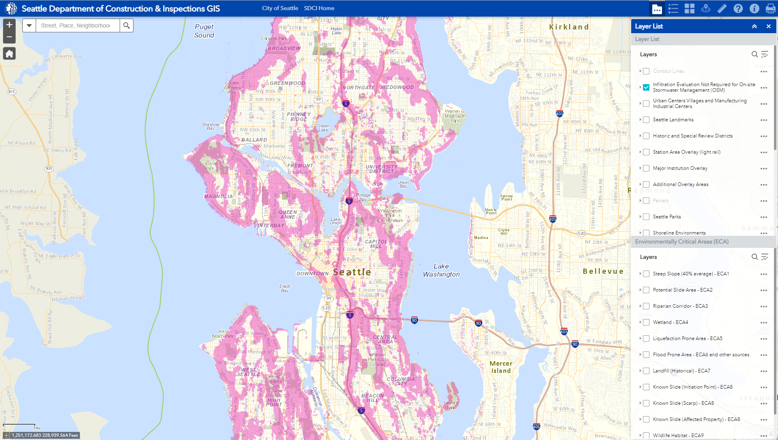
Onsite Stormwater Management Infiltration Evaluation Not Required
https://seattlecitygis.maps.arcgis.com/apps/webappviewer/index.html?id=f822b2c6498c4163b0cf908e2241e9c2
Notes:
Step 1 (Evaluate Infiltration Investigation Map) updates
Clarified that the Infiltration Investigation Map is advisory and does not include all site constraints
Clarified that if the site is partially within a mapped area or not at all within the mapped area, that Steps 2-7 should be followed to determine if infiltration is feasible on any portion of the site

Slide 20
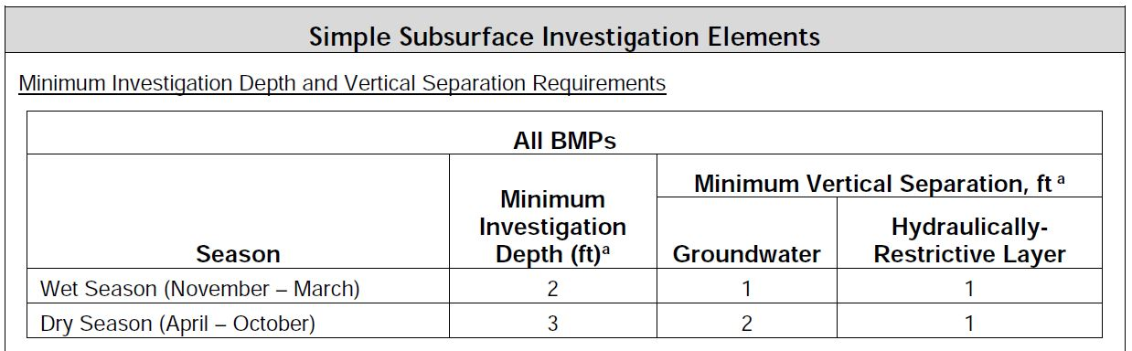
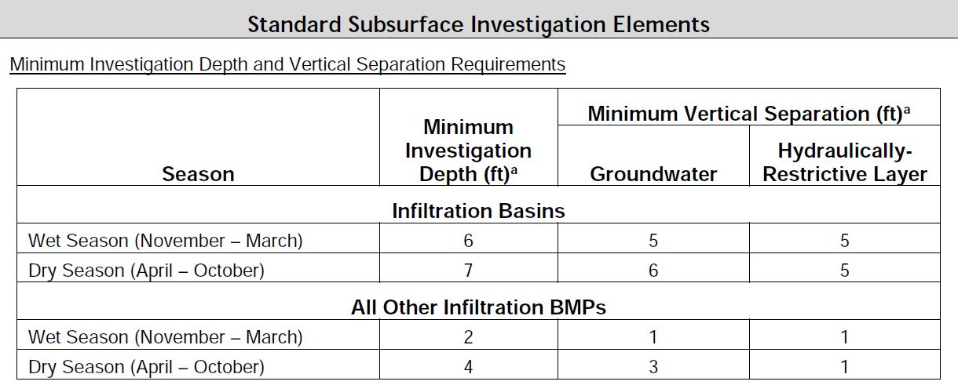
Infiltration Feasibility and Testing
Simple
Standard
Map of investigation and testing locations
Soil characteristics
Depth to groundwater
Results of subsurface investigations
Soil characteristics
Detailed soil logs
Small PIT report must be signed & stamped by a licensed professional

Slide 21
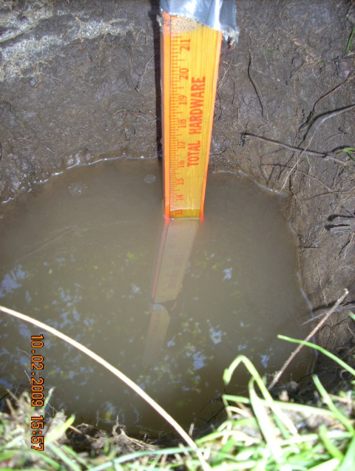
Infiltration Feasibility and Testing
Simple Infiltration Test
Dry Season vs Wet Season
Minimum 2-feet deep x 2-feet across hole
Pre-soak
Testing
Measured Rate
Design Rate
Use Checklist
www.seattle.gov/Documents/Departments/SDCI/Forms/ SimpleInfilTestChecklist.pdf

Slide 22
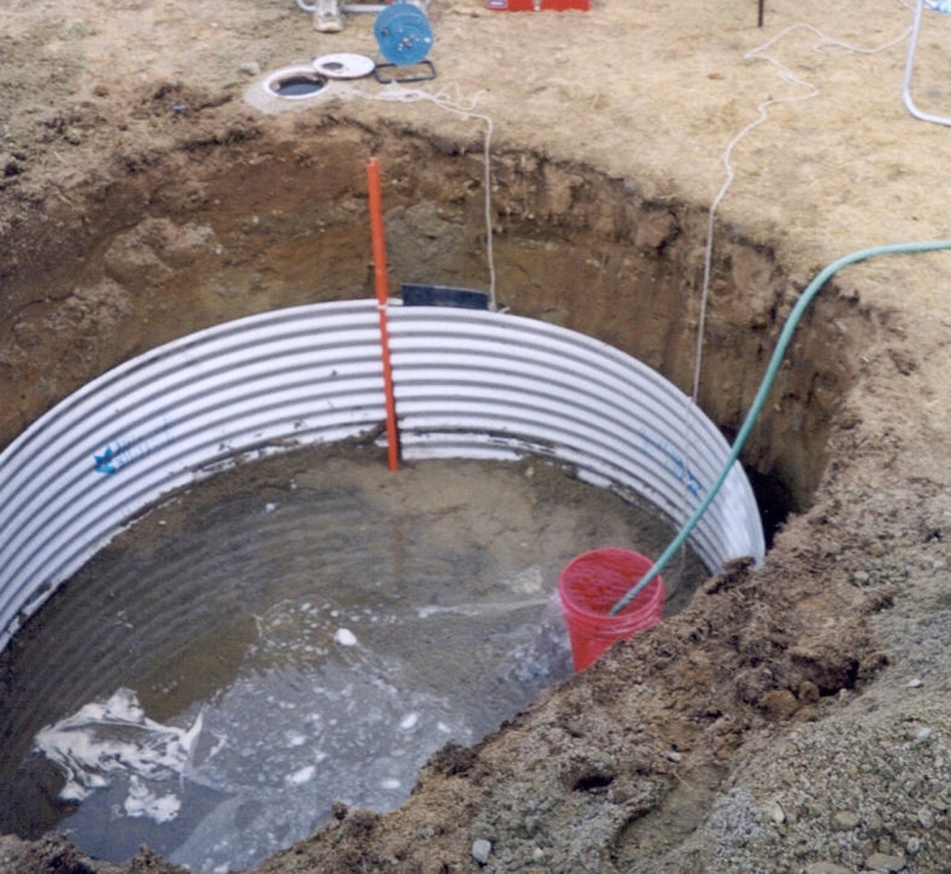
Infiltration Feasibility and Testing
Pilot Infiltration Test (PIT)
Mimics constructed facility
Licensed Professional Required
Small vs. Large PIT
Use Checklist
www.seattle.gov/Documents/Departments/SDCI/Forms/StormwaterPITChecklist.pdf

Slide 23
Infiltration Feasibility and Testing
Notes:
Table 3.3 updates
Added Sidewalk/Trail Compost-Amended Strip

Slide 24
Infiltration Feasibility and Testing
On-site List Calculator
Summary Sheet
BMP Sizing

Slide 25
Infiltration feasibility and testing
Sites with No Approved Offsite Point of Discharge
Must discharge Stormwater Onsite via infiltration or by dispersion if infiltration is not required
Small Pilot Infiltration Test by a Licensed Professional is required
Slope Stability Analysis by a Licensed Professional is required if within setback from Steep Slope
Design of Facility by a Licensed Professional unless using Pre-Sized Drywell table

Slide 26
OSM BMP Overview

Slide 27
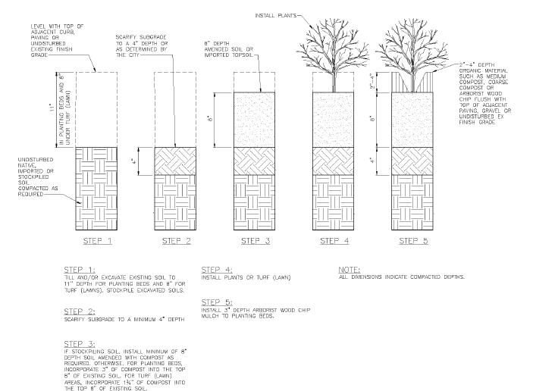
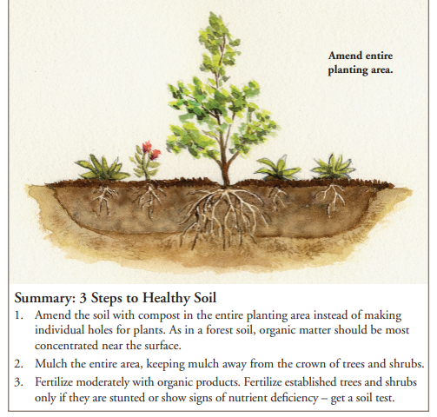
OSM BMP Overview
Volume 3, Chapter 5, Section 5.1
Soil Amendment BMP
Amended soil helps with stormwater retention, treatment of pollutants, sediment retention, minimize need for chemicals for week/pest control and plant vigor.
Till in 1.75 – 3 inches of compost into 8-inches of topsoil
Notes:
2021 Updates
Added language on Soil Management Plan requirements
Updated Figure 5.1
Clarified
Modeling guidance
Acceptable mulching materials (medium and coarse compost, removed bark and leaves)
Compost and other materials can meet either of the two listed organic content requirements

Slide 28
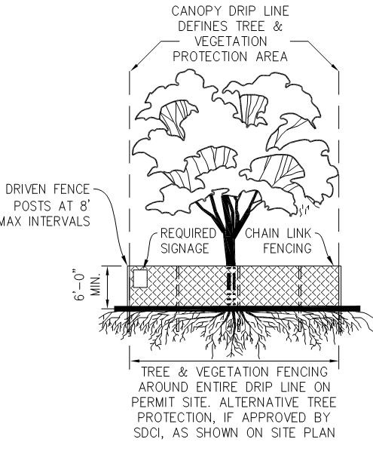
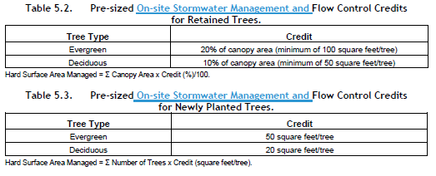
OSM BMP Overview
Volume 3, Chapter 5, Section 5.2
Tree Planting and Retention
Trees provide flow control via interception transpiration and increased infiltration along with other environmental benefits.
https://www.seattle.gov/Documents/Departments/SDOT/PublicSpaceManagement/2015-Street_Tree_List.pdf
Notes:
2021 Updates
Updated
Tree list and tree size requirements for newly planted trees for consistency with the Green Factor Director’s Rule
Reference to approved tree species (updated list will be posted on SDCI’s website in the future)
Structure setback for newly planted trees (now a minimum of 5 feet or 1/3 the mature canopy diameter, whichever is greater)
Supplemental irrigation requirements (3 growing seasons -> at least 5 growing seasons)
Clarified
On‐site List Approach credits

Slide 29
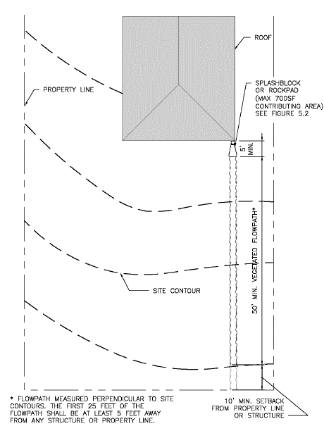
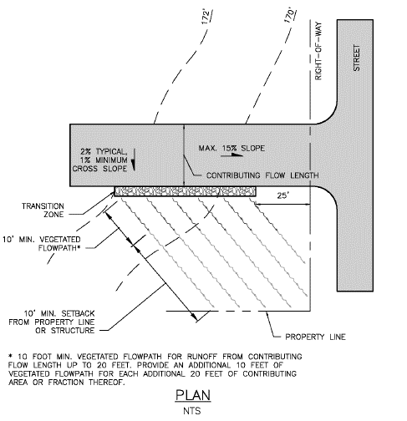
OSM BMP Overview
Volume 3, Chapter 5, Sections 5.3.2 through 5.3.6
Dispersion BMPs
Can provide flow control via attenuation, soil storage and losses to infiltration evaporation and transpiration.
Need space onsite for flowpath and setbacks.
Restrictions for certain ECA’s
Notes:
2021 Updates
Updated
Dispersion flowpath requirements
Figures 5.3, 5.4 and 5.5
Pre-sized flow control credits (Tables 5.4, 5.6, 5.8, & 5.10)
Continuous modeling assumptions (Tables 5.5, 5.7, 5.9, & 5.11)
Clarified
Portions of a site may be fully dispersed (with a vegetated flow path of at least 100 feet)
Modeling assumptions for hard surface area dispersed (Table 5.11)

Slide 30
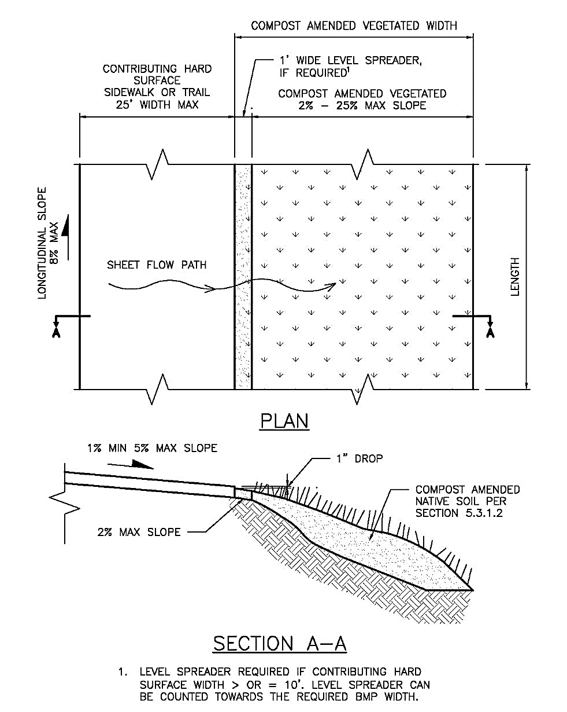
OSM BMP Overview
Volume 3, Chapter 5, Section 5.3.7
Sidewalk/trail compost-amended strip
Notes:
New BMP
Can be used for trails or sidewalks up to 25 feet wide
All widths (hard surface, BMP, level spreader) are measured perpendicular to edge of the hard surface adjacent to the BMP
Type of vegetation is clarified (turf or dense ground cover but additional shrubs and trees are acceptable)
Overflow path must be vegetated and at least 10 feet from a building or property line (excluding ROW)
Added sizing factors and clarified how to model the BMP explicitly

Slide 31
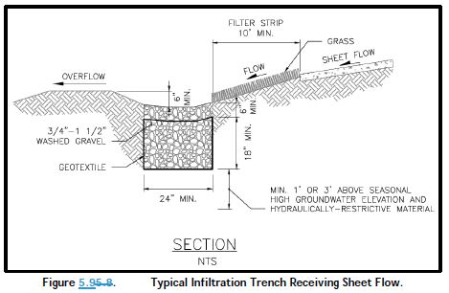
OSM BMP Overview
Volume 3, Chapter 5, Section 5.4.2
Infiltration Trenches
Temporary storage in the spatial voids of aggregate material and subsequent infiltration of stormwater into the underlying soils.
Needs infiltration investigation
Restrictions for certain ECA’s
Notes:
2021 Updates
Updated
Modeling approach text for clarity
Figure 5.8
Clarified
Exemption related to UIC wells at single family homes
A constructed overflow is not required for BMPs designed to infiltrate all flows for required simulation period
Removed
Yard drain option (flow entrance and presettling)

Slide 32
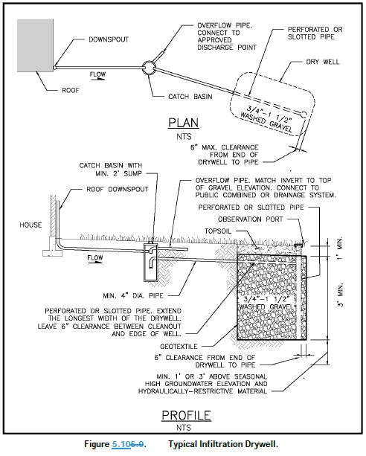
OSM BMP Overview
Volume 3, Chapter 5, Section 5.4.3
Drywells
Temporary storage in the spatial voids of aggregate material and subsequent infiltration of stormwater into the underlying soils.
Needs infiltration investigation
Restrictions for certain ECA’s
Catch Basin to reduce sediment from clogging the voids.
Notes:
2021 Updates
Updated
Modeling approach text for clarity
Figure 5.10
Peak control standard sizing factors (Table 5.18)
Clarified
Exemption related to UIC wells at single family homes
A constructed overflow is not required for BMPs designed to infiltrate all flows for required simulation period

Slide 33
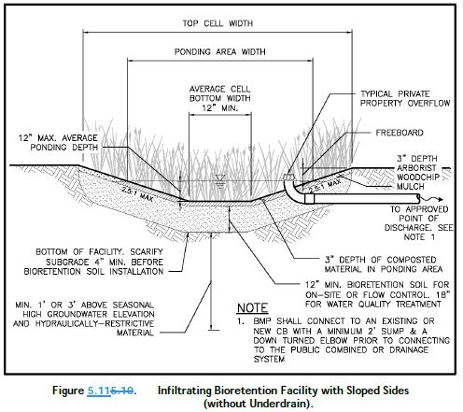
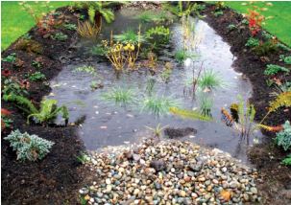
OSM BMP Overview
Volume 3, Chapter 5, Section 5.4.4
Infiltrating Bioretention/Rain Gardens
Provides flow control via detention, attenuation and losses due to infiltration, interception, evaporation and transpiration. Water quality treatment is also provided.
Infiltration testing required. Restrictions in certain ECA’s
Notes:
2021 Updates
Clarified and Updated
Design criteria for contributing area, ponding area, bioretention soil, plants, and mulch layer
Updated
Sizing factors (Tables 5.21, 5.22, and 5.23)
Figures 5.11 through 5.15
Clarified
Cells larger than 800 sf are allowable to treat a regional area, but requires the permission of the Director
A constructed overflow is not required for BMP designed to infiltrate all flows for required simulation period
Modeling approach for projects that have no off‐site point of discharge
Clean, washed drainage gravel or mulch is allowed in lieu of plants if a licensed landscape architect determines plants will not survive in shaded conditions

Slide 34
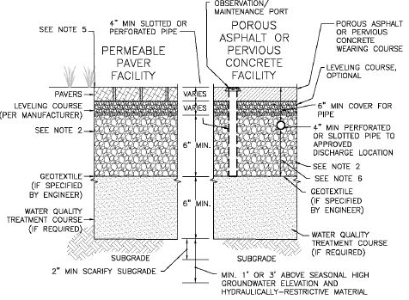
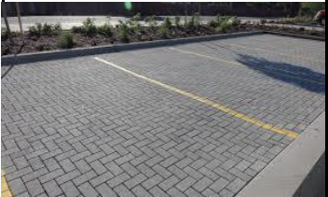
OSM BMP Overview
Volume 3, Chapter 5, Section 5.4.6
Permeable Pavement Facilities
Flow Control through storage of stormwater runoff in voids and subsequent infiltration of stormwater into underlying soils. Water quality benefits as well.
Infiltration testing, restriction in certain ECA’s
Notes:
2021 Updates
Clarified and Updated
Design criteria for flow entrance/presettling, wearing course, subsurface check dams, geotextiles, and observation/maintenance ports
Updated
Peak control standard sizing factors (Table 5.26)
Figures 5.17 and 5.18
Minimum construction requirements
Clarified
A constructed overflow is not required for BMP designed to infiltrate all flows for required simulation period
Removed
Simplified comparison table; replaced with text describing the main difference between permeable pavement facilities and permeable pavement surfaces

Slide 35
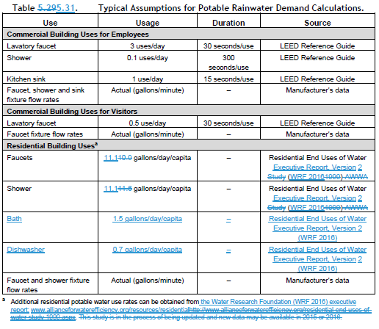
OSM BMP Overview
Volume 3, Chapter 5, Section 5.5.1
Rainwater Harvesting
Reduction in peak flows flow durations and runoff volumes
Differs from SFR Cisterns as the stormwater is reused for domestic use
Notes:
Rainwater Harvesting – New Category 4 sizing criteria
If rainwater harvesting is selected for Category 4 of the On-site List, the rainwater harvesting system shall reduce discharged rooftop runoff volume by 25 percent on an average annual basis, as determined by an approved continuous simulation model.
Updated
Site considerations
On‐site List Approach
On‐site Performance Standard modeling approach
Assumptions for determining rainwater demand
Added
Added BMP sizing approach for Category 2 and Category 4 of the On-site List

Slide 36
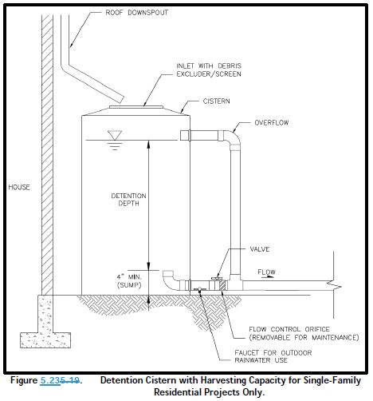
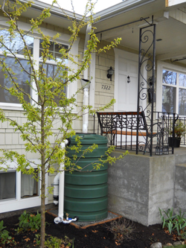
OSM BMP Overview
Volume 3, Chapter 5, Section 5.5.2
Single-Family Residential (SFR) Cistern
Uses an orifice to slowly release stormwater also can be used for irrigation
Notes:
Updated
Site considerations
Sizing factors (Table 5.33)

Slide 37
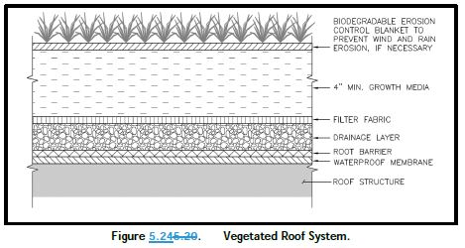
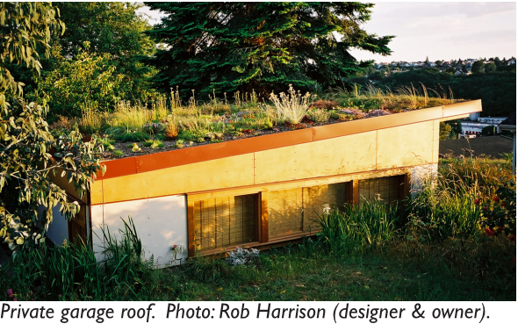
OSM BMP Overview
Volume 3, Chapter 5, Section 5.6.1
Vegetated Roof Systems
Flow control via attenuation, soil storage and losses to interception, evaporation and transpiration
Notes:
Updated
Sizing factors (Table 5.34)
Clarified
Above‐grade impervious surfaces (at least 10 feet above grade)
Added
Irrigation requirement (minimum of 5 growing seasons)
Note to clarify fertilizer application on vegetated roofs
Removed
Restriction on fertilizer/pesticides/herbicides after 2‐year plant establishment period

Slide 38
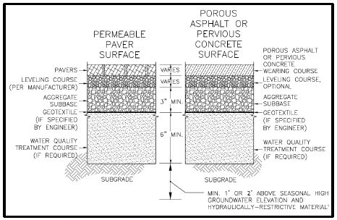
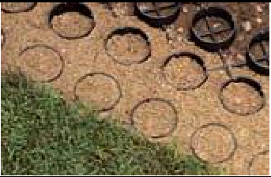
OSM BMP Overview
Volume 3, Chapter 5, Section 5.6.2
Permeable Pavement Surfaces
Similar to Permeable Pavement Facilities without underdrain and storage reservoir
Typically, does not require infiltration testing and does not have restrictions for most ECA’s (except polluted sites)
https://www.seattle.gov/documents/Departments/SDCI/Codes/StormwaterSPUAllowablePermeablePavement.pdf
Notes:
Updated
Sizing factors (Table 5.36) for permeable pavement surfaces (with and without check dams)
Modeling approach (for consistency with SWMMWW)
Added
New design criteria for the design of underdrained surfaces to be equivalent to Permeable Pavement Surfaces
Note regarding additional aggregate depth for stormwater storage

Slide 39
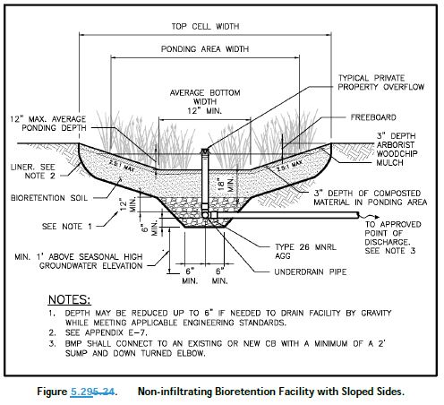
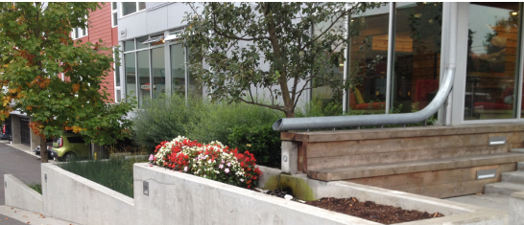
OSM BMP Overview
Volume 3, Chapter 5, Section 5.8.2
Non-infiltrating Bioretention
Provides flow control through detention, losses due to interception, evaporation and transpiration. Also provides water quality
Does not infiltrate, as such restrictions for ECA’s do not apply
Notes:
The on-site list sizing table (Table 5.45) was updated to align with the water quality treatment sizing factors.
The pre-sizing table (Table 5.46) was also updated to remove sizing for the Peak Control Standard since non-infiltrating bioretention with 12 inches of ponding does not meet the Peak Control Standard.
Liner can be omitted if the horizontal setbacks are met and there are no geotechnical or contamination concerns
Updated
Sizing factors (Table 5.45 and 5.46)
Figures 5.29 and 5.30
Clarified
Setbacks
Design criteria for hydraulic restriction layer, liner, and bioretention soil mix

Slide 40
Examples Plans

Slide 41
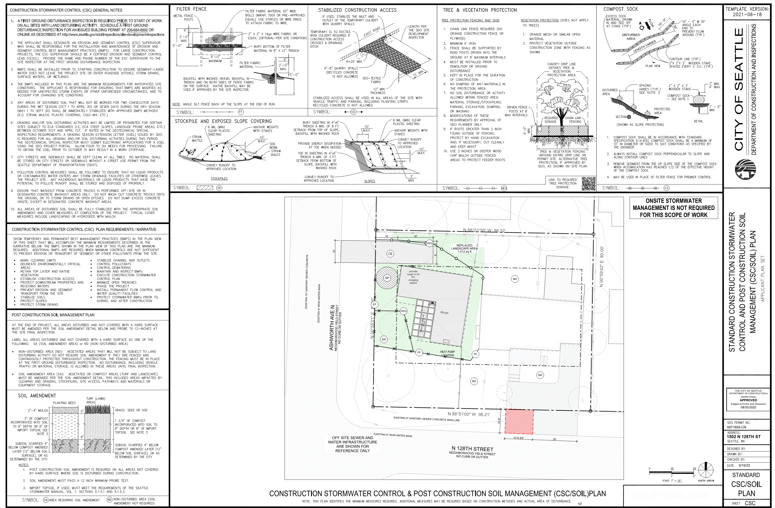

Slide 42
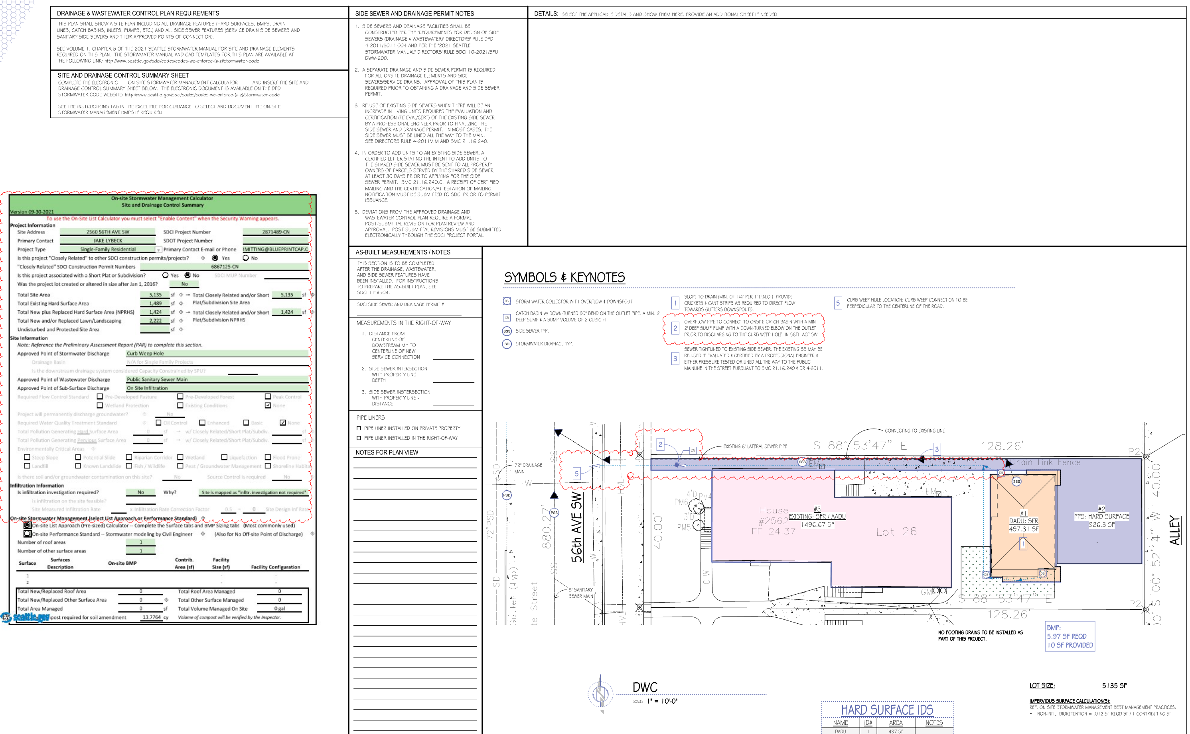

Slide 43
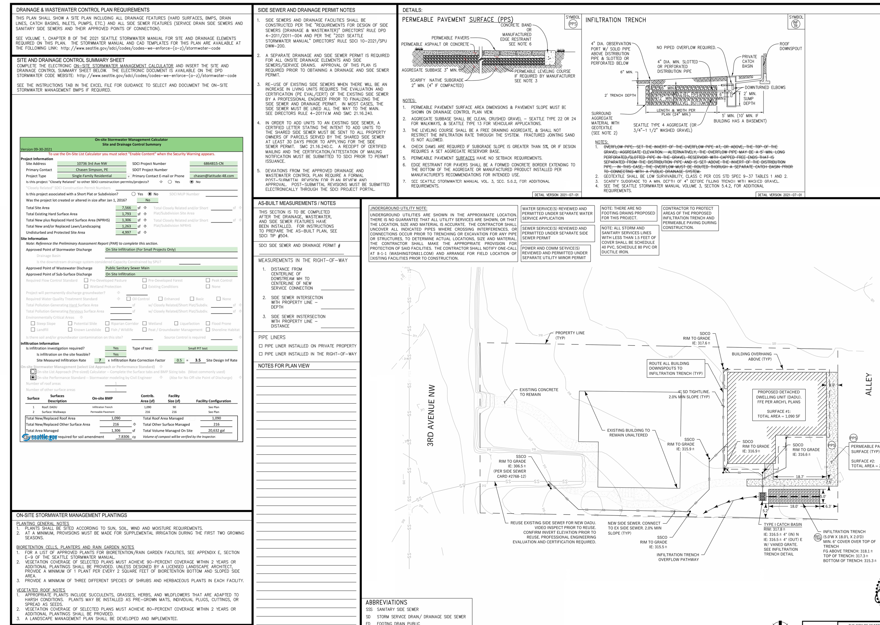

Slide 44
Other resources/Info
How to apply for a Side Sewer Permit: https://seattlegov.zendesk.com/hc/en-us/articles/360003487754-How-to-Apply-for-a-Side-Sewer-Permit
King County Sewer Use Capacity Charge – Applies to New/Reconnected Dwelling Units https://kingcounty.gov/services/environment/wastewater/capacity-charge.aspx
RainWise – Program that provides rebates for Cisterns and/or Rain Gardens for certain eligible properties https://700milliongallons.org/rainwise/
Financial help (zero interest loans) for side sewer repairs for income-qualified homeowners. https://www.seattle.gov/housing/homeowners/home-repair

Slide 45
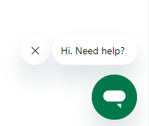
Questions?
SideSewerInfo@seattle.gov
206-684-5362
Use the Chat function on the SDCI website M, W, Fr 9-3; Tu, Th 10:30-3
https://www.seattle.gov/sdci/about-us/contact-us
Eric Dripps
Eric.Dripps@seattle.gov
Please fill out Survey after presentation – Link in the Chat
Jessica Batterman
Jessica.Batterman@seattle.gov

