Slide 1

Equitable Development Initiative RFP Workshops
February 2022
Briefing Objectives:
EDI & EDI Fund background
Current Status

Slide 2
EDI Origin Story
South CORE
South Communities Organizing for Racial/Regional Equity: a coalition of 21 community organizations working on a vision for community controlled and inspired development in the Rainier Valley (including Puget Sound Sage)
RSET
Race and Social Equity Taskforce: Coalition formed. Create, inform, and implement the EDIP
OPCD and OCR
City of Seattle Office of Planning and Community Development
Office of Civil Rights
CSI
Consulting/ capacity building

Slide 3
EDI Values
Centering communities most impacted by displacement
Community-driven strategies
Acknowledging historic injustices
Accountability
Leverage
Flexibility and interdependence
System change

Slide 4
Equitable Development Initiative
Equity Analysis as companion to the Comprehensive Plan update EIS to inform Growth Strategy
Race and Social Equity Goals and Policies in the Comprehensive Plan
Equitable Development Implementation Plan

Slide 5
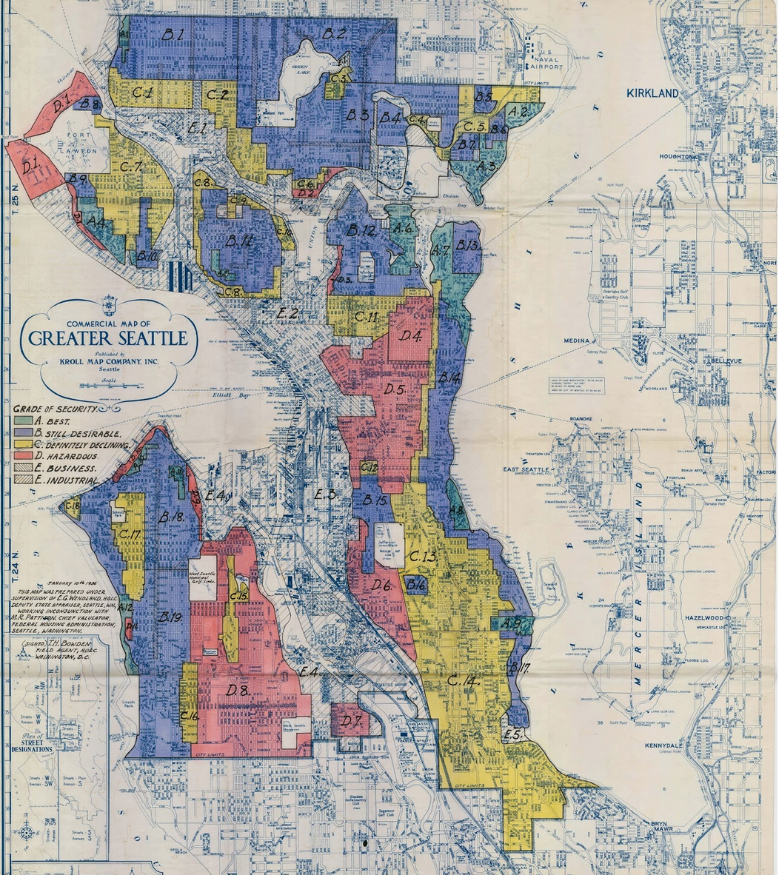
Redlining in Seattle
Investment decisions made by previous generations contributed to the inequities communities experience today.

Slide 6
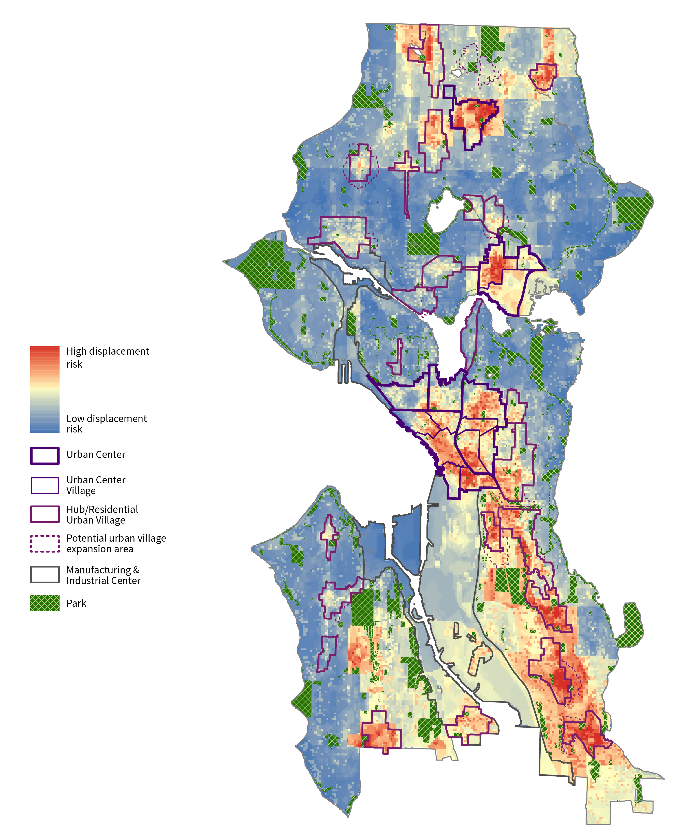
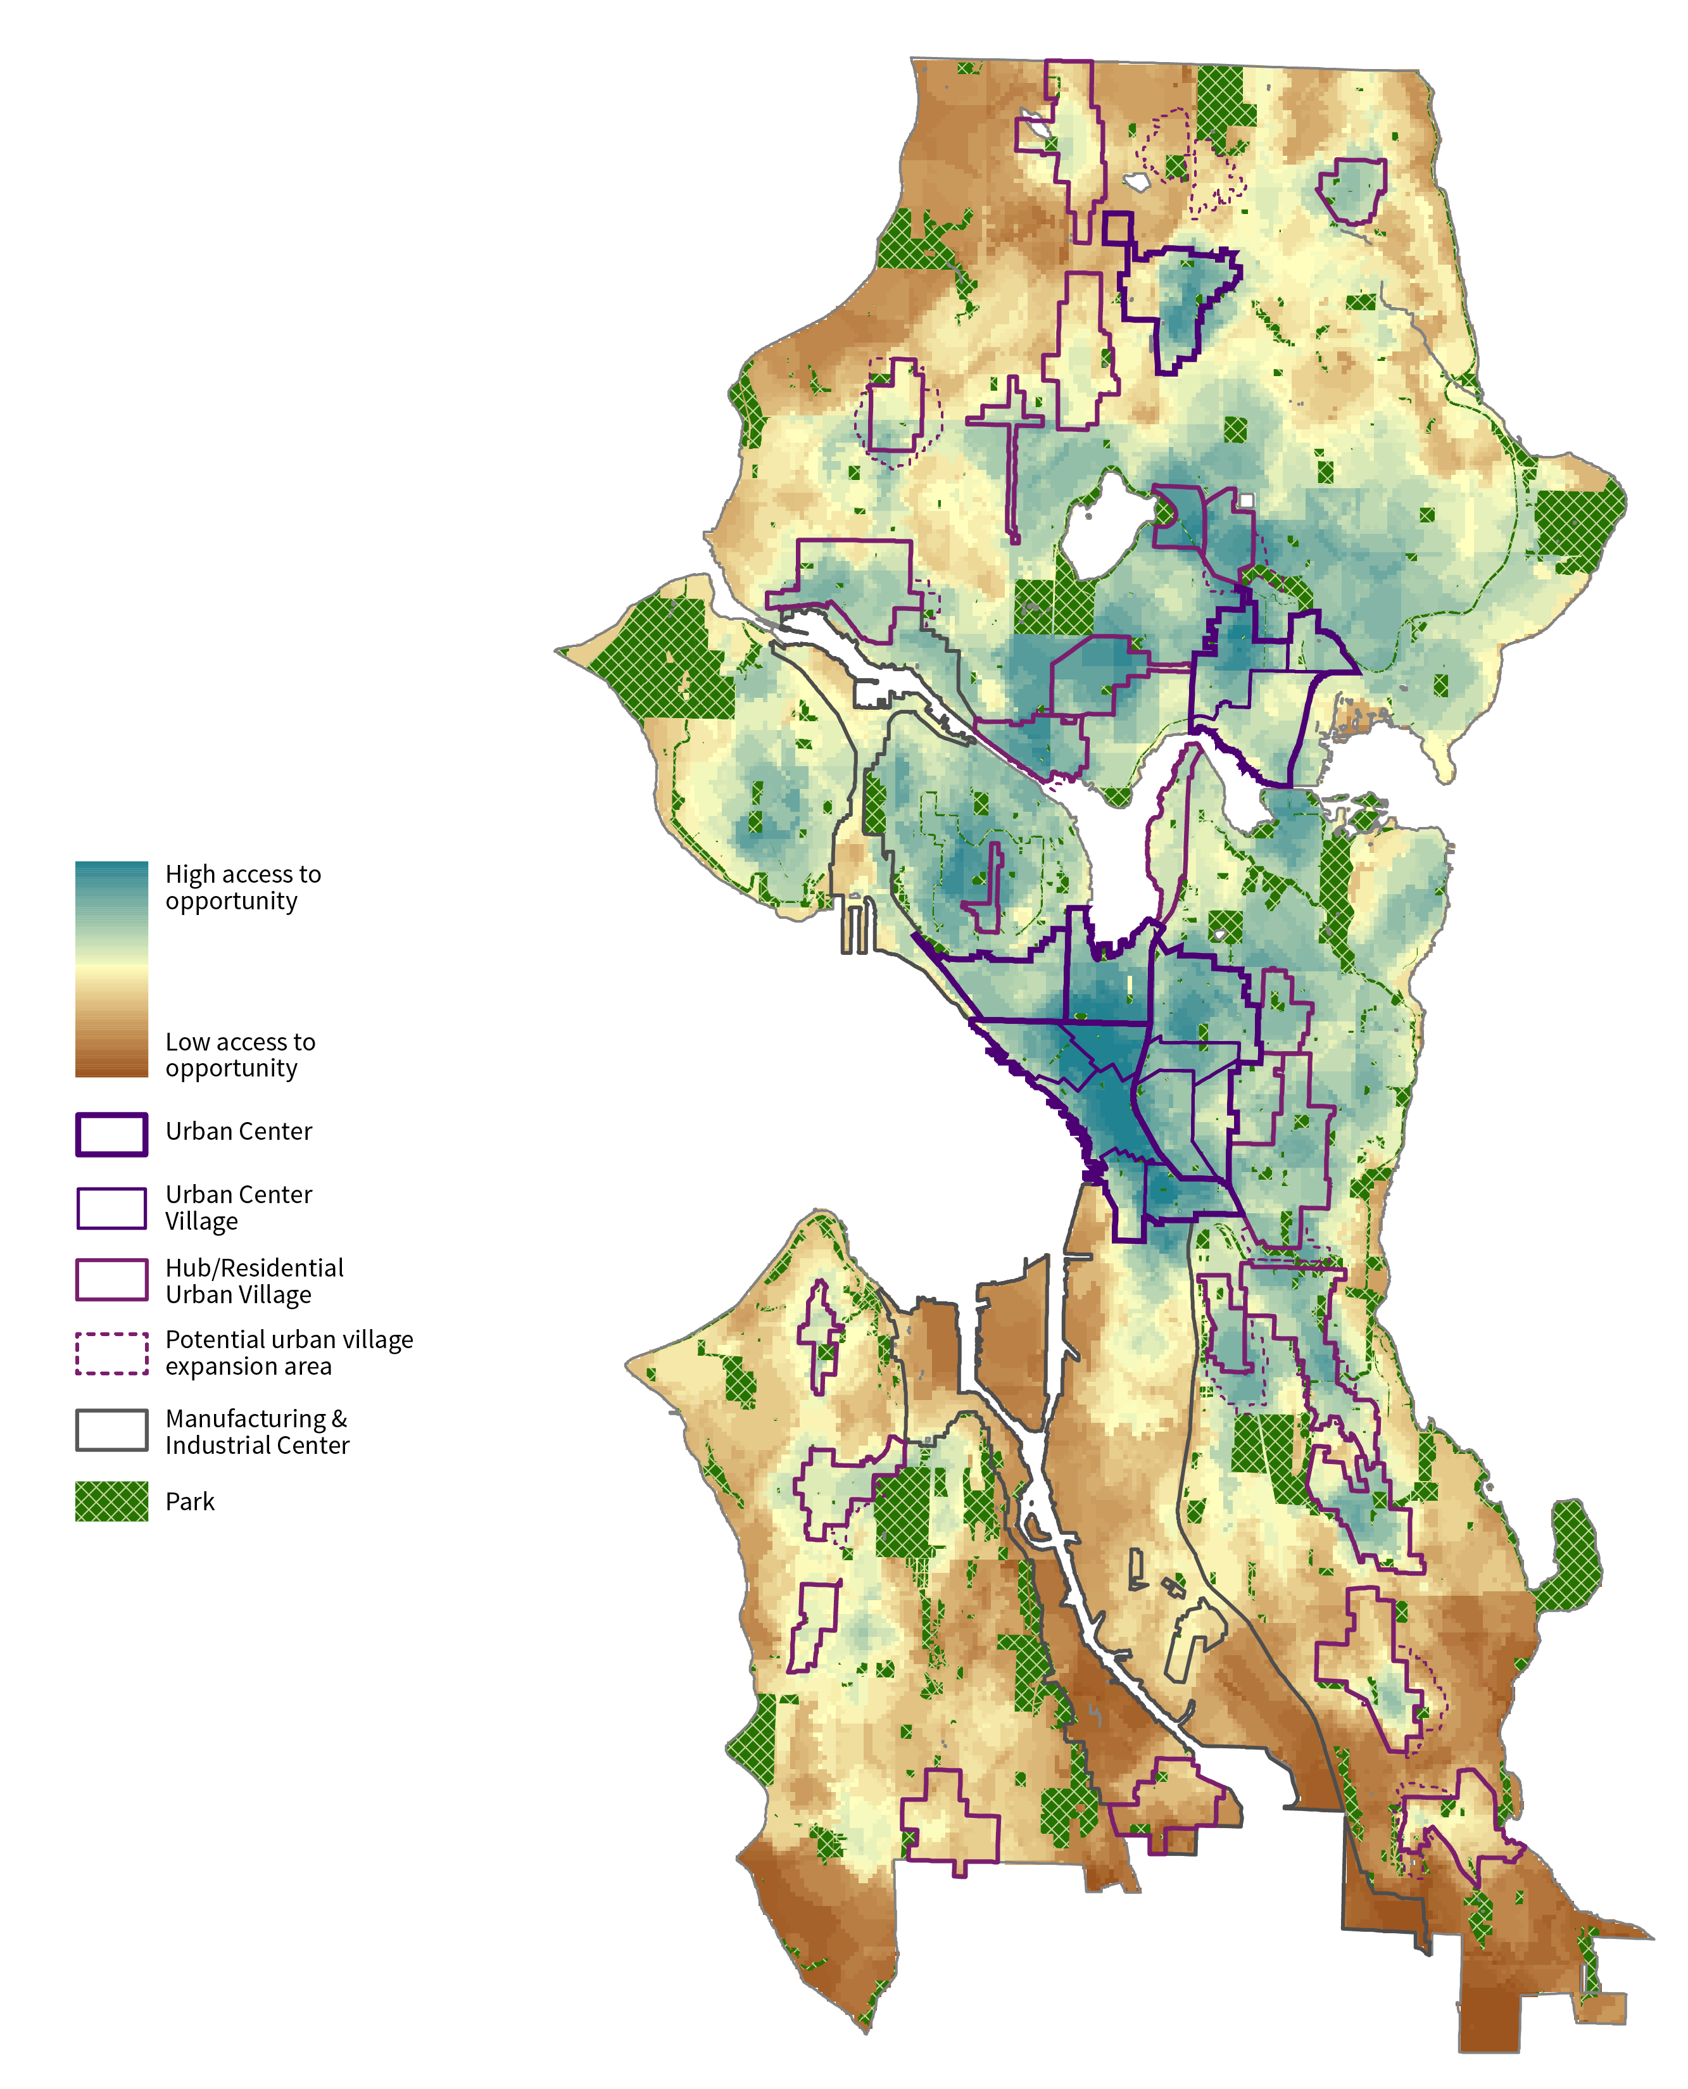
Equity Analysis
Risk of
Displacement
Access to
Opportunity

Slide 7
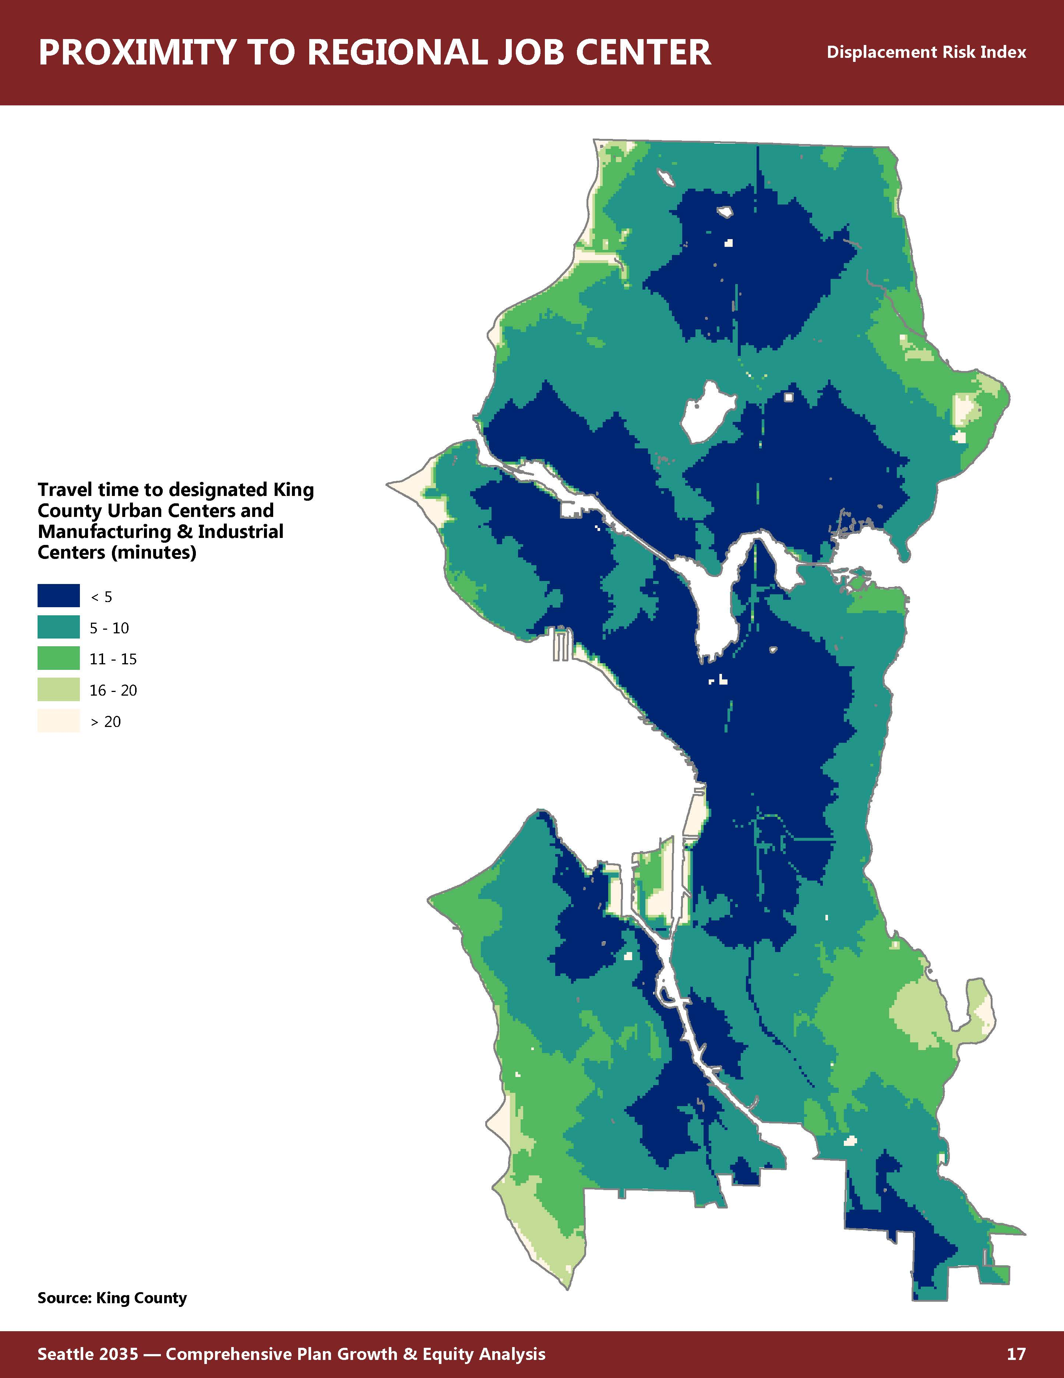
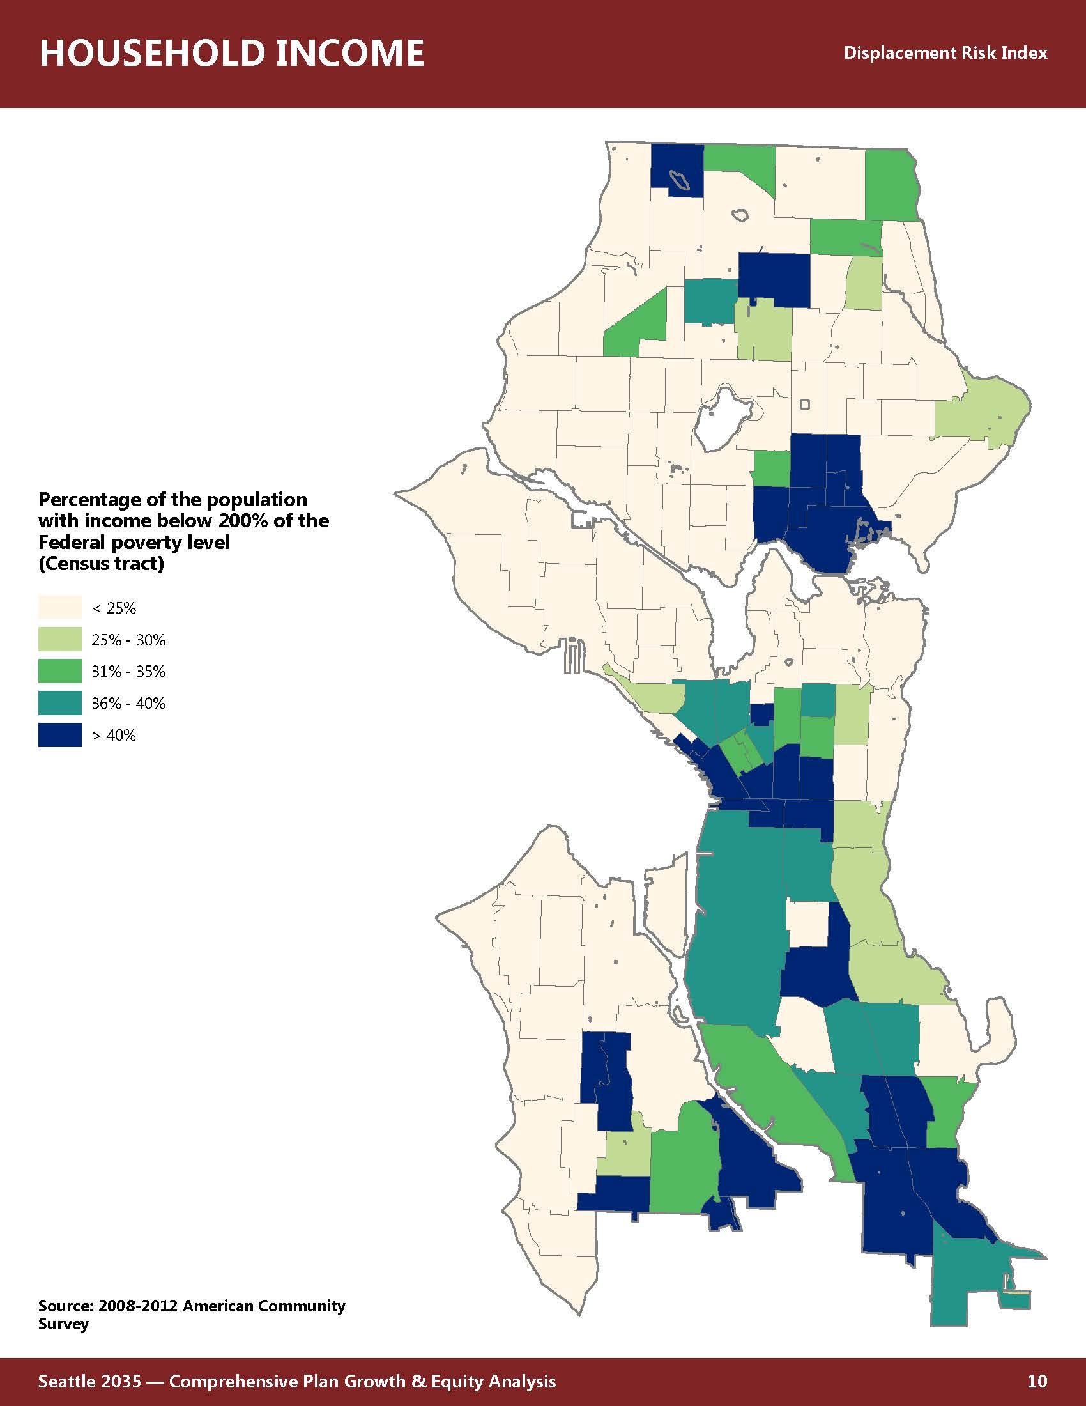
Examples of layers in Equity Analysis Index
Proximity to
Regional Job Center
Household Income

Slide 8






Equitable Development Framework:
Strong People, Strong Communities
Strategies to achieve community stability and resilience in the face of displacement, and great neighborhoods with access by all:
 | Advance economic mobility and opportunity |  | Promote transportation mobility and connectivity
 | Prevent residential, commercial, and cultural displacement |  | Develop healthy and safe neighborhoods
 | Build on local cultural assets |  | Provide equitable access to all neighborhoods
Notes:
Equitable Development Toolkit
GOALS:
To achieve racial and social equity, we need strong communities and strong people.
This means community stability and resilience in the face of displacement pressure and
great neighborhoods throughout the city with equitable access for all.
Growth that achieves these goals will require more public investment above current levels – specifically into these drivers (each has outcomes associated with it)
Promote economic opportunities for marginalized populations and enhance community anchors. Provide access to quality education, training and living wage jobs
Enact policies and programs that allow marginalized populations, businesses and community organizations the ability to stay in their communities
Respect local community character, cultural diversity, and values. Support and strengthen cultural communities
Prioritize investment in effective and affordable transportation that supports transit-dependent communities
Create neighborhoods that enhance community health through access to public amenities, healthy food and safe environments for everyone
Leverage private development to fill gaps in amenities and expand the supply and variety of housing and employment choices.

Slide 9
Place-based Targeted Strategies
Priority Neighborhoods
High levels of chronic / recent displacement
History of racially driven disinvestment
Significant populations of marginalized communities
Community strategies created through inclusive community engagement
Major transportation investment
Notes:
Neighborhood Characteristics
high levels of chronic and more recent displacement risk,
disinvestment due to a history of red-lining and racial covenants,
recent major transportation investments,
significant population of marginalized communities who have participated in years of neighborhood planning
recently updated neighborhood plans or action plans, and
key community-driven strategies prioritized to mitigate further displacement and increase access to opportunity.

Slide 10
Priorities identified as Gaps in the EDI Portfolio for 2022
There will be targeted outreach to these potential applicant types:
Religious Institutions utilizing the affordable housing density bonus legislation
Projects located in North Seattle
Projects led-by and serving Latinx communities
Projects led-by and serving LGBTQ communites
NNOTE: All communities at high-risk of displacement are encouraged to apply.
Notes:
Neighborhood Characteristics
high levels of chronic and more recent displacement risk,
disinvestment due to a history of red-lining and racial covenants,
recent major transportation investments,
significant population of marginalized communities who have participated in years of neighborhood planning
recently updated neighborhood plans or action plans, and
key community-driven strategies prioritized to mitigate further displacement and increase access to opportunity.

Slide 11
Equitable Development Initiative Fund
Investment in targeted place-based strategies
FUNDING | Historically – EDI receives funding from the Short-Term Rental Tax and this year anticipates utilizing funds from the JumpStart Tax.
WHY | Address historic and market inequities through investing in projects and programs that mitigate displacement and increase access to opportunity.
HOW | Community Capacity Development Project Development

Slide 12
Eligibility
EDI Partners from 2017-2019 and 2021
New Applicants
May amend project lead organization (ex. No longer needing a fiscal sponsor after receiving 501c3 status)
Must complete supplemental questions in EDI application
Can apply for capacity-building and/or capital funding
Does not have to be a 501c3 but must be registered in WA State and City
Do not need to complete supplemental questions
Can apply for capacity-building and/or capital funding

Slide 13
Supplemental Questions
Why are we asking?
Helps the review committee track progress from previous awards
Ensures that projects are remaining consistent with the goals that were previously approved

Slide 14
Criteria
Selection Criterion
Core Scoring
Examples of other Consideration
Geographic distribution
Balance of Shovel-Hungry vs. Shovel-Ready projects
Mix of project types
Demonstrated nexus with historic disinvestment and discriminatory policies
2022 Priorities
Equity Drivers
Depth of Relationship
Project Reasonableness
Displacement Risk
Access to Opportunity

Slide 15

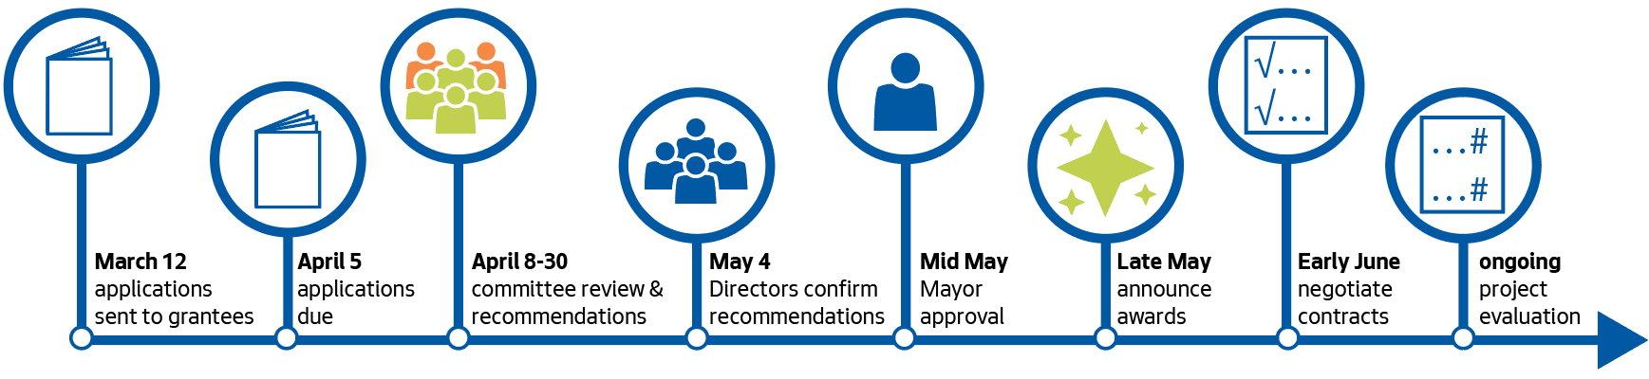
2022 Classic EDI Fund RFP
Timeline
Feb. 28
June 5
July
Early August
August
September
September
RFP Released
Community review committee:
Real estate and community financing experts, impacted community members without conflicts of interest

Slide 16
What’s New 2022?
Selection Criterion
Same
New
2022 Outreach Priorities
Funding cap raised to $2M
Anticipated at least 10 new organizations funded
Application
Core Criteria
Review process
Displacement Risk

Slide 17
EDI Scoring Ex. Depth of Relationship
Strong (deserves high score) | Weak (deserves low score)
Does the leadership (Board and Executives) reflect the community being served? | Is there significant disparity between the organization’s staff and community?
Does the organization focus on anti-displacement or community development work? | Is this proposal a departure from the org’s founding mission and purpose?
Is the proposal the result of previous community efforts? | Was the proposal developed solely in the context of the EDI funding round?
Does the total proposed budget adequately resource all collaborative partners? | Does the collaboration rely on the unreimbursed work of partner organizations?
Does the organization demonstrate clear reasoning as to why they are leading the work? | Are there other organization in the area that would potentially do a better job as the project sponsor?

Slide 18
Equity Drivers
STRONG (deserves high score) | WEAK (deserves low score)
Does the proposal show a clear connection between the project and Equity Drivers from the EDI Implementation Plan? | Does the proposal have a limited logical connection to EDI Implementation Plan?
Does the proposal describe measurable outcomes that it aims to influence to advance EDI drivers? | Does the proposal lack a vision for how effectiveness would be viewed?
Is the proposal at a sufficient scale to be able to address the community need? | Does the proposal not have a way to scale to the point where there would be significant benefit to the community?
Does the project represent a substantial effort to address three Equity Drivers equally? | Is the project mostly about one Equity Driver with others thrown in to comply with the application rules?
Do the proposed Equity Drivers clearly align with needs in the community? | Are the proposed Equity Drivers driven primarily by an organization’s existing programs?

Slide 19
Equitable Zoning Pilot
The purpose of the pilot is to explore whether other OPCD skill sets can be used to help EDI projects address zoning and land use challenges.
  The next steps are identifying potential groups of needs that may share common solutions
  Finding projects that have a schedule that is consistent with the potential solutions
  Collaborating on implementing solutions and assessing their effectiveness

