Slide 1
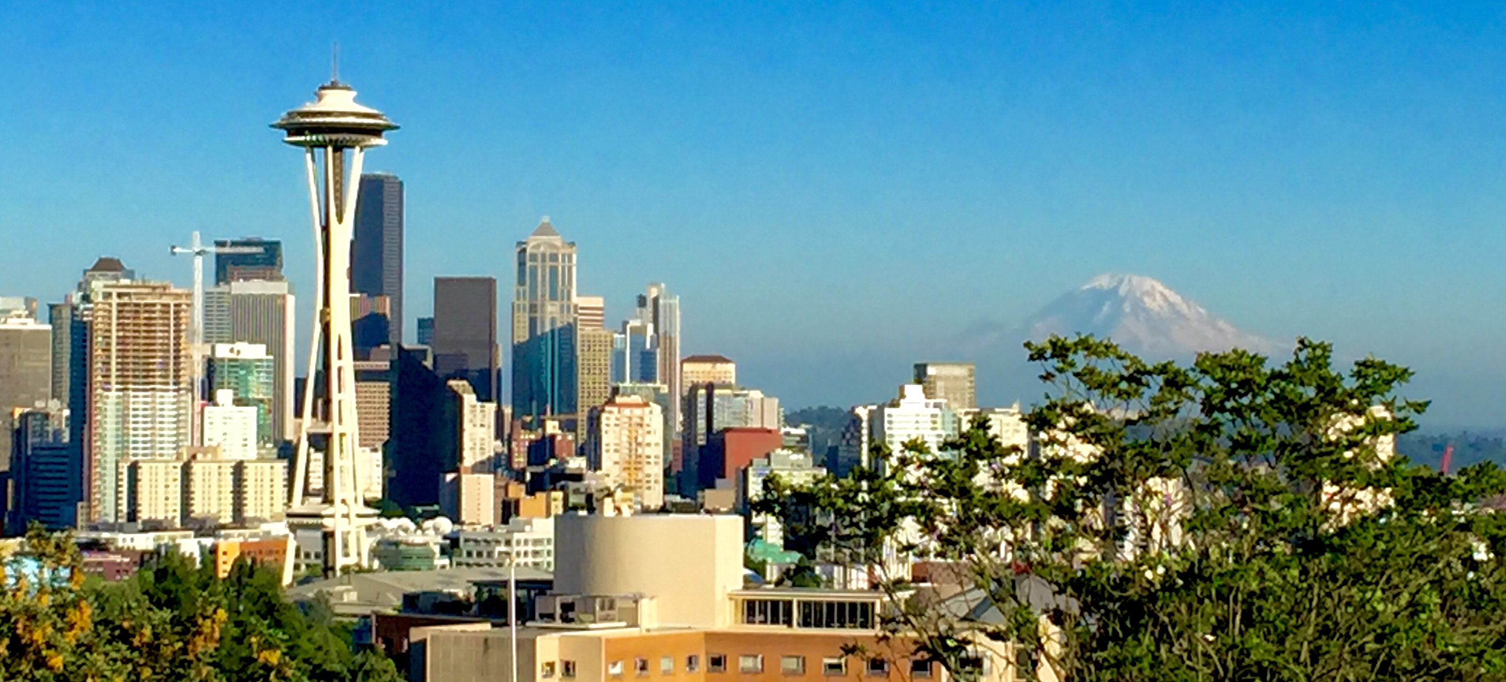
Tree Protections Update and Racial Equity
Photo by John Skelton
Renters’ Commission
Charlie Spear I November 2, 2020

Slide 2
Today’s presentation
Importance of urban trees
Tree protection regulation update
Racial equity toolkit process
Racial equity outcomes
Outreach efforts
What we’ve learned
Issues to explore
Next steps
Urban Forest Management Plan update open for public input
Request

Slide 3
SDCI PURPOSE AND VALUES
Our Purpose
Helping people build a safe, livable, and inclusive Seattle.
Our Values
Equity
Respect
Quality
Integrity
Service

Slide 4
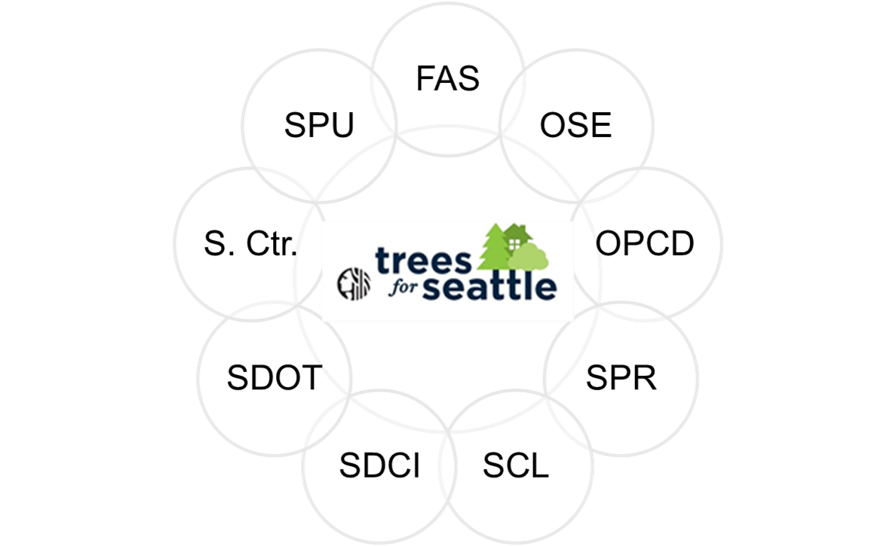
SEATTLE’S URBAN FOREST
Trees are fundamental to Seattle’s character and out quality of life as we continue to grow
The City’s urban forestry team is currently updating Seattle’s Urban Forest Management Plan
SDCI and OSE have been working on tree protection

Slide 5
IMPORTANCE OF URBAN TREES
Stormwater runoff reduction
Air and water pollution removal
Carbon storage and sequestration
Wildlife habitat
Watershed function
Heat island effect mitigation
Economic vitality
Public health effects
Neighborhood livability and community building
Urban agriculture and foraging
Notes:
Urban trees provide numerous ecological, economic, and social benefits.
Charlie: See details on page 3 of the draft UFMP (will send separately).

Slide 6
Questions to keep in mind
How might tree protections benefit black, indigenous and people of color (BIPOC) renters?
What burdens might tree protections create for BIPOC renters?

Slide 7
Tree protections update
Proposals include …
Requiring permits for tree removal on private property
Requiring mitigation for tree removal, which can be done by:
planting new trees on site
making a payment in lieu if tree planting onsite is not possible or desirable
Setting new limits on how many significant trees can be removed
Requiring tree service providers to sign an acknowledgement that they know the City’s tree protection requirements

Slide 8
Racial equity toolkit process
Identify desired outcomes
Involve stakeholders and analyze data
Determine benefit and/or burden
Advance opportunity and reduce harm
Evaluate, be accountable, report back

Slide 9
Racial equity outcomes
Ensure urban forestry benefits and responsibilities are shared fairly across communities, particularly BIPOC (black, indigenous and people of color) communities.
Reduce the disproportionate negative impacts to BIPOC communities due to having fewer trees.
Specifically, reduce the burdens of tree regulations implementation and enforcement on BIPOC communities.

Slide 10
Outreach efforts we can leverage
Significant work done in 2017 and 2019 for Urban Forestry Management Plan and UFMP Update
Other sources
2016 Tree Canopy Assessment
Equity and Environment Agenda
Duwamish Action Plan
Possible deficiency in these sources: outreach to renters

Slide 11
Examples of what we have learned
Lack of trust in government can influence participation and views about regulations.
BIPOC communities care about trees and want equitable access to the benefits they provide. However, tree planting and maintenance can be expensive.
Tree planting is important to BIPOC communities, and they want to partner with the City to increase canopy cover in their communities.
BIPOC communities tend to have lower tree canopy.
As of 2016, Seattle has 28% tree canopy cover (the City’s goal is 30%).
Areas where BIPOC communities live have only 20% canopy cover.
White, affluent communities tend to enjoy higher levels of canopy cover, can better afford tree maintenance, and have greater influence over City policies.

Slide 12
Some issues to explore
The complexity of private property regulations, requiring a strong engagement effort in order to elicit informed input from a variety of stakeholders.
The need to balance other priorities (i.e. – high rents, shortage of affordable housing, budget pressures from pandemic and recession) with these proposals for increased tree protections on private property
Possible disproportionate impact of regulations on BIPOC communities due to factors such as:
language barriers
access to information
distrust of government
disparities in financial resources

Slide 13
Next steps in racial equity toolkit
Continue reaching out and gathering data
Renters’ Commission
Partner with Community Liaisons
Internal stakeholders
Draft Racial Equity Toolkit
Benefits, burdens
Actions to advance opportunity and minimize harm
Review draft with stakeholders and affected communities
Start implementing actions and evaluating

Slide 14
Urban forest management plan
Framework for citywide policy and action
Update process started in 2018 with BIPOC and key stakeholder engagement
Draft plan out for public input through November 30
www.seattle.gov/trees/management
Draft document and executive summary
Presentation
Input survey
Notes:
The UFMP provides a framework for policy and action that guides City government decision-making to help Seattle maintain, preserve, enhance, and restore its urban forest.
The UF Core Team began the update process in 2018 with a focused effort to engage BIPOC communities prior to drafting the plan. Team also engaged key stakeholders such as: Urban Forestry Commission, tree advocates, tree service providers, government agencies, and non-profit partners.
The draft plan is now out for public input through November 30.

Slide 15
Requests and questions for you
How might tree protections benefit BIPOC renters?
What burdens might tree protections create for BIPOC renters?
Any feedback, guidance or ideas you might have to offer right now or any time!
Review Racial Equity Toolkit draft and provide feedback when the time comes

Slide 16
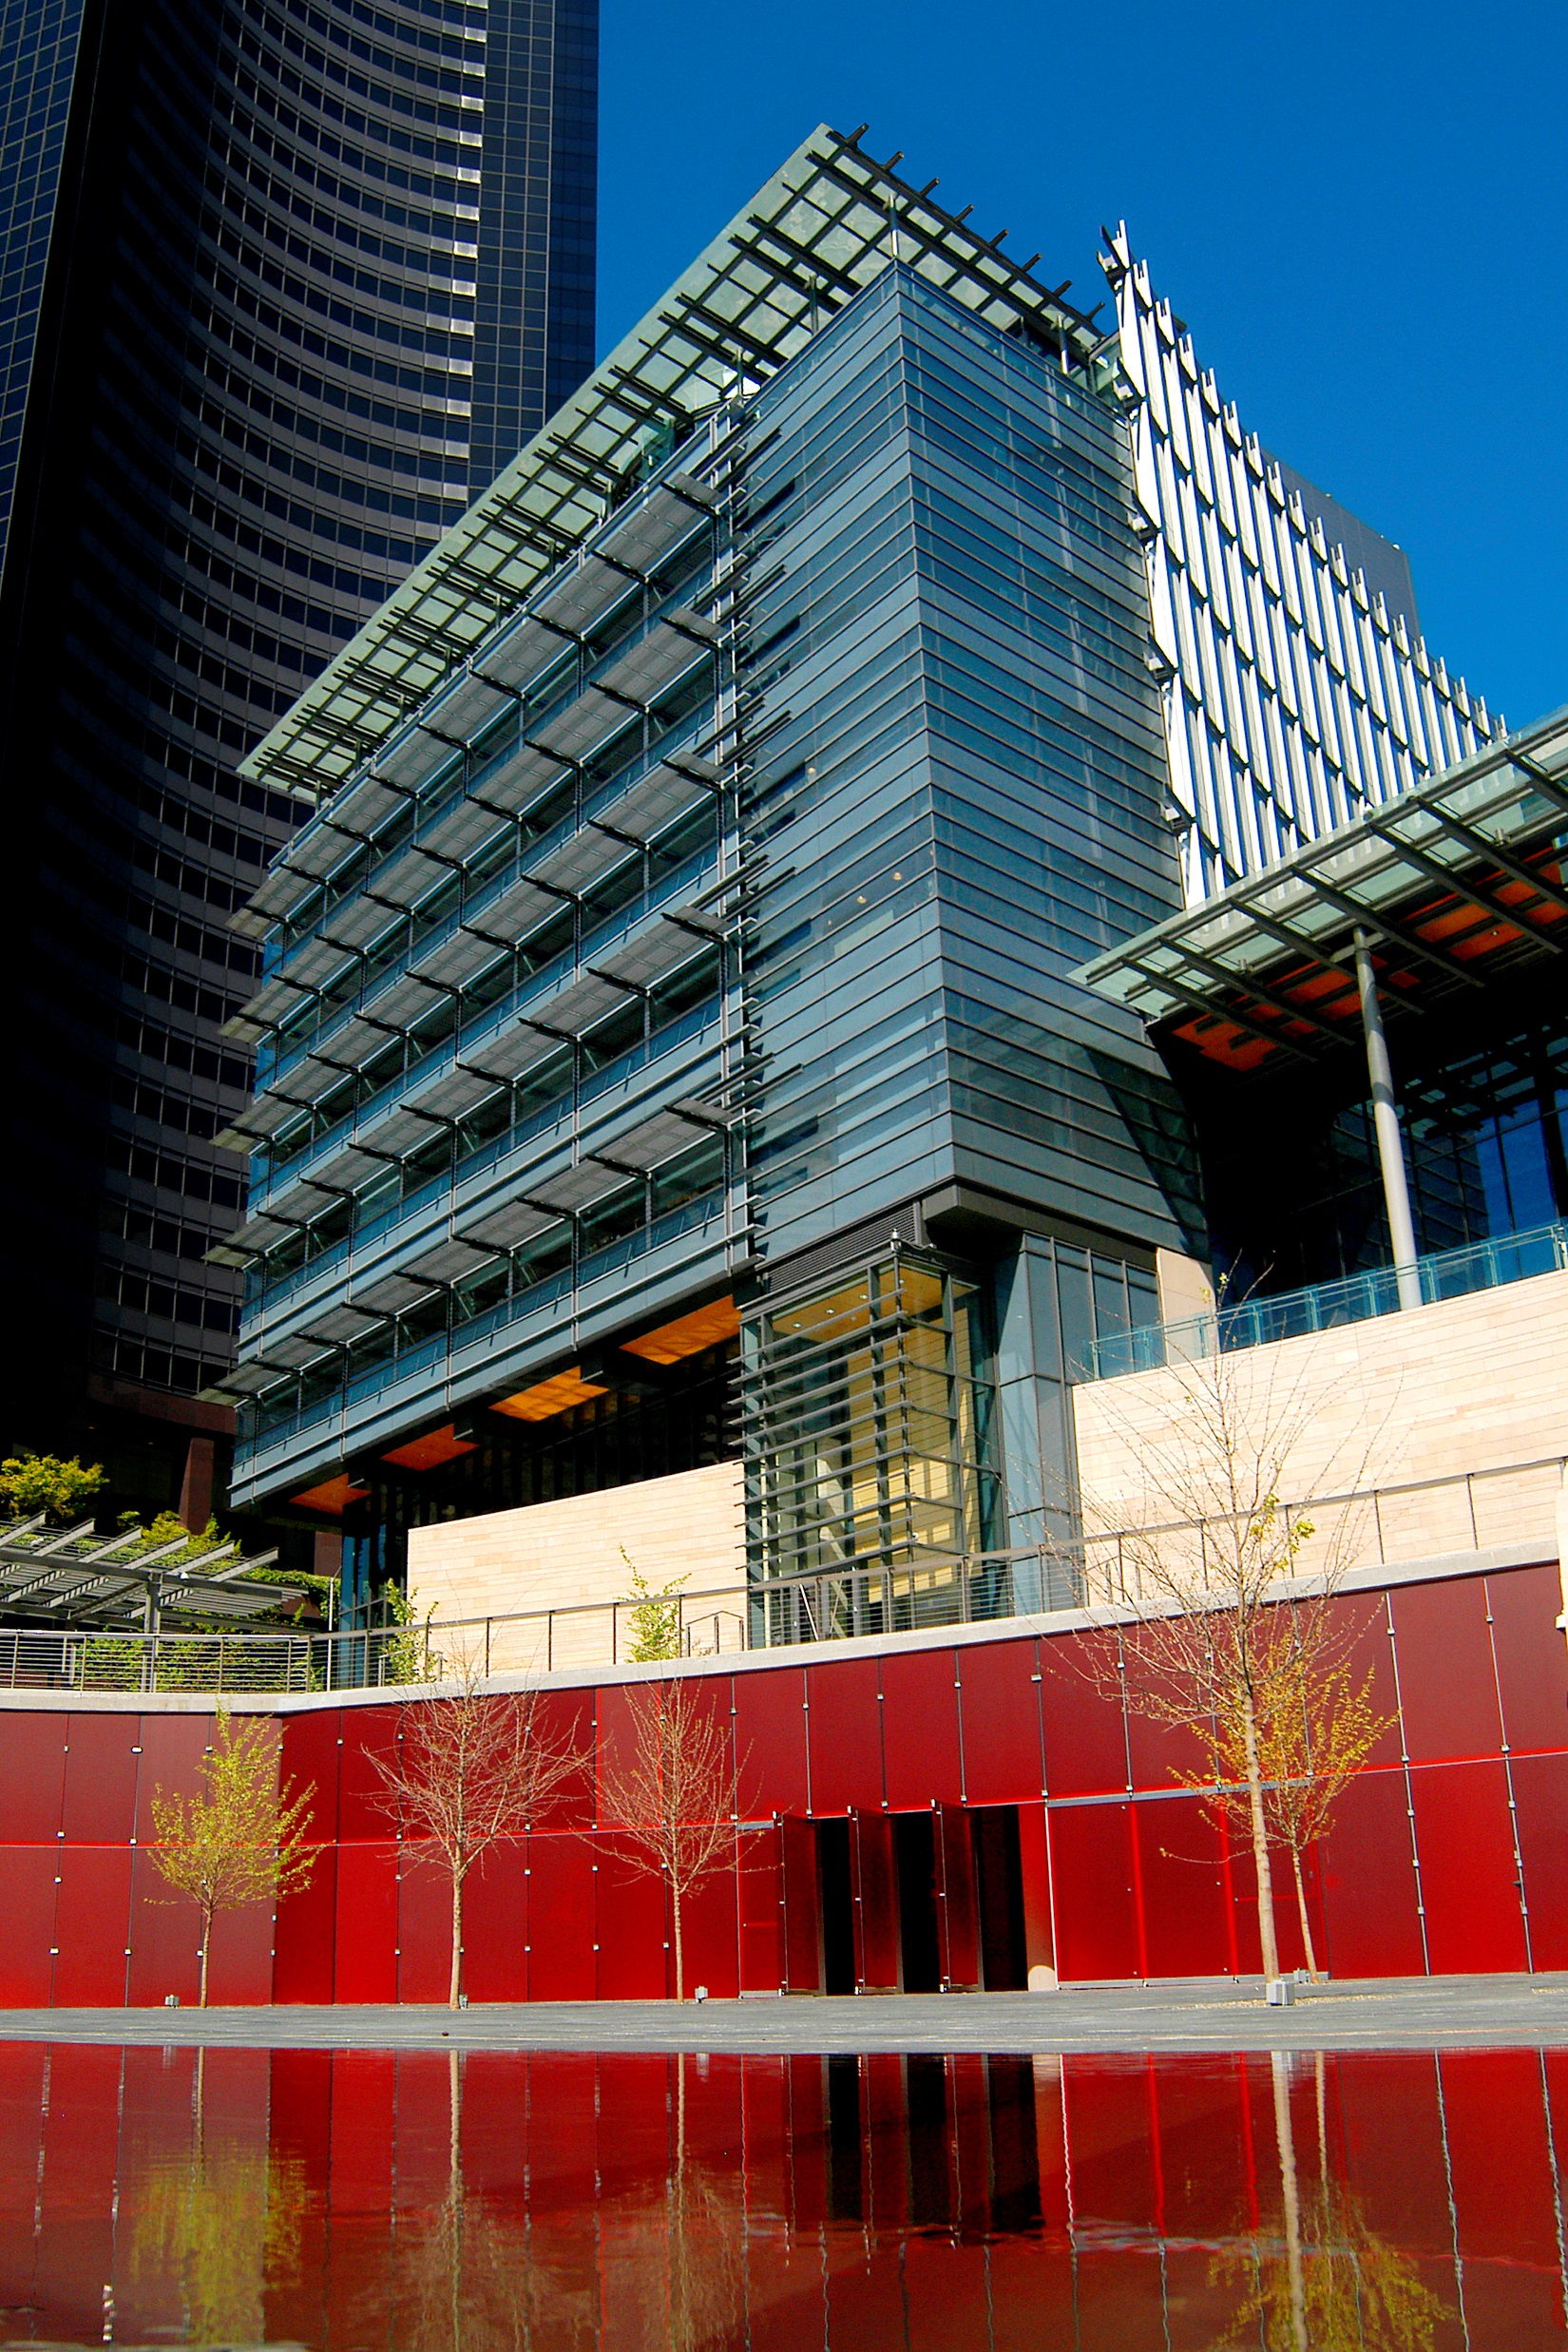
QUESTIONS?
Charlie Spear
charles.spear@seattle.gov
www.seattle.gov/sdci

