Slide 1
Family Support RFP Information Session
February 21, 2018
Catherine L. Lester, Director | Jenny A. Durkan, Mayor

Slide 2
Session Agenda
Introduction
Timeline
HSD’s Theory of Change
Eligibility, Populations, Strategies, Performance Measures, Staff
Submission Instructions
Review and Rating Process
Tips
Appeal Process
Help Sessions
Question & Answer

Slide 3
Introduction
Open and competitive funding process
City of Seattle General Fund $2.6 million
Funding awards will be made for the period of January 1, 2019-December 31, 2019
Services for families with children/youth up to age 24 who live in Seattle

Slide 4
Timeline
Funding Opportunity Announcement was February 16
Help Sessions February 23, 9:30 a.m.-12 p.m.
Northgate Community Center
10510 5th Avenue
February 26, 9 a.m.-1p.m.
2100 Building
2100 24th Avenue South
March 1, 2 p.m.-6 p.m. Rainier Beach Public Library
9125 Rainier Avenue South

Slide 5
Timeline
Last Day to Submit Questions March 19 5 p.m.
Application Deadline Friday, March 30, 12 p.m. (noon)
Review & Rating Process April 2-July 6
Interviews May 21-June 1
Award announcement July 10
Appeal Process July 11-July 23
Contract Period January 1, 2019- December 31, 2019

Slide 6
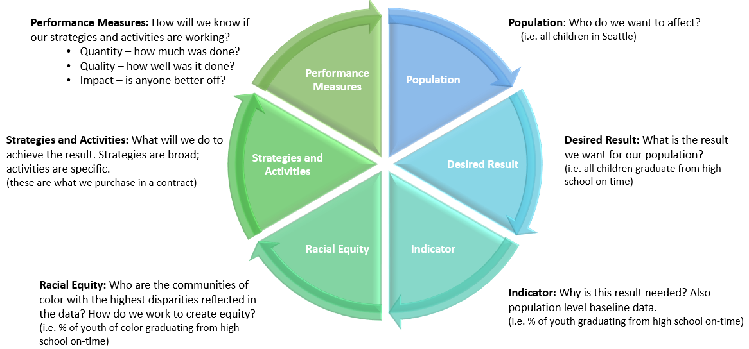
HSD Theory of Change
Uses Results-Based Accountability and leads with race

Slide 7
Eligibility
Organization Eligibility
Nonprofit in State of Washington with 501(C) (3) tax exempt status
OR
Federally or Washington State recognized Indian tribe
Or
Corporation, commission, other legal entity or authority established pursuant to RCW 35.21.660 or RCW 35.21.730
Services must take place in Seattle city limits
For the full list of eligibility requirements for organizations, go to:
Funding Opportunities - HumanServices | seattle.gov

Slide 8
Eligibility
Client Eligibility
Families must live in Seattle city limits.
For the purposes of this RFP, family is defined as one or more adults raising children/youth up to the age of 24.
This funding is not intended to provide services for young adults, without children, who live independently.

Slide 9
Populations
Priority Population
Families of color and limited English speaking families with children/youth up to age 24.
Focus Population
Native American/Alaskan Native and Hispanic/Latino families with children/youth up to age 24.
If you want to serve a population not included here, you need to demonstrate that there is an urgent need.

Slide 10
Strategies
HSD is funding two strategies:
Family Systems Navigation Support: training and support to help families learn how to access services and navigate systems on their own.
Family Management: training and support to help families build and maintain positive, healthy relationships within their families and with their communities.
Organizations may apply for funding for one or both strategies

Slide 11
Strategy
Systems Navigation Support Strategy
Help families learn to independently negotiate complex systems that provide needed services
Systems should be identified and prioritized by community
Not intended to be a referral service
This support should include at a minimum:
information about the rights and responsibilities of families within systems;
the purpose of systems, or what function they serve for families; and
when and how systems should be utilized.

Slide 12
Strategy
Systems may include but are not limited to:
City and County
education
employment
federal and state social service systems
health
immigration
law enforcement
emergency response systems

Slide 13
Strategy
Family Management Strategy
Training and support to help families build and maintain positive, healthy relationships within their family and with their communities.
Training and support that could be covered under this strategy includes but isn’t limited to:
needs of kinship care providers
parent-to-parent relationships
the challenge of parenting in a new country
how parents can address discrimination their children may encounter

Slide 14
Strategy
Type of needs continued:
parent and child relationships
parenting different developmental stages/ages of children
parenting support for all parents and guardians, including but not limited to fathers and male guardians, LGBTQ families, and families with disabilities
family communication
parenting with a cultural lens/supporting children’s learning about their family’s culture and language

Slide 15
Performance Measures
Quantity
# of individuals and families participating in systems navigation support activities.
# of individuals and families participating in family management activities.
Quality
Staff reflect the communities being served (i.e. language, race, ethnicity, sexual orientation and gender).
Services are tailored to the specific needs of the communities being served and incorporate participant feedback.
Impact
% of adults report increased utilization of systems and services.
% of adults have the skills needed to help children and youth transition to the next developmental stage.
% of adults report improved relationships and social connections within their families and/or broader community.

Slide 16
Staff
Culturally and linguistically competent
Experience working with families from the priority and focus populations.
Understand of the cultural backgrounds, needs, and challenges of the populations they will serve.

Slide 17
Rating Criteria
Scoring for Core Narrative Questions
Populations | 15 points
Data and Financial Management | 10 points
Cultural Competency | 15 points
Subtotal | 40 points

Slide 18
Rating Criteria
Scoring for Strategy Specific Narrative Questions
Program Design | 20 points
Capacity and Experience | 20 points
Partnerships and Collaboration | 10 points
Budget and Leveraging | 10 points
Subtotal | 60 points

Slide 19
Application
Organizations may apply for one or both strategies
Fill out the core narrative questions once
Fill out the strategy specific narrative questions for each strategy
Fill out a proposed program budget and a Proposed personnel detail budget for each strategy

Slide 20
Complete Applications
Late applications will not be accepted. HSD is not responsible for ensuring that applications are received by the deadline.
Applications must include:
Application Cover Sheet with a physical signature
Core Narrative Response (3-page limit) and
Strategy Specific Narrative Response(s) for each strategy (6 page limit per strategy)
Proposed Program Budget and Proposed Personnel Detail Budget form for each strategy
Proof of status as: IRS nonprofit, legal entity incorporation, or tribe
Current Board of Directors roster
Minutes from last 3 Board of Directors meetings
Federally approved Indirect rate, if applicable
Signed letter(s) from partnering organizations, if applicable

Slide 21
Fiscal Documents
Agencies for which we have current financial and insurance documents will not be required to resubmit
Agencies for which we have incomplete or no financial and/or insurance documents will be notified by the Coordinator and required to submit ALL requested documents within 4 business days from the date of written request
Financial and Insurance documentation that may be requested are listed in Section IV. of the Application

Slide 22
Submission Instructions
Applications due on Friday, March 30 by 12 p.m. (noon)
Mail or hand deliver to:
Seattle Human Services Department
RFP Response – 2018 Family Support
ATTN: Ann-Margaret Webb
700 Fifth Ave, Suite 5800
P.O. Box 34215
Seattle, WA 98124-4215
Online at: http://web6.seattle.gov/hsd/rfi/index.aspx.
No faxed or e-mailed submissions
Applications must be complete and on-time

Slide 23
HSD Online Submission System
The system is NOT an online Application – no saving
You may upload files up to a maximum of 100 MB
Acceptable file types include: .pdf .doc .docx .rtf .xls .xlsx
There are required fields to be completed. Ensure you allow sufficient time to complete the steps in order to submit your application by the deadline.
The system automatically sends a confirmation to all e-mail addresses you enter

Slide 24
Interviews
To receive an interview you have to pass the application minimum eligibility screen
One scheduled interview time
No rescheduling once interview time confirmed
If organization fails to send staff to the interview, HSD will not provide that organization another opportunity to interview
Interview questions will be provided 3 days in advance of the interview.
Interview questions may not be shared with other organizations.

Slide 25
Review and Rating Summary
Applications submitted
Minimum eligibility screening
Fiscal and insurance documents requested
Rating committee reviews complete applications
Interviews
Fiscal review
Final recommendations to HSD Director
Agency and public announcement

Slide 26
Appeal Process
Applicants have the right to protest or appeal certain decisions in the award process
Grounds for Appeals:
Violation of policies outlined in the Funding Process Manual
Violation of policies or failure to adhere to guidelines or published criteria and/or procedures established in the funding opportunity
Appeals Deadlines:
Appeals must be received within four (4) business days from the date of written application status (award/denial)
A written decision by the HSD Director will be made within four (4) business days of the receipt of the appeal. The HSD Director’s decision is final.
No contracts resulting from the solicitation will be executed until the appeal process has closed. An appeal may not prevent HSD from issuing an interim contract for services to meet important client needs.

Slide 27
Tips
Follow the required format defined in the Guidelines
Be specific, detailed, and concise
Answer all questions and in the context of your proposed program(s)
Submit an accurate budget; double check your numbers
Propose plans for addressing services that are not in place

Slide 28
Tips (continued)
Have someone else read your application before submitting
Don’t go over the page limit
Use the application submission checklist
Start early
Review the Online Submission Assistance Page for helpful information: http://web6.seattle.gov/hsd/rfi/help.aspx
E-mail questions by the Q&A deadline Monday, March 19, 5 p.m. to: ann-margaret.webb@seattle.gov

Slide 29
Help Sessions
Contact: (206) 615-0744 to make an appointment
Appointments are for 30 minutes, 1 appointment per agency
Help sessions are optional, but you must make an appointment
Topics HSD can cover in the Help Sessions:
Review budget forms
Clarify allowable expenses and activities
Review online application system
Clarify which documents you need to submit

Slide 30
Questions?
Questions & Answers posted on RFP website
Only written answers are official
Contact Ann-Margaret Webb at ann-margaret.webb@seattle.gov with questions prior to March 19 at 5 p.m.
Any issues and/or questions about the online submission system, contact Susan McCallister, Funding Process Advisor, at (206) 233-0014 or susan.mccallister@seattle.gov
(v3.0 - 2017)

