Slide 1
Notice of Intent to Sell
Amended Requirements Webinar
April 27, 2020
Jessica Gomez – Strategic Advisor for Policy and Equitable Development

Slide 2
Presentation Format
Welcome
Objectives for Presentation
Notice of Intent to Sell (NOIS) Background
How is the New Ordinance Different?
What is considered an Affordable Unit?
Required Notifications
Required Tenant Notifications
Where to find help?
Q&A

Slide 3
Objectives for Presentation
The objective of this presentation is for property owners to:
Understand the ordinance and what properties it applies to
Learn how to comply with the notification requirements
Know where to get help

Slide 4
NOIS Background
In 2015, the City Council adopted Ordinance 124861 establishing the Notice of Intent to Sell (NOIS) policy, and on July 22, 2019, City Council adopted Ordinance 125873, amending certain provisions of the original NOIS policy.
The Notice of Intent to Sell ordinance requires owners of multi-family buildings providing naturally occurring affordable housing units to notify the city and tenants 90 days prior to listing their property for sale. This ordinance allows for a potential purchase by the tenants, the City or an affordable housing developer. The ordinance also provides early notification to tenants that may be impacted if the building is sold.

Slide 5
How is the New Ordinance Different?
2015 Ordinance | 2019 Amended Ordinance
Building size = 5 units or > | Building size = 2 units or >
With at least one unit rented at 80% AMI or less | With at least one unit rented at 80% AMI or less
Notification required in writing 60 days prior to listing | Notification & declaration form required 90 days prior to listing
Described the City and affordable housing developers as potential purchasers | Describes the City, affordable housing developers, and tenants as potential purchasers
Limited details on process for owners | Gives more direction on process to owners
 | Requires notification to tenants posted in common areas providing resources for renters and potential purchasers
Non-compliance penalty = $500 | Non-compliance penalty = $2000

Slide 6
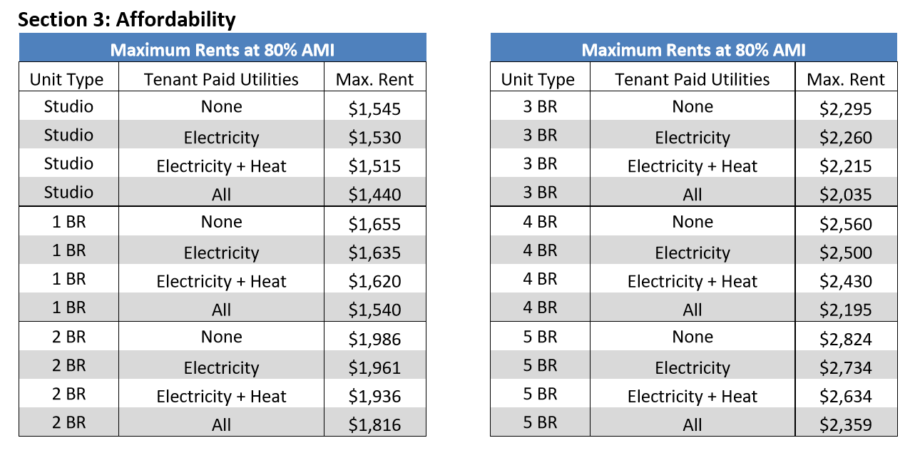
What is an Affordable Unit?
Owners must notify the Office of Housing 90 days prior to listing the property or executing a contract with a realtor
https://www.seattle.gov/housing/intent-to-sell
2019 Income and Rent Limits published by HUD April 24, 2019 – Rent limits change annually and will be updated on OH’s website

Slide 7
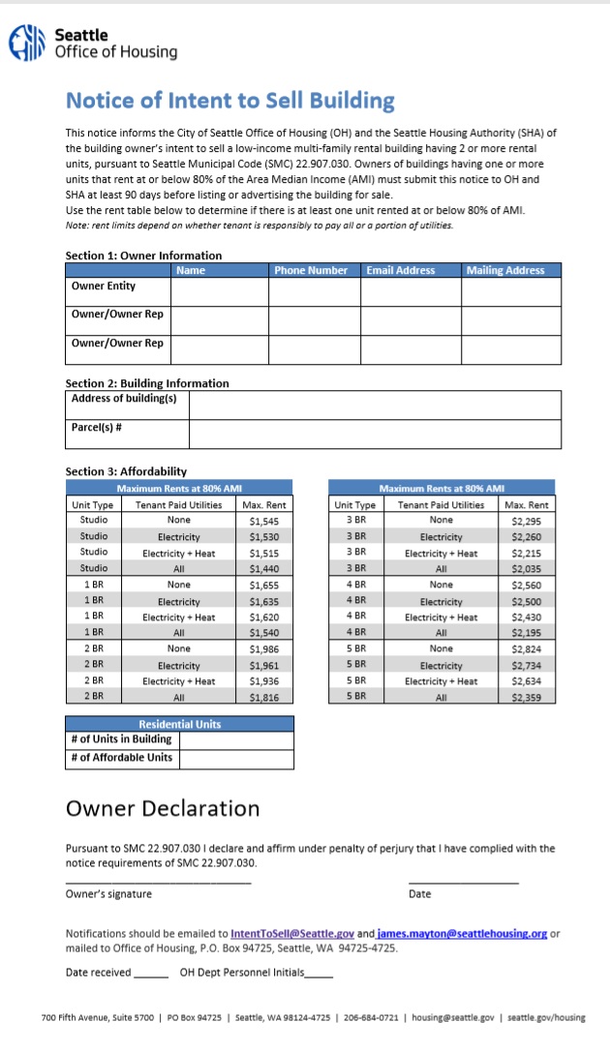
Required Notifications
Owners must notify the Office of Housing 90- days prior to listing the property or executing a contract with a realtor.
Once a notification is received by OH an email it sent out over our Notice of Intent to Sell listserv that consists of mainly housing developers and community members interested in preservation opportunities.
To subscribe please go to: https://www.seattle.gov/housing/intent-to-sell/information-for-landlords

Slide 8
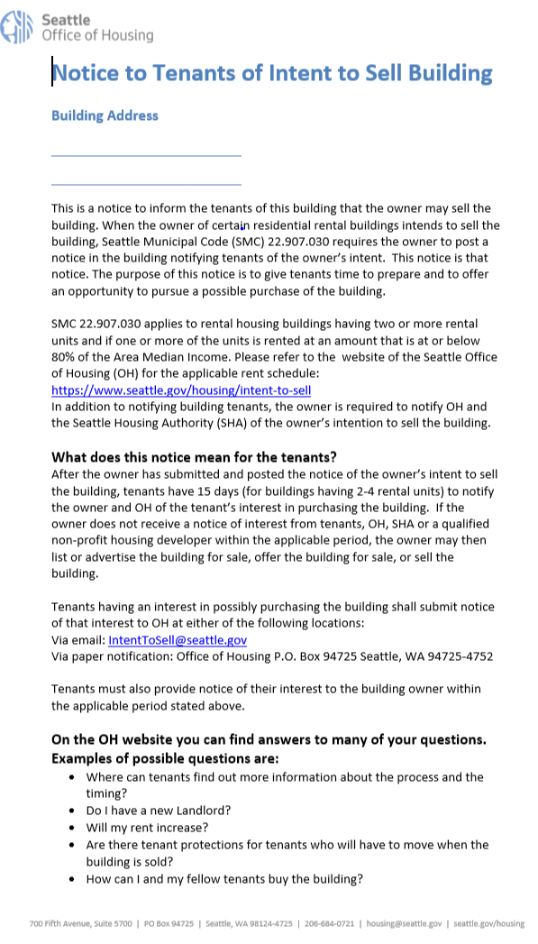
Required Tenant Notifications
Two types of notifications
2-4 unit buildings
15 days for potential purchasers to notify the owner
5 units or > buildings
30 days for potential purchasers to notify the owner

Slide 9
Jessica Gomez
Strategic Advisor of Policy and Equitable Development
Phone: 206-684-5081
Email: Jessica.Gomez@seattle.gov

Slide 10
Questions & Answers

Slide 11
Thank you!

