Slide 1

Unreinforced Masonry Buildings

Slide 2
What Are Unreinforced Masonry Buildings
Newer buildings are designed to ride out an earthquake, but old brick and stone structures are vulnerable to collapse.

Slide 3
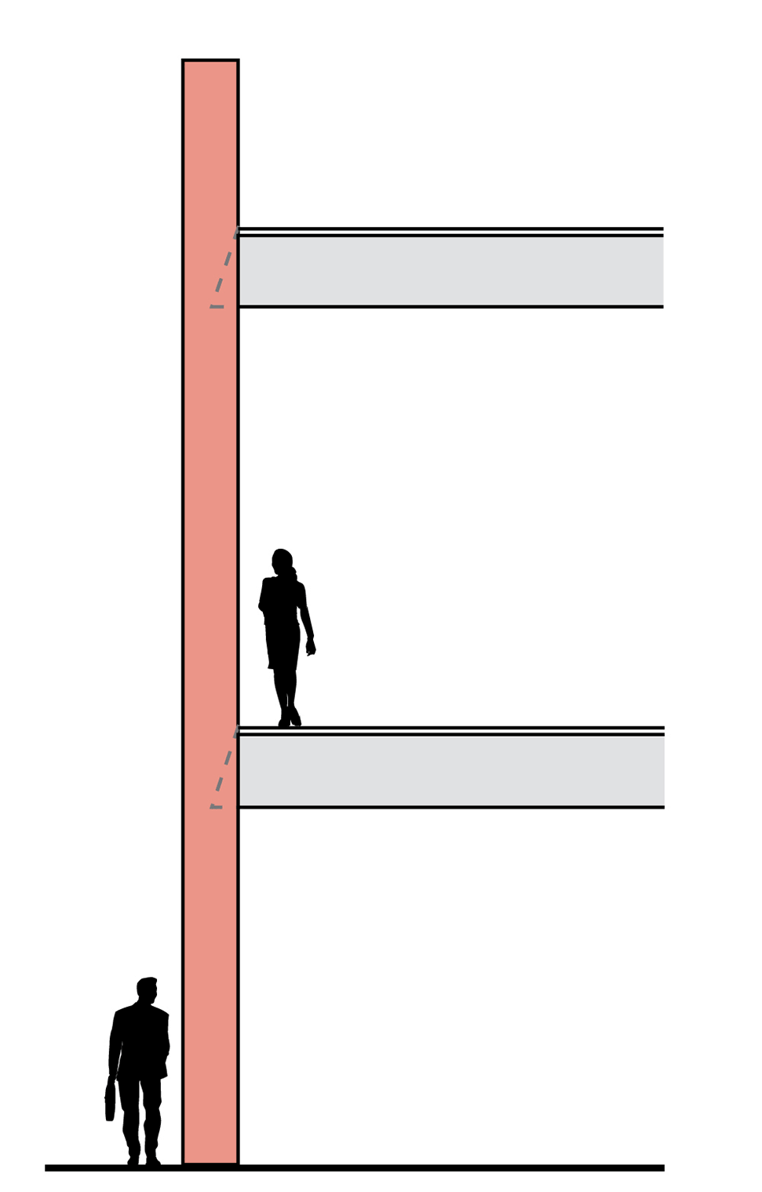
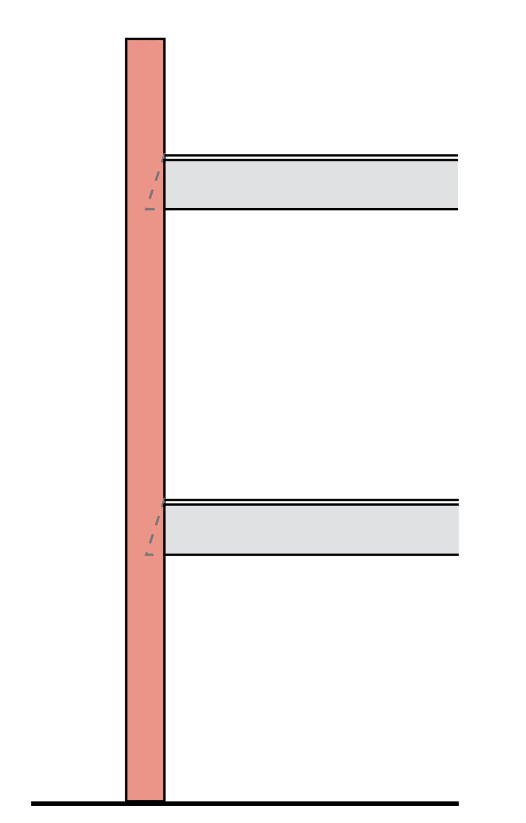
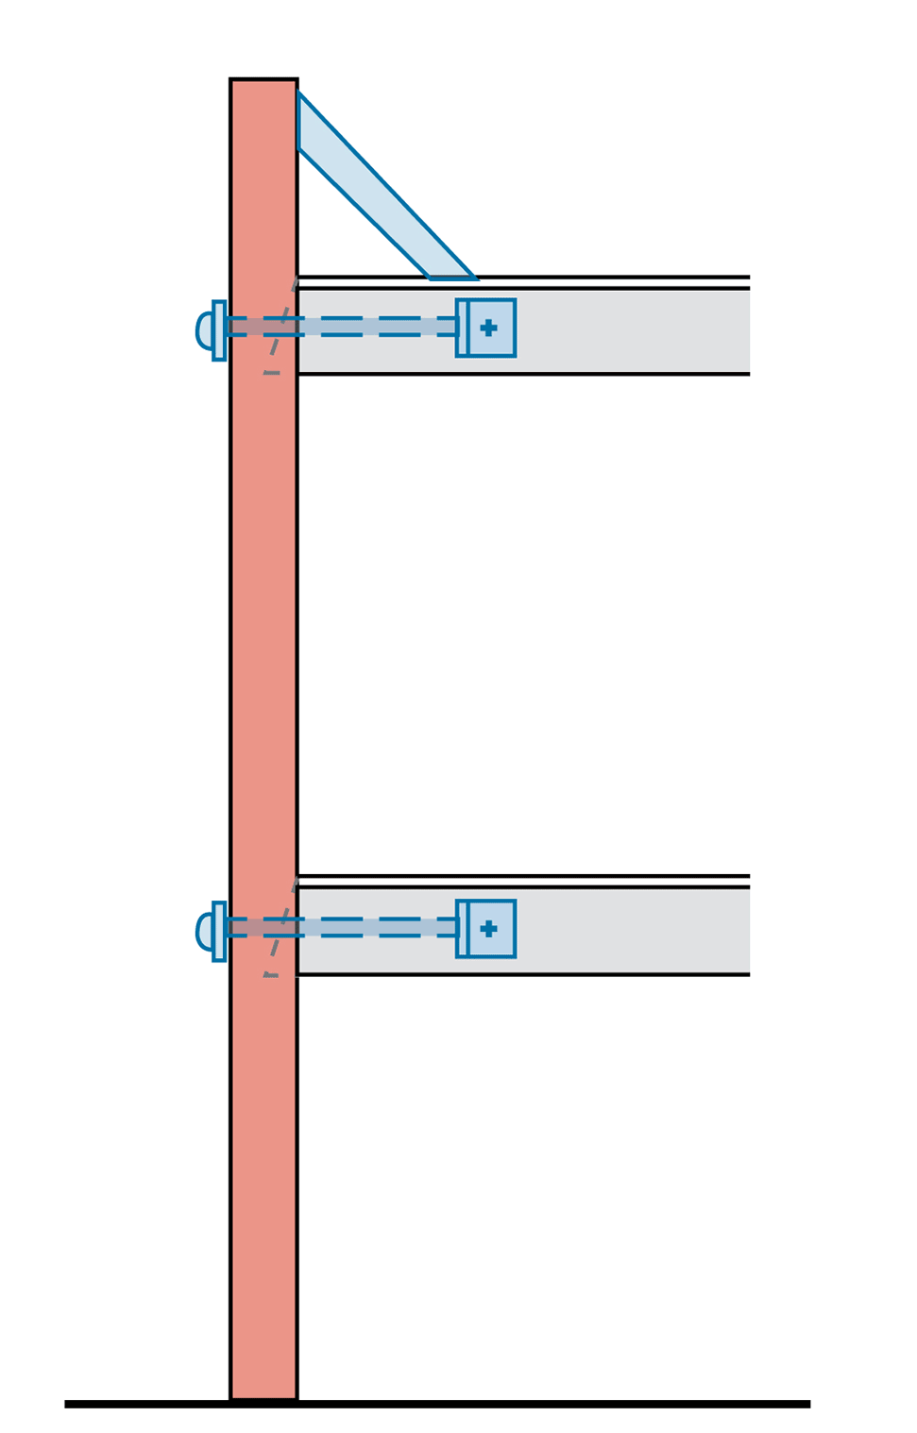
URM’s during an Earthquake

Slide 4
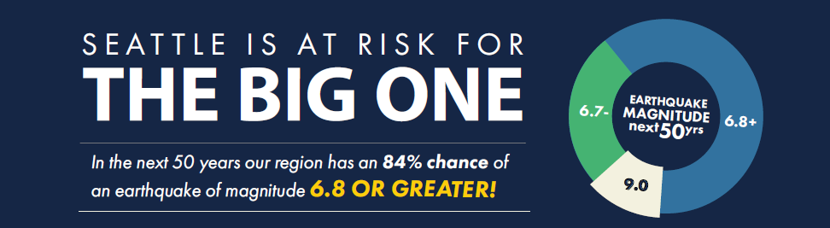
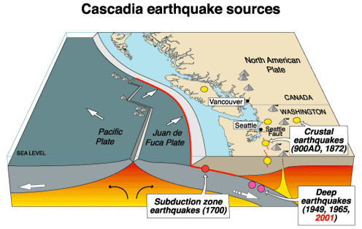
Seattle’s Earthquake Risk

Slide 5
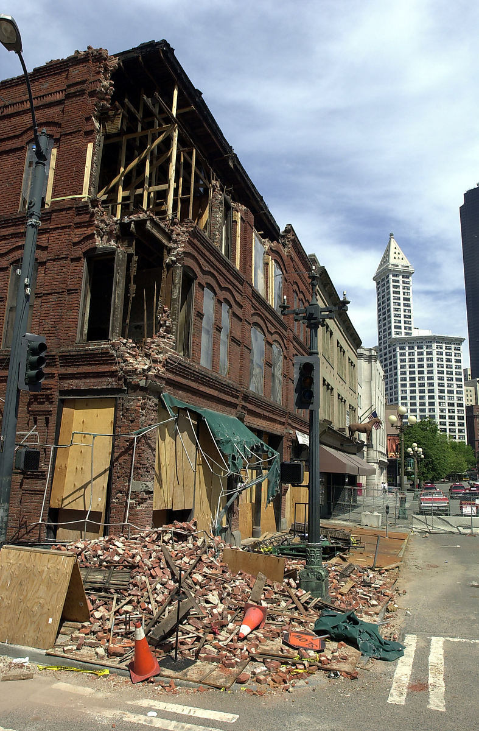
Nisqually Earthquake: 2001
20 of the 31 buildings that were red tagged (deemed unsafe to enter) were unreinforced masonry buildings.
A 9.0 Cascadia subduction zone quake would be roughly 2,000 times as strong as the Nisqually quake

Slide 6
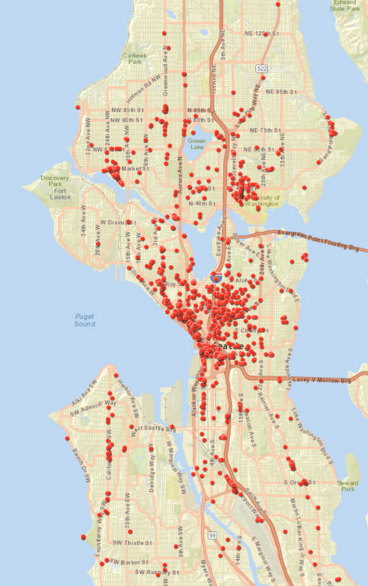
URMs in Seattle
1164 total URMs
Neighborhood | # of URMs
Capitol Hill | 142
Pioneer Sq./Intl District | 122
Duwamish/SODO | 79
Queen Anne | 79
University District | 74
Cascade/Eastlake | 73
Belltown | 72
Ballard | 70

Slide 7
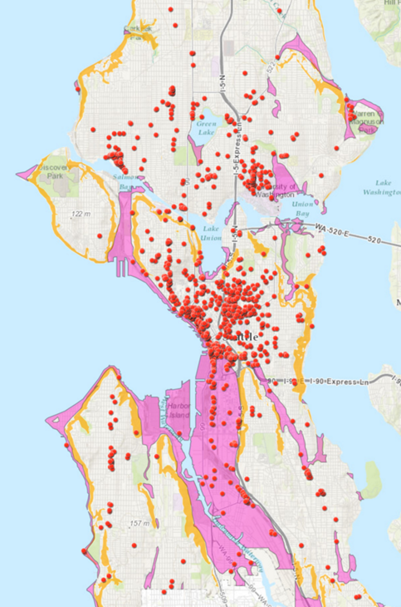
URMs and Environmentally Critical Areas
Many of Seattle's URMs are in areas that make them even more vulnerable neighborhoods
Many of the URMs in Pioneer Square and areas south of downtown, are in areas that are prone to liquefaction.

Slide 8
What Can you Do?
If you Own a URM
Find out if your building has been retrofitted and if not, look into retrofitting your building
Purchase earthquake insurance
Encourage tenants to have adequate insurance, including earthquake insurance and business interruption insurance
Train tenants on what they should do during and immediately following a disaster

Slide 9
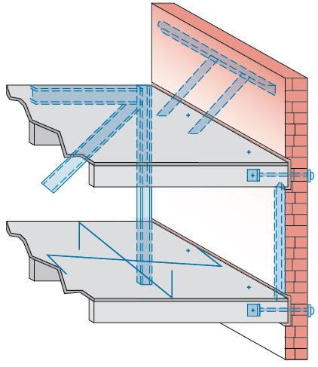
Retrofitting Old Brick Buildings
1
1
5
5
2
2
4
4
6
6
3
3

Slide 10
What Can you Do?
If you own a Business in a URM
Find out if your building has been retrofitted (Ask your landlord or building manager)
Find out if your landlord has insurance coverage and emergency plans for tenants
Purchase earthquake insurance
Create a continuity plan for your business
Teach your employees how to be safe (Drop, Cover, Hold)
Talk with other business owners in the building about how to work together and get prepared

Slide 11
What Can you Do?
If you Live or Work in a URM
Find out if your building has been retrofitted (Ask your landlord or building manager)
Find out if your landlord has insurance coverage and emergency plans for tenants
Purchase earthquake insurance
Know multiple ways out of the building in case exits are blocked with debris
Have a plan that identifies where you can stay if your building is damaged

