Slide 1
Emergency Preparedness
Presented by the Seattle Office of Emergency Management

Slide 2
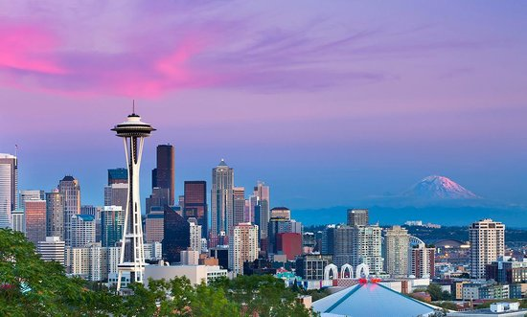
Seattle is vulnerable to many disasters…

Slide 3
Top Hazards around Seattle
Earthquakes
Snow and Ice
Infrastructure/Cyber
Windstorms
Power Outages
Terrorism
Disease Outbreaks
Flooding
Excessive Heat
10. Fires
11. Tsunamis/Seiches
12. Landslides
13. Transportation Accidents
14. Water Shortages
15. Social Unrest
16. HAZMAT Incidents
17. Volcano
18. Active Shooter

Slide 4
Know the reality
Earthquakes - no other hazard has the combination
of likelihood and potential destructiveness
The things you rely on will be significantly disrupted
  People may not be able to get anywhere
  easily (roads, bridges damaged; transit will stop)
  Stores may quickly run out of supplies
  Utilities may be damaged (electricity, water, sewer)
  Gas stations and ATM machines may not work
  Hospitals may be overwhelmed
  Phones, cable TV, and internet may not work
  First responders may not be able to help you for some time

Slide 5
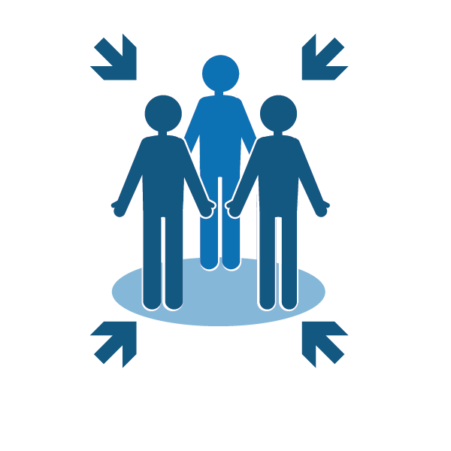

Develop a plan
Consider the following:
How will you reunite with Family?
Know alternate routes home and to work
Know plans for work and children’s schools or day care
What if you have no electricity?
What if you have no water service?

Slide 6


Communications plan
Include the following in
your communications plan:
Texting is your best option
Establish text message groups
Social media
Don’t make calls unless absolutely necessary

Slide 7
Retrofit your home
Secure the following:
Large furniture
Wall hangings
Kitchen cabinets & contents
Water heater
Washer/Dryer
Stoves
Hazardous materials
Go on a 30 min. hazard hunt
Attend a free home retrofit class
Was your home built before 1980?
Retrofit your home
See list of contractors on OEM’s webpage

Slide 8
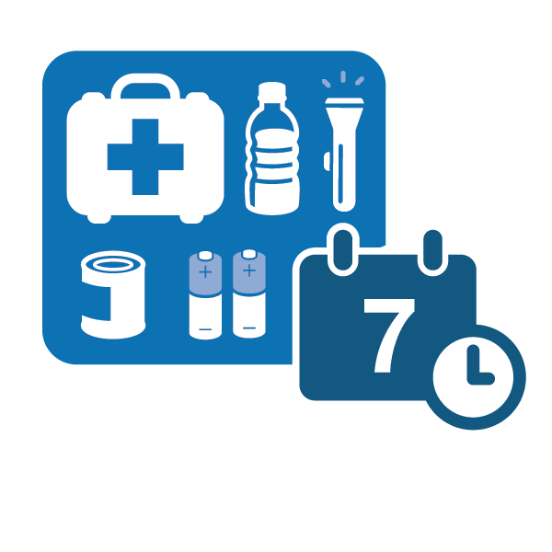
Build a kit
Be prepared to be on
your own for 14 days
Think about what you
use on a daily basis,
and include those
items in your kit
Have a kit in your car and at work

Slide 9
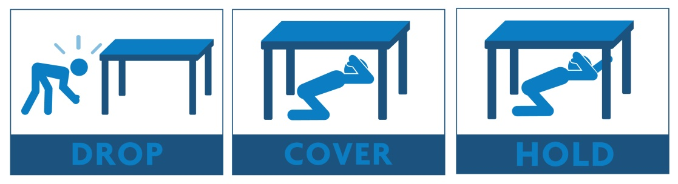
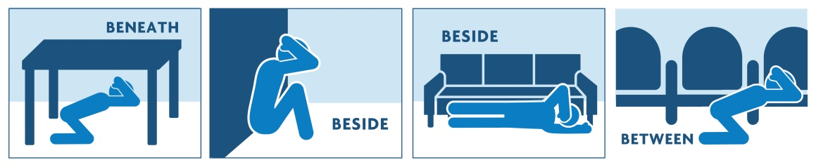
What to do during an earthquake
Quake Advice:
Don’t run during the shaking
Drop, Cover and Hold under a desk or table
If there’s not table, find the nearest safe place beside an inside wall or lower than furnishings; get into a corner or against a supporting column
If outside and in an open area, sit down and cover your head with your arms
If in the ‘danger zone’
next to a building, try to
get back into the
building to find shelter

Slide 10
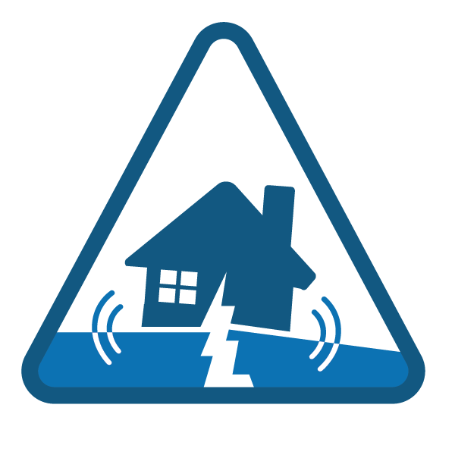
What to do after an earthquake
Check on yourself and
your family for injuries
Check on your home
Check on others
Find out more information

Slide 11
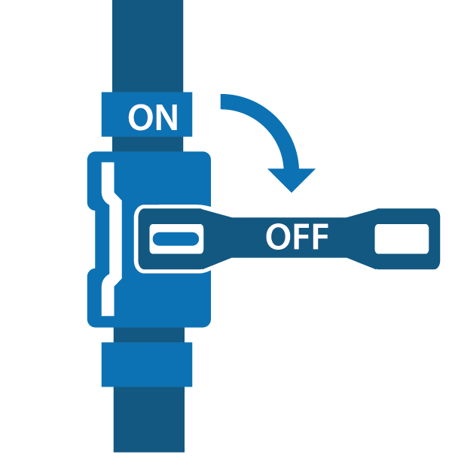
Know how and when to control utilities
Shut off natural gas ONLY if necessary
Only shut it off if you smell natural gas, hear
a hissing sound, or dial is spinning rapidly
Shut off water at the main house valve
Typically located right outside your house or inside
This saves the water in your hot water heater
and toilet from possible contamination
Turn off power to the water heater – attach a hose
Check to see if your home
sustained structural damage
Rope off damaged areas so others know

Slide 12





Find out more information
Get Alert King County messages
Sign up online at https://public.coderedweb.com/CNE/en-US/BF0D5C5CC09C
Get Alert Seattle Messages alert.seattle.gov
Tune in to local emergency radio stations
Tune into local television
Follow City departments on social media

Slide 13

Questions?
Thank you for attending – you’ll be happy you
prepared ahead of time when the next disaster strikes!

