Slide 1


CHILD CARE PROVIDER DISASTER PLANNING

Slide 3
Childcare Provider Disaster Planning
“Welcome to our Childcare Disaster Planning workshop. Today we will discuss different ways that you can keep the children in your care safe during any major disasters.
Activity:
Who here has experienced a major disaster before?
What was your experience like?
What did you do to prepare?
Were you prepared?”

Slide 4

1.0 INTRODUCTION
Washington is vulnerable to many disasters.
S E A T T L E
O F F I C E
O F
E M E R G E N C Y
M A N A G E M E N T

Slide 5
Washington is Vulnerable to many disaster
CSA: Some of the major disasters that Seattle may face
Earthquakes
Snow and Ice
Infrastructure/Cyber
Windstorms
Power Outages
Terrorism
Disease Outbreaks
Flooding
Excessive Heat
10. Fires
11. Tsunamis/Seiches
12. Landslides
13. Transportation Accidents
14. Water Shortages
15. Social Unrest
16. HAZMAT Incidents
17. Volcano
18. Active Shooter

Slide 6
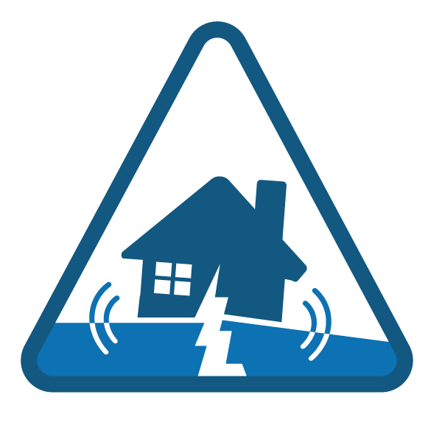
VS.
DISASTERS
EMERGENCIES
In a disaster or catastrophic event, expect to be on your own without help from outside agencies for days or weeks.
In an emergency, you can generally expect outside help from first responders.
S E A T T L E
O F F I C E
O F
E M E R G E N C Y
M A N A G E M E N T

Slide 7
Emergencies vs Disasters
“In an emergency situation usually first responders (fire and police) will be available to respond. In a major disaster, fire responders may not be able to respond to you, because of disrupted infrastructure (roads, bridges, telephone down).
Activity:
What is an example of an emergency? What is an example of a disaster?”

Slide 8

Key Components of Disaster Preparedness
PLANNING
CONSIDERATIONS
Communication Sheltering
Child Information Form/Child Release Form Hazard Mitigation
Disaster Kit/Supplies
Additional Planning Considerations
Some things to keep in mind while planning.
Relationships Special Needs
S E A T T L E
O F F I C E
O F
E M E R G E N C Y
M A N A G E M E N T

Slide 9
Key Components of Disaster Preparedness
CSA: As a childcare provider, you are responsible for taking care of children in your care during a major disaster. Some things you should think about are the following:
Communication (how will you get information to the people you need to get information to)
Sheltering (can you shelter in place, or go to a nearby neighbor)
Child Information Form/Child Release Form (if guardians and parents come to pick up their children, do y ou have a procedure to release children to them?)
Hazard Mitigation ( Are there things around the home/facility that can fall and hurt you or the children)
Disaster Kit/Supplies (Do you have enough food, water, and items to last for at least 3 days to take care of the children)

Slide 10
Have mulitple means of communicating with parents and staff.
COMMUNICATION
Have access to landline
Cell phones and text messaging Email
Out-of-area contact numbers Changing your voicemail Markers, pens, paper
Out-of-Area Contact Number
For yourself (caretaker) For your family
For each child that you are babysitting
Family on speed dial!
S E A T T L E
O F F I C E
O F
E M E R G E N C Y
M A N A G E M E N T

Slide 11
Communication
“Have access to landline (landlines may still work during a power outages, and does not use cell towers, that may be bombarded with people making calls
Cell phones and text messaging (have a power bank on hand, try text messaging because it will continue to try to push through the message)
Email ( have an email on hand)
Out-of-area contact numbers (Most likely you are able to reach someone who lives out of state, then in state after major disasters, because they are not affected by the disaster, and long distance lines will not be as tied up as local lines.)
Changing your voicemail (Changing your voicemail to let people know you are okay”
Markers, pens, paper (to write where you will and children will be going if home/facility not safe to shelter in, then place sign where folks can see)
Out-of-Area Contact Number
For yourself (caretaker)
For each child that you are babysitting”

Slide 12


Relationships are key to coping with disasters.
RELATIONSHIPS
RELIGIOUS SCHOOLS NEIGHBORHOODS
COMMUNITY CENTERS
Can you think of other relationships?
0 5
S E A T T L E
O F F I C E
O F

Slide 13
Relationships
“Relationships are key to coping with disasters. In the event of major disasters neighbors are more likely to come together and help one another. The earlier you get to know your neighbors the better. They can potentially be a place for you to seek refuge, share supplies and resource with, etc.”

Slide 14
Shelter in Place
Stay where you are at if it is safe to do so
Make sure you have enough supplies to last at least 3 days(first responders may not be able to get to you)
Off site evacuation
Have at least 3 options you can take children if home is not safe Leave a note on home for parents/ guardians who may arrive at your site to look for children
SHELTERING
S E A T T L E
O F F I C E
O F

Slide 15
Shelter in Place
“Shelter in place, stay where you are at if you are able to. Make sure after a major disaster that your home/facility is safe for you and the children to stay in. We recommend sheltering in place if safe to do so.
Supplies – Make sure you have enough food and water to last for at least 3 days, generally we say 2 weeks but most likely parents and guardians will come to get their children
Off site evacuation- As mentioned before knowing your neighbors and building relationships with them are key after a disaster. These places can act as an off site evacuation location.”

Slide 16
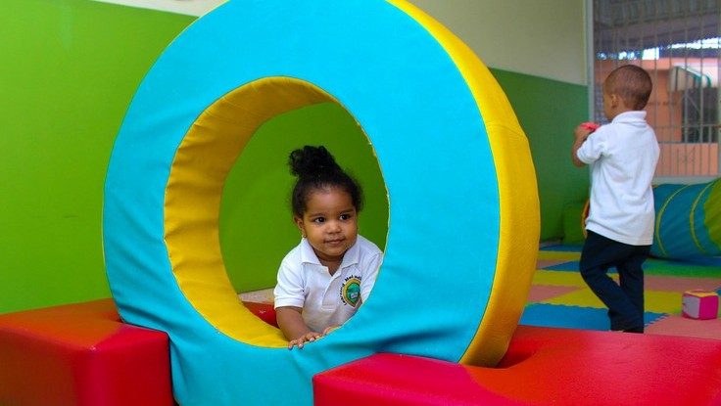
2.0 CHILD RELEASE
S E A T T L E
O F F I C E
O F

Slide 17
Child Release
The next topic we will discuss is child release. We will talk about how to safely release your child to a responsible adult.

Slide 18

Why have a specific emergency child release process?
PLANNING PROCESS
To ensure children are under continuous supervision
To ensure children have only been released to parents/guardians or designated emergency contacts
To aid families in reuniting after they have left the facility
For clear and thorough documentation.
S E A T T L E
O F F I C E
O F

Slide 19
Planning Process
CSA – Why have a specific emergency child release process?
To ensure children are under continuous supervision – you want to make sure that the children are being handed over to the correct individuals.

Slide 20

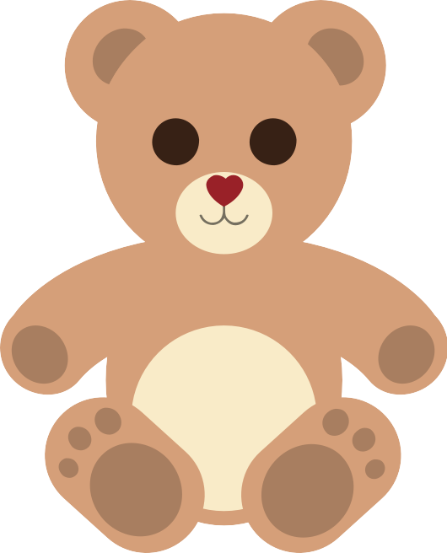
Child Information Form
Have child release information on a document
List multiple names of individuals you can release child to Keep it up to date
Individuals listed will need ID for pickup
CHILD RELEASE FORM
S E A T T L E
O F F I C E
O F

Slide 21
Child Release Form
“Have child release information somewhere safe, so that you have on file which individuals you can release the child to safely to.”

Slide 22
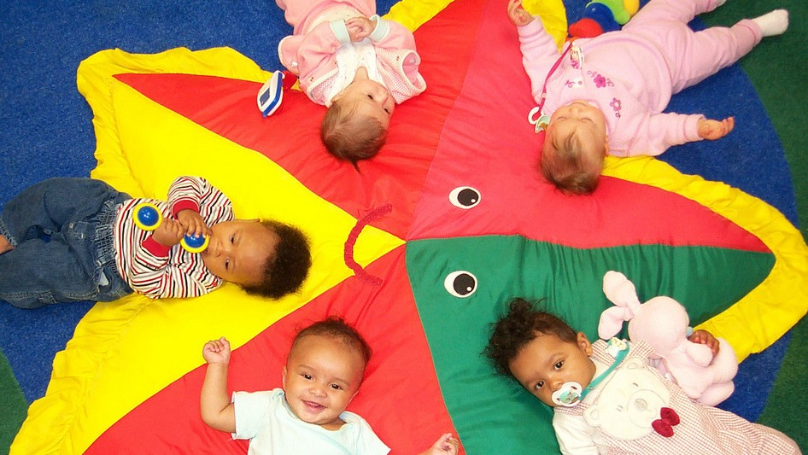
3.0 HAZARD MITIGATION
S E A T T L E
O F F I C E
O F

Slide 23
Structural
Non-Structural
Architectural components (such as windows)
Building contents (such as furniture) Elements not necessary to structural integrity, but often crucial to the occupation and operation of the building.
STRUCTURAL VS. NON-STRUCTURAL
Elements that contribute to the structural integrity of a building
S E A T T L E
O F F I C E
O F

Slide 24
Structural vs. Non Structual
“Structural – buildings, home that you live in. Find out if you building, child care facility is structurally mitigated (protected from disasters or hazards)?
Non-structural – Include things that are not bolted to the ground. Furniture, decorations, things that can be secured to avoid injuries during a major disaster.”

Slide 25
Ask yourself these following questions?
Can it break or fall and cause injury?
Can it break or fall and block an exit from a room?
Can it break or fall and prevent normal operations of the program?
Does it hold sentimental or emotional value?
Mitigation Actions
Make sure you take actions to prevent this from happening!
NON-STRUCTURAL MITIGATION
S E A T T L E
O F F I C E
O F

Slide 26
Non-Structural Mitigation
“Here are some mitigation actions you can take:
Attach heavy furniture to walls
Use closed-loop hangers for heavy hanging objects Secure cabinet doors
Secure objects on open shelves
Secure water heater to wall
Back up essential records
Store heavy objects close to group
Keep nap mats, beds, cribs, etc. away from windows or glass
Use safety glass or Plexiglass whenever possible, or cover windows with safety film”

Slide 27

Let's Practice, Let's walk around together, using the Hazard Mitigation form!
NON-STRUCTURAL MITIGATION
S E A T T L E
O F F I C E
O F

Slide 28
Non – Structural Mitigation
Activity- Walk around with the Hazard Mitigation checklist with the caretaker, and complete the list.

Slide 29

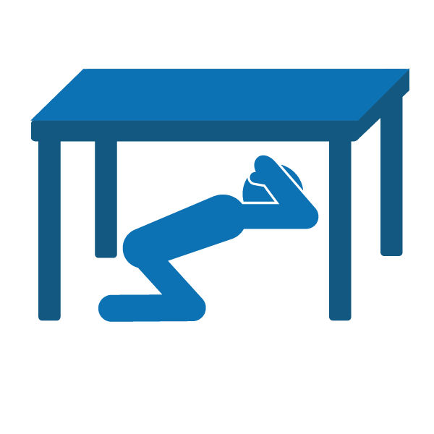
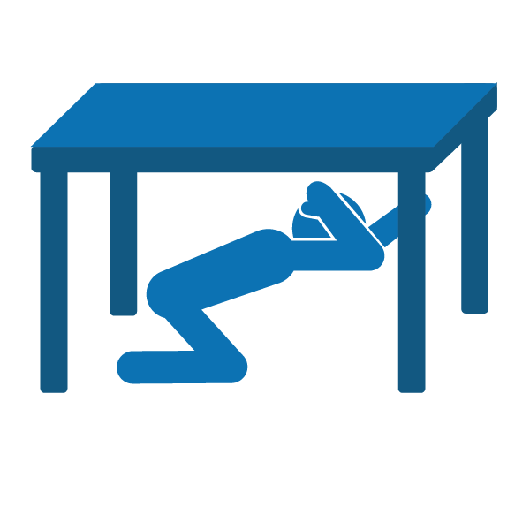
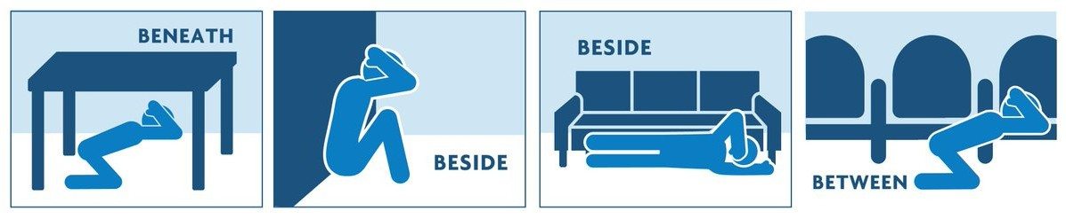
Drop, Cover, and Hold
EARTHQUAKE SAFETY
Beneath, Beside, Between
S E A T T L E
O F F I C E
O F

Slide 30
Earthquake Safety
“During an earthquake you must practice these earthquake safety tips, if possible.
Drop to the floor, crawl under a table
Cover you’re your head
Hold onto the legs of the table.”

Slide 31
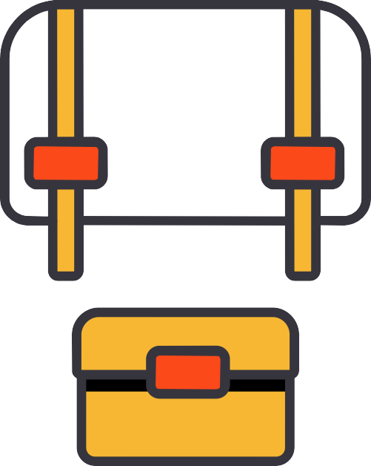
Personal Preparedness
Review Preparedness Infographic (Go over Infographic
Review childcare checklist items (Go over checklist)
Review skills
Hazard mitigation
Personal roles and responsibilities before, during, and after an event Utility Control
Offsite evacuation Earthquake-safe actions
PREPAREDNESS FOR YOU AND CHILDREN
S E A T T L E
O F F I C E
O F

Slide 32
Preparedness for you and children
Activity-
1. Go over the infographic, front to back, including inserts.
2. Go over childcare checklist with participants.
3. Review hazard mitigation, participants role before during and after earthquake. Before- prepare, During – drop, cover and hold, After – shelter in place if safe, turn off gas if you smell or hear it leaking.

Slide 33
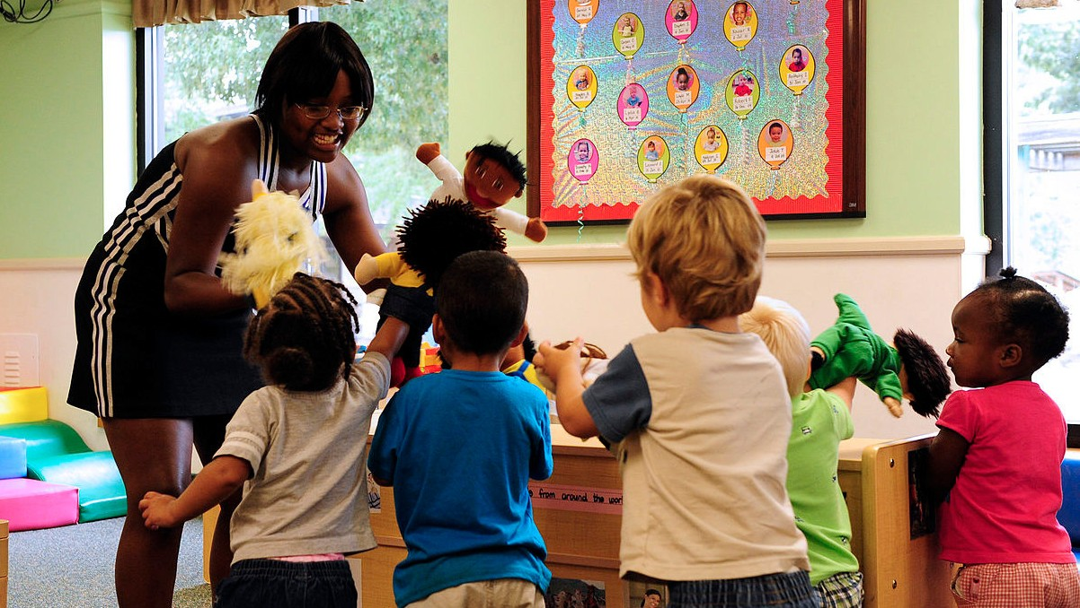
THANK YOU!
S E A T T L E
O F F I C E
O F

