Slide 1
Hello from the Seattle Public Library!
Elizabeth Iaukea & CJ Glenn

Slide 2
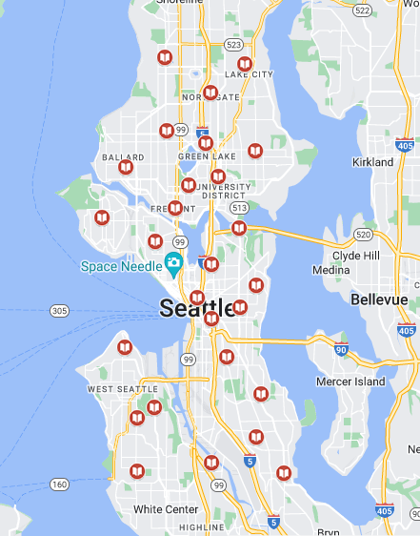
Seattle Libraries
27 Locations across Seattle
Separate from King County Library System
Reciprocal relationships with many local library systems (including KCLS)
Vertical photo here

Slide 3
What Can You Do Without a Library Card?
Read books, magazines and newspapers at the Library
Ask Library staff for help
Use computers and WiFi
Print & Copy, Fax, Scan & Translate, Use Adaptive Equipment, including LEAP Lab @ Central Library
Use study rooms, meeting rooms, and tables
Attend online and in person events and programs
Relax in libraries with Air Conditioning/Heating (21 branches have AC)

Slide 4
What Can You Do Without a Library Card?
Programs for Immigrants and Refugees
Adult Education Tutoring
Broadview Branch – Saturdays 10:30am – 12pm
Lake City Branch – Saturdays 1 – 3pm
Rainier Beach Branch – 5:30 – 7:30pm
English Conversation Circles
Beacon Hill Branch – Saturdays 10:30am – 12pm
Delridge Branch – Saturdays 10:30am – 12pm
Northgate Branch – Thursdays 4 – 5:30pm
2 virtual sessions – Tuesdays 6-7pm & Thursdays 3-4pm
Citizenship Classes
English for Work

Slide 5
In-language Online Learning
Northstar – learn basic/intermediate computer skills in English or Spanish, take short exams to earn certificates.
News for You Online - news articles written for English Language learners. Read, write, listen, and understand English with audio, exercises and vocabulary.
ProLiteracy Education Network - self-paced courses, videos, activities and resources supporting adult literacy, English language learning and other adult basic education topics. Resources for adult learners, tutors, and instructors.
spl.org/BasicSkills

Slide 6
What Can You Do With A Library Card?
Check out books, movies and music (physical and digital)
View magazines and newspapers online (www.spl.org/DigitalMagazinesAndNewspapers)
Stream movies and TV shows online (www.spl.org/MoviesAndTV)

Slide 7
With a Library Card you can also:
Get Online Tutoring | www.spl.org/VirtualTutoringForAdults
Museum Pass | www.spl.org/MuseumPass
State Parks Pass | www.spl.org/OutdoorRecreation
Programs for Adult Learners | www.spl.org/AdultLearners
WiFi Hotspots | www.spl.org/hotspot

Slide 8
In-language Online Learning
LinkedIn Learning – video courses for tech & business skills in English, French, German, Japanese, Spanish, Mandarin, Portuguese, Dutch, Italian, Turkish, Polish, Korean & Bahasa Indonesia.
Mango Languages – ELL for speakers of Arabic, Armenian, Bengali, Chinese, French, Haitian Creole, Hmong, Japanese, Korean, Polish, Brazilian Portuguese, Russian, Somali, Latin American Spanish, Turkish & Vietnamese
spl.org/OnlineLearning

Slide 9
Resources for Learning Digital Skills www.spl.org/technologyskills
Northstar Digital Literacy – assessments, beginning and intermediate courses, certificates
DigitalLearn.org – short beginner & intermediate courses with activities to help you learn computers, the internet, and staying safe online.
Grow with Google – dozens of online courses including basic digital skills, math, science, job and careers, study skills, and much more. Change language from bottom right side of page.
LinkedIn Learning – video courses for computer, tech & business skills
spl.org/OnlineLearning

Slide 10
Computer Help & Technical Support
TechConnect Washington (techconnectwa.org)– Free, virtual tech assistance for Washington residents via chat, email, or phone. Available 7 days a week, 8am – 8pm (closed for lunch)

Slide 11
How To Get A Library Card
Visit your local library or www.spl.org/Card to get a Library card and access to books and online resources.
You can get a free library card if you:
Live, work, go to school or own property in Seattle
You may also qualify if you have a library card from one of the library systems in Washington State

Slide 12
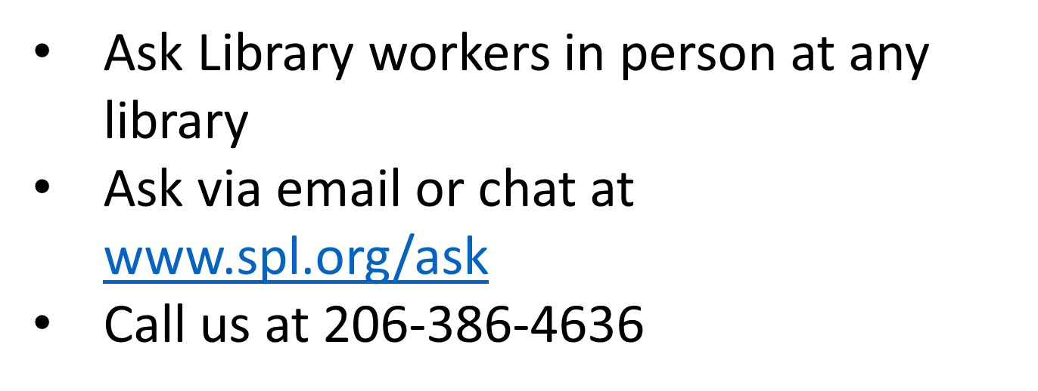
Need Help with Any Library Resource?

Slide 13
Other SPL-sponsored opportunities for immigrants and refugees
2 ESOL level 1 classes (Literacy Source & Southwest Branch) – Each class is 13 weeks, September – December; Southwest location participants can take advantage of free childcare during class.
Spanish-language computer classes, beginning and intermediate offered at Delridge Branch, September – December. Learn to earn opportunity with free childcare for participants
Your Vote Counts: Voting Information for New Citizens webinar October 21st 2-3pm. In partnership with ACRS. Coming in 2025 – Life Skills for Recent Arrivals monthly webinar series

Slide 14
Partnership opportunities – we want to work with you!
Collaboration- does your organization offer a program or resources we can help you grow? Are you willing to share information about library opportunities?
Community meeting space – free meeting rooms at most library branches, Central Library for a fee (unless co-sponsored by SPL)
Help promote programs and resources – post fliers in library branches, if the event is co-hosted we can post on Library’s Event Calendar and via social media
Other ideas? Please get in touch – elizabeth.iaukea@spl.org and c.j.glenn@spl.org

Slide 15
Seattle Libraries
27 Locations across Seattle
Separate from King County Library System
Reciprocal relationships with many local library systems (including KCLS)
Vertical photo here

Slide 16
Do You Have Any Questions?
Elizabeth Iaukea Workforce Development & Adult Basic Education Program Manager
CJ Glenn LEAP Program Manager, Lifelong Access Program

