Slide 1
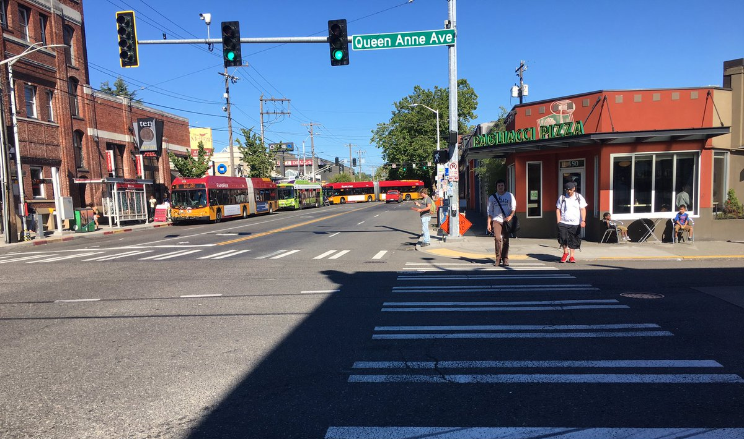
North Downtown Mobility Action Plan
Ian Macek
Bicycle Advisory Board
January 3, 2018

Slide 2
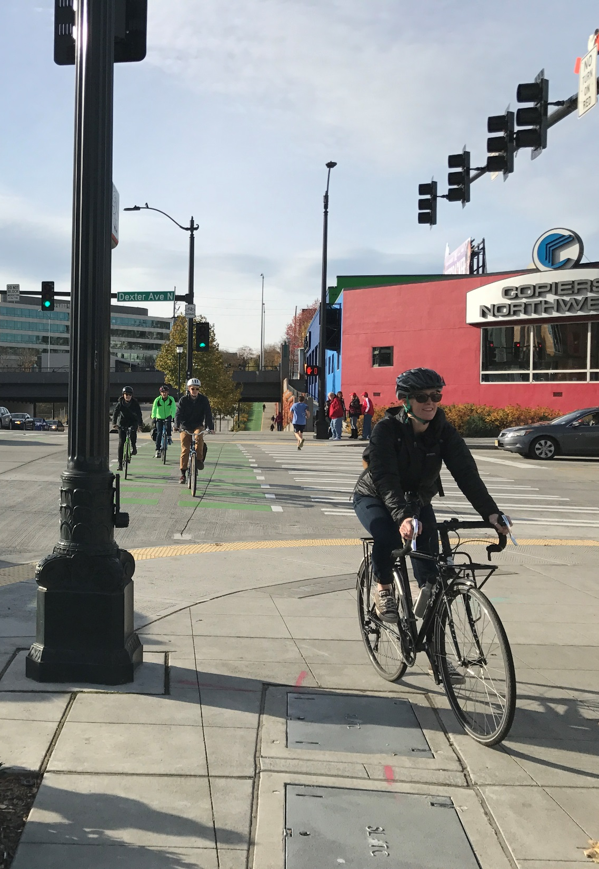
Overview
Project context
Key tasks
Guiding principles
Mobility needs
What we’ve heard
Next steps
2
Notes:
Let the audience know the purpose of your presentation (is it purely informational, are you seeking feedback, etc). Then walk them through what you’ll be covering.

Slide 3
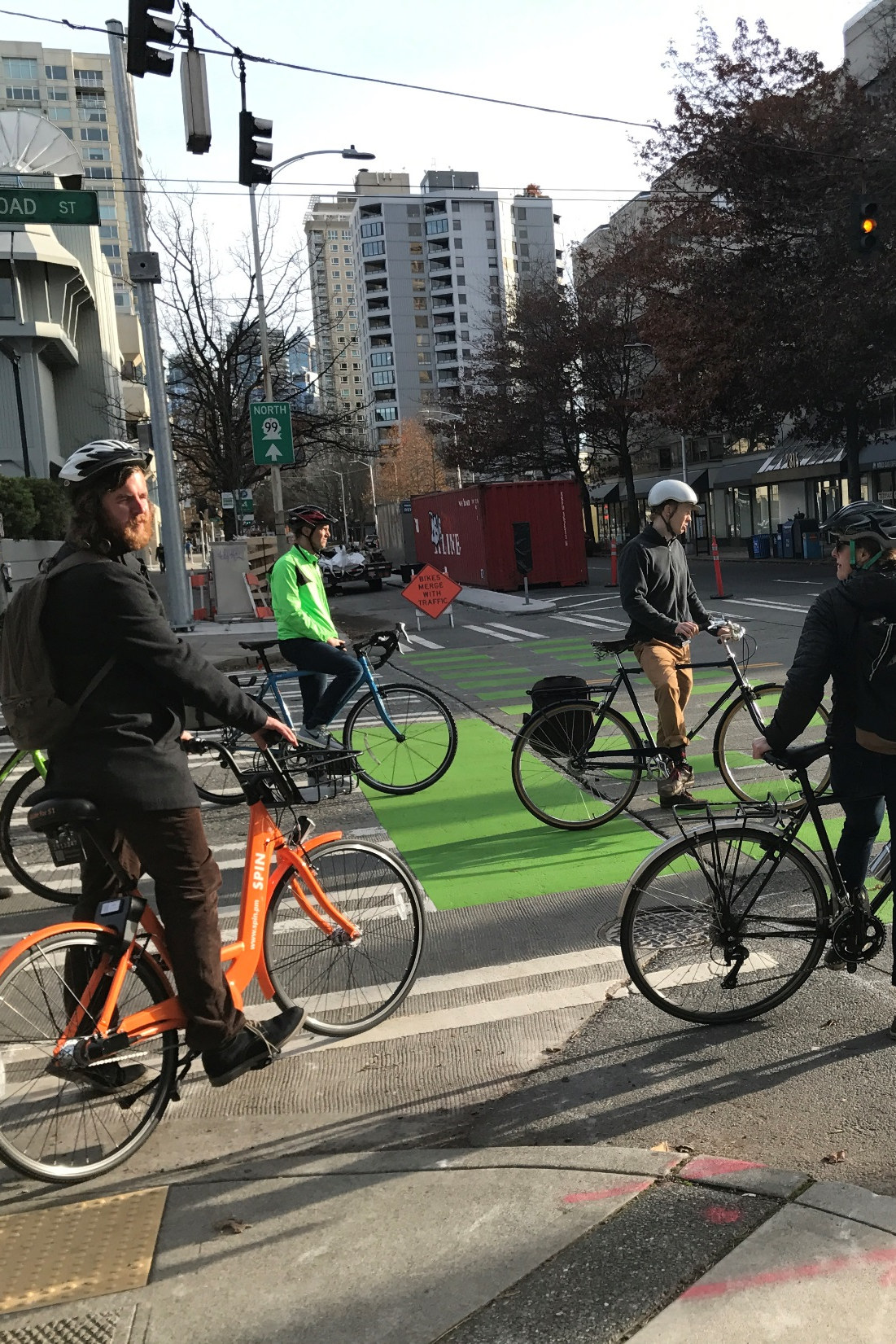
Goals
Support access to and mobility through North Downtown
Uptown, Belltown, and South Lake Union
Identify and prioritize transportation improvements for all modes
Build on existing community plans

Slide 4
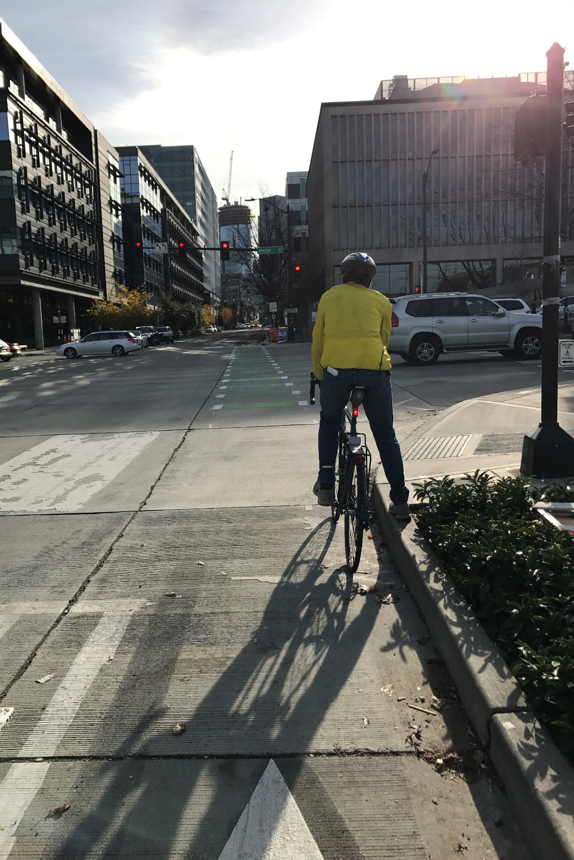
Project Need
Projected 23% growth in jobs and 60% growth in households by 2035 in Seattle’s Center City
$4B in permitting activity citywide in 2015
Transportation investments
Arena renovation
4
Notes:
Opportunity to build a thriving public realm and improve transportation options amid rapid growth

Slide 5
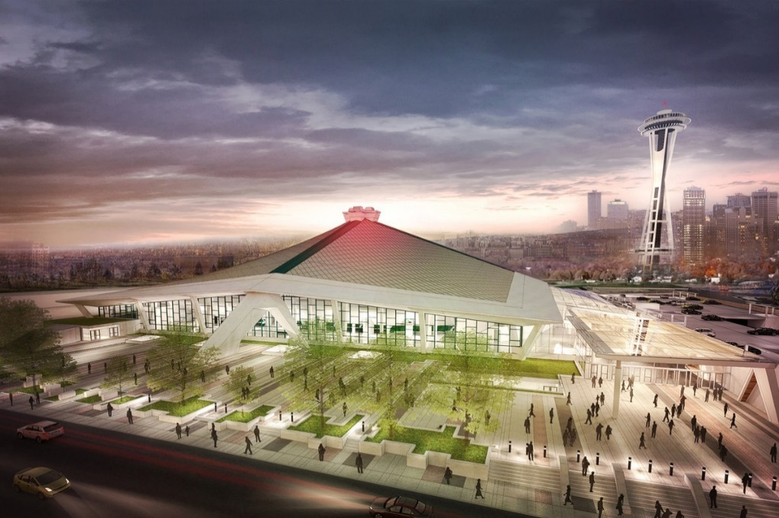
Context
One Center City
Near-term plan and 20-year vision for how we move through, connect to, and experience Seattle’s Center City
Arena EIS
Evaluates probable adverse environmental impacts from the renovation of the Seattle Center Arena and recommends ways to mitigate these impacts

Slide 6
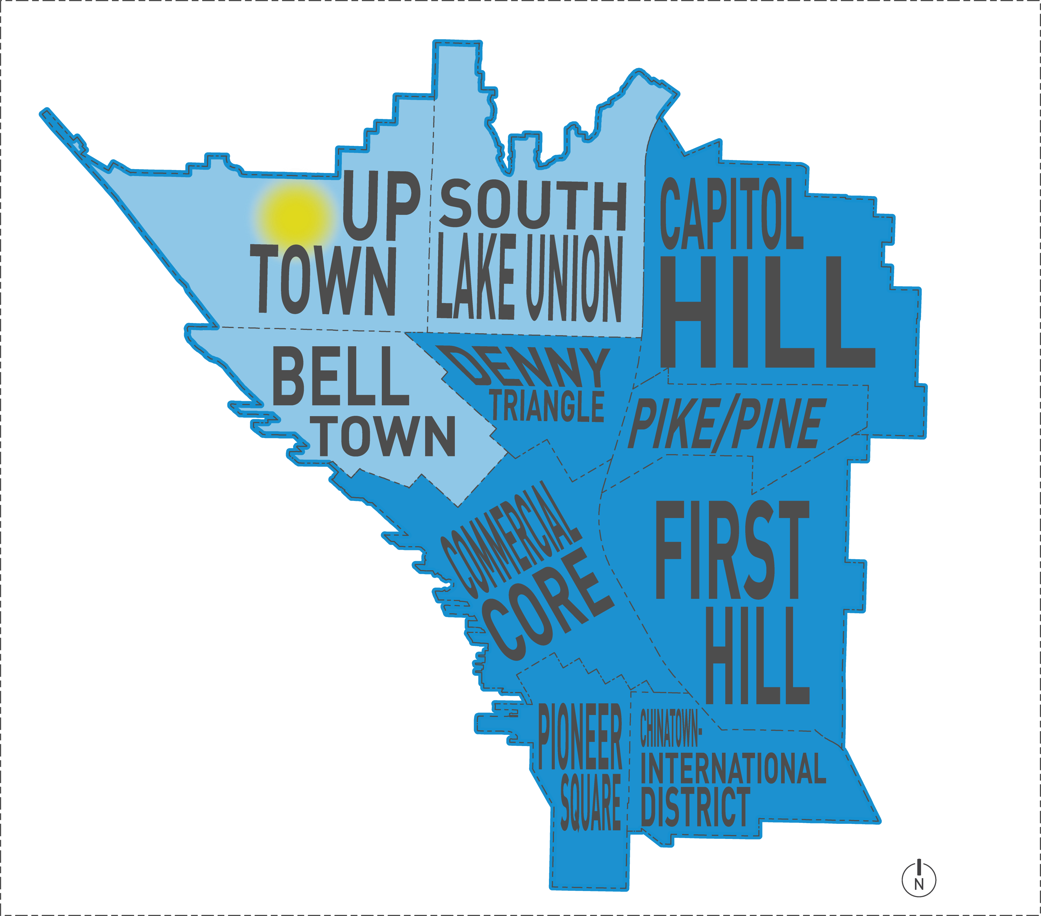
Study Area
6
Notes:
Synthesize and build on findings from previous projects
Analyze multimodal safety and access opportunities
Identify public realm improvements
Build a strategy to implement prioritized projects

Slide 7
Schedule
7

Slide 8
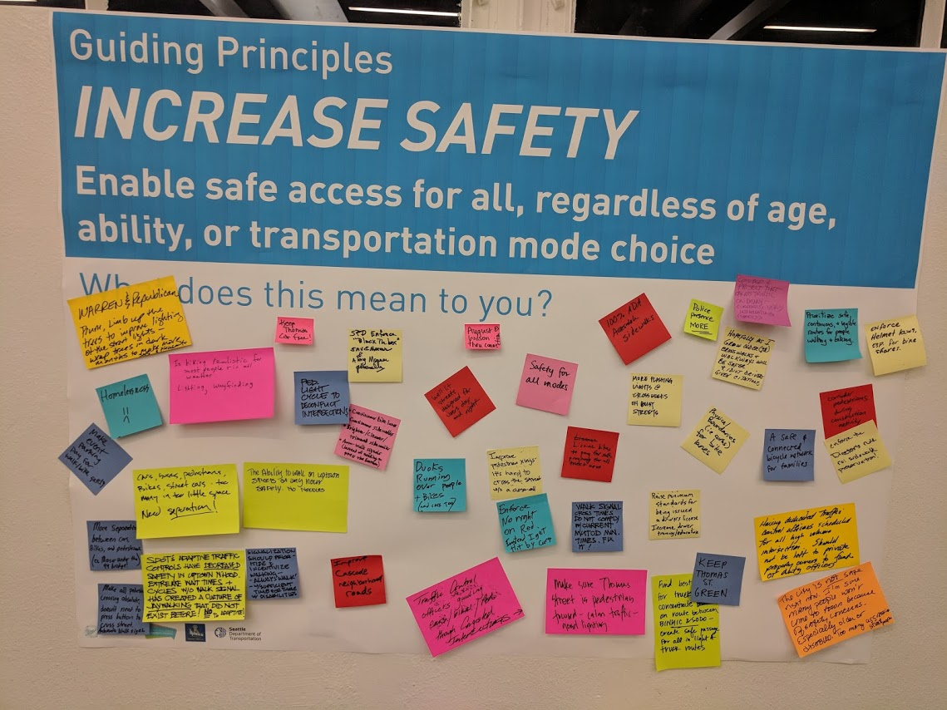
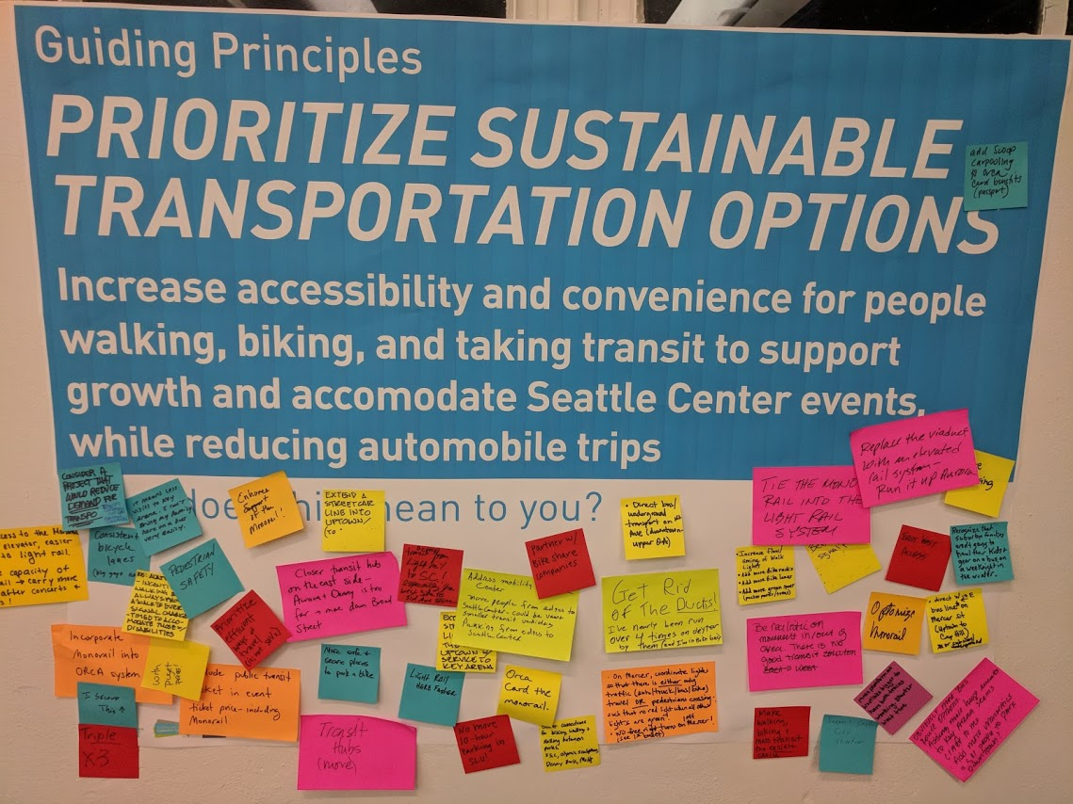
Guiding Principles
Build on community vision
Increase safety
Prioritize sustainable transportation options
Improve connectivity
Enhance the public realm

Slide 9
Build an evaluation framework

Slide 10
Mobility Needs
Support new east-west connections
Address freight needs
Improve pedestrian access across busy streets
Add all ages bicycling connections
Activate the public realm with green streets
10

Slide 11
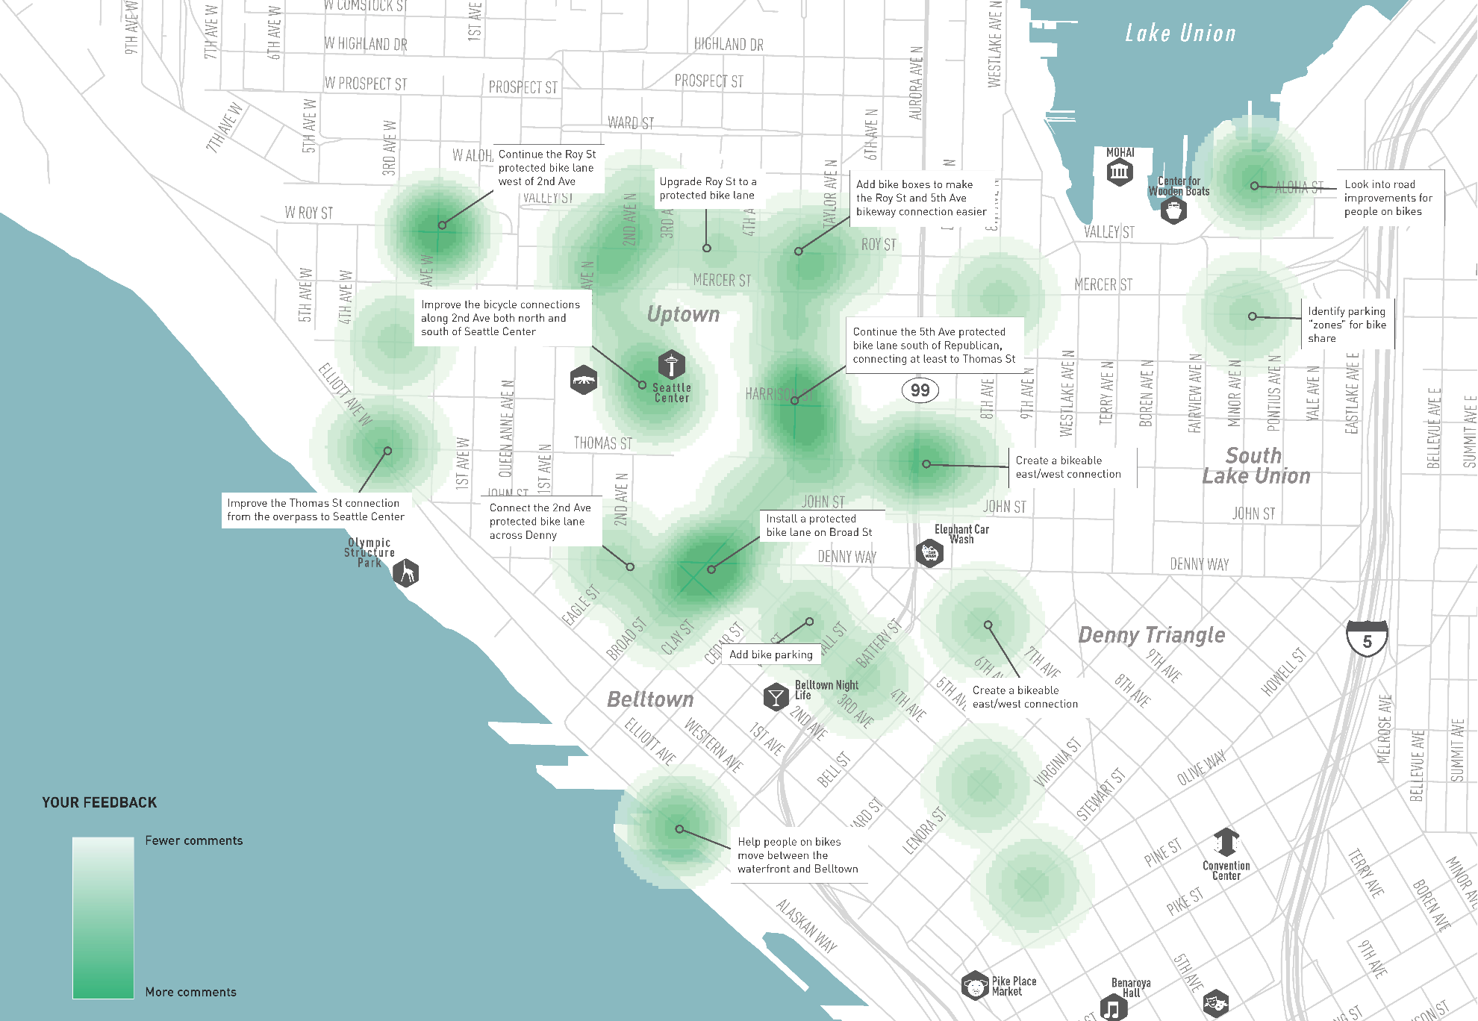
Identifying Gaps
11
Notes:
Let the audience know the purpose of your presentation (is it purely informational, are you seeking feedback, etc). Then walk them through what you’ll be covering.

Slide 12
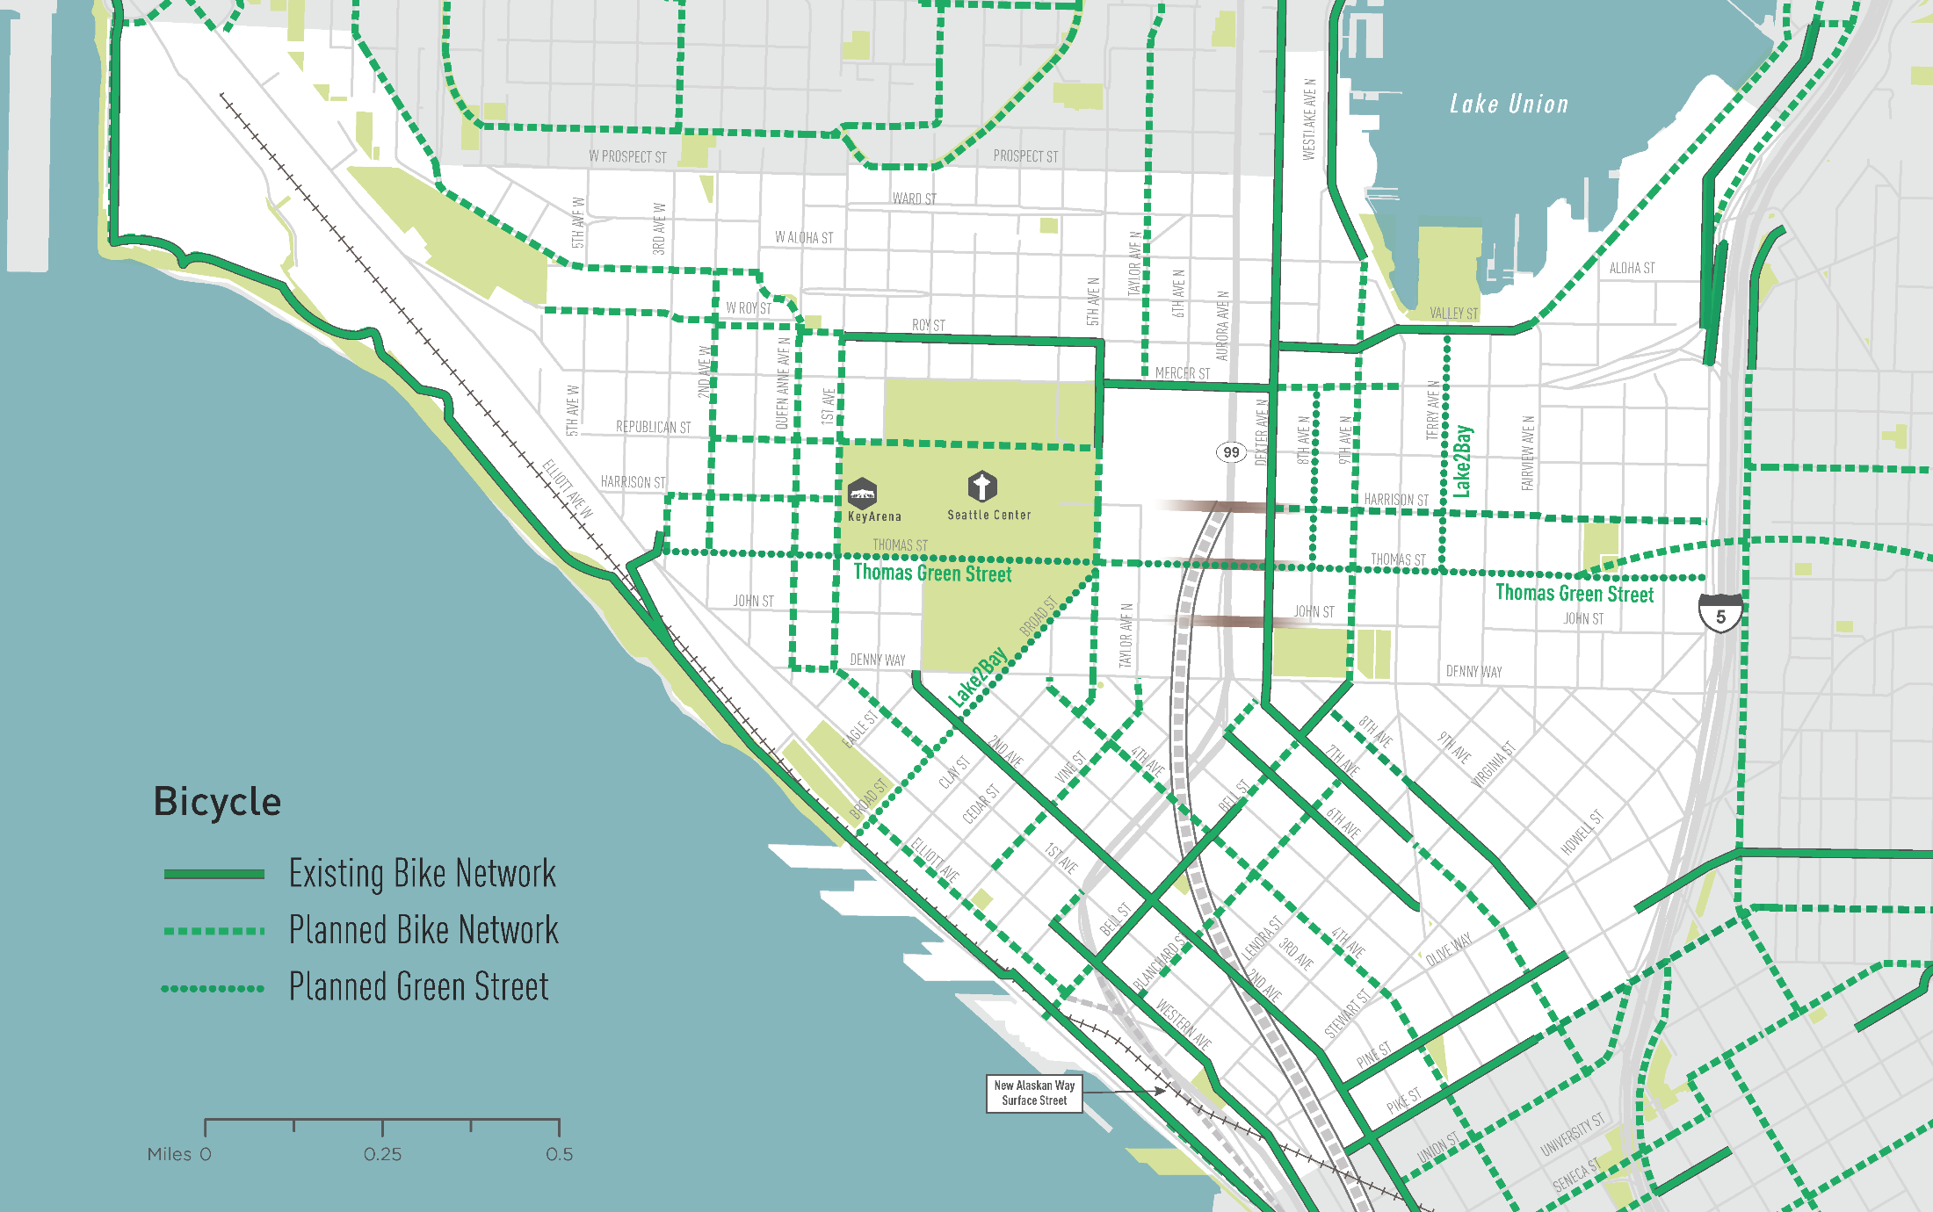
Identifying Gaps

Slide 13
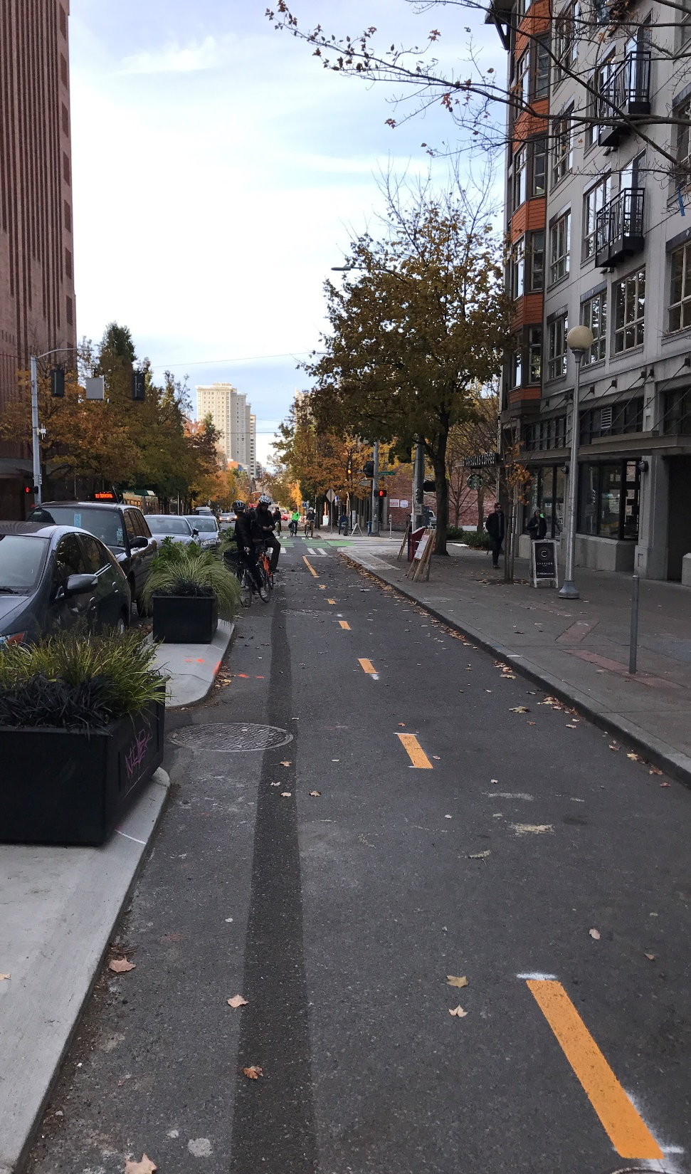
What we’ve heard
Improve/develop protected bicycle connections
W Mercer Pl
Roy St
5th Ave/Broad
Dexter Ave N to downtown
Bike lane/parking impacts
Bicycle wayfinding through Seattle Center
Thomas St – Green Street

Slide 14
What are your priorities?

Slide 15
Next Steps
Date | Activity/action
Dec/Jan | Finalize Evaluation Framework & Further Develop Analysis/Projects
Feb/March | Draft Project List*
April to June | Community Feedback & Refinement
July/August | Final Mobility Action Plan*
*Public meeting
15
Notes:
Insert a project timeline. Clarify the process and opportunities for engagement/feedback.

Slide 16
Questions?
northdowntown@seattle.gov | (206) 684-7576
http://www.seattle.gov/transportation/NODOMAP

