Slide 1
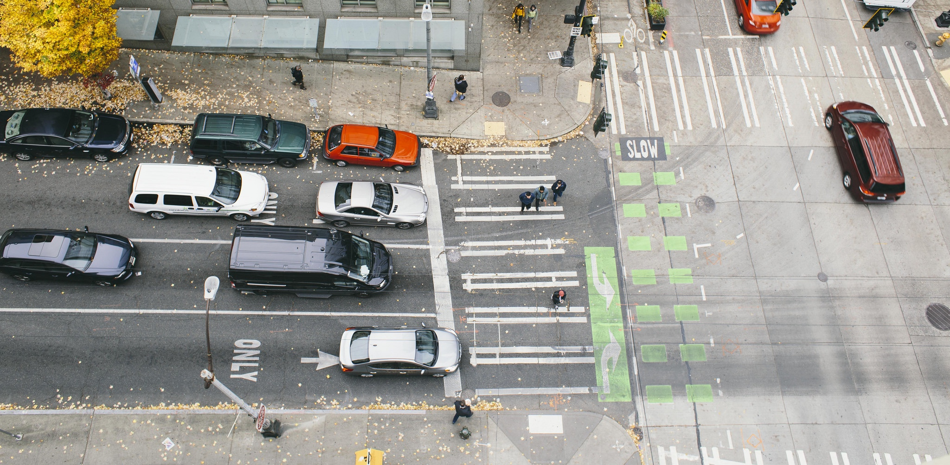
Policy & Operations Advisory Group
Kick-Off Meeting
Policy & Operations Advisory Group
Transportation Operations and Policy & Planning Divisions

Slide 2
Meeting overview
Background: SDOT policy and operations
POAG: group activity, purpose, agendas and topic look-ahead, expectations
Break
Introduction to Signals Operations
Wrap-up and next steps

Slide 3
Meeting format
We want to hear from you; we encourage you to chime in and participate; some meetings will have more time for open discussion
During presentations:
We will screenshare slides
Please stay on mute
If you want to chime in or have quick questions answered as we go, please use the chat function or raise hand function
Please say your name before you speak
If you are having technical difficulties, please use the chat or email ellie.smith@seattle.gov

Slide 4
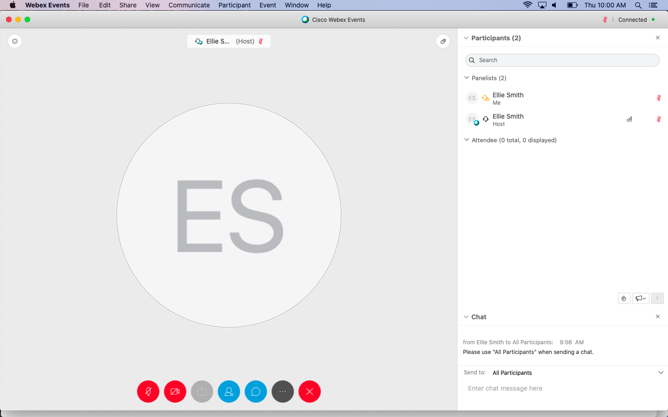

Slide 5
raise hand
mute/
unmute
video
chat

Slide 6
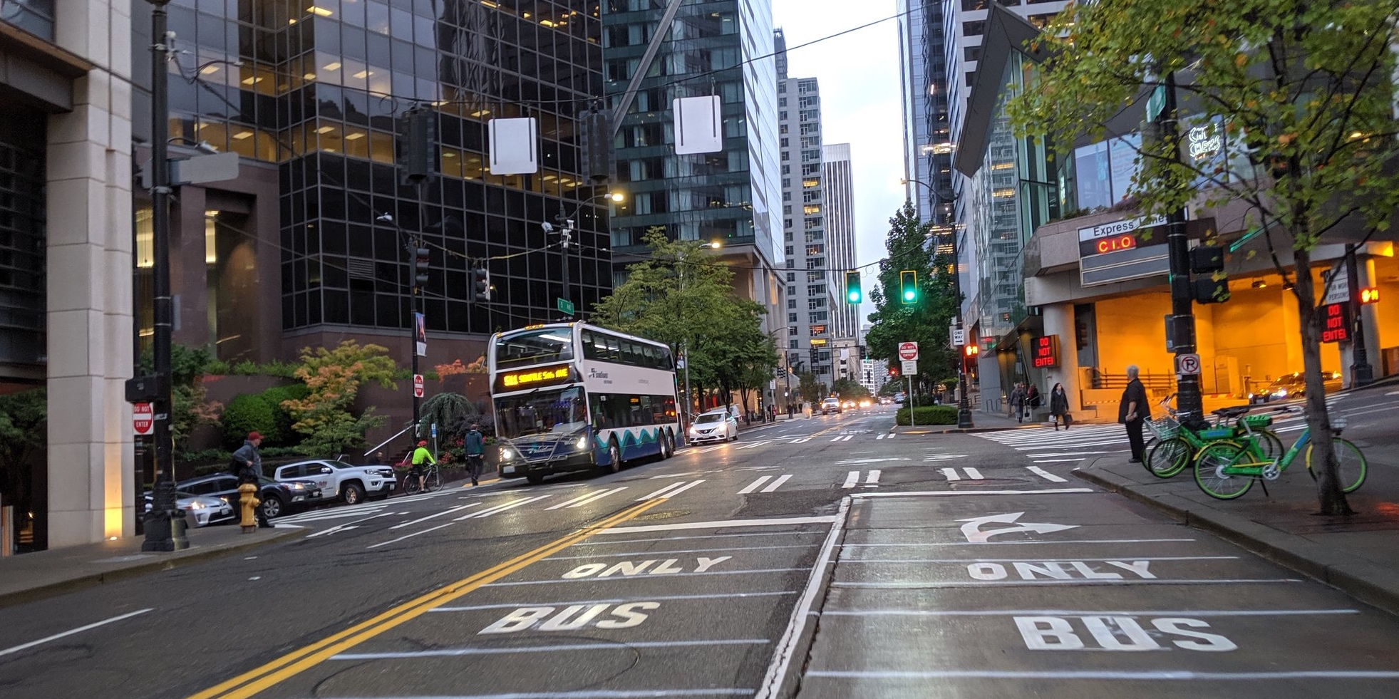
Background
Getting to know Seattle Department of Transportation.

Slide 7
Land acknowledgement
“I acknowledge that we all live, work, and gather on the traditional land and water of the first people of Seattle, the traditional and present home of the Central Coast Salish, the Duwamish, Suquamish, Tulalip and Muckleshoot people. We honor with gratitude the land and water itself and acknowledge the value that has been placed upon it by the work we do here today.”

Slide 8
Our vision and mission
Vision: Seattle is a thriving equitable community powered by dependable transportation
Mission: to deliver a transportation system that provides safe and affordable access to places and opportunities

Slide 9
Our core values and goals
EQUITY - We believe transportation must meet the needs of communities of color and those of all incomes, abilities, and ages. Our goal is to partner with our communities to build a racially equitable and socially just transportation system.
SAFETY - We believe everyone should be able to move safely throughout the city. Our goal is to create safe transportation environments and eliminate serious and fatal crashes in Seattle.
MOBILITY - We believe transportation choices are critical to access opportunity. Our goal is to build, operate, and maintain an accessible transportation system that reliably connects people, places, and goods.
SUSTAINABILITY - We believe environmental health should be improved for future generations through sustainable transportation. Our goal is to address the climate crisis through a sustainable, resilient transportation system.
LIVABILITY - We believe transportation is essential to support daily life. Our goal is to manage our streets and sidewalks to enrich public life and improve community health.
EXCELLENCE - We believe in exceeding the expectations of the communities we serve. Our goal is to build an SDOT team committed to excellence and equipped with skills to meet the challenges of today and tomorrow.

Slide 10
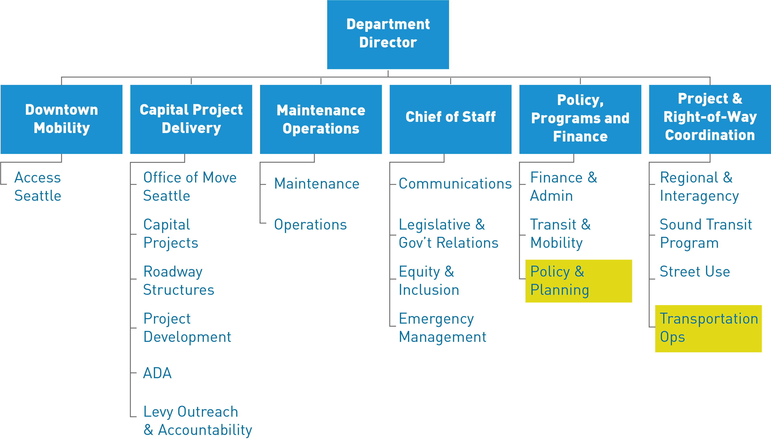
SDOT: who we are

Slide 11
Transportation Operations division
Transportation Operations Division: responsible for operation of the city's street system, including bicycle, pedestrian, freight, and transit facilities.
Design, install and operate traffic signals
Intelligent transportation systems
Conduct freight programs
Commercial vehicle enforcement
Administer permits for traffic, truck and parking
Review temporary traffic control plans for construction
Manage traffic data and records
Design signs and pavement markings
Coordinate special events in the public right of way

Slide 12
Policy & Planning division
Policy & Planning Division:
develops policies plans to improve mobility and access; transforms streets into inviting places; informs local and regional transportation investment decisions; and secures new funding
Transportation policy
Transportation planning (citywide and community)
Regional coordination
Urban design guidance for streets and public places
Capital planning and programming
Revenue development and grants

Slide 13
Current policy needs
Coordinate and consolidate our operational policies, with an emphasis on person movement and safety
Clarify our policy guidance for balancing competing modal priorities and access needs, particularly on constrained corridors
Establish a connection between modal priority within our modal plans and operations

Slide 14
POAG goals
Provide early input on policy development
Provide perspectives from many user groups reliant on the transportation network
Support SDOT management of a balanced, multimodal transportation network

Slide 15
Desired outcomes
Pedestrian signal operations policy
Traffic signal cycle time
Pedestrian signal timing
Pedestrian actuation

Slide 16
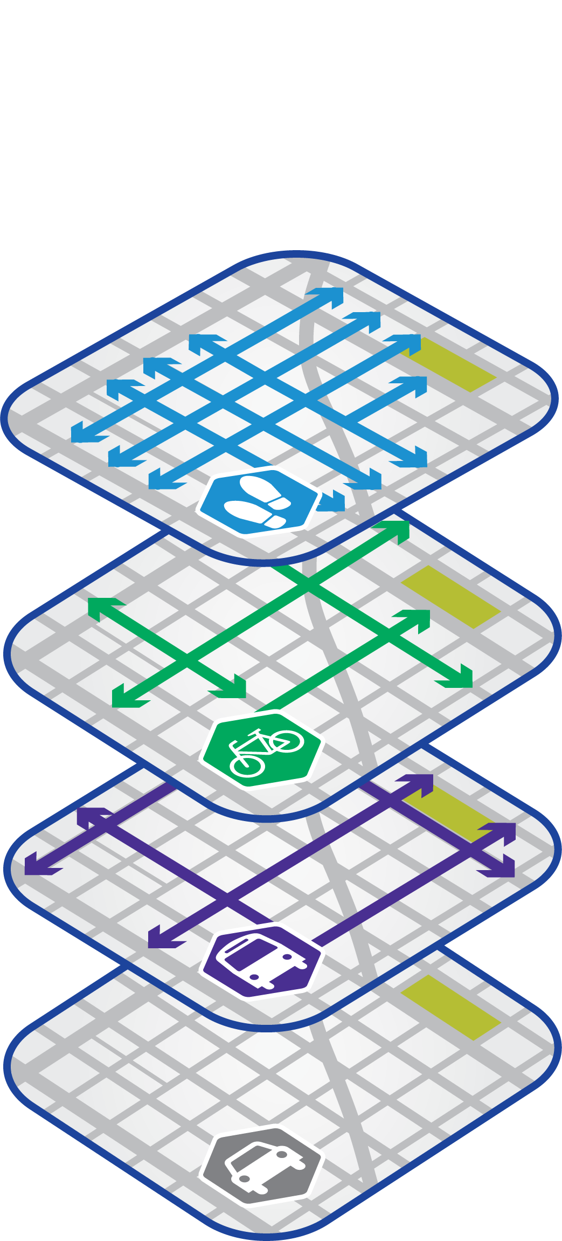
Desired outcomes (cont.)
Modal integration policy outcomes:
Comprehensive and network approach to our ROW
ROW allocation decisions independent of funding
Transparency, especially publicly, around our ROW allocation process
Connect our operational priorities to our modal priorities
Speed our project development process

Slide 17
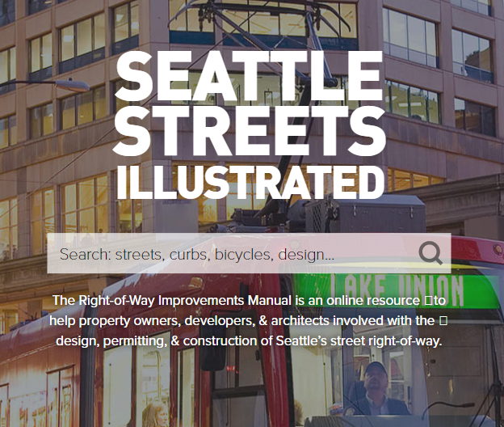
What could this lead to?
POAG inputs may contribute to revised policies and procedures
Seattle’s Comprehensive Plan updates
Streets Illustrated updates
Complete Streets ordinance update
At the end of 2020, SDOT will evaluate and report on the efficacy of POAG
POAG member input will be key to the evaluation
Evaluation will be based on ability to meet the POAG Goals

Slide 18
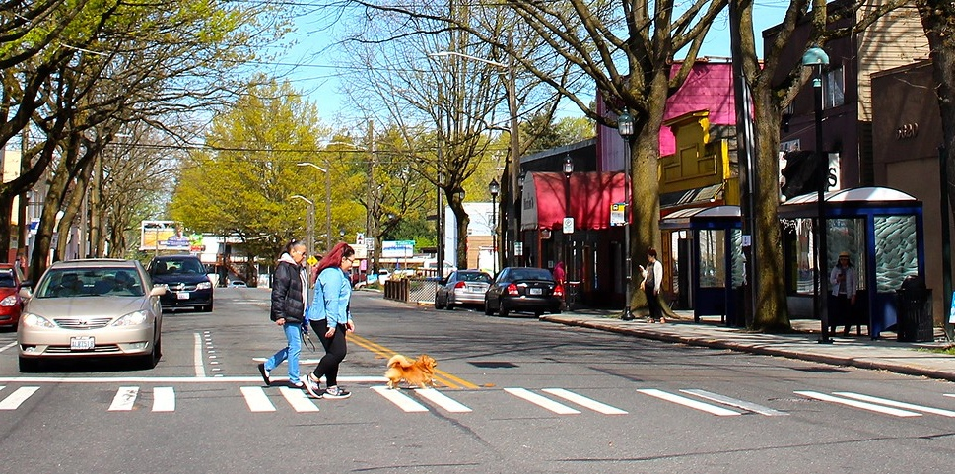
POAG
Policy & Operations Advisory Group

Slide 19
Role of POAG
Serve as a sounding board
Confer with respective constituent groups
Advise SDOT on integration of the various modal plans and related policy objectives
Learn about one another's interests, priorities, and concerns
Discuss current policies and how we analyze policies and evaluate tradeoffs
Contribute to development of draft policies for a balanced, multimodal transportation network

Slide 20
POAG roster
Board, Committee, or Commission | Members
Bike Advisory Board | Pierre Brunelle and Alexander Lew
Business Improvement Association | Mike Stewart (Ballard)
Freight Advisory Board | Warren Aakervik and Geri Poor
Pedestrian Access Advisory Committee | Dorene Cornwell and Steven Feher
Pedestrian Advisory Board | David Seater and Anna Zivarts
Planning Commission | David Goldberg and Grace Kim
Transit Advisory Board | Erin Tighe and Bryce Kolton
Transportation Equity Workgroup | Kiana Parker and Yordano Teferi

Slide 21
Introductions
How you would like to be addressed: name/nickname, pronoun
Neighborhood you call home
Questions
Name one thing, big or small, that has changed your outlook on life over the last few months?
What inspired you to be part of the POAG?

Slide 22
Introductions for SDOT staff
Transportation Operations
Adiam Emery – Division Director
Dusty Rasmussen – Signal Design & Field Operations Manager
Laura Wojcicki – Signal Operations Supervisor
Policy & Planning
Tracy Krawczyk– Division Director
Susan McLaughlin – Urban Design Manager
Jonathan Lewis – Transportation Planning Manager
Ellie Smith – Transportation Planner

Slide 23
Meeting schedule and draft topics
#1 – June 25
Kick-off
Introduction to signal operations
#2 – July 23
Draft Comprehensive Traffic Signal Operations Policy: presentation and discussion
Modal Integration: introduction
#3 – August 27
Draft Comprehensive Traffic Signal Operations Policy: continued discussion
Modal Integration: analysis
#4 – Sept 24
Modal Integration: draft policy options
#5 – Oct 22
Modal Integration: draft policy options and operational priority
#6 – date TBD
Modal Integration: policy recommendations and discussion
Wrap-up and reflections

Slide 24
Expectations of SDOT
SDOT staff will aim to send out agendas and other materials a week in advance of the meeting
Meetings will be facilitated by SDOT staff and consultants. Some topics will begin with an informational session to ensure all POAG members are on the same page
Meeting summaries from the prior meeting will be compiled by SDOT staff and distributed to the POAG in advance of the next meeting date
SDOT may record virtual meetings for the purposes of compiling notes after the fact, but will not be publishing meetings
Maintain webpage with information about the POAG, meeting agendas, and meeting summaries

Slide 25
Expectations of SDOT (cont.)
SDOT will make meetings available to the general public and publish information on the City calendar and POAG webpage
Any input relating to policies not on the POAG agenda will be referred to the appropriate SDOT resource or contact
Further SDOT policy development will follow normal SDOT practice for public outreach

Slide 26
Expectations of POAG members
Attend 6 meetings in 2020
Come prepared and ready to engage
Ask questions for clarification to help avoid making assumptions
Balance your participation – speak and listen
All voices count and all opinions are valid, offer reasoning behind your thinking
POAG members may choose to share information pertinent to the upcoming meeting topic with the group
E.g., examples from other cities, record of prior discussions with SDOT, studies, news reports
Please provide to SDOT at least one week prior to the meeting for distribution

Slide 27
Expectations of POAG members
Serve as conduit between this group and your respective boards, committees, and networks; inform them of the topics discussed here, and communicate their feedback to us, as appropriate
You are not required to achieve consensus when providing input to SDOT. If consensus is not reached, perspectives will be documented in the meeting summaries

Slide 28
Break

Slide 29
Introduction to Signal Operations

Slide 30
Purpose
Role of traffic signals
Background
Explain our current practices and discuss future policy update

Slide 31
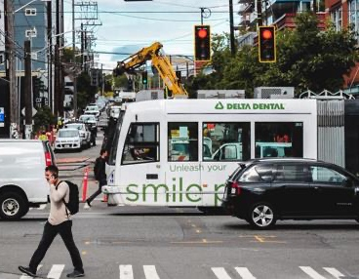
Role of traffic signals
Provide orderly movement of people driving, riding, rolling and walking
Reduce frequency and severity of certain types of crashes
Help to manage travel speeds along a given route
Interrupt travel flow where streets cross, creating regular and reliable crossing opportunities

Slide 32
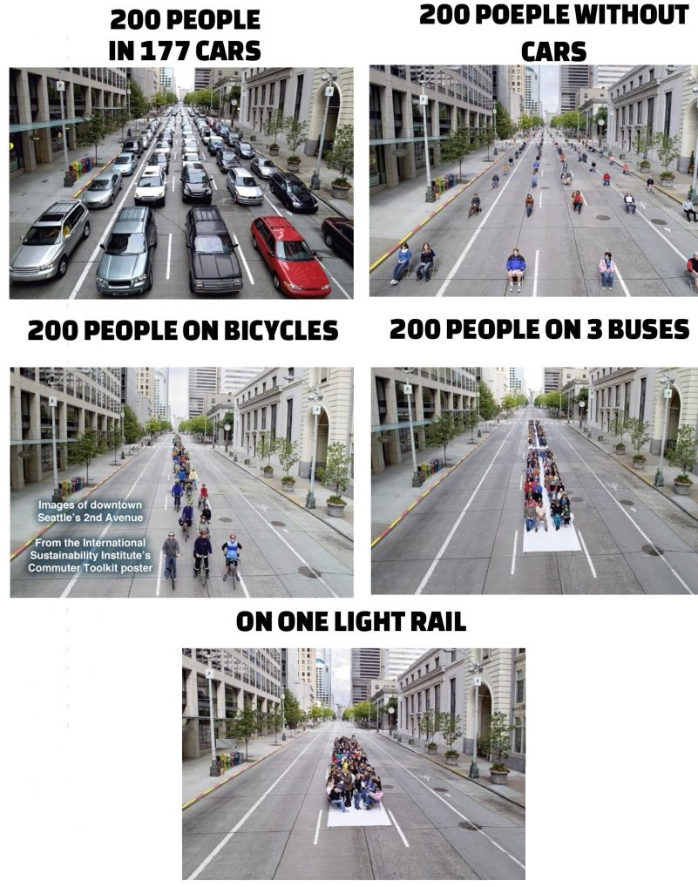
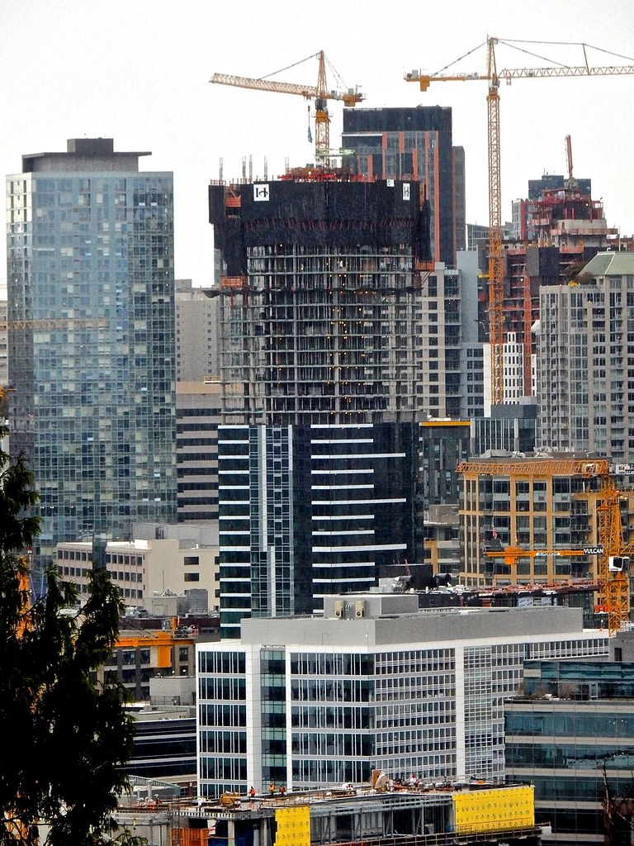
Growth Congestion & Capacity
Signal Ops background

Slide 33
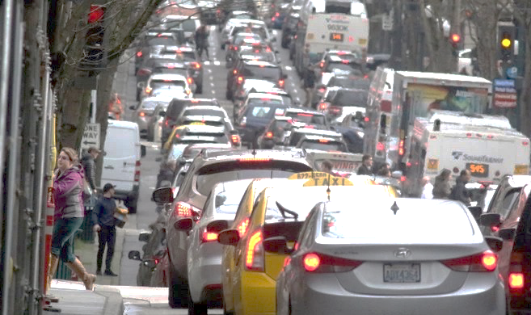
Revisiting our policies
Historic Practice:
Move vehicles and goods as safe and efficiently as possible
Provide opportunity for pedestrian access
Current and Updated Practice:
Understanding recurring congestion
Focused on moving people within multimodal operations
Inclusive, people focused with equitable opportunity and access for all user

Slide 34
Signal essentials: operations and phasing
Signal operations provides order in a multimodal environment

Slide 35
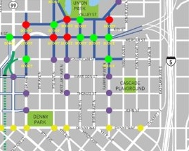
Types of signal operations
Adaptive
Signals respond in real time to detected changes in traffic conditions.
Coordinated
Signals are timed with respect to other signals in a corridor or network.
Isolated
Signals operate alone and do not consider other intersections.

Slide 36
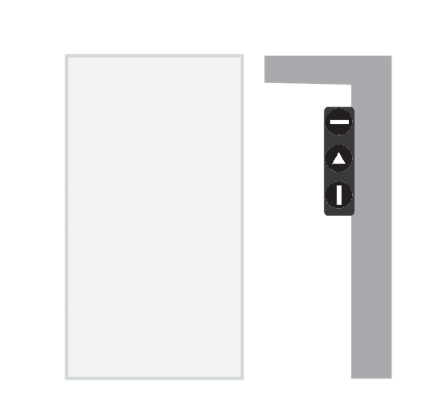
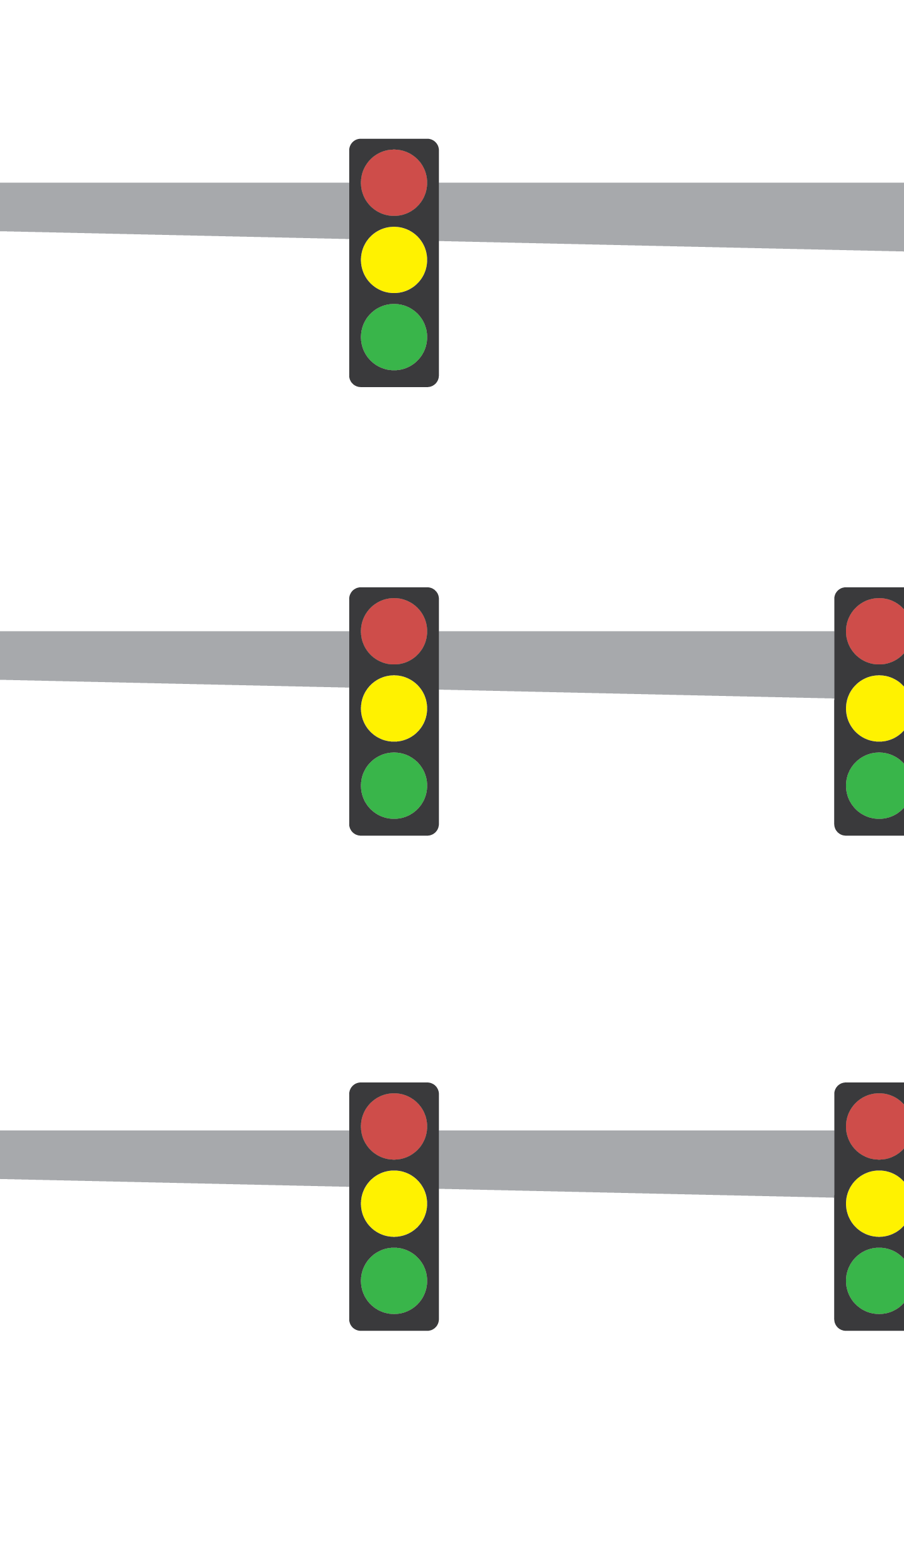
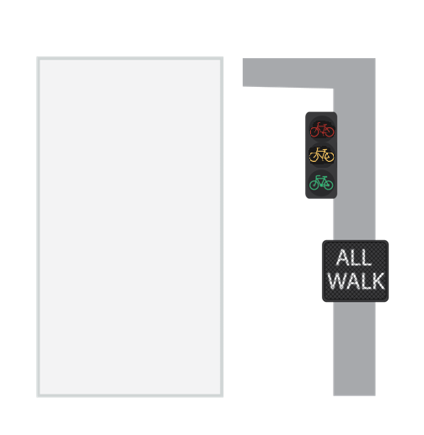
Types of signal phasing
Signal Indications
Transit Priority Signal
Permitted
Permitted, Protected-Permitted, or Protected (flashing yellow) Note: Controller can implement any of the three phasing types depending on traffic cond.
Bike Phase
Pedestrian Phase
Protected

Slide 37
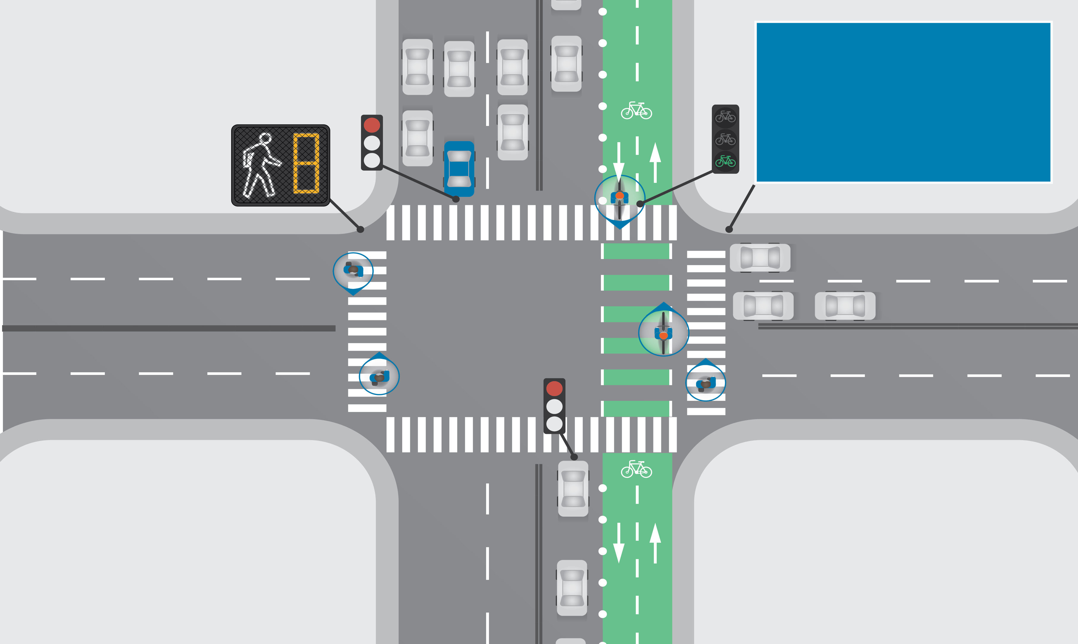
Types of signal phasing
Bike and Ped Only Phases/Leading Intervals
Leading pedestrian intervals (LPI) give people walking a head start before drivers get a green phase

Slide 38
Moving people, actuation, and timing signals
Timing is very important when it comes to transportation safety.

Slide 39
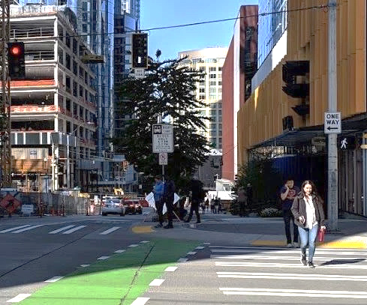
Pedestrian signal timing
Importance:
Key to access, opportunity, and mobility when walking
Streets should not be barriers for anyone
Create an inclusive environment that provides safe opportunity for all people to cross

Slide 40
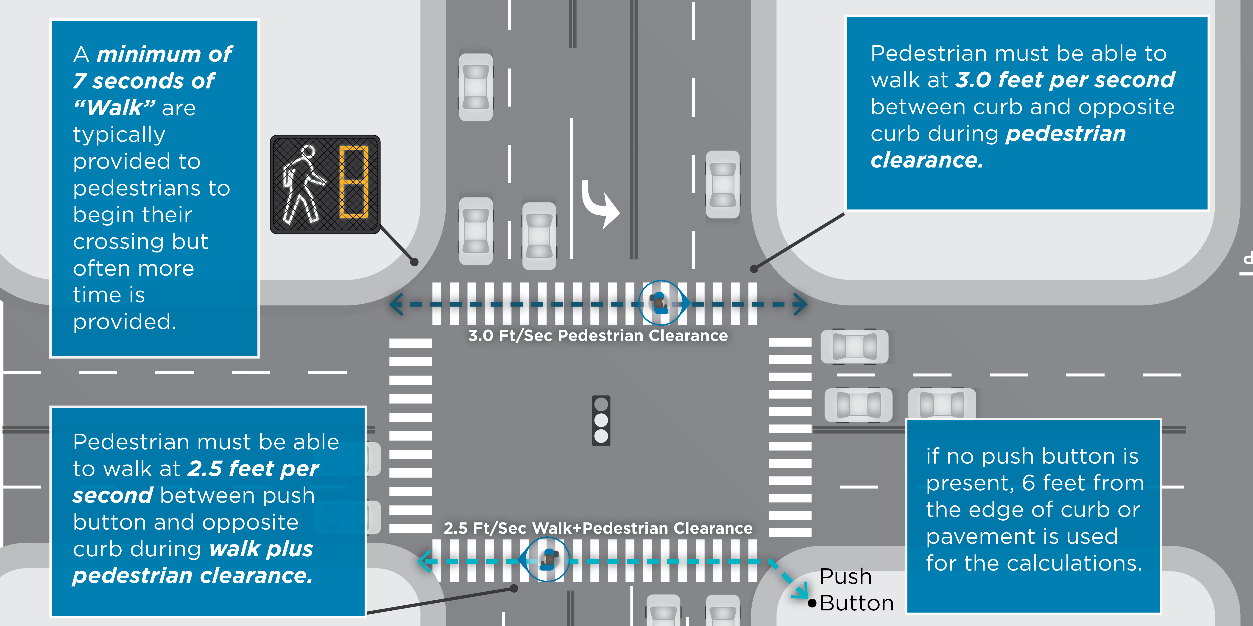
Calculating pedestrian crossing time
Calculating pedestrian crossing

Slide 41
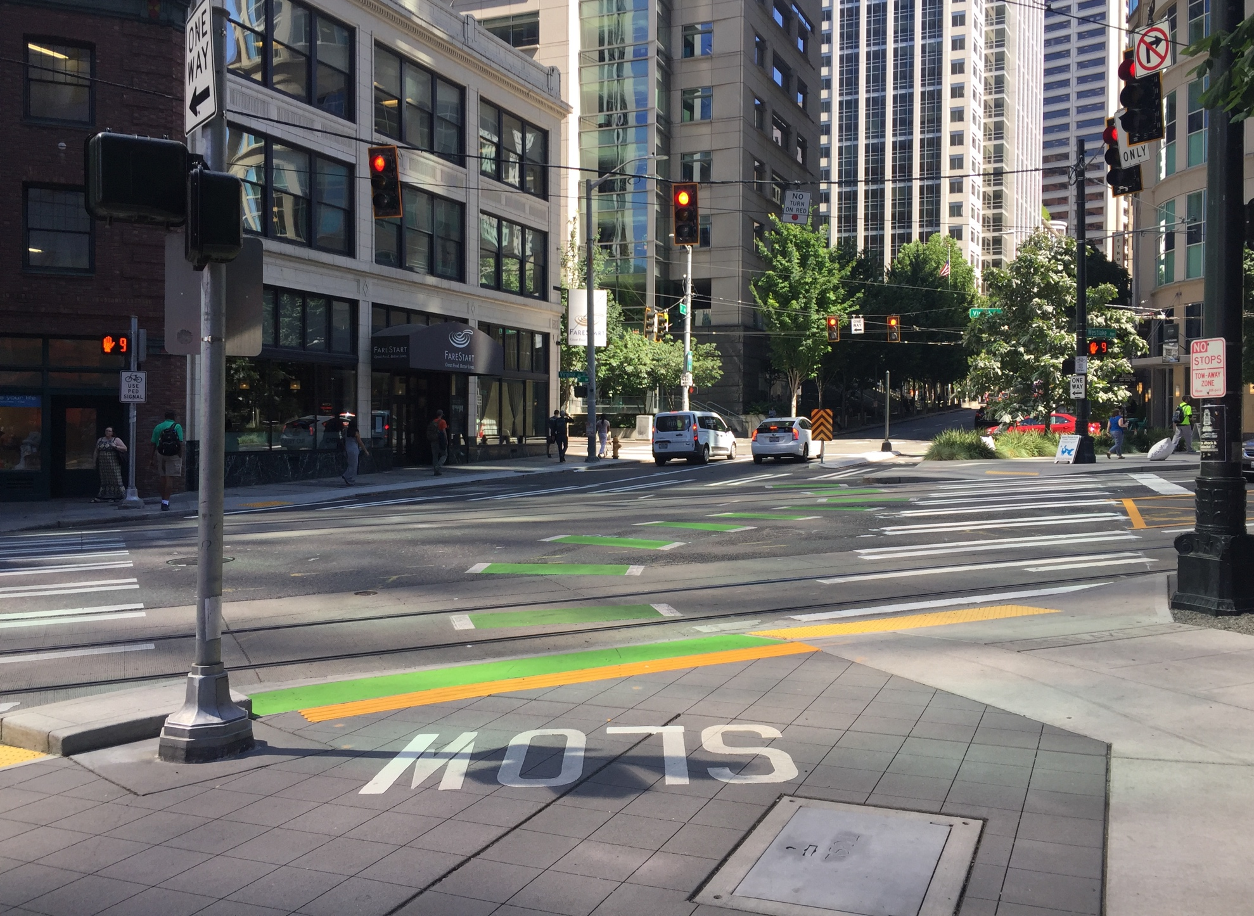
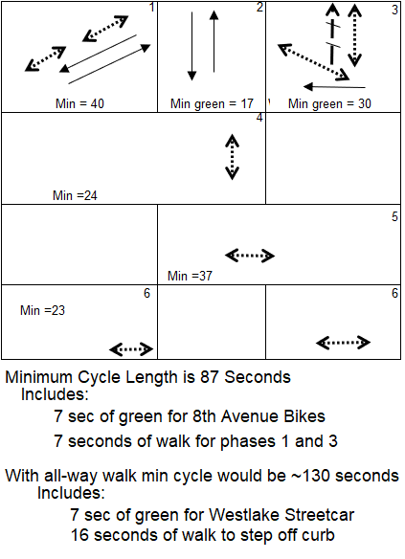
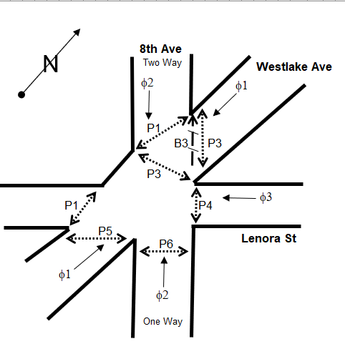
Example and tradeoffs
8th Ave, Westlake Ave & Lenora St

Slide 42
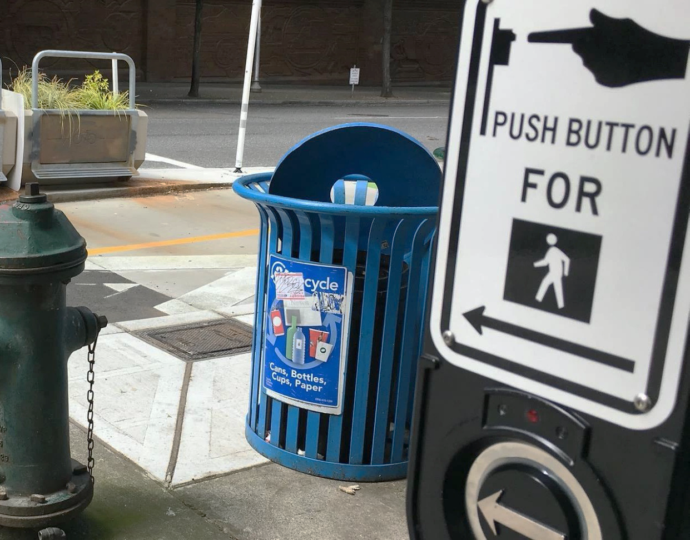
Pedestrian signal actuation
Actuation definition: Activation of a specific detection device; for pedestrians, typically a push button.
Pedestrian recall definition: pedestrian signal (walk and pedestrian clearance) come up automatically, without input.

Slide 43
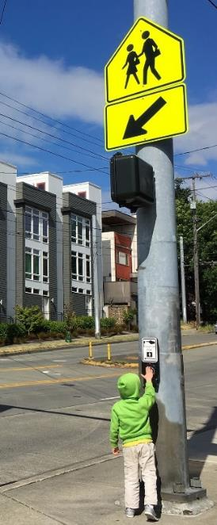
Pedestrian signal actuation
Importance:
Allows for coordinated operations along transit priority corridors while providing access, opportunity and mobility crossing arterials
Creates an inclusive environment that provides safe opportunity for all people to cross
Allows for more efficient operations where pedestrian volumes are low

Slide 44
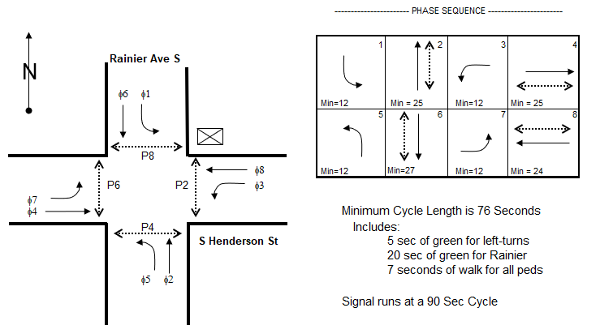
Rainier Ave S example and tradeoffs

Slide 45
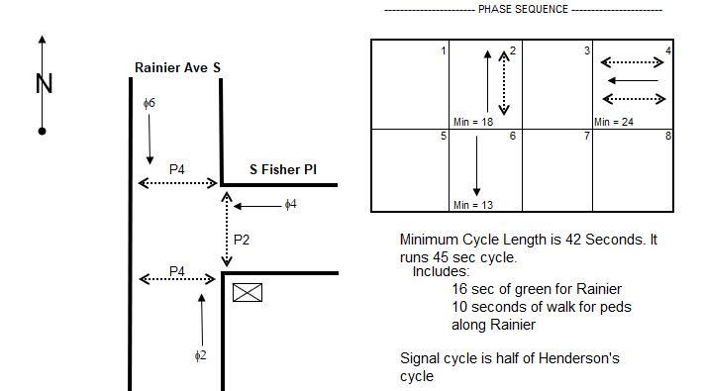
Rainier Ave S example and tradeoffs

Slide 46
Pedestrian signal actuation
Reasons to use pedestrian actuation | Reasons to use pedestrian recall
Allows flexibility and efficient operations for locations with low pedestrian volumes | Provides consistent operations, cycle to cycle
Can result in reduced delay for all users including people walking and biking. | Ensures that the pedestrian walk will be displayed will always be displayed even when someone does not push the button
Provides priority for people traveling along the main street, which often has greater volumes of vehicles and pedestrians | Prioritized pedestrians in Urban Centers with high pedestrian volumes

Slide 47
Signal systems and cycle length
Different systems allow us to be flexible in operations while providing efficient mobility and ensuring safety

Slide 48
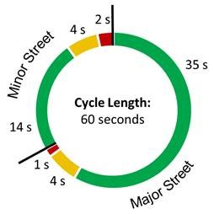
Cycle length
Cycle Length—the time required to complete one entire sequence of signal indications for all movements
Our typical cycle lengths range from 60 to 120 seconds
Importance:
Allows for prioritization of movements
Dictates delay for people crossing streets
Allows for exclusive movements (turning, bicycle, transit, etc.)

Slide 49
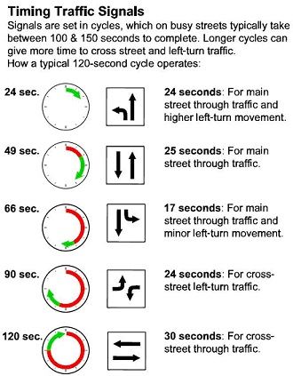
Cycle length
Key factors:
Width of intersections and pedestrian crossing time
Number of protected movements and separate phases
Multiple phase intersections typically require long cycle lengths
Two phase intersections can usually run short cycle lengths

Slide 50
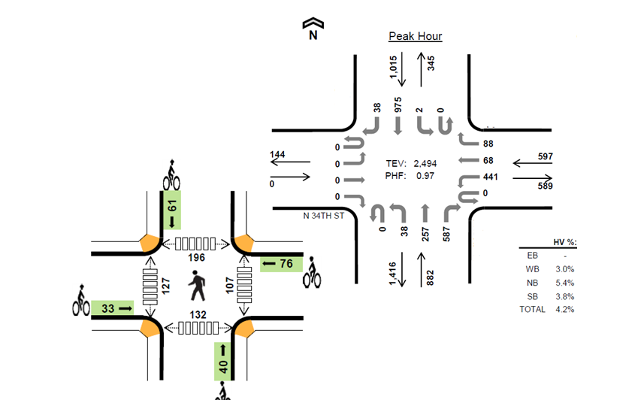
How we time traffic signals
Establish user and modal priorities
Identify operational objectives and performance measures​
Collect data

Slide 51
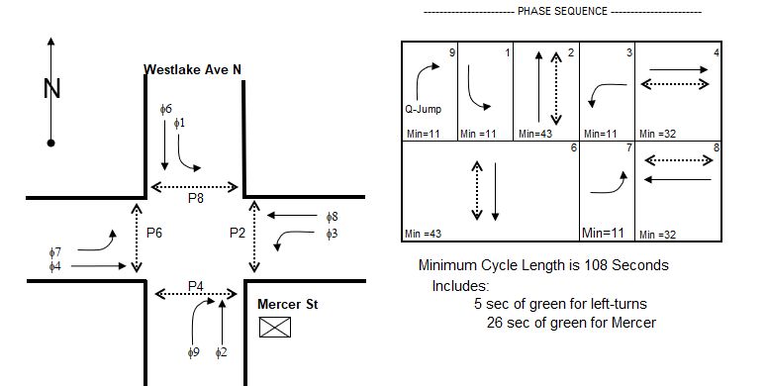
Mercer St example and trade offs

Slide 52
Develop intersection/corridor timing
Determine desired operations
Determine cycle lengths
Develop timing for each movement
Coordinate signals
Observe and adjust

Slide 53
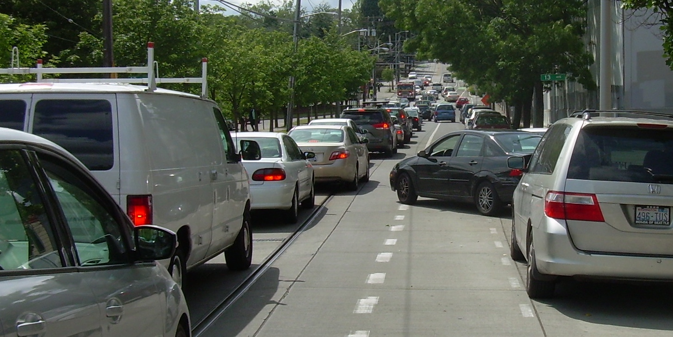
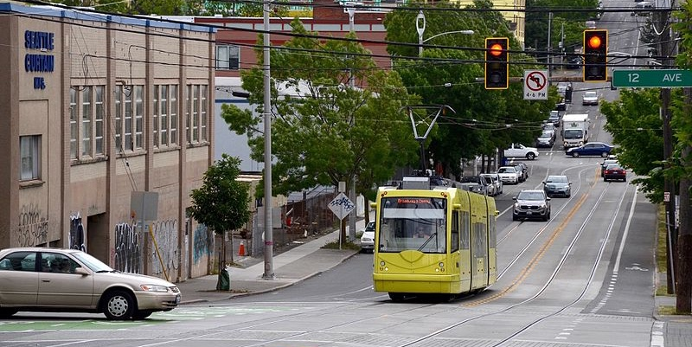
12th Ave & Yesler Way example
Current Signal Operations:
Two phases with pedestrian recall
Bike lanes and streetcar on Yesler
Near an Elementary School
High Collision Location WB LT vs Bikes and Peds
No space for left-turn pockets on Yesler (streetcar)
Closely spaced signalized intersections

Slide 54
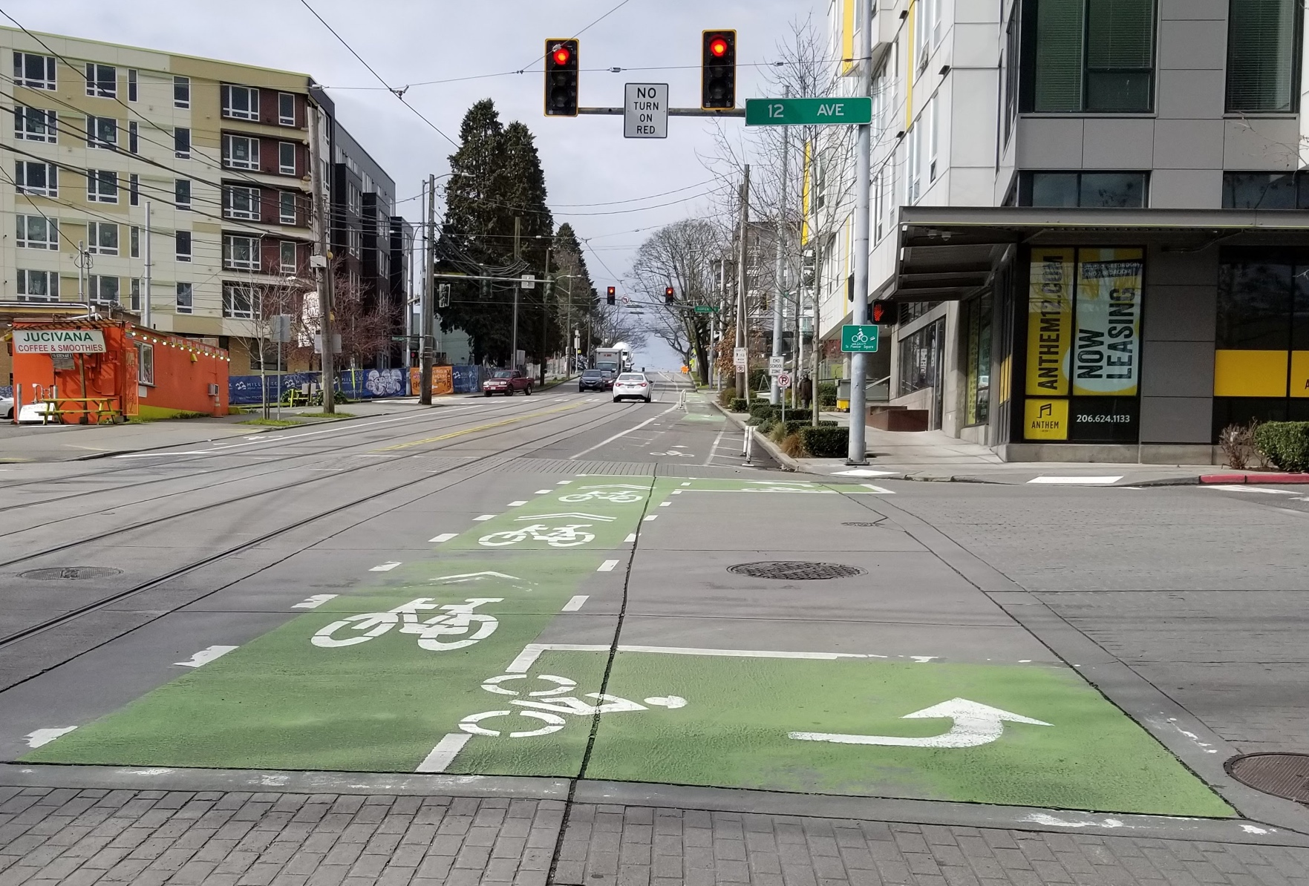
12th Ave & Yesler Way example
Potential Signal Operations:
Protect eastbound and westbound left-turns
Benefits:
Separates the left-turns from opposing traffic and pedestrians and bikes
Challenges:
Only one eastbound and westbound lane (no left-turn pockets)
Requires split phased operations

Slide 55
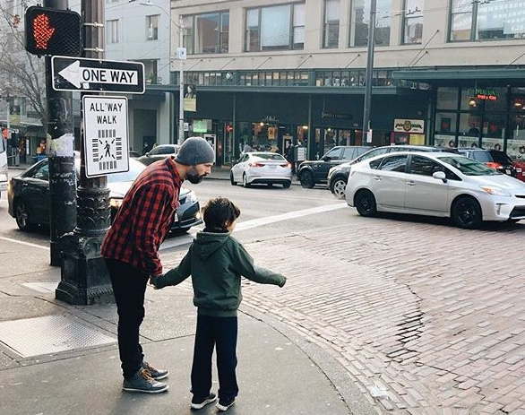
Next Steps
Provide Draft Signal Policy to POAG prior to Meeting 2
POAG Meeting 2:
Present Draft Signal Policy update
Conversation with Group
Opportunity to ask clarifying questions
POAG Meeting 3:
Present and finalize signal policy
Discussion with Group

Slide 56
Questions?
ellie.smith@seattle.gov | (206) 300-1690
www.seattle.gov/transportation

