Slide 1
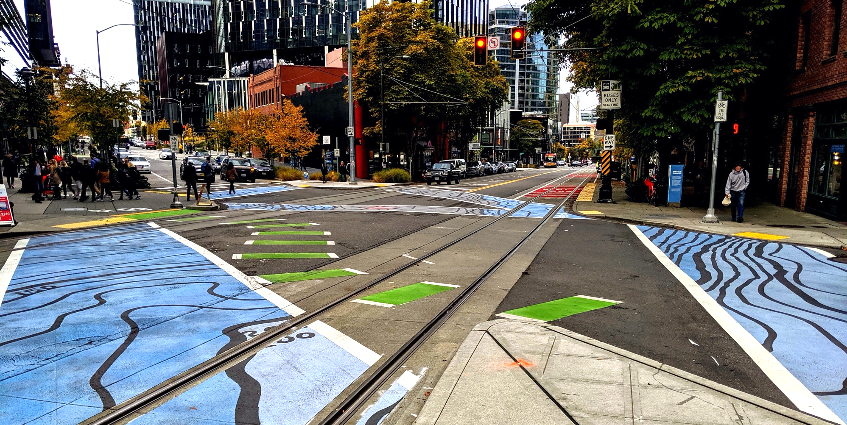
Policy & Operations Advisory Group
Policy & Operations Advisory Group
Transportation Operations and Policy & Planning Divisions

Slide 2
Meeting overview
Welcome and re-introductions
Modal integration: approach and recommendations
Modal integration policy
Modal integration: report and next steps

Slide 3
Meeting format
We want to hear from you; we encourage you to chime in and participate; some meetings will have more time for open discussion
During presentations:
  We will screenshare slides
  Please stay on mute
  If you want to chime in or have quick questions answered as we go, please use the chat function (send to "all participants" or "all panelists") or raise hand function
Please say your name before you speak
If you are having technical difficulties, please use the chat or email ellie.smith@seattle.gov

Slide 4
Re-introductions
Name
Organization you represent

Slide 5
POAG roster
Members
Warren Aakervik | Emily Mannetti
Dorene Cornwell | Kiana Parker
Steven Feher | Geri Poor
David Goldberg | Mike Stewart
Grace Kim | Yordanos Teferi
Bryce Kolton | Erin Tighe
Alexander Lew | Anna Zivarts

Slide 6
Meeting objectives
Clarify role of the Modal Integration Policy in the planning and project delivery process
Gain common understanding of right-of-way deficiencies and discuss draft policy concepts
Discuss near-term and longer-term implementation strategies for modal integration
Discuss next steps

Slide 7
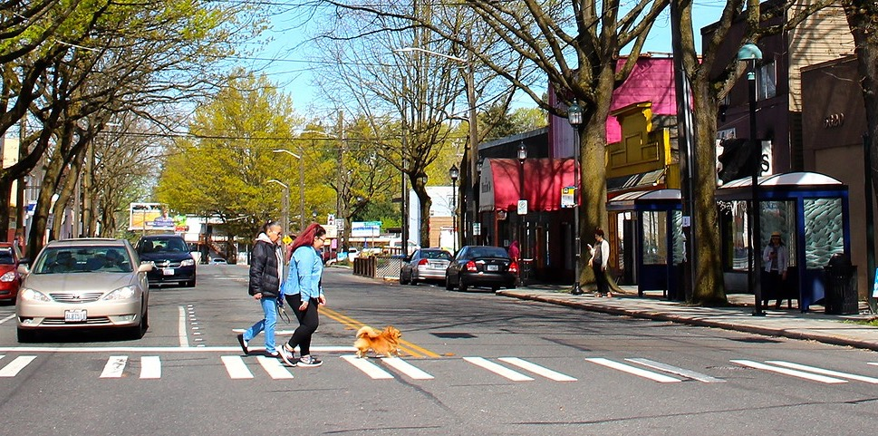
Modal Integration:
Approach & Overview of Recommendations

Slide 8
Where we've been
Developed outcome statements
Mapped modal priority networks
Identified right-of-way deficiencies
Developed draft policy concepts to address deficiencies
Truth tested application of policies on deficient segments

Slide 9
What we've heard from the POAG
Modal priority considerations​
Address modes not included in modal networks (e.g., personal vehicles) and space dedicated to general purpose traffic
Transit travel time and reliability is a key priority
While useful, the urban center framework has limitations
  Freight access to key destinations and major highways from MICs is critical
  Pedestrian access citywide is critical
Scope and approach
Be clear how this work supports City goals including equity, sustainability, and livability
Beyond technical details, collect and consider input on how this policy will impact people
Ensure there is sufficient opportunity for input from all communities to update modal networks, consistent with racial equity analysis

Slide 10
Racial equity analysis
The basis for our work is the modal plans and networks, which considered equity within their development. The modal plans, however, were focused primarily on priority network development and modal goals, rather than community mobility needs.
Policy development has consisted of a technical analysis to inform the integration of the existing modal networks, with an end goal of ensuring network integrity.
When considering equity in this work, we have felt it is inappropriate for us to make assumptions about how underserved communities would benefit from prioritization decisions for right-of-way allocation without having further community conversations
Time and effort are needed to authentically work with communities to focus on community mobility needs and affect equitable transportation outcomes, as well as create integrated modal networks.

Slide 11
Where we’re headed
Preparing policy framework and implementing actions report (Q1 2021)
to describe policy framework to resolve right-of-way conflict, along with recommended actions to operationalize the policy
Near-term – internal tools and process improvement
  Policy framework for resolving modal conflicts
  Modal conflict map
  Outreach tools to support community conversations
  Flex zone change guidance
Longer-term
Integrate 4 modal plans within a Citywide Transportation Plan

Slide 12
Near-term implementation: policy
  Complete interim policy framework to inform ROW allocation decisions to resolve deficiencies
    Modal integration policies
    Pedestrian-first Urban Village/Urban Center policy
    Bus-only lane policy
    Freight-only lane policy
    Bike priority segments

Slide 13
Near-term implementation: project development
  Develop modal conflict map and proposed solutions by applying policy framework
    In-house tool for project development purposes
  Develop outreach tools to support community conversations
    Create storytelling materials to connect Comprehensive Plan policies to individual projects
  Prepare curbside/flex zone change guidance

Slide 14
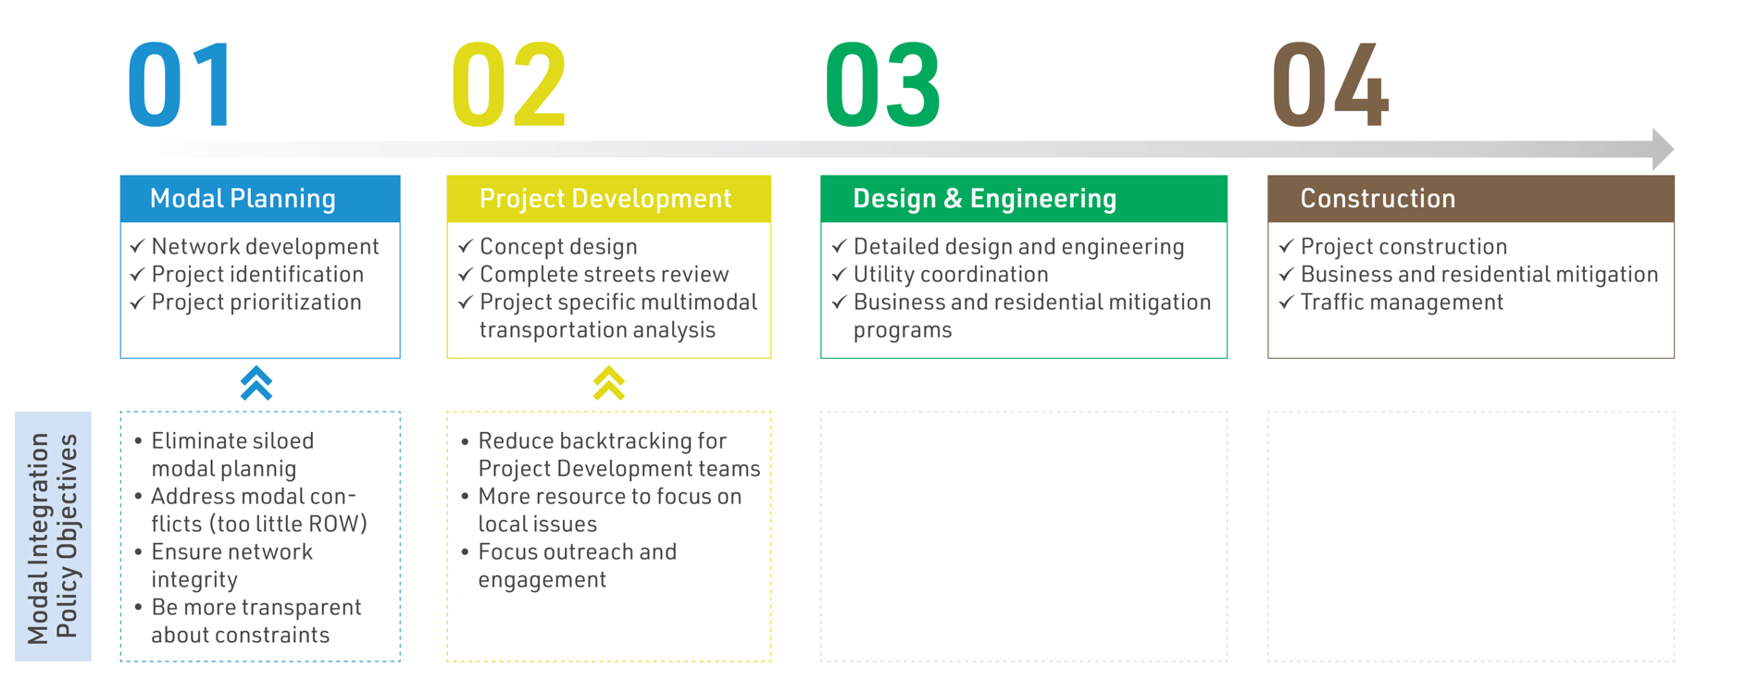
Current SDOT project development process
Proposed steps to resolve modal conflicts early
Notes:
I don't understand what is meant by the first 2 bullets here.

Slide 15
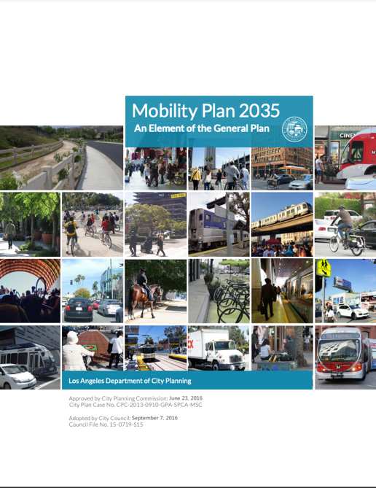
Longer-term implementation actions
Integrate 4 modal plans within a Citywide Transportation Plan
  Leverage 2024 Comprehensive Plan update
  Engage in a community conversation around mobility and public space needs
  Combine four modal master plan and integrated policy framework
  Prepare for next transportation levy
    This action is dependent on identifying resources

Slide 16
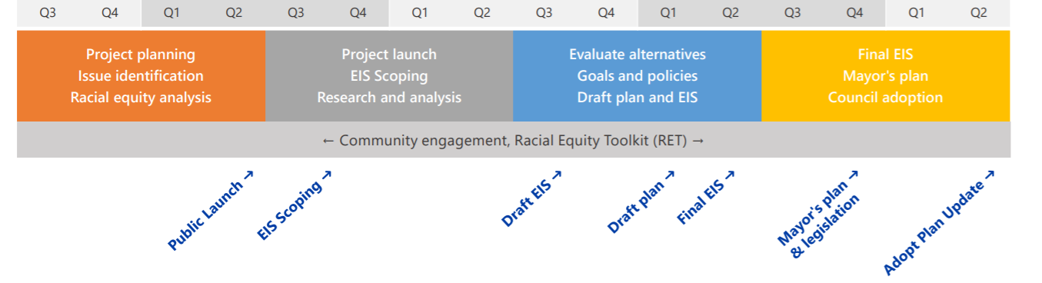
Comprehensive Plan update
Seattle’s vision for a livable, sustainable, prosperous, and equitable city in 2043
Currently underway:
Engagement planning
Racial equity analysis of urban village strategy
COVID-19 recovery, resilience, and adaptation
Opportunities:
Leverage engagement efforts
Update citywide policies
Potentially include integrated network map
2020
2021
2022
2023
2024

Slide 17
Discussion
Do you have questions about our proposed approach and process?

Slide 18
Modal Integration Policy

Slide 19
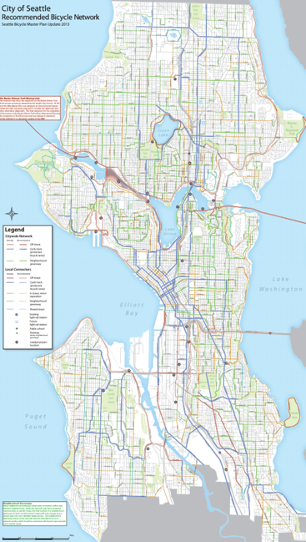
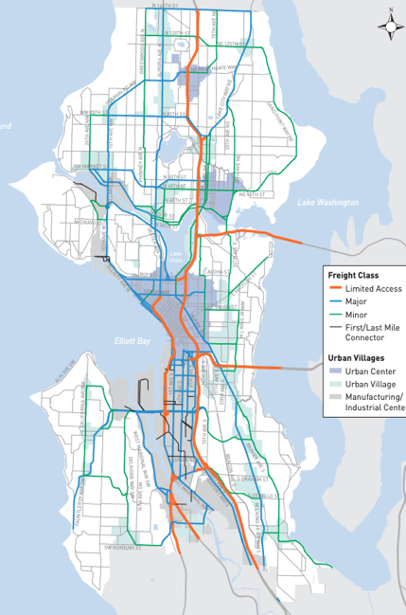
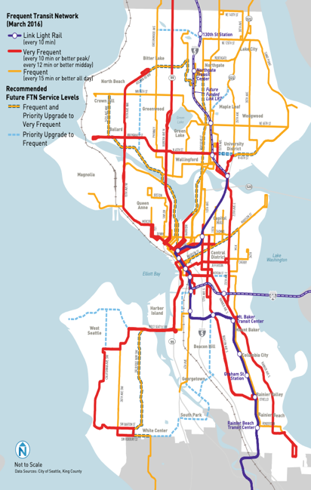
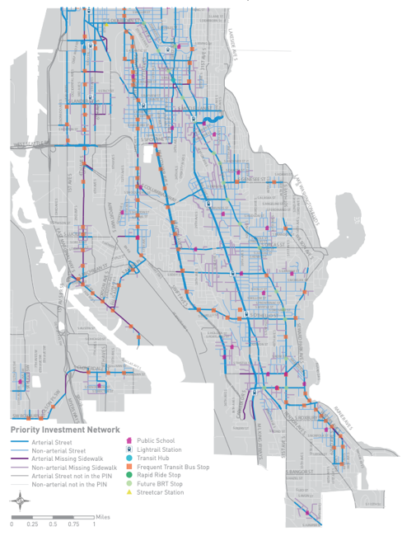
Network maps
Bicycle Network Map
Freight Network Map
Frequent Transit Network
Pedestrian Priority Investment Network

Slide 20
Network deficiencies
6,500 total arterial and collector block segments
  2,900 segments in a center, urban village, or neighborhood commercial area
432 deficient segments
424 segments are sidewalk ROW deficient
  Of those, 242 segments are within an NC, UV, or UC area

Slide 21

Policy concepts to resolve modal conflicts:
Overview
In urban villages and centers, prioritize pedestrian movement
Between urban villages and centers, prioritize transit
In manufacturing/industrial centers, prioritize goods movement
At critical connections, prioritize bicycle network and legibility
all without compromising the safety of other users

Slide 22
Overview of deficiencies
During the meeting, we will share an online map that overlays the modal network maps.

Slide 23
Policy concepts to resolve modal conflicts:
Land use context matters
When there are ROW deficiencies:
A. In urban villages and centers:
  Prioritize pedestrian infrastructure when there are competing uses for limited ROW
  Protect flex zone where sidewalk right-of-way is deficient (at least 3-feet too narrow)
    Establish pedestrian-first policy
B. Connecting urban villages/urban centers:
  Prioritize transit key arterials that connect UV/UC’s
    Establish bus-only lane policy, including ridership thresholds such as travel times and reliability
C. In manufacturing/industrial centers:
  Prioritize freight reliability, safety, and design; high ridership transit routes are a shared priority with freight
    Establish freight-only lane policy (including freight + transit-only lanes)

Slide 24
Policy concepts to resolve modal conflicts:
Critical bike segments
D. At critical connections, prioritize bicycle network and legibility
  Our Bicycle Master Plan identifies bike network as flexible to meet other modal needs
  Proposed policy refinement: define critical bike segments for ROW priority, citywide
    Locations where there is not a good alternative within the corridor (e.g., Eastlake)
    Draft criteria include topography, destination connectivity, and traffic speeds
    When a ROW deficiency exists, these segments would prioritize bikeway infrastructure
  Within urban villages, critical bike segments share priority with pedestrians

Slide 25
4 examples, 4 questions
We picked 4 locations with right-of-way deficiencies; we’d like you to consider 4 questions
EXAMPLES:
Pedestrian priority example: 12th Ave E
Transit priority example: 35th Ave SW
Freight priority example: Elliott Ave W/15th Ave W
Critical bike segment example: Sylvan Way SW
QUESTIONS FOR EACH EXAMPLE
Is the policy intent achieved? (as described in slide 21)
Does the outcome best support current and future land use and access needs?
Who might see disproportionate burden or benefit?
Can you think of another example where this approach would or would not work?

Slide 26
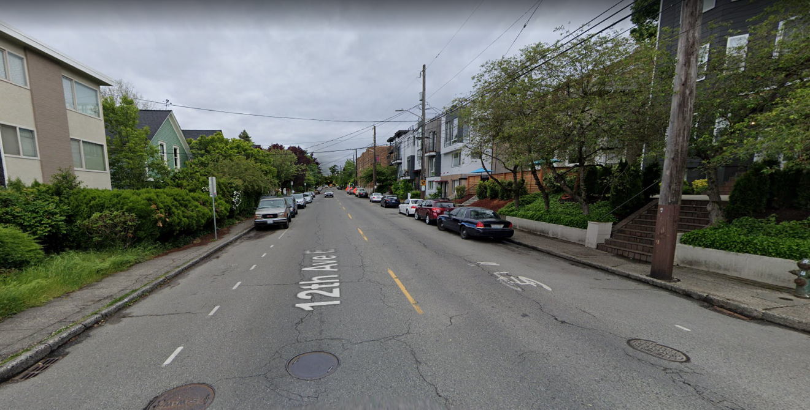
A. Pedestrian priority example: 12th Ave E
Google streetview
Capitol Hill Urban Center
  Proposed policy defines pedestrian priority when right-of-way is deficient
Sidewalk deficiency:
  Width: 6 feet
  Streets Illustrated standard: 12 feet

Slide 27
A. Pedestrian priority example: 12th Ave E
Modal priority networks:
  Transit – planned Frequent Transit Network route, but no current service
  Freight – minor truck street
  Bike – planned standard bike lane
Average daily traffic: <10,000
Proposed approach based on applying the modal integration policy:
This is an unlikely critical bike segment.
Prioritize future sidewalk widening to meet Streets Illustrated standards.
In near term, retain curb side functions and identify strategic widenings at intersections, bike parking, other pedestrian realm uses.

Slide 28
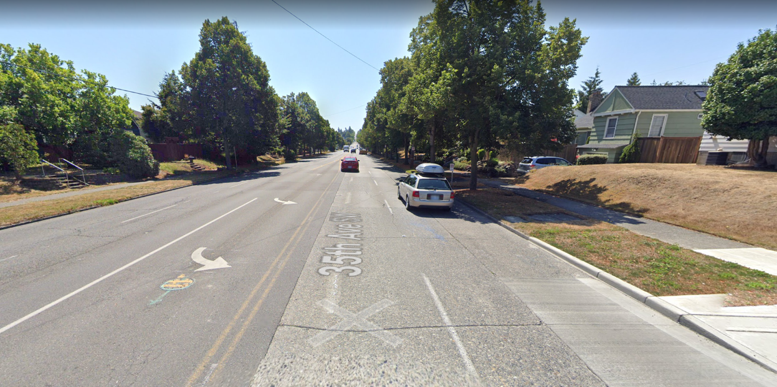
B. Transit priority example: 35th Ave SW
Google streetview
Arterial outside of Urban Center/Village
  Proposed policy defines transit priority when right-of-way is deficient
ROW deficiencies:
  Candidate for bus-only lanes
  Planned for protected bike lanes

Slide 29
B. Transit priority example: 35th Ave SW
Modal priority networks:
  Transit – Frequent Transit Network (3,000 daily bus passengers)
  Freight – not on network
  Bike – planned protected bike lane
Average daily traffic: 24,000
Turn lanes required due to vehicle volume
Proposed approach based on applying the modal integration policy:
This is an unlikely critical bike segment as there are parallel bike routes that are flatter than 35th Ave SW.
Prioritize transit in right-of-way allocation.

Slide 30
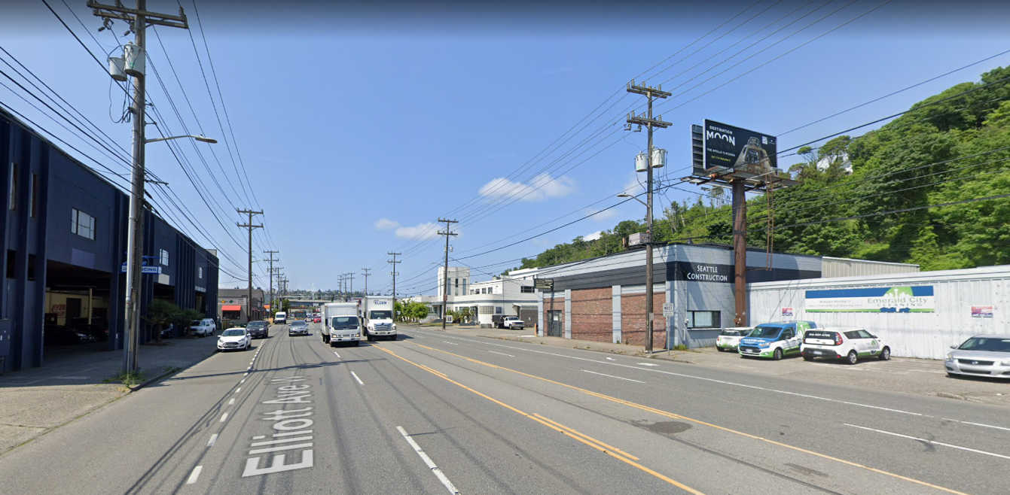
C. Freight priority example:
Elliott Ave W/15th Ave W
Google streetview
Ballard-Interbay-Northend Manufacturing / Industrial Center
Proposed policy defines:
  Freight priority when right-of-way is deficient
  Share priority with transit on busy transit routes

Slide 31
C. Freight priority example:
Elliott Ave W/15th Ave W
Modal priority networks:
  Transit – Frequent Transit Network (12,000 daily bus passengers)
  Freight – major truck street, over-legal, National Highway System, seaport network
  Bike – not on network
Average daily traffic: 52,000
Proposed approach based on applying the modal integration policy:
Existing bus-only lane or Business Access and Transit (BAT) lane.
Allow freight in lane, likely with time-of-day limitations.

Slide 32
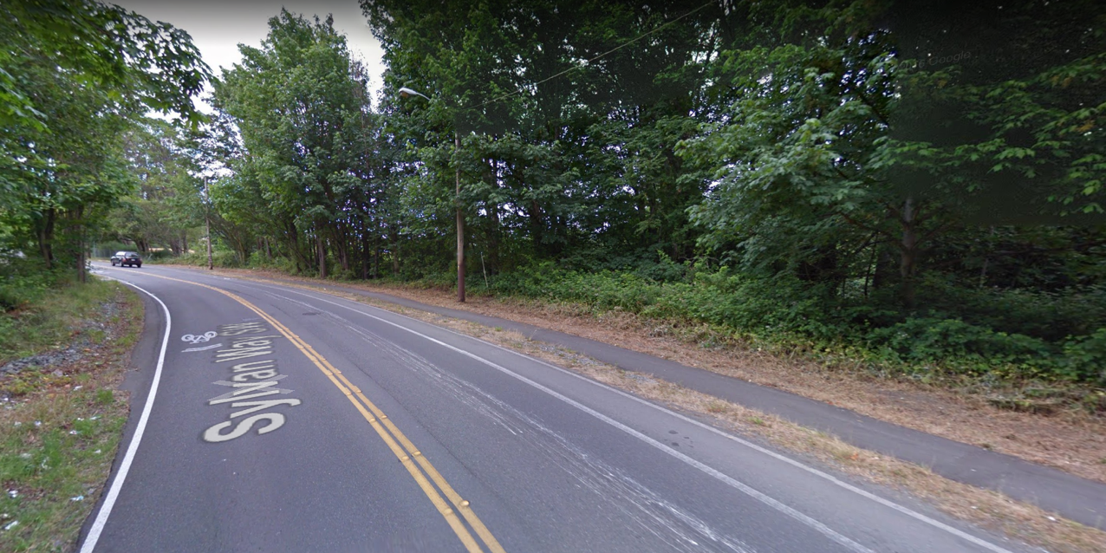
D. Critical bike segment example:
Sylvan Way SW
Google streetview
Critical bike segment
  Proposed policy defines bike priority when right-of-way is deficient
  Sylvan Way is an excellent candidate
ROW deficiencies:
  Planned for PBL, roadway is too narrow
  Sidewalks are also deficient

Slide 33
D. Critical bike segment example:
Sylvan Way SW
Modal priority networks:
  Transit – Frequent Transit Network (<1,000 daily bus passengers)
  Freight – minor truck street
  Bike – planned protected bike lane (PBL)
Average daily traffic: 9,000
Proposed approach based on applying the modal integration policy:
Sylvan is an excellent candidate for designation as a “critical bike segment” because it is one of the few pathways between the Delridge Valley and High Point.
As such, the bikeway would be prioritized in ROW allocation. Options include constructing a multi-use trail side path, or widening the street to accommodate the PBL.

Slide 34
Modal Integration:
Report and Next Steps

Slide 35
Draft outline for Modal Integration Report
Introduction and Context
Study Approach and Findings
  Deficiency analysis
  Racial equity analysis
  Lessons from other City's Complete Street Policies
  Engaging with the Policy and Operations Advisory Group, SDOT Core Team, 1x1 SDOT interviews, SDOT Complete Streets Steering Committee
  Key Findings
Policy Approach
  Existing priority networks from the four modal plans
  Modal integration policy
  Additional policies (pedestrian first, transit-only lane, freight-only lane, critical bike segments)
Next Steps
  Mapping tool (near term)
  Outreach tool (near term)
  Curbside change guidance (near term)
  Citywide Transportation Plan and associated community engagement effort (long term)

Slide 36
Next steps
#1 – June 25
Kick-off
Introduction to signal operations
#2 – July 23
Draft Comprehensive Traffic Signal Operations Policy: presentation and discussion
Modal Integration: introduction
#3 – August 27
Draft Comprehensive Traffic Signal Operations Policy: continued discussion
Modal Integration: analysis
#4 – Sept 24
Modal Integration: draft policy concepts
#5 – Nov 30
Modal Integration: draft policy concepts and other implementation actions
#6 – Jan 28
Modal Integration: policy recommendations and discussion
Wrap-up and reflections
2021+
Q1 2021: SDOT completes near-term implementation (Policies and PD tools)
2022+: SDOT advances longer-term implementation (Citywide Transportation Plan)

Slide 37

Questions?
ellie.smith@seattle.gov | (206) 300-1690
www.seattle.gov/transportation

