Slide 1
Surveillance Technologies Public Comment Meeting
Seattle Department of Transportation
Seattle Fire Department
Seattle Police Department
Seattle City Light

Slide 2
City of Seattle’s Definition of Surveillance
Surveillance is defined as technologies that "observe or analyze the movements, behavior, or actions of identifiable individuals in a manner that is reasonably likely to raise concerns about civil liberties, freedom of speech or association, racial equity or social justice."
Certain technologies, such as police body cameras and technologies for everyday office use, are excluded from the law.

Slide 3
City’s Commitment to Privacy
Jim Loter
Director of Digital Engagement

Slide 4
Rundown of Events
SDOT will present on technologies currently in use
SPD will present on technologies currently in use
SFD will present on technologies currently in use
SCL will present on technologies currently in use
Open House

Slide 5
How to Comment on Technologies
Comment card
Comment online at seattle.gov/privacy
Mail a comment to Surveillance & Privacy Program: Seattle IT, PO Box 94709, Seattle, WA 98124

Slide 6
Ground Rules
We are here to talk about the technologies currently in use
Be polite and allow others to have time to speak
Keep it civil and respectful

Slide 7
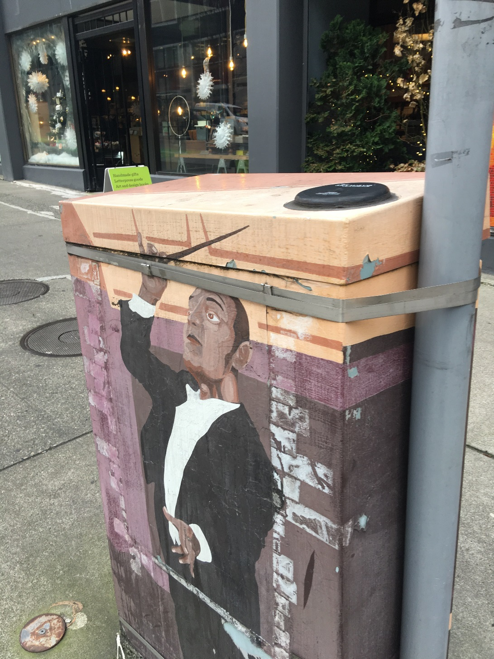
SDOT: Acyclica Traffic Data Collection Tool
Collection
Acyclica collects unique phone identifiers, called a MAC address, using a sensor installed inside of traffic control cabinets and immediately encrypts the data. Acyclica further anonymizes the data by hashing and assigning a random set of additional characters.
Use
SDOT uses the aggregated data provided by Acyclica to assess traffic flow and congestion, correct signal timing, and share information to travelers about expected delays.
Protections
Acyclica always encrypts the unique addresses they collect, and this process cannot be reversed. Personally-identifiable information that could be used to identify, contact, or locate a single person, is not accessible to SDOT, the vendor, or the public.

Slide 8
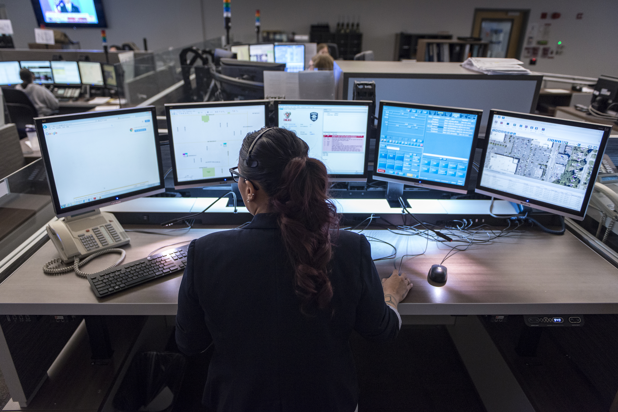
Computer Aided Dispatch (CAD) Providing professional dispatch, notification, and communication
Allows SPD to allocate patrol resources effectively while reducing response times and provides real-time documentation of SPD’s response to calls for police services
Of the over 900,000 9-1-1 Center received calls, approximately 250,000 CAD events are created per year
135,000 more CAD events are initiated by police officers during normal patrol activities each year
Data entered into CAD includes information provided by 9-1-1 callers, and caller information provided by the phone company, such as phone number, location, and name
Information about the police response is entered by dispatchers and SPD officers responding to service events

Slide 9
9-1-1 Logging Recorder Providing transparency, accountability, and quality assurance
Records all 9-1-1 and non-emergency calls and all radio traffic between dispatchers and patrol officers
Data collected includes call audio, time stamps, staff position of the individual answering the call, duration, phone number, and/or radio channels used to contact 9-1-1
900,000+ calls are received each year and approximately 5,000 recordings are released to the Seattle Law Department per year to support legal proceedings
Used by the 9-1-1 Center for training and quality control purposes

Slide 10
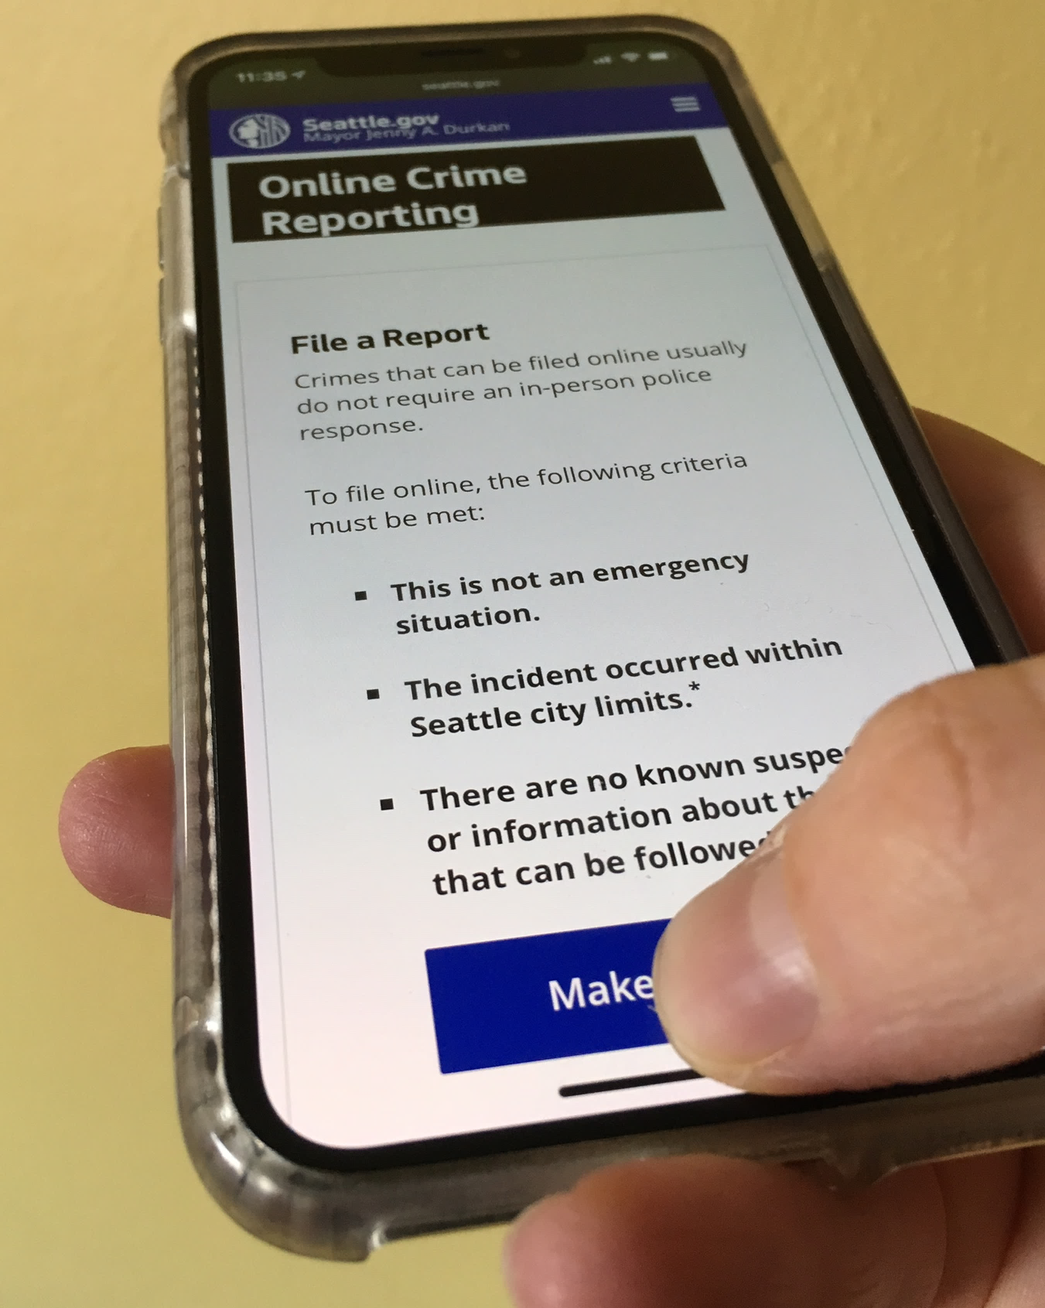
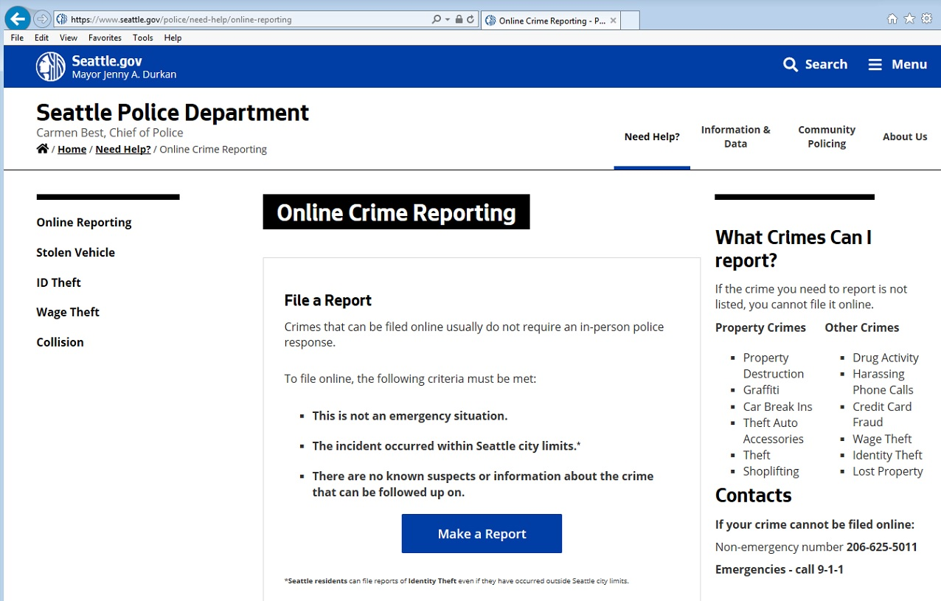
CopLogic Providing community members a secure, convenient, and timely interface to report some crimes online
CopLogic is a 2-part technology:
Online public interface: Individuals may report certain crimes without waiting for an officer to be dispatched
Password-protected interface: Retailers may report retail theft
Users can report crimes at their own convenience, 24/7/365
Once the report is complete it is reviewed by SPD and the information is transferred into SPD’s records management system. The user then receives a general offence number (GO) for their records and insurance purposes
2017: 14,356 crimes reported via CopLogic
Saves SPD more than $1,000,000/year

Slide 11
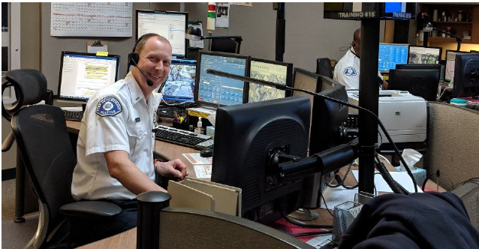
SFD: Computer-Aided Dispatch (CAD)
What is CAD?
CAD is a suite of software packages for first responders that helps the Seattle Fire Department manage the right responses to 911 calls based on the reported problem and location of a caller in need of assistance.
Collection and Use
CAD receives information from callers to properly respond to emergency situations, often including their name, phone number, address from which they are calling, and medical conditions. Some of the information may be stored for future reference in emergency situations or for quality assurance purposes.
Protections
Uniformed Seattle Fire Department personnel assigned to emergency response are involved with the use of the CAD system. This includes but is not limited to dispatchers, departmental operations, and mobile apparatus operators. All access to CAD information is role-based and updated daily to ensure that only appropriate responders have access. Only SFD personnel have access to critical infrastructure and personal information stored in CAD.

Slide 12
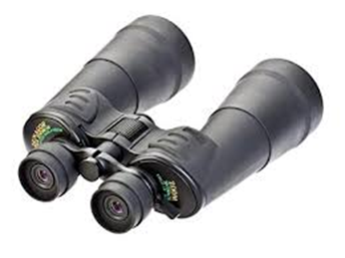
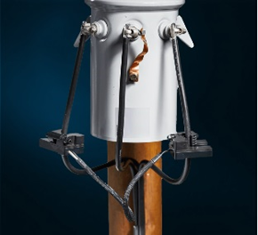
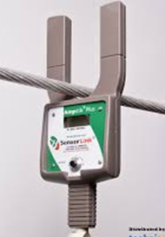
Seattle City Light: Current Diversion Detection Technologies
Technologies
The Current Diversion Team uses three technologies to discover if electricity is being used illegally without payment:
Standard, commercial-grade, unpowered binoculars
Sensorlink Ampstik
Sensorlink Transformer Meter System (TMS)
Why do we use these technologies?
These investigative technologies allow City Light to:
Maintain integrity of the electric distribution system
Determine whether suspected current diversion has taken place
Provide the value of the diverted energy to proper authorities for cost recovery
Binoculars
TMS
Ampstik

Slide 13
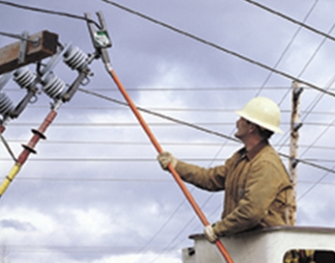
Seattle City Light: Current Diversion Detection Technologies
Collection
The binoculars are used to remotely read meters, and do not collect information. Both of the Sensorlink devices collect accumulated consumption, in kilowatt-hours, average volts (current strength), average amps (current flow), and interval consumption, in kilowatt-hours per a pre-defined time-unit.
Use
The Current Diversion team members are the only City Light staff who deploy the technologies, and only do so upon suspicion of current diversion (e.g., neighbor report, unusual or no energy consumption detected upon a routine meter reading by City Light staff, visual observation of a tampered meter).
Protections
Once a case is properly opened, these current diversion investigative technologies are deployed on the basis of case number and need. For a Transformer Meter System, the data collected is sent to City Light using a secure radio protocol and a specific, password-protected software program.

Slide 14
Ways to Comment
Seattle.gov/privacy
Fill out a comment card
Mail a comment to Surveillance & Privacy Program: Seattle IT, PO Box 94709, Seattle, WA 98124

Slide 15
What’s Next?
Written comments collected will be included in the SIR submitted to the Surveillance Advisory Working Group, and then City Council for full Council vote.

Slide 16
Open House for Surveillance Technologies

