Slide 1
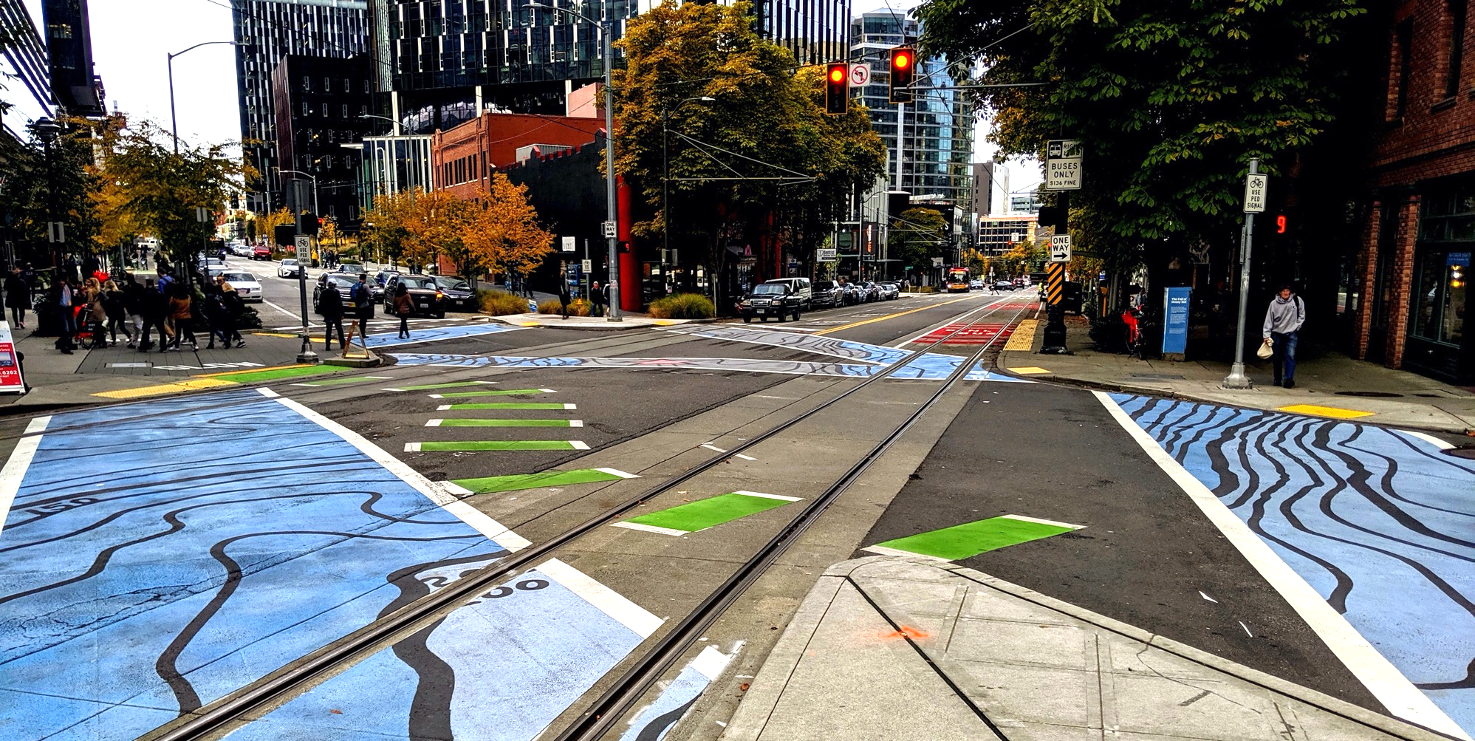
Policy & Operations Advisory Group
Policy & Operations Advisory Group
Transportation Operations and Policy & Planning Divisions

Slide 2
Meeting overview
Welcome and re-introductions
Modal integration policy: where are we heading
Policies and criteria in development
Examples from other cities
Wrap up + next steps

Slide 3
Meeting format
We want to hear from you; we encourage you to chime in and participate; some meetings will have more time for open discussion
During presentations:
  We will screenshare slides
  Please stay on mute
  If you want to chime in or have quick questions answered as we go, please use the chat function (send to "all participants" or "all panelists") or raise hand function
Please say your name before you speak
If you are having technical difficulties, please use the chat or email ellie.smith@seattle.gov

Slide 4
Re-introductions
Name
Organization you represent

Slide 5
POAG roster
Board, Committee, or Commission | Members
Bike Advisory Board | Alexander Lew & Pierre Brunelle
Business Improvement Association | Mike Stewart
Freight Advisory Board | Warren Aakervik & Geri Poor
Pedestrian Access Advisory Committee | Dorene Cornwell & Steven Feher
Pedestrian Advisory Board | Emily Mannetti & Anna Zivarts
Planning Commission | David Goldberg & Grace Kim
Transit Advisory Board | Erin Tighe & Bryce Kolton
Transportation Equity Workgroup | Kiana Parker & Yordanos Teferi

Slide 6
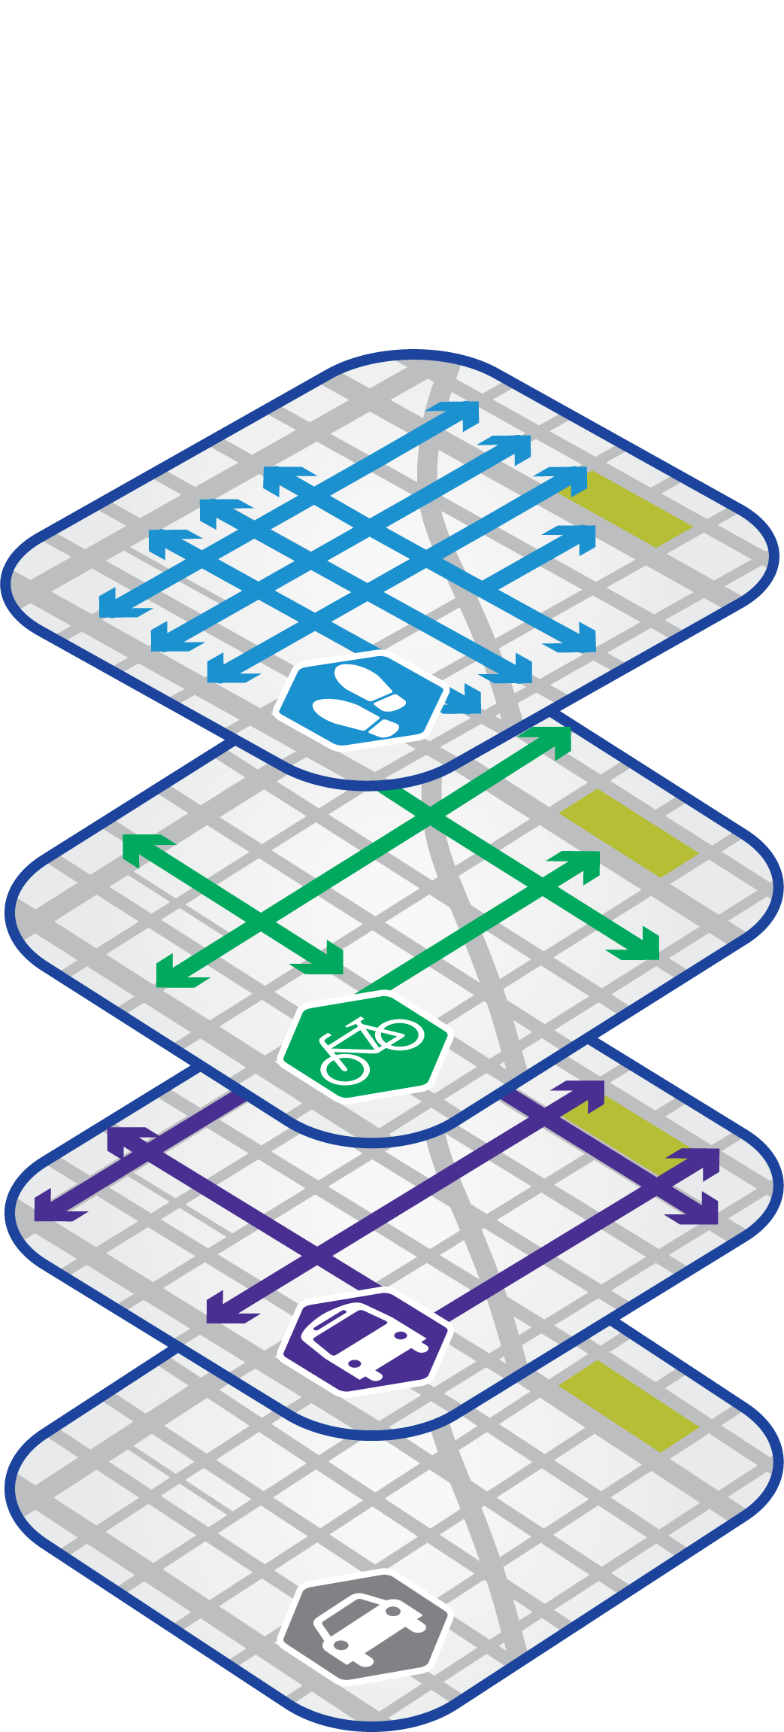
Modal integration key outcomes
Resolve modal conflicts at the planning stage (rather than project delivery stage)
ROW allocation decisions independent of funding source
Consistent and transparent approach to plans and policies
Improve our project development and outreach processes
Operate our streets to support our modal plan priorities

Slide 7
Tonight’s objectives
Gain common understanding of right-of-way deficiencies and our adopted modal plan networks
Review potential principles, policies and criteria to address right-of-way deficiencies
Explore other cities' priority network approaches to inform ROW allocation

Slide 8
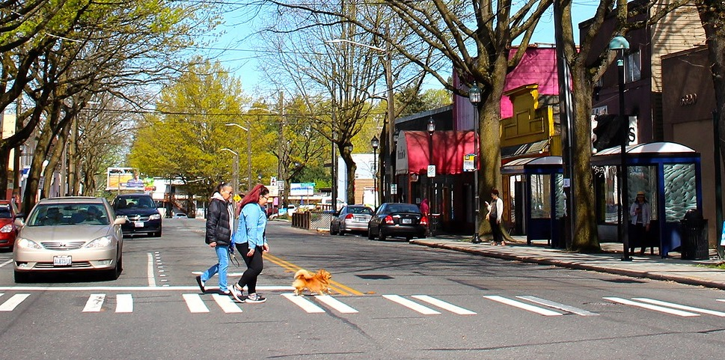
Policy Framework Elements

Slide 9
Network deficiencies
6,500 total arterial and collector block segments
2,900 segments in a center, urban village, or neighborhood commercial area
432 deficient segments

Slide 10
Guiding principles for ROW allocation
Protect network integrity
Prioritize pedestrian movement and safety within urban villages and centers
Prioritize person throughput in between urban villages and centers
Prioritize bicycle safety and legibility at critical connections
Prioritize goods movement in Manufacturing/Industrial Centers

Slide 11
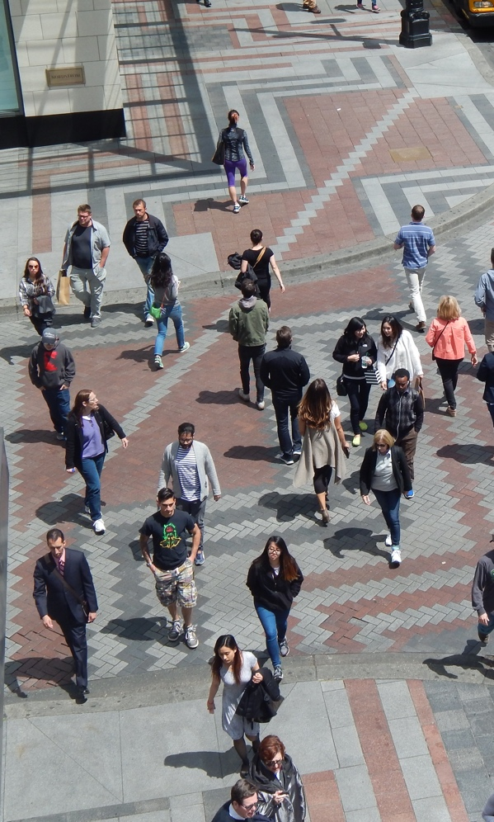
Comprehensive Plan
T 1.3 Design transportation infrastructure in urban centers and villages to support compact, accessible, and walkable neighborhoods for all ages and abilities.
T 2.5 Prioritize mobility needs in the street travelway based on safety and … the modal plan networks
T 2.8 Not every function can fit in every street. […] Two or more streets can combine to serve as a “complete corridor,” since not every street can accommodate every need
T 2.9 Develop a decision-making framework to direct the planning, design, and optimization of street right-of-way

Slide 12
Policies and criteria in development
  Bus-only lane policy
  Freight-only lane policy
  Urban village and urban center pedestrian priority
  Critical bicycle network segments

Slide 13
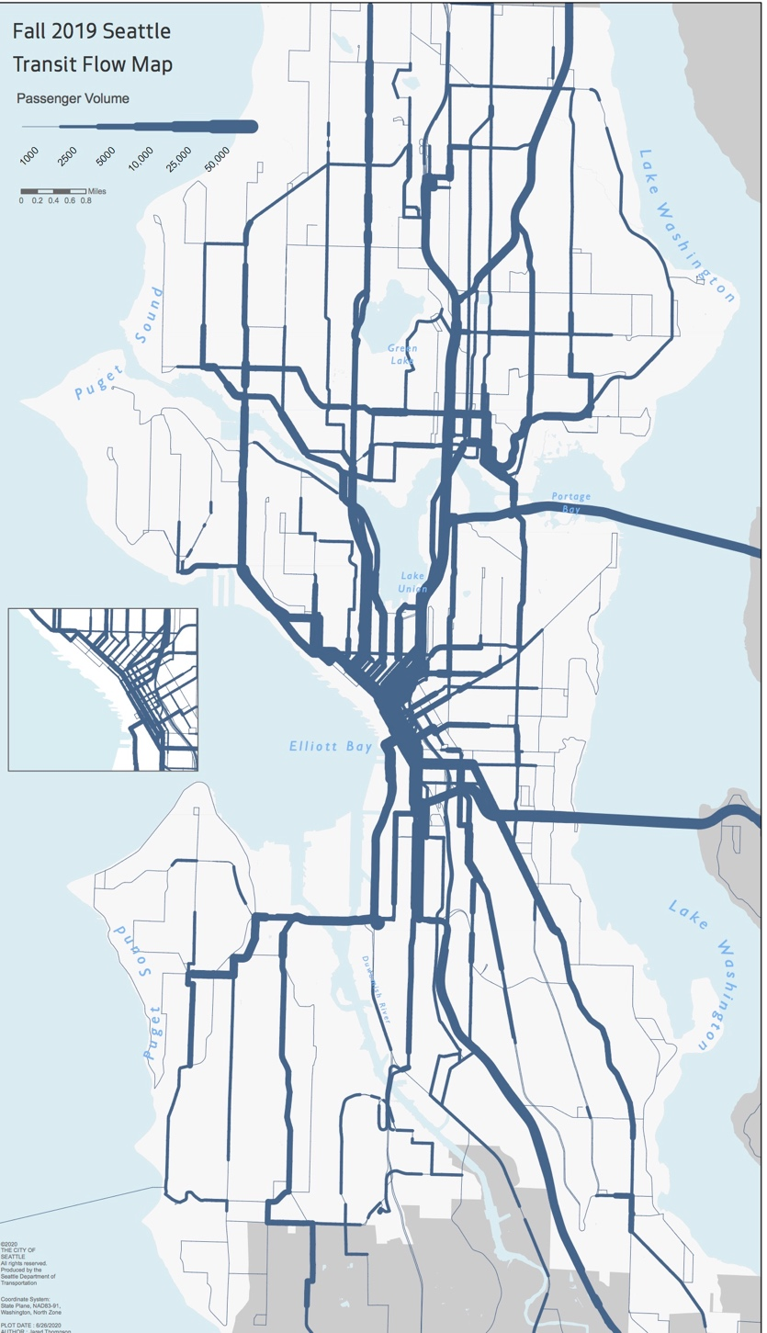
Bus-only lane policy
Establish passenger volume threshold by street segment to inform installation of bus-only lanes
Primarily focused on frequent transit network
Identify consistent parameters (e.g., time of day)

Slide 14
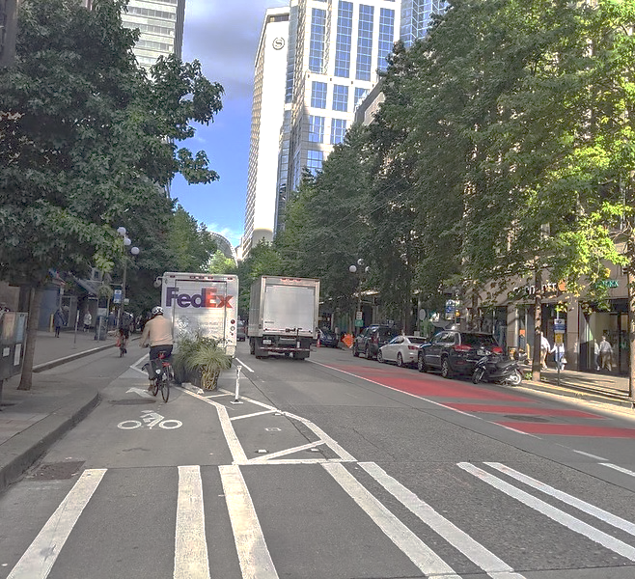
Freight-only lane policy
Determine if and when to establish freight-only lanes
Primarily focused in our Manufacturing/Industrial Centers and Major Truck Streets
Clarify opportunity to establish bus-only + freight-only lanes
Consider potential impacts on the bike network

Slide 15
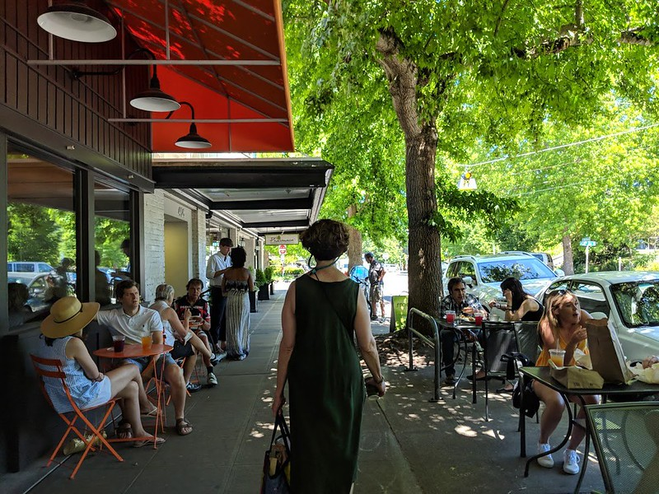
  Urban center & urban village pedestrian priority
Prioritize pedestrian comfort and safety
Support our urban center growth strategy
Focus on pedestrian experience, not person throughput
Consistent with our signal policy update

Slide 16
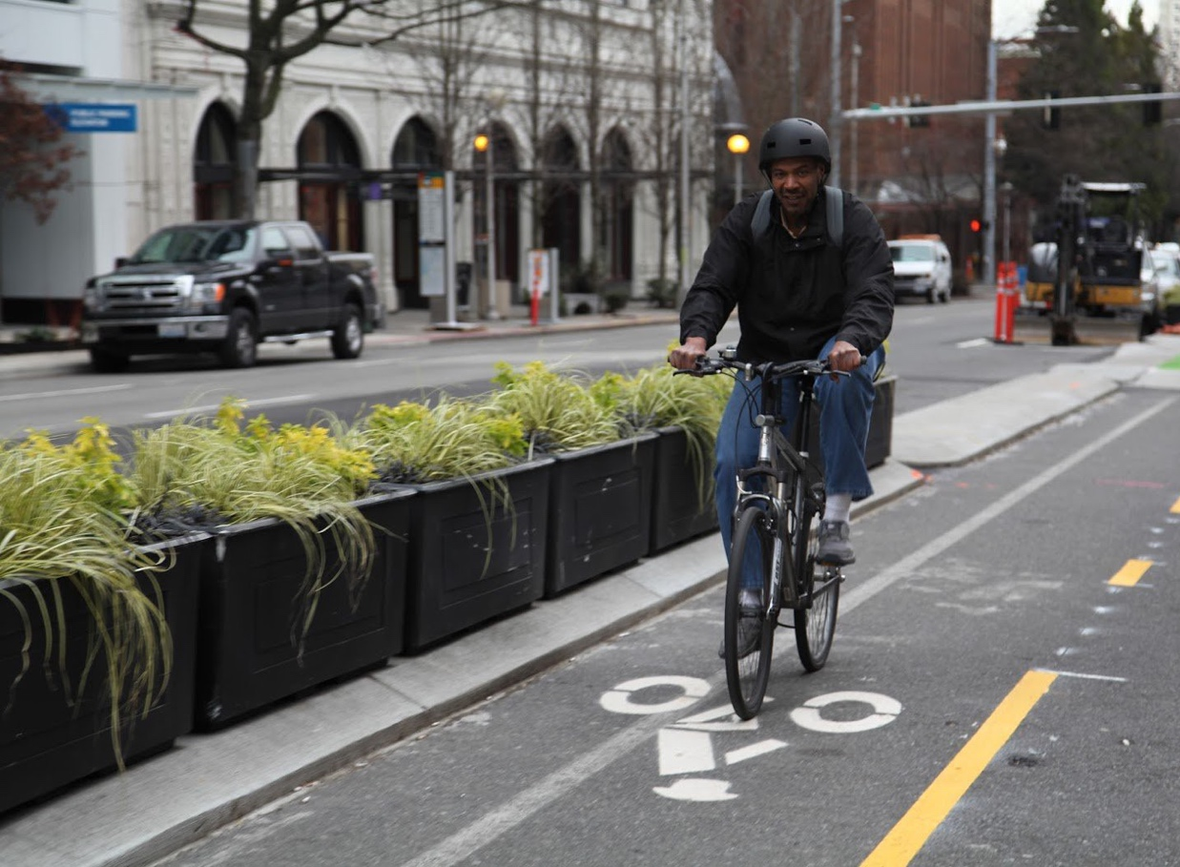
Critical bicycle network segments
Identify segments in the BMP that are critical to completing the network
Prioritize network and design integrity
Identify criteria and add class to BMP

Slide 17
ROW Deficiencies Exploration

Slide 18
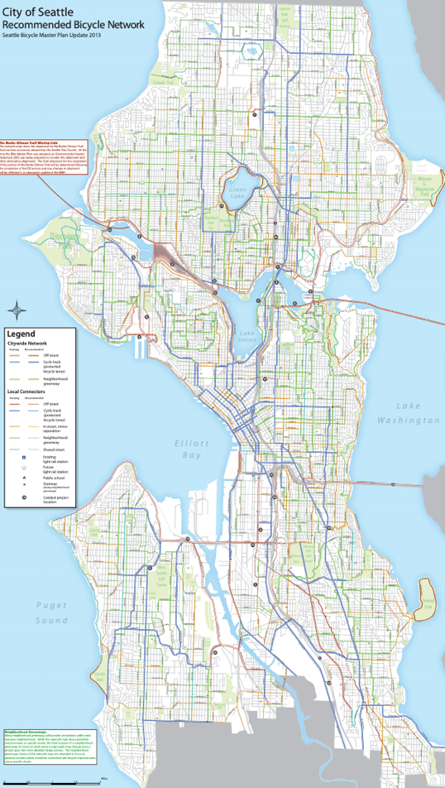
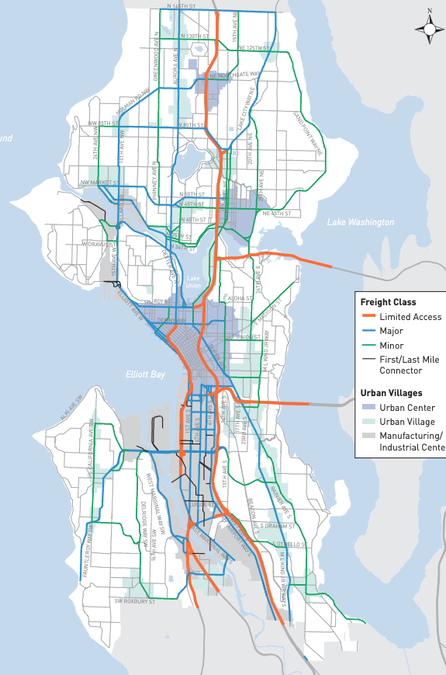
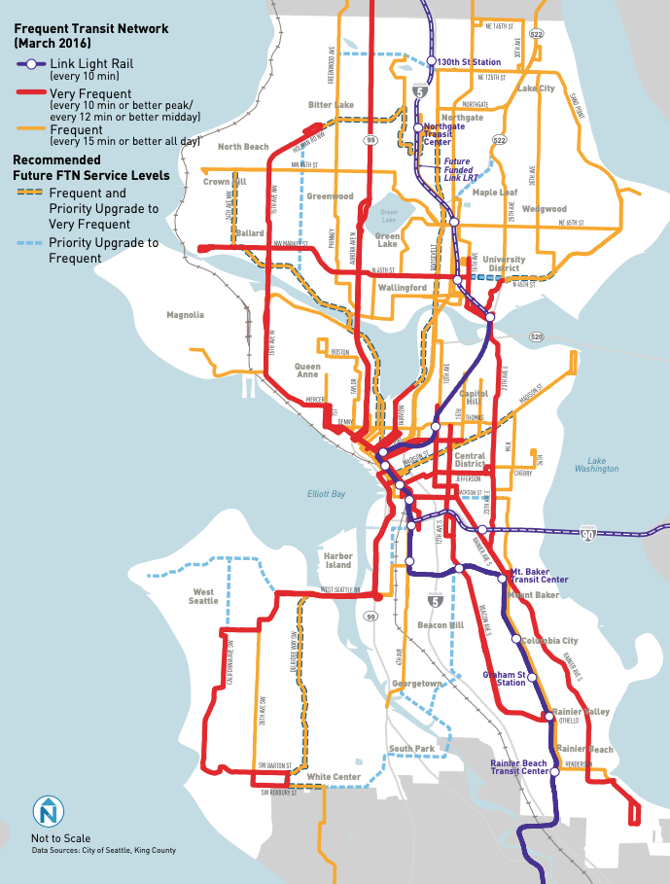
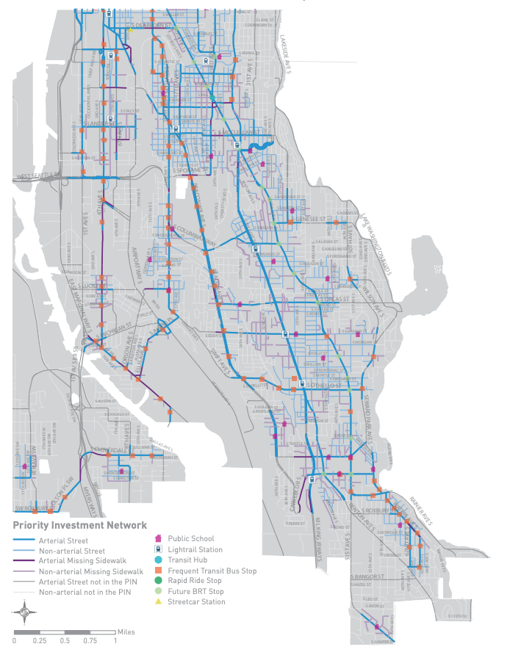
Network maps
Bicycle Network Map
Freight Network Map
Frequent Transit Network
Pedestrian Priority Investment Network

Slide 19
Exploring network maps & ROW deficiencies
During the meeting, we will share an online map that overlays the modal network maps.

Slide 20
Examples from Other Cities

Slide 21
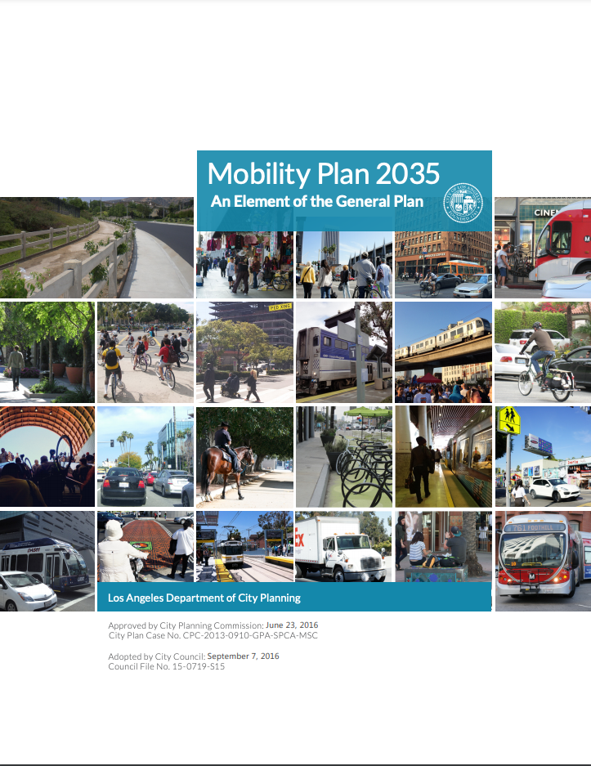
Los Angeles example
Re-framed Complete Streets Policy around "Enahnced Networks"
The Complete Street Network layers roadway systems that prioritize a certain mode (transit/bicycle/vehicle) within each layer.
Enhanced networks prioritize right-of-way allocation

Slide 22
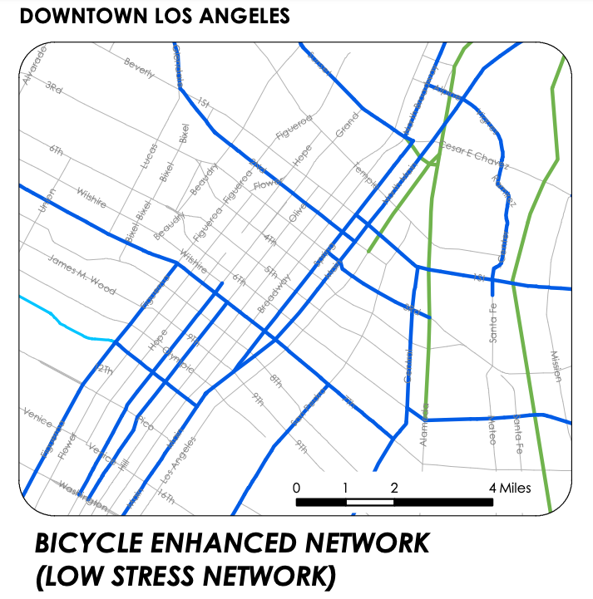
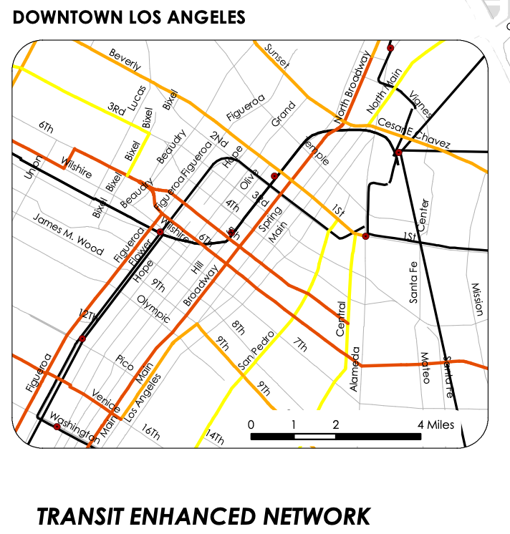
Los Angeles example
Plan establishes five enhanced networks or districts:
Pedestrian Enhanced Districts
Bicycle Enhanced Network
Transit Enhanced Network
Neighborhood Enhanced Network
Vehicle Enhanced Network

Slide 23
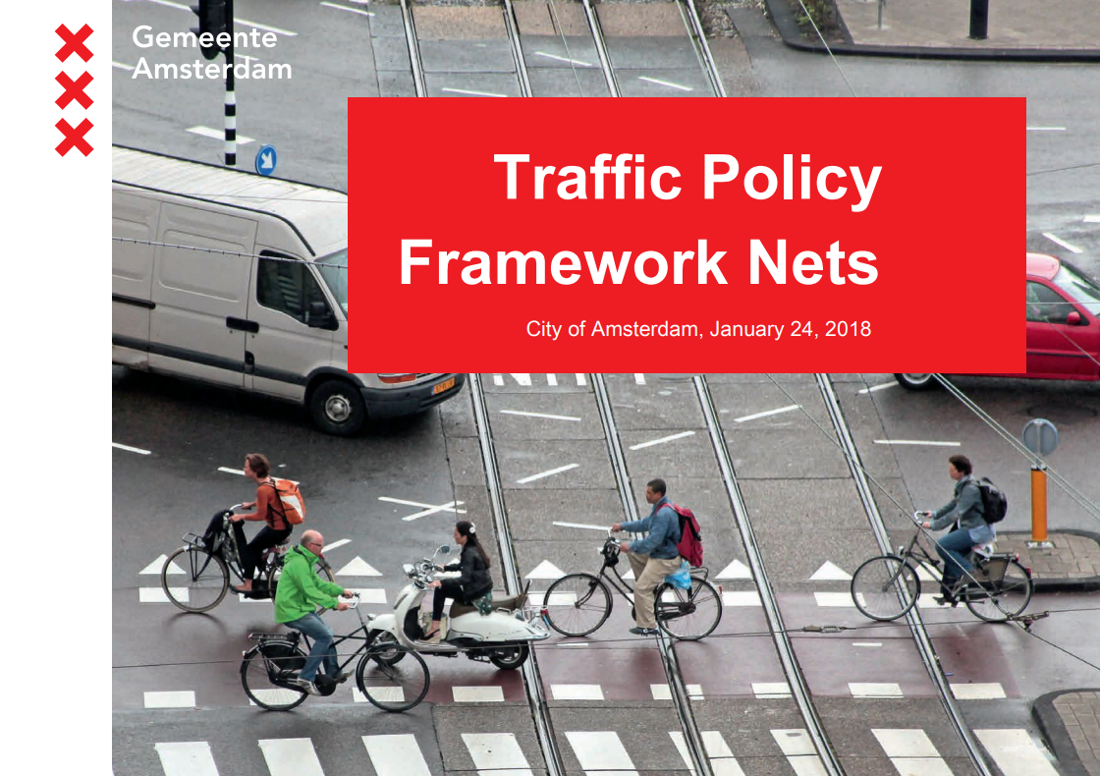
Amsterdam example
Similar to LA, integrates all planned networks
Establishes "Plus Nets" as the premier facilities for each mode
Guides right-of-way allocation and signal operations

Slide 24
Next steps
#1 – June 25
Kick-off
Introduction to signal operations
#2 – July 23
Draft Comprehensive Traffic Signal Operations Policy: presentation and discussion
Modal Integration: introduction
#3 – August 27
Draft Comprehensive Traffic Signal Operations Policy: continued discussion
Modal Integration: analysis
#4 – Sept 24
Modal Integration: draft policy concepts
#5 – Oct 22 (?)
Modal Integration: draft policy options and operational priority
#6 – date TBD
Modal Integration: policy recommendations and discussion
Wrap-up and reflections

Slide 25

Questions?
ellie.smith@seattle.gov | (206) 300-1690
www.seattle.gov/transportation

